Slide 1












Hello & Welcome to my English class.

Slide 2

HOW ARE YOU FEELING RIGHT NOW?

Slide 3
LET’S INTRODUCE YOURSELF!
  What is your name?
  How old are you?
  Where are you from?
  What is your hobby?
  What ( food, color, movie) do you like?
  Why do you like to learn English?

Slide 4






I. PRONUNCIATION
Lets pronunce the word correctly.
  I hate the summer heat.
  She bakes and rides bikes.
  She opens the gate for the goat.

Slide 5


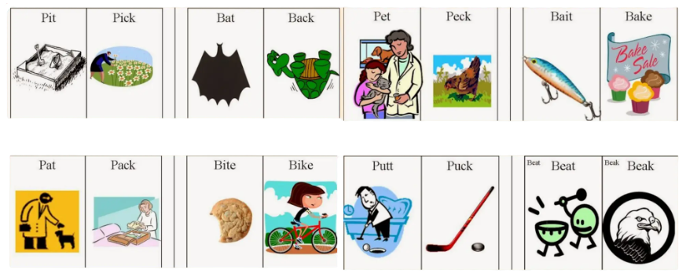
Let’ pronounce the words correctly.

Slide 6
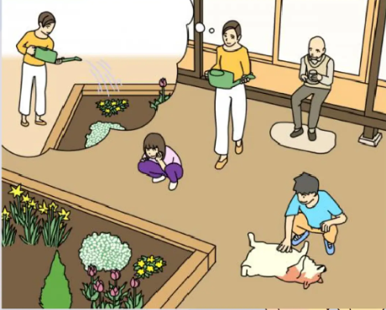
II. SPEAKING
Describe the picture.

Slide 7

Make questions and ask your teacher.
  What...
  Where...
  When...
  Why...
  How...
  How often...
  How much...

Slide 8
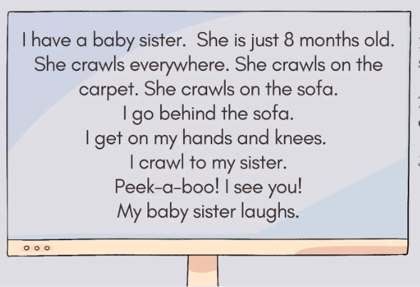
III. READING COMPREHENSION
QUESTIONS TO ANSWER.
  How old is the baby sister?
  Who crawls everywhere?
3. TRUE or FALSE.
a. The baby can’t crawl well.
b. The baby goes behind the sofa.

Slide 9

WORD BANK
IV. GRAMMAR
was had how
your please see
  She ___ late for school.
  We ___ a good time at the party.
  ___ did you find it?
  Sit down, ____.
  I ____ a picture on the wall.
  Is this ___ book?

Slide 10




THANK YOU
FOR COMING!
HOPE YOU HAD A FUN!

