Slide 1

Reproduced by permission of Oxford University Press
From Can You Believe It? by Jann and Linda Huizenga
© Oxford University Press

Slide 2

Please Get Rid of That Smell!
Lesson 1
Student Book
pp. 8-10

Slide 3
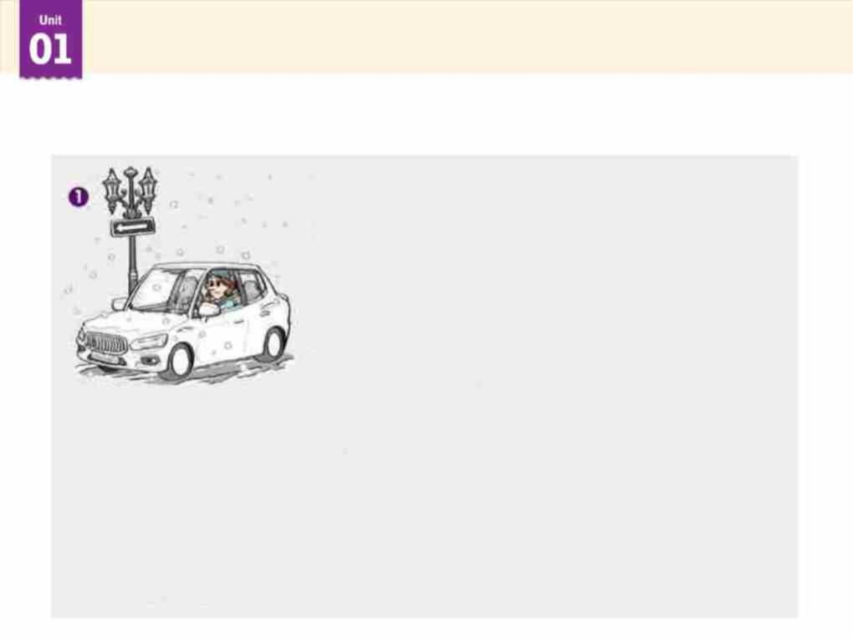
Picture Walk
Look at the pictures and guess the story.

Slide 4
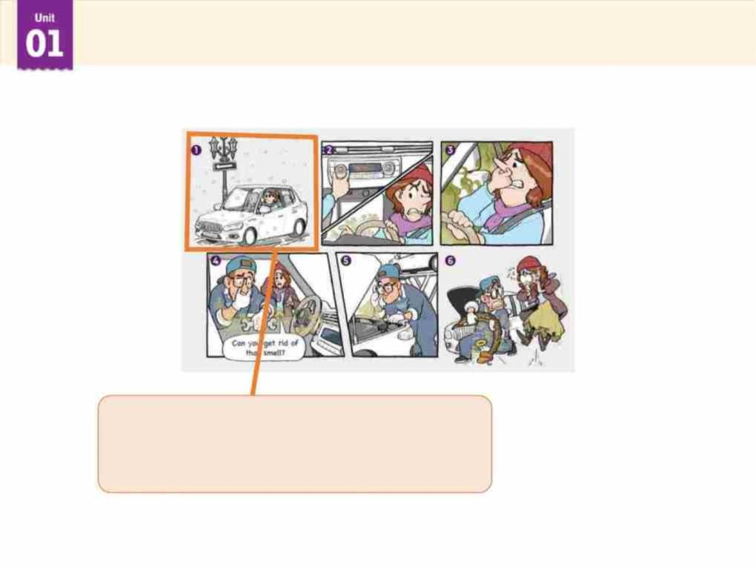
Picture Reading
Look at the pictures and answer the questions.
What season is it in the story?
It is winter.

Slide 5
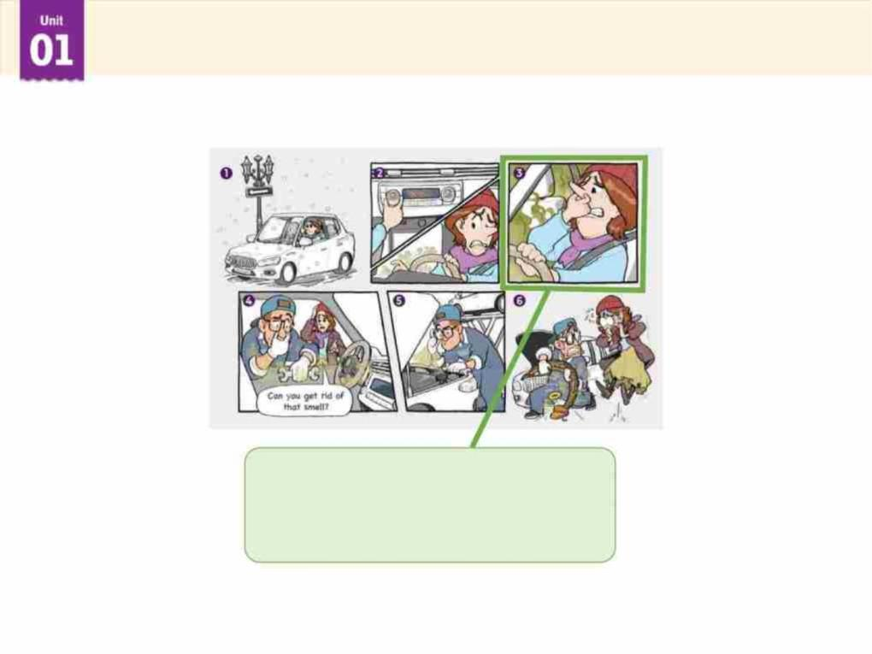
Picture Reading
Look at the pictures and answer the questions.
What is she doing?
She is grabbing her nose.

Slide 6
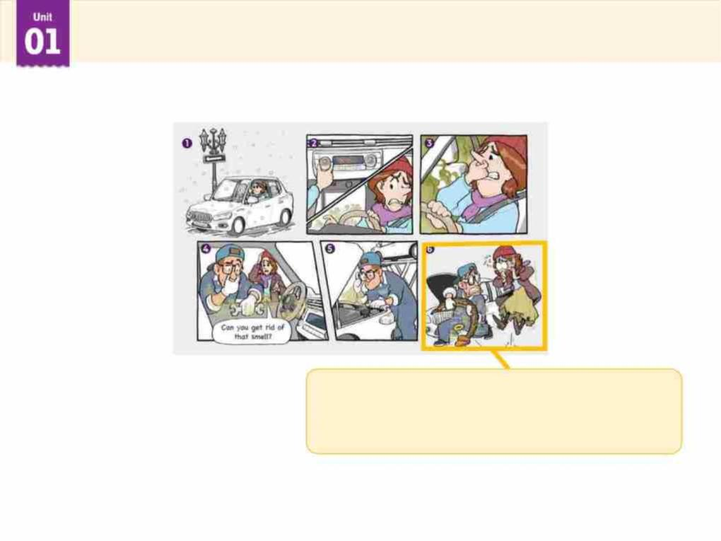
Picture Reading
Look at the pictures and answer the questions.
What is the mechanic
holding?
He is holding the dead snake.

Slide 7
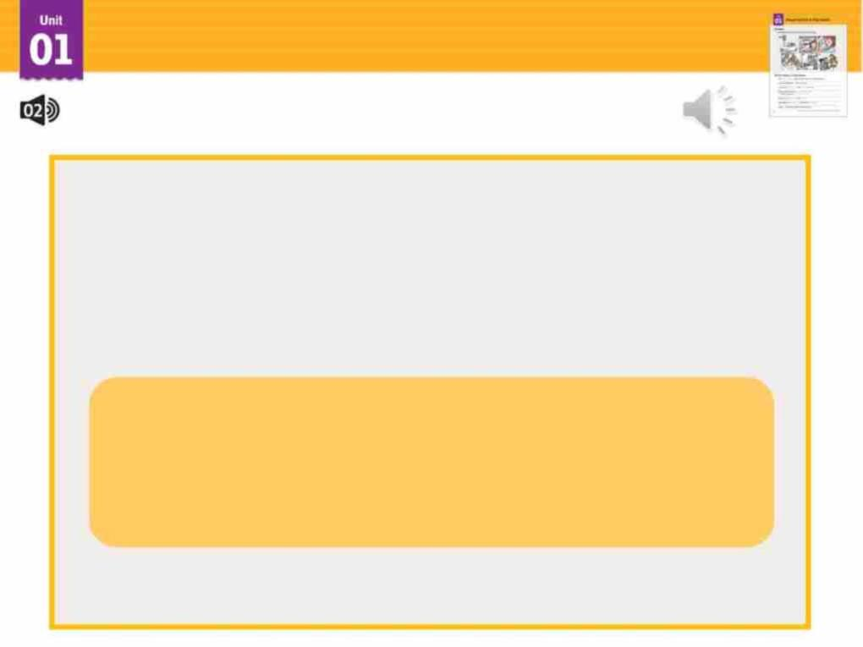
Listen
Look at the pictures and listen to the story.
While you are listening to the story, think
about the answer to the question below.
What causes the terrible smell
in the car?

Slide 8
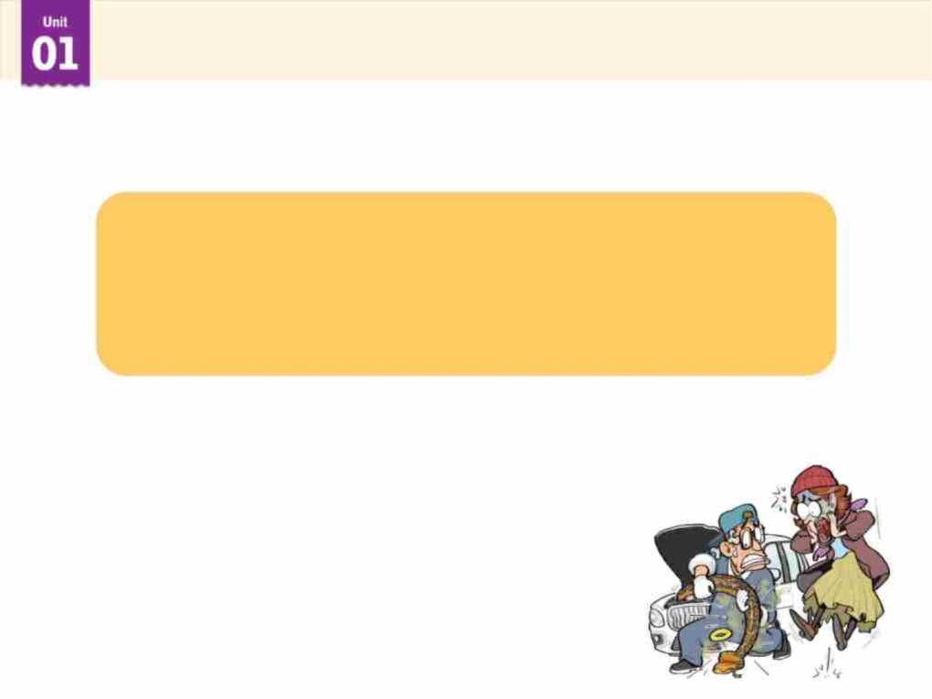
Listen
Answer the question.
What causes the terrible smell
in the car?
The dead python causes the terrible
smell in the car.

Slide 9
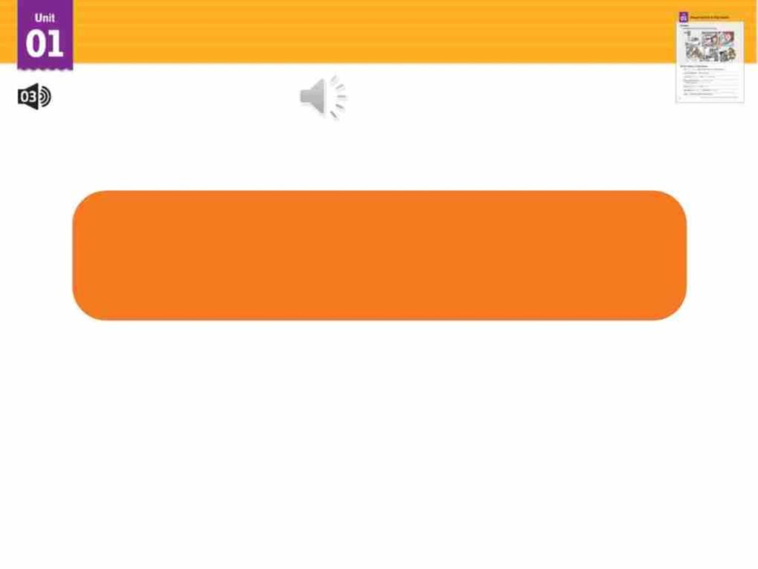
New Idioms & Expressions
Listen and repeat.
turn something on
start a machine or
the flow of electricity, water, etc.

Slide 10
New Idioms & Expressions
Listen and repeat.
get worse and worse
become very bad

Slide 11
New Idioms & Expressions
Listen and repeat.
can’t stand something
dislike something very much

Slide 12
New Idioms & Expressions
Listen and repeat.
What’s the matter
(with something or
someone)?
What’s wrong
(with something or someone)?

Slide 13
New Idioms & Expressions
Listen and repeat.
get rid of something
remove something

Slide 14
New Idioms & Expressions
Listen and repeat.
take a look
(at something)
look quickly (at something)

Slide 15
New Idioms & Expressions
Listen and repeat.
lose it
become too excited;
lose one’s self-control

Slide 16
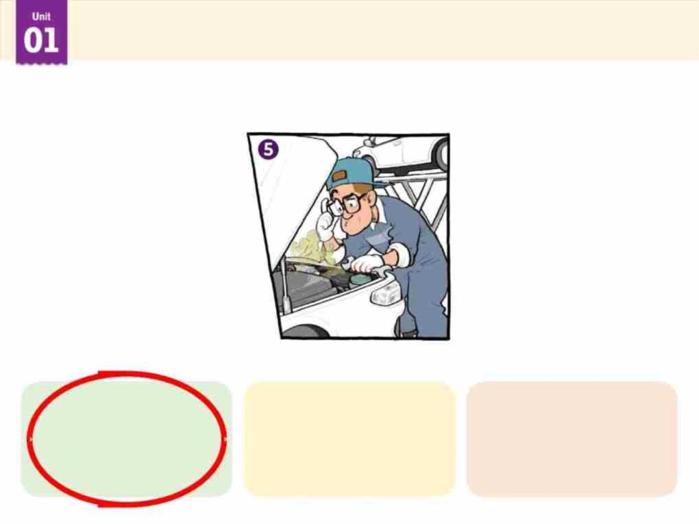
New Idioms & Expressions
Choose the correct idiom or expression for the picture.
take a look
(at something)
get rid of
something
turn something
on

Slide 17
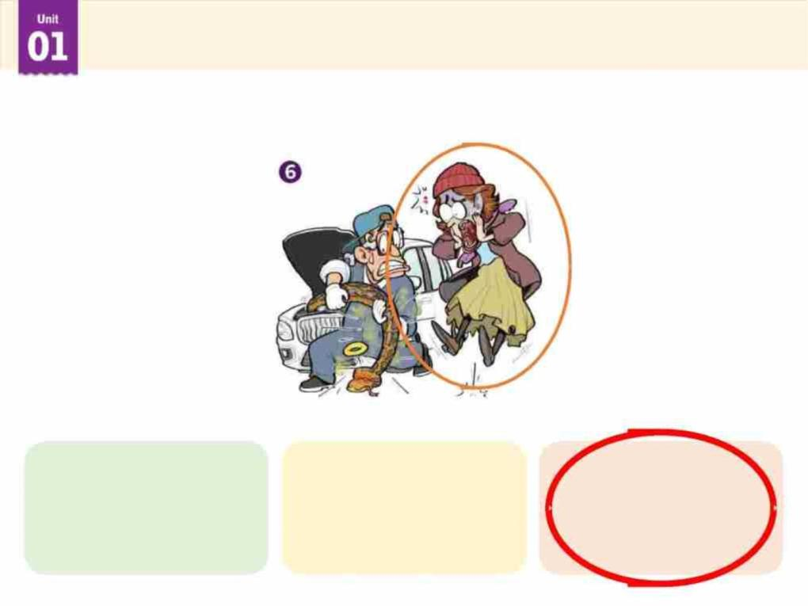
New Idioms & Expressions
Choose the correct idiom or expression for the picture.
turn something get worse and
on worse
lose it

Slide 18
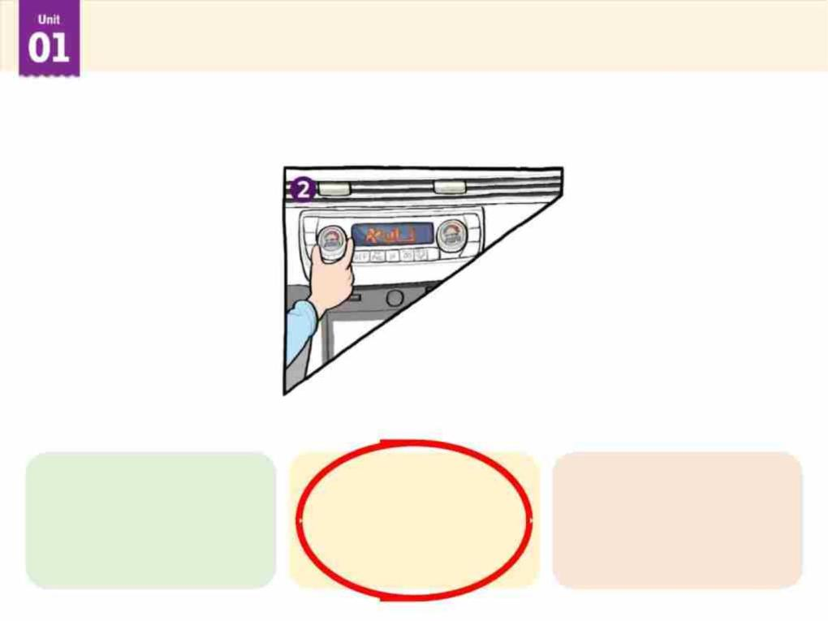
New Idioms & Expressions
Choose the correct idiom or expression for the picture.
get rid of
something
turn something get worse and
on worse

Slide 19
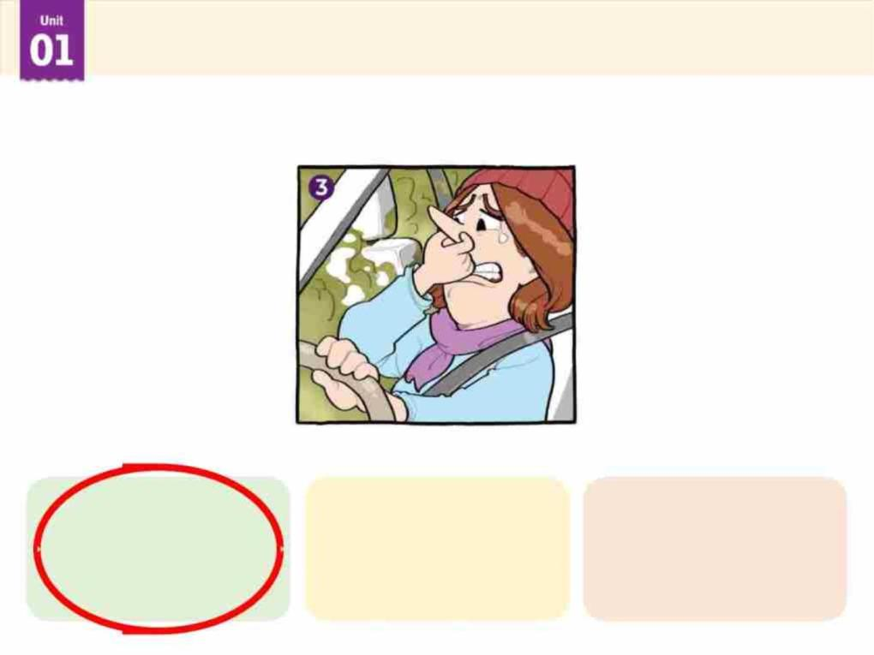
New Idioms & Expressions
Choose the correct idiom or expression for the picture.
can’t stand
something
What’s the matter
(with something or
someone)?
lose it

Slide 20
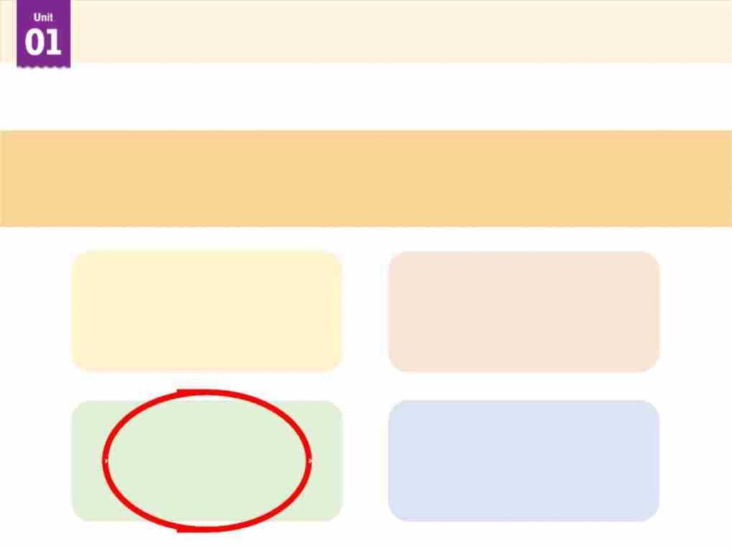
New Idioms & Expressions
Choose the correct idiom or expression for the definition.
become very bad
can’t stand
something
get rid of
something
get worse and
worse
turn something
on

Slide 21
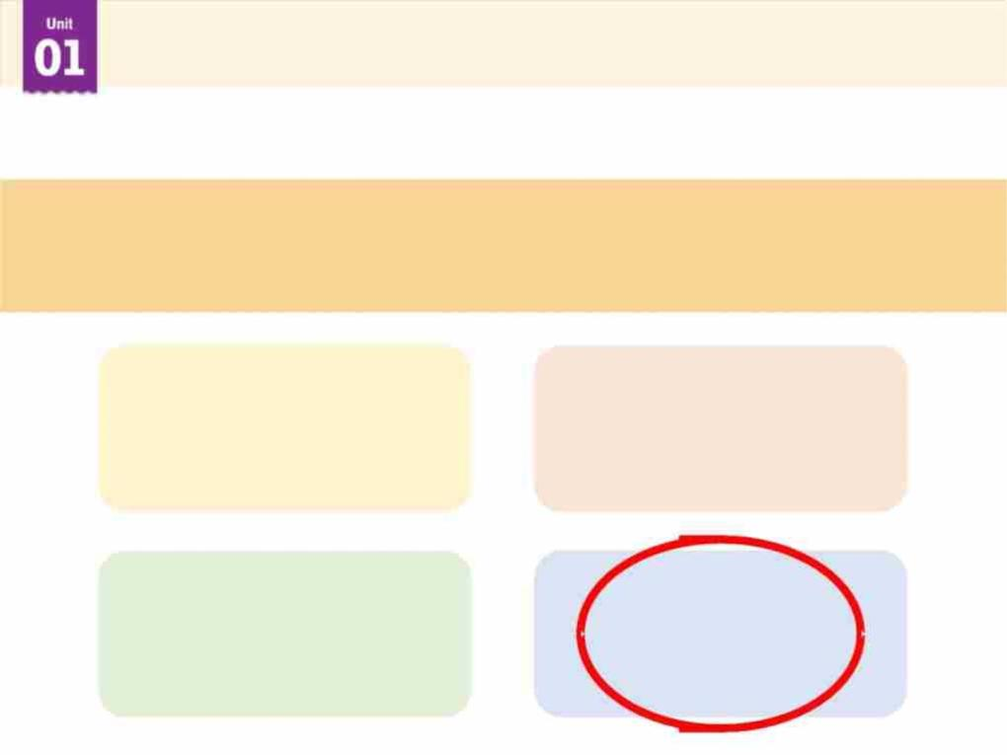
New Idioms & Expressions
Choose the correct idiom or expression for the definition.
What’s wrong (with something or someone)?
take a look
(at something)
get worse and
worse
What’s the matter
(with something or
someone)?
lose it

Slide 22
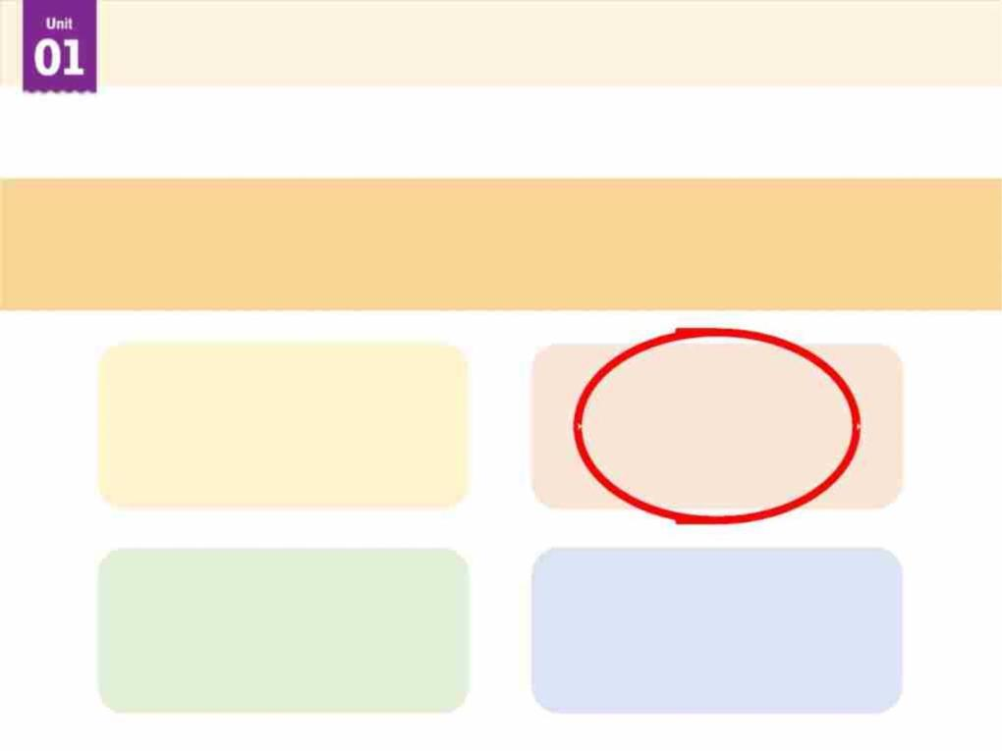
New Idioms & Expressions
Choose the correct idiom or expression for the definition.
remove something
get rid of
something
lose it
take a look
(at something)
can’t stand
something

Slide 23
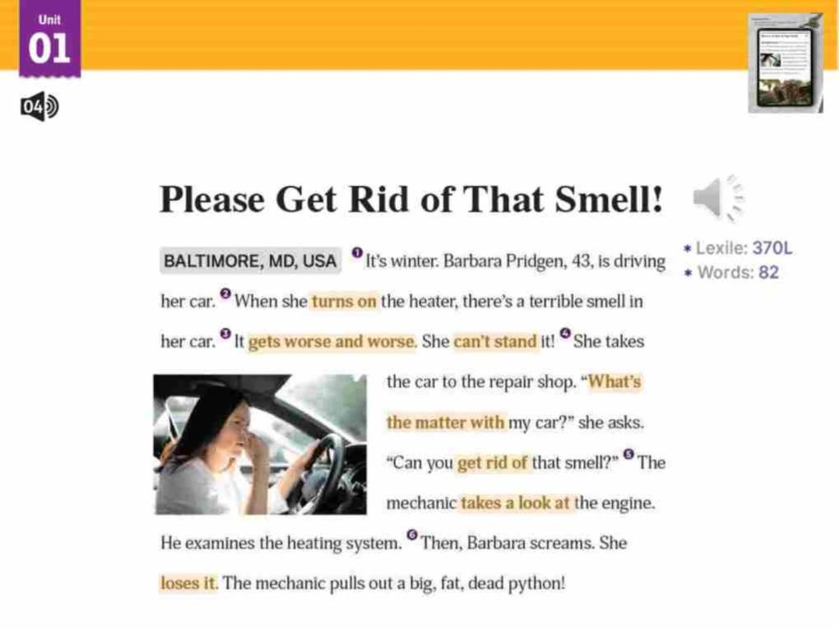
Read the Story
Now, read the story carefully. Pay attention to
the idioms and expressions.

Slide 24
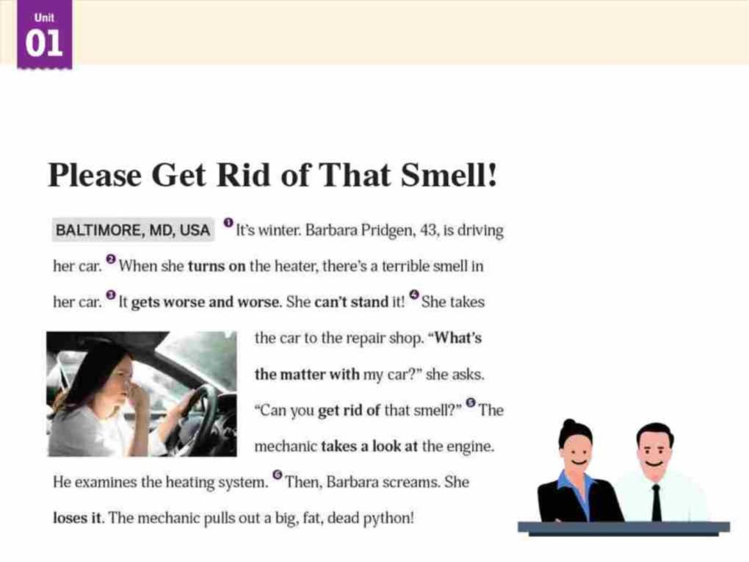
Choral Reading
Read the story together in unison, like you are news
anchors.

Slide 25
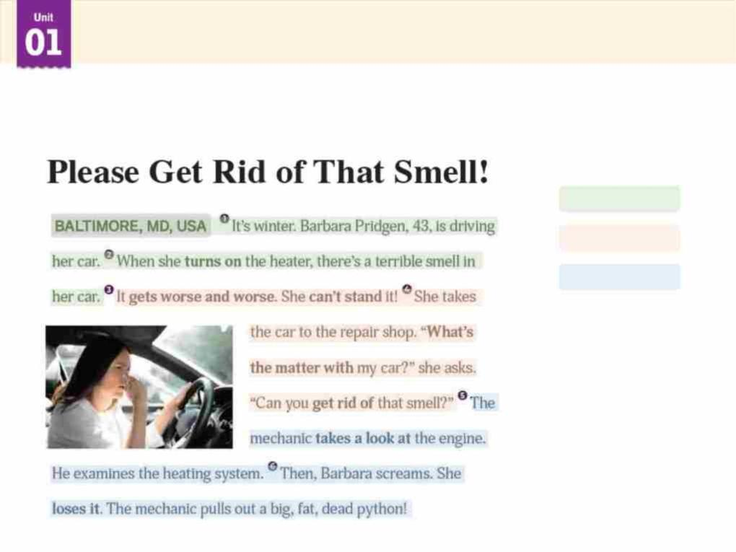
Group Reading
Make groups of three and read the story.
Student A
Student B
Student C

Slide 26

True or False?
Choose True or False.
There's a terrible smell when Barbara
turns on the heater in her car.
True False

Slide 27
True or False?
Choose True or False.
The mechanic examines
the heating system.
True False

Slide 28
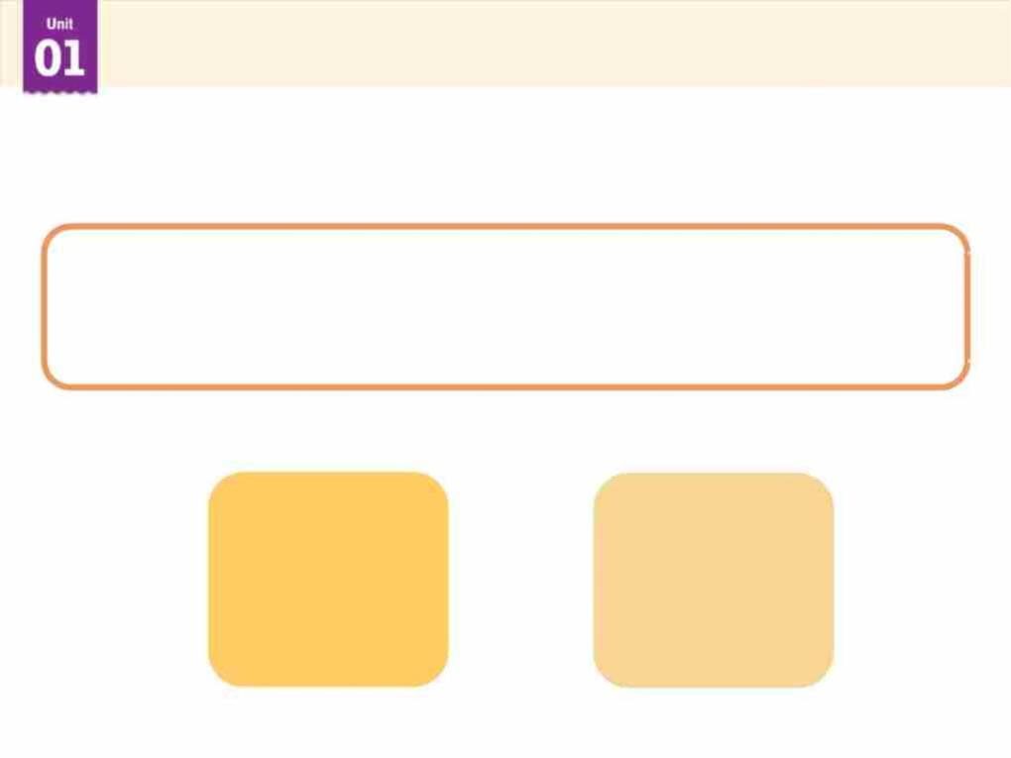
True or False?
Choose True or False.
The mechanic finds a dead python
in Barbara's car.
True False

Slide 29
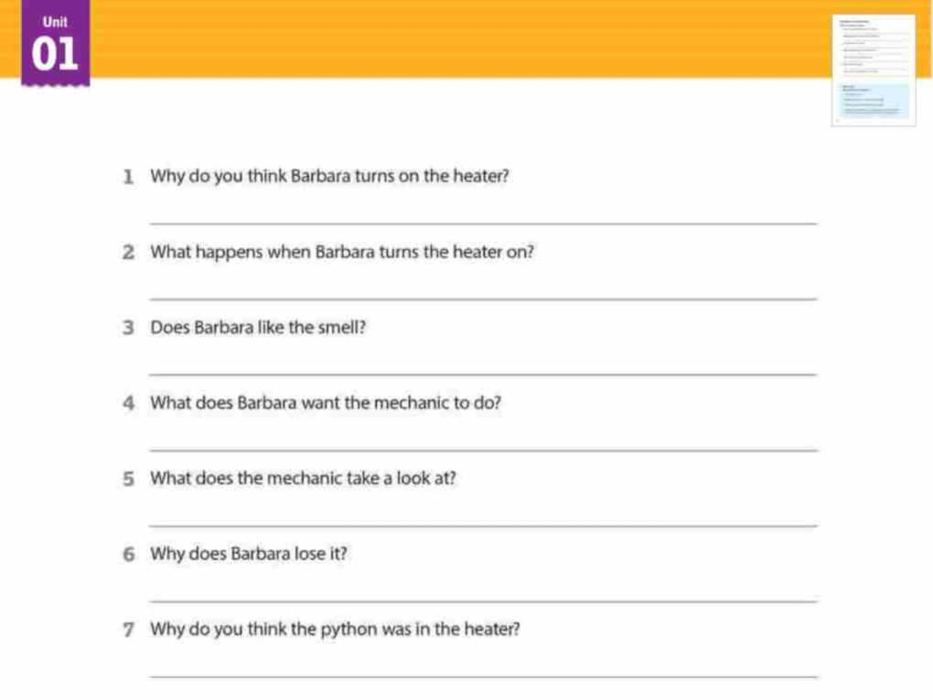
Reading Comprehension
Read and write the answers.
I think she turns on the heater because it is winter, and she feels cold.
There is a terrible smell in her car.
No, she doesn’t. it gets worse and worse. She can’t stand it.
She wants him to get rid of the smell.
He takes a look at the engine.
Because the mechanic pulls out a big, fat, dead python.
I think it looked for a warm place to sleep in winter.

Slide 30
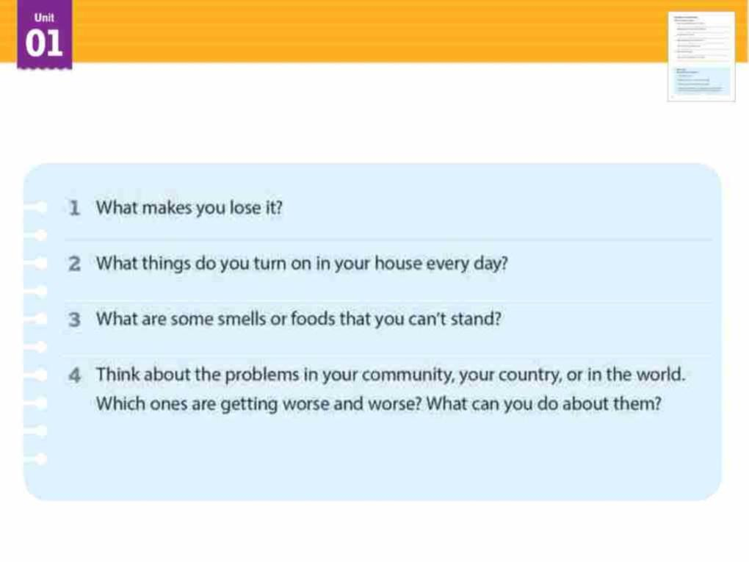
About You
Read and answer the questions.
[Model Answers]
Whenever my brother makes a mess in my room, I lose it.
I turn on my speaker every day to listen to music.
I can’t stand the smell of onions.
At school, my friends spend more time on smartphones, and we don’t
talk much. It is getting worse and worse. I’m going to ask them to take
a walk and play sports together.

Slide 31
Please Get Rid of That Smell!
Workbook
Workbook
p. 2

Slide 32
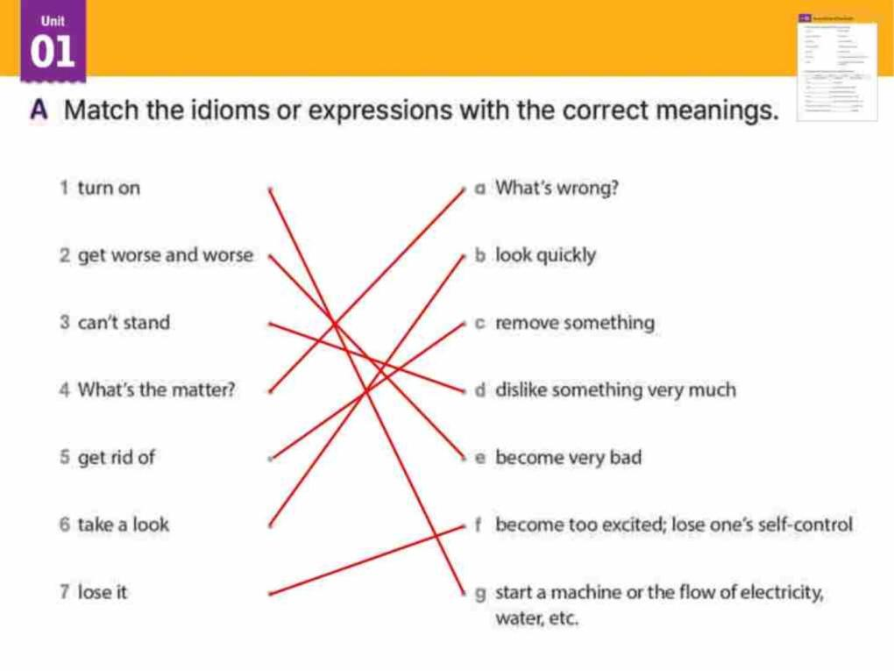
Workbook

Slide 33
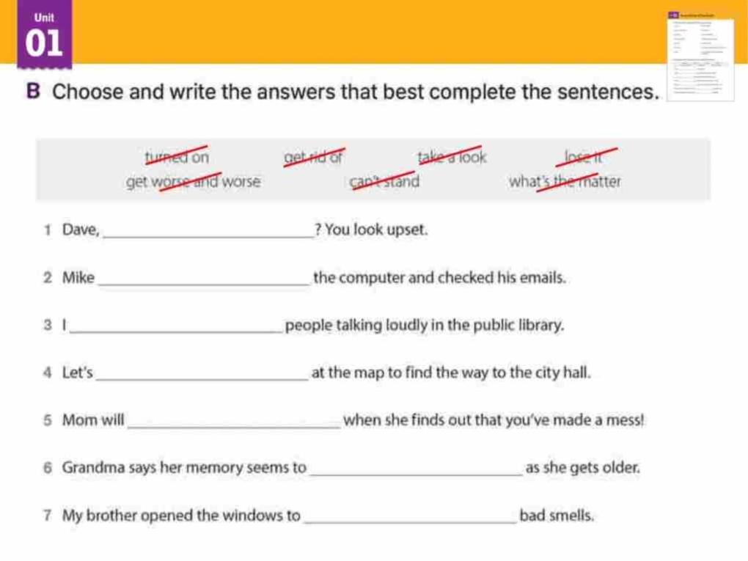
Workbook
what’s the matter
turned on
can’t stand
take a look
lose it
get worse and worse
get rid of

Slide 34

End of Lesson 1

