Slide 1

The Role of Labour Tribunals in Employment Disputes
Tutor: Okwudili O. ONWURAH, LL.B. (Nigeria); BL (Abuja, Nigeria); LLM (Exeter, UK); LLM (Qingdao, PRC); LLM (Shanghai, PRC)
PhD in Law (Hong Kong)
Dr Okwudili O. Onwurah

Slide 2
Minor House Keeping
The purpose of the online lesson is to encourage you to participate actively in achieving your needs and simplifying your legal education. I want you to be the best!
Will make the learning process more interactive discussions and feel free to ask any question or you can speak.
You have the right to choose whether to turn on your video or not.
Participation prepares you for your exam and learning needs with ease.

Slide 3

Introduction
Welcome to this comprehensive presentation on the crucial role of Labour Tribunals in resolving employment disputes. As we navigate through the complexities of workplace conflicts, we'll explore the jurisdiction, processes, and impact of these specialised forums. Drawing from relevant case law in both Hong Kong and the UK, we'll provide practical insights for legal and HR professionals alike. This presentation aims to equip you with a deeper understanding of Labour Tribunals, their benefits and limitations, and strategies for successful dispute resolution. Let's embark on this journey to unravel the intricacies of employment law and dispute management in the context of Labour Tribunals.

Slide 4
Labour Tribunal Jurisdiction
1
Establishment
Labour Tribunals were established to provide a speedy, informal, and inexpensive method for resolving employment disputes. In Hong Kong, they were set up under the Labour Tribunal Ordinance (Cap. 25) in 1973, while in the UK, Employment Tribunals (formerly Industrial Tribunals) have been operating since 1964.
2
Jurisdiction
These tribunals have jurisdiction over a wide range of employment-related matters, including claims for wages, severance payments, unfair dismissal, and breach of employment contracts. The monetary jurisdiction varies; in Hong Kong, it's currently capped at HK$50,000, while UK Employment Tribunals have no upper limit for most claims.
3
Accessibility
Labour Tribunals are designed to be accessible to all workers, regardless of their financial means. They operate with simplified procedures, allowing parties to represent themselves without the need for legal representation, thus making justice more attainable for the average worker.

Slide 5
Types of Cases Handled
1
Wage Claims
One of the most common types of cases handled by Labour Tribunals are wage claims. These can include disputes over unpaid salaries, overtime pay, holiday pay, and other monetary entitlements. In Hong Kong, the "J.A.G. Gounaropoulos v. Well Aim Limited" case set a precedent for calculating holiday pay for employees with variable income.
2
Unfair Dismissal
Unfair dismissal claims are another significant category. These cases involve employees who believe they have been terminated without a valid reason or proper procedure. The UK case of "Jhuti v Royal Mail Group Ltd" highlighted the importance of considering the real reason for dismissal, even when hidden from the decision-maker.
3
Discrimination and Harassment
While complex discrimination cases are often referred to higher courts, Labour Tribunals do handle some discrimination and harassment claims. The Hong Kong case of "Lam Wing Lai v. YT Cheng (Chingtai) Ltd" addressed sexual harassment in the workplace and the employer's liability.
4
Contract Disputes
Disputes over employment contract terms, including breaches of contract, are frequently brought before Labour Tribunals. The UK case of "Uber BV v Aslam" redefined the interpretation of worker status in the gig economy, impacting contract disputes across various sectors.

Slide 6
Case Law: Lee Chung Ming v Hong Kong International Terminals Ltd
Background
The case of Lee Chung Ming v Hong Kong International Terminals Ltd [2013] HKEC 1334 is a landmark decision in Hong Kong employment law. Lee, a crane operator, was dismissed after refusing to work overtime, citing fatigue and safety concerns. He brought a claim for unreasonable dismissal to the Labour Tribunal.
Key Issues
The case centred on two main issues: the reasonableness of the dismissal and the interpretation of the Employment Ordinance regarding rest days and overtime. It raised questions about an employee's right to refuse overtime work and the balance between employer operational needs and worker safety.
Tribunal Decision and Impact
The Labour Tribunal ruled in favour of Lee, finding his dismissal unreasonable. This decision set a significant precedent, affirming that employees have the right to refuse overtime work if it poses a genuine safety risk. It emphasized the importance of work-life balance and occupational safety in Hong Kong's labour landscape, influencing subsequent cases and employer practices.

Slide 7
Practical Guidance on Preparing for Hearings
Gather Evidence
Start by collecting all relevant documents, including employment contracts, payslips, correspondence, and any other evidence supporting your case. Organize these chronologically and create a clear index for easy reference during the hearing.
Prepare Statements
Draft a concise yet comprehensive statement outlining your case. Include key dates, events, and details of any attempts to resolve the dispute. If there are witnesses, prepare their statements as well, ensuring they are factual and relevant to the case.
Understand Procedures
Familiarize yourself with the tribunal's procedures. Attend a pre-hearing if available, and review any guidance provided by the tribunal.
Practice presenting your case clearly and concisely, anticipating potential questions from the tribunal officer.
Seek Advice
While legal representation is not required, consider seeking advice from a labour law specialist or trade union representative. They can provide valuable insights into the strengths and weaknesses of your case and suggest effective presentation strategies.

Slide 8
Benefits and Limitations of Labour Tribunals
Benefits
Limitations
Considerations
While Labour Tribunals offer a valuable forum for resolving employment disputes, parties should carefully consider the nature and value of their claim. Complex cases or those exceeding jurisdictional limits may be better suited to higher courts. The informal nature, while beneficial, may also mean less rigorous legal analysis in some instances.
Accessibility: Low-cost option for resolving disputes
Efficiency: Faster resolution compared to traditional courts
Informality: Less intimidating for non-legal professionals
Specialization: Adjudicators with
expertise in employment law
Jurisdictional limits: Monetary caps on claims (e.g., HK$50,000 in Hong Kong)
Complexity: May struggle with highly technical or legally complex cases
Enforcement: Limited powers to
enforce judgments
Appeal restrictions: Limited grounds for appealing decisions

Slide 9
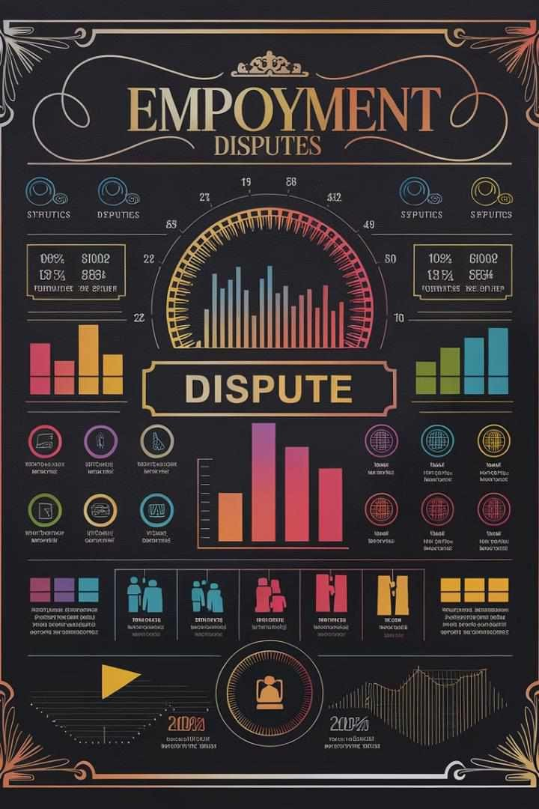
Key Statistics on Employment Disputes
Jurisdiction | Annual Cases | Average Resolution Time | Success Rate
Hong Kong Labour Tribunal | ~4,000 | 50 days | 65%
UK Employment Tribunal | ~100,000 | 27 weeks | 9% (full hearing)
Most Common Claim Type | Wage Disputes (HK) | Unfair Dismissal (UK) | N/A

Slide 10
Alternatives to Tribunal Resolution
Mediation
Mediation offers a confidential, non-adversarial approach to dispute resolution. A neutral third party facilitates discussions between the employer and employee to reach a mutually agreeable solution. This process is often quicker and less costly than tribunal hearings, with the added benefit of preserving working relationships.
Arbitration
Arbitration involves an independent arbitrator making a binding decision on the dispute. While more formal than mediation, it's still generally faster and more flexible than tribunal proceedings. It's particularly useful for complex cases or those requiring industry-specific expertise.
Internal Grievance Procedures
Many organizations have established internal grievance procedures. These can effectively resolve disputes at an early stage, avoiding the need for external intervention. They often involve a series of steps, from informal discussions to formal hearings with senior management.
Conciliation Services
In the UK, ACAS (Advisory, Conciliation and Arbitration Service) offers free conciliation services. Similarly, Hong Kong's Labour Department provides conciliation services. These can help parties reach a settlement without the need for a formal tribunal hearing, often resulting in quicker and more satisfactory outcomes.

Slide 11




Tips for Successful Litigation or Settlement
Document Everything
Keep detailed records of all communications, incidents, and attempts to resolve the dispute. Contemporaneous notes and emails can be crucial evidence in supporting your case.
Know Your Objectives
Clearly define your goals before entering litigation or settlement negotiations.
Understanding what you
want to achieve will help guide your strategy and decision-making throughout the process.
Be Realistic
Assess the strengths and weaknesses of your case objectively. Consider the potential costs, time, and stress involved in litigation versus the likely outcomes. This realistic approach can lead to more effective negotiation and decision- making.
Consider Settlement
Remain open to settlement opportunities throughout the process. A well-negotiated settlement can often provide a quicker, less stressful, and more satisfactory resolution than a tribunal hearing.

Slide 12
Q&A: What is the typical timeline for a Labour Tribunal case?
1 2 3 4
Filing (Day 1)
The process begins when a claim is filed with the Labour Tribunal. In Hong Kong, this involves submitting a claim form detailing the dispute and the remedy sought. The tribunal then sets a date for the first hearing, typically within 10-14 days of filing.
First Hearing (Day
10-14)
At the first hearing, the tribunal officer explains the process and attempts conciliation. If unsuccessful, a date is set for the main hearing, usually within 30-45 days. Parties are directed to exchange relevant documents and prepare their cases.
Main Hearing (Day
40-60)
The main hearing involves both parties presenting their cases, including evidence and witnesses. The tribunal officer may ask questions to clarify points. In straightforward cases, a decision may be reached on the same day.
Decision and Award
(Day 60-90)
If not delivered immediately, the tribunal's decision is typically issued within 7-14 days after the hearing. The entire process, from filing to decision, usually takes between 60 to 90 days, though complex cases may take longer.

Slide 13
Q&A: How does the Labour Tribunal handle issues of legal representation?
General Rule
Labour Tribunals in both Hong Kong and the UK generally operate on the principle that parties represent themselves. This is intended to keep proceedings informal, accessible, and cost-effective. The absence of lawyers is meant to level the playing field between employers and employees.
Exceptions
In complex cases or where there's a significant imbalance between parties, the tribunal may allow legal representation. This is at the discretion of the presiding officer. In the UK, parties can apply for representation, which may be granted if it's deemed necessary for a fair hearing.
Support and Advice
While direct representation is limited, parties are allowed to seek legal advice before and during proceedings. Many seek guidance from trade unions, legal clinics, or employment law specialists. In Hong Kong, the Free Legal Advice Scheme provides preliminary advice to those preparing for tribunal hearings.

Slide 14

Q&A: What are the key differences between Labour Tribunals and regular courts?
Aspect | Labour Tribunals | Regular Courts
Formality | Less formal, simplified procedures | Highly formal, strict procedural rules
Legal Representation | Generally not allowed | Typically required or advisable
Speed of Resolution | Faster (weeks to months) | Slower (months to years)
Cost | Lower filing fees, fewer associated costs | Higher court fees, significant legal costs
Jurisdiction | Limited to employment- related matters | Wide-ranging legal matters
Appeal Process | Limited grounds for appeal | More extensive appeal options

Slide 15

Q&A: How are Labour Tribunal decisions enforced?
Award Issuance
Once the Labour Tribunal reaches a decision, it issues an award or order. This document outlines the tribunal's findings and specifies any
compensation or actions required from the parties involved.
Voluntary Compliance
Initially, parties are expected to comply voluntarily with the tribunal's decision. Many cases are resolved at this stage, with the losing party fulfilling their obligations without further intervention.
Registration of Award
If voluntary compliance fails, the winning party can register the award with the District Court (in Hong Kong) or County Court (in the UK). This registration gives the award the same status as a court judgment, enabling further enforcement measures.
Enforcement Measures
After registration, various enforcement methods become available, including: Writ of execution to seize assets, garnishee order to intercept
payments due to the debtor, charging order on property, or bankruptcy/winding-up proceedings against the non-compliant party.

Slide 16
Q&A: What role do precedents play in Labour Tribunal decisions?
Limited Binding Effect
Unlike higher courts, Labour Tribunals are not strictly bound by precedent. This allows for greater flexibility in decision- making, taking into account the unique circumstances of each case. However, precedents from higher courts on points of law are generally followed.
Case-by-Case Approach
Labour Tribunals primarily focus on the facts of each individual case. The informal nature of proceedings allows for a more flexible approach, considering the specific context and circumstances of the dispute at hand.
Guidance and Consistency
While not binding, previous decisions do provide guidance to tribunal officers. They help ensure consistency in the interpretation of employment laws and regulations. Significant cases, especially those from higher courts, often influence tribunal decisions on similar issues.
Evolving Interpretations
The role of precedents in Labour Tribunals reflects the evolving nature of employment law. As new cases arise addressing modern workplace issues, tribunals can adapt their interpretations, contributing to the development of employment law principles.

Slide 17
Q&A: How do Labour Tribunals handle cases involving multiple jurisdictions?
Jurisdiction Assessment
When a case involves multiple jurisdictions, the tribunal first assesses whether it has the authority to hear the case. This involves considering factors such as the location of employment, the employer's place of business, and any relevant employment
contract clauses specifying jurisdiction.
1
2
Applicable Law
If jurisdiction is established, the tribunal determines which law applies to the dispute. This may involve considering conflict of law principles, international treaties, or specific provisions in employment contracts regarding choice of law.
Evidence Gathering
Collecting evidence from multiple jurisdictions can be challenging. Tribunals may allow more time for document procurement and may accept evidence in various forms, including video testimonies or
sworn statements from overseas witnesses.
3
4
Enforcement Considerations
The tribunal considers the enforceability of its decision across different jurisdictions. In some cases, it may recommend alternative dispute resolution methods or suggest pursuing the case in a more appropriate forum if enforcement is likely to be problematic.

