Slide 1
Table of Contents
Lesson 1. Introductions ................................................................................................................................1
Story 1: About Me..............................................................................................................................................1
WH-Questions:- ...................................................................................................................................................2
Role Play..............................................................................................................................................................3
Activity: Vocabulary games ..............................................................................................................................4
Lesson 2. At the office..................................................................................................................................6
Story 2: My Work place.....................................................................................................................................6
Conversation .......................................................................................................................................................8
Activity: Vocabulary games ..............................................................................................................................9
Lesson 3. At the meeting .......................................................................................................................... 11
Story 3: The meeting.......................................................................................................................................11
Conversation .....................................................................................................................................................13
Activity: Vocabulary games ............................................................................................................................14
Lesson 4. Office Project Presentation .................................................................................................... 16
Story 4: Presentation about Foreign workers in Phichit ...........................................................................16 Conversation .....................................................................................................................................................18
ACTIVITY: Presentation about work ..............................................................................................................18
Lesson 5: Office Work ................................................................................................................................ 20
Item 5: Letter requesting for leave ..............................................................................................................20
Dialogue .............................................................................................................................................................22 ACTIVITY: Letter requesting leave from work.............................................................................................23 Lesson 6: Time............................................................................................................................................. 25
Story 6: OUR ENGLISH CAMP..........................................................................................................................25
3

Slide 2
Dialogue .............................................................................................................................................................28
Activity: Telling time........................................................................................................................................29
Lesson 7. New Job ...................................................................................................................................... 32
Story 7: Work at the law firm ........................................................................................................................32
Lesson 8: Food............................................................................................................................................. 37 Story 8: Chloe and Kevin’s food experience..............................................................................................37 Dialogue .............................................................................................................................................................39
Activity: Food dictionary puzzle....................................................................................................................40
Lesson 9: TRAVEL ........................................................................................................................................ 42
Story 9: Vacation trip to Chanthaburi province .........................................................................................42 Dialogue .............................................................................................................................................................44
Activity: Vacation vocabulary.........................................................................................................................45
Lesson 10: PLACES ...................................................................................................................................... 47
Story 10: Getting lost in Nakhonsawan........................................................................................................47 Dialogue .............................................................................................................................................................49
Activity: Places vocabulary.............................................................................................................................50
3

Slide 3
3

Slide 4
INTRODUCTIONS
Lesson 1
1

Slide 5

Lesson 1. Introductions
1. Listening Practice Story 1: About Me
My surname is Kitsuwan, My first name is Siriporn but my nickname is Wan, My father’s name is Chatchai Suripawong and my mother’s name is Kiramus Sanuvit. My father lives in Phichit but my mother lives with me. I live in Phitsanulok.
I am a Thai person from the Chiangmai province but currently live in Phitsanulok. I am a student and I go to school at Janokrong Secondary school. I go to school every day but Saturday and Sunday I don’t go to school. I normally ride my motorcycle to school. I have so many friends at school.
I like eating Som tam and my favorite drink is cold green tea. I have a pet dog, his name is Scooby and he likes playing so much. My hobby is travelling, I have been to many of the places in Thailand, and I hope one day I will go to Europe.
My favorite sport is badminton I usually play four times a week. My favorite kind of movie
is Titanic because it is so sad.
My sister is a teacher and she teaches at Teeratada primary school in Phitsanulok. she usually ride a motorcycle to school every morning. In order to contact me, my phone number is 0983442374 and my e-mail is kitsiri@gmail.com
Reading Practice
For the story 1 above, please read through in order to practice reading the vocabulary words in the
“About Me” story.
Vocabulary
Surname | Student | Nick name | Morning | Currently
First name | school | Usually | In order to | Places
Still alive | Favorite | Because | Contact | Movie
already dead | Pet | Sad – sia jai | About | Hope
Live | Hobby | Teacher | Work
Province | Travelling | Ride | Sport
1

Slide 6
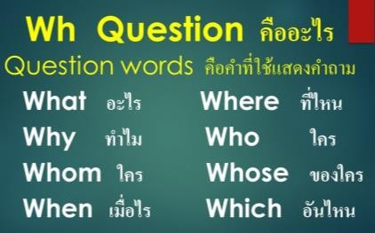
4. Writing Practice
WH-Questions:-
For questions below, please answer according to the story “About Me” above
What is the first name of the person in the story?
What is the surname name of the person in the story?
What is the nick name of the person in the story?
What is the father’s name of the person in the story?
What is the mother’s name of the person in the story?
Where is she from?
What is her hobby?
Does she have a pet?
What is her pet’s name?
Where does she live?
11
. What is her phone number?
12
. What is her email address?

Slide 7
What is her favorite food?
What is favorite drink?
15
. What is her favorite sport?
16
. What is her favorite movie? Why?
17
. What does she do?
18
. How does she get to school?
19
. Where does she go to school?
5. Speaking Practice
Role Play
Hullo, What’s your first name?
My first name is
Hullo, What’s your surname?
My surname is
Where are you from?
I am from
What’s your favorite drink?
My favorite drink is
Do you have a pet?
Yes, I have
What do you do?
I am a
Where do you work?
I work at

Slide 8
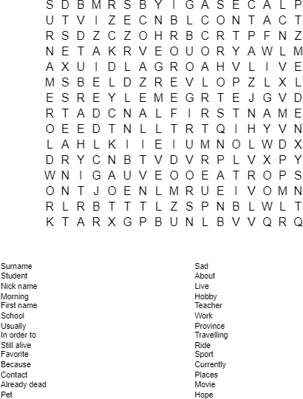
Activity: Vocabulary games

Slide 9
AT THE OFFICE
Lesson 2

Slide 10
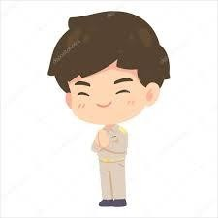
Lesson 2. At the office
Listening Practice Story 2: My Work place
My office is on the third floor of the government
labor office in Phitsanulok province I go to work every day apart from the weekends and public holidays. I usually take the bus to work although sometimes I drive when I wake up very late. At my work place it is my responsibility to buy office stationery for all the other employees. Every year in June I receive a list of office stationery from different offices the most common are staplers, erasers, pens, paper clips, pins pencils, sharpeners, glue, scissors and papers.
Some of the stationery I usually buy locally but some others like folders, envelopes, notebooks, clipboards I usually order online My job can be difficult but I make sure I finish everything well.
Reading Practice
For the story 2 above, please read through in order to practice reading the vocabulary words in the
“My workplace” story.
Vocabulary
labor office | Job | Public holidays | Employees | Erasers
Third floor | Difficult | Although | Receive | Workplace
Government | finish | Apart from weekends | List | Paper clips
List | papers | Wake up | Different | Pins
Pens | Envelopes | Responsibility | Most common | Pencils
Drive | clipboards | Office stationery | staplers | Sharpeners
Glue | scissors | Papers | Folders

Slide 11
4. Writing Practice
For questions below, please answer according to the story “My Workplace” above
What floor is the office?
Which province does he work?
Does he work for the government?
Does he work on weekends and public holidays?
Does he usually take the bus to work?
Why does he drive to work sometimes?
What is his responsibility at work?
In which month does he receive a list of office stationery?
What are the most common stationery on the list?
Does he usually buy some stationery locally?
Which Stationery does he order online?
Is his job very difficult?

Slide 12
5. Speaking Practice
Conversation
A: "Do you have a lot of work?" B: "Yeah. I'm pretty busy. Why?"
A: "Oh. I needed some help on this project." B: "Does this have to be done right now?"
A: "The manager wants it by Friday."
B: "I'll try to free up my schedule. Remind me again tomorrow morning, and I'll help you in the afternoon."
A: "Do you need to see the project first?"
B: "Yeah. That would help." A: "I'll print you a copy."
B: "Make sure you drop it off early." A: "No problem. Thanks."

Slide 13
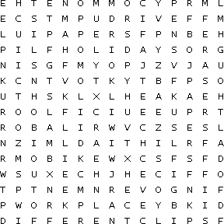
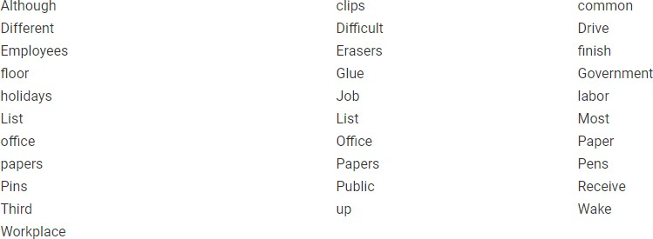
Activity: Vocabulary games

Slide 14
AT THE MEETING
Lesson 3

Slide 15
Lesson 3. At the meeting
Listening Practice Story 3: The meeting
It was Saturday morning and the sky was dark and covered with clouds. The weather had
been the same for days. Mr. Ivan had scheduled a meeting with his office staff for that afternoon. The secretary was supposed to prepare a financial report. She looked at her wristwatch, she realised that it was almost 2 o’clock in the afternoon “I'm late!" the secretary shouted. She quickly got up, ran to the bathroom where she took a shower and brushed her teeth. It was raining cats and dogs.
When she arrived at the office, she quickly grabbed her case. She walked very fast to the
main entrance, and headed inside the building. One of the receptionists Miss Hilaria, was at the front desk, and saw her enter. "You're late," she told her. She rushed to the elevator and went up the fifth floor. When she got out, her boss was outside waiting for her. She greeted him but he didn’t reply. Everybody was in the meeting room waiting for her. As soon as she arrived she apologised for coming late and the meeting started. When the meeting ended, she explained everything to her boss and everything was fine.
Reading Practice
For the story 3 above, please read through in order to practice reading the vocabulary words in the
“The meeting” story.
Vocabulary
Sky | Financial report | Arrived | Front desk | Waiting
Dark | Wristwatch | Grabbed | Late | Apologized
Weather | Realized | Main entrance | rushed | Started
Scheduled | Almost | Headed inside | Elevator | ended
secretary | Shouted | Building | Fifth floor | explained
prepare | Raining cats and dogs | receptionists | reply

Slide 16
4. Writing Practice
For questions below, please answer according to the story “The meeting” above
What day was the meeting?
Was the meeting on Sunday afternoon?
Who scheduled the meeting?
Was the weather the same for days?
Was the secretary supposed to prepare lunch?
Who was supposed to prepare a financial report?
Who looked at her wristwatch?
Who got up and ran to the bathroom?
Was it raining?
What did she do when she arrived at the office?
What is the name of the receptionist?
Who was the front desk?

Slide 17
Who was late?
Who was in the meeting waiting for the secretary?
Did the secretary apologize for coming late?
5. Speaking Practice
Conversation
A: Hello Jane, how are you?
B: Am fine Peter, how is your morning A: "I can't get the printer to work."
B: "Did you check to see if it had paper?"
A: "Yeah. That's the first thing I checked."
B: "I don't know then. You might have to call the technician." A: "How do I do that?"
B: "Just tell the admin and she should take care of it."
A: "Is there another printer that I can use?"
B: "Yeah. There's one down the hall next to the supply room." A: "Oh yeah... I remember that one. Thanks."
B: "No problem."

Slide 18
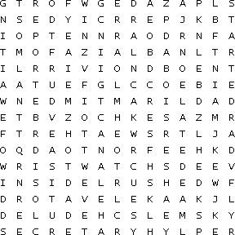
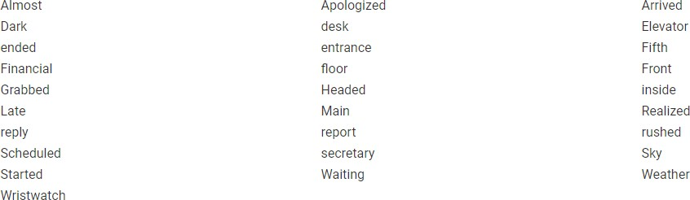
Activity: Vocabulary games

Slide 19
OFFICE PROJECT PRESENTATION
Lesson 4

Slide 20

Lesson 4. Office Project Presentation
1. Listening Practice
Story 4: Presentation about Foreign workers in Phichit
Hello everyone, my name is Noppadon today I will be presenting about foreign workers in Phichit. In this presentation I will be talking about the different jobs foreigners do, some examples of companies where they work and why they love working in Phichit
Phichit is an important city in North Eastern Thailand. Many foreigners come to visit and work in Phichit every year.
There are more than 500 people from different countries
working in Phichit city doing different jobs. Most foreigners in Phichit work in schools but others are working in factories, hospitals, hotels and other businesses
An example of a company with foreign workers is Phichit Packaging factory having a total of
5 foreign workers. Many foreigners like working in Phichit because it’s a nice city with so many tourist attractions and the people are very friendly
In summary many people go to so many different places but many choose Phichit because it’s a
wonderful place to work. Thank you all for listening do you have any questions?
Reading Practice
For the story 4 above, please read through in order to practice reading the vocabulary words in the
“Presentation about Foreign workers in Phichit” story.
Vocabulary
Foreign workers | companies | Factory | Packaging
Presenting/presentations | Working | Hospital | Because
Jobs | Important | Hotel | Tourist attraction
Foreigners | Countries | Business | Summary
choose | Listening | questions

Slide 21
4. Writing Practice
For questions below, please answer according to the presentation “about Foreign workers in Phichit” above
What is the name of the presenter?
What is the presentation about?
About how many foreign workers are in Phichit?
Is Phichit in the south of Thailand?
Where do most foreigners in Phichit work?
Do foreigners love working in Phichit?
Apart from schools what other places do foreigners work?
From the story, what is the example of a company with foreign workers?
How many foreign workers are working with Phichit packaging company?
Why do foreigners love working in Phichit?
Does Phichit have so many tourist attractions?
Are there foreigners working in Phichit?
Is Phichit in the West of Thailand?

Slide 22
Is Phichit an important historical city in Thailand?
Is the presentation about Chiangmai?
6. Speaking Practice
Conversation
A: Hello James, how are you?
B: Hello Carol, are you ready for your presentation this Friday? A: Oh, yes am ready.
B: What will your presentation be about?
A: Our group will be presenting about a solar power project. B: Wow, what time will you be presenting this Friday?
A: We will be presenting at 2.00pm in the meeting hall.
B: How many people are in your presentation group? A: We have five people in the group.
B: Okay, good luck with the presentation.
A: Thank you James, hopefully you will enjoy our presentation.
ACTIVITY: Presentation about work
Make groups of 3 people and prepare a short presentation about WORK separate into 3
parts: -
Introduction
Body
Summary
1. Introduction
(Introduce yourself, introduce topic) 2 sentences
2. Body
(talk about the details of the topic) 3 sentences
3. Summary
(summary of the presentation) 1 sentence

Slide 23
OFFICE WORK
Lesson 5

Slide 24
Lesson 5: Office Work
1. Listening Practice
Item 5: Letter requesting for leave
Human Resource Manager, Department of Labor
3 Wang Chan Road Phitsanulok Thailand Dear Mr. Rongsook,
I would like to request for a vacation leave for the following dates: 11th/09/2021 – 12th/09/2021. It has been 5 years since I have had a vacation and I wish to use some of my vacation hours for family time. Currently, I have 60 vacation hours and would want to use 18 hours of it.
At the moment, all of my work has been completed and I will make sure that all the
pending work will be completed before I leave for this trip. I will also make sure that whoever fills in for me in my absence will not have a hard time.
As you know, I am a hard worker and put in more than 28 hours a week. A good way to keep refreshed is to have a vacation once in a while I would like to have sometime to travel with my family and take a rest from all the work.
I have filled out the official company Vacation Request Form and have attached it for your
review. Regards,
Thitaree Nuantin
2. Reading Practice
For the item 5 above, please read through in order to practice reading the vocabulary words in the
“letter requesting for leave”.

Slide 25
3. Vocabulary
Hard time | Vacation Leave | Department | Following dates | labor
would | Once in a while | Manager | At the moment | review
Since | Family time | Currently | Whoever fills in | Take a rest
Completed | Vacation request form | Pending | Refreshed | Make sure
absence | Human resource | Hard worker | Attached | Request
Filled out
4. Writing Practice
For questions below, please answer according to the letter “Requesting for a leave” above
What is the letter about?
Who is requesting for leave?
What is the name of the human resource manager?
What is the name of the person writing the letter?
Why is she requesting for a vacation leave?
What dates is the leave?
How many hours is the vacation leave does Thitaree?
Is Thitaree a hardworker?
Is Thitaree’s work complete at the moment?

Slide 26
Who is Mr Rongsook?
Is Thitaree the Human resource manager?
Is Mr. Rongsook requesting for leave?
How many hours does Thitaree work in a week?
Is Thitaree going to spend the vacation with family?
Is Mr. Rongsoo requesting for leave?
5. Speaking Practice
Dialogue
A: Good morning, Mr. Greenwood
B: Good morning Clark, are you okay?
A: Am okay sir, did you receive my letter? B: Not yet Clark, what was the letter about?
A: It’s a letter requesting for a vacation leave.
B: Oh, when do you want to go for your vacation?
A: I was planning to go next week if I get permission B: How long do you want to go for vacation?
A: I was planning to go for two days.
B: I will look at your letter and reply immediately A: Thank you so much Mr. Greenwood

Slide 27
ACTIVITY: Letter requesting leave from work
Prepare a short letter requesting leave following the format below: -
Human Resource Manager, Department of Labor
3 Wang Chan Road Phitsanulok Thailand
Dear Mr. ,
I would like to request for a vacation leave for the following dates: – . I wish to use some of my vacation hours for . Currently, I have vacation hours and would want to use hours of it.
At the moment, all of my work has been completed and I will make sure that all the pending work will be completed before I leave for this trip.
As you know, I am a hard worker and put in more than hours a week. I would like to have sometime to travel with my family and take a rest from all the work.
I have filled out the official company Vacation Request Form and have attached it for your review.
Regards,

Slide 28
TIME
Lesson 6

Slide 29

Lesson 6: Time
Listening Practice Story 6: OURENGLISH CAMP
Date: Saturday 25th September 2018
Venue:Sukothai Historical Park
My name is Candy, I like English camps a lot and this is my story about our English camp. We usually have English camps at our school once a year. Last Saturday we had an English Camp for Phitsanulok Vocational College student at Sukothai province. It was a fun day for learning and practicing English language. I woke up at 6.00 am. I took a shower and brushed my teeth. At about 6.30 am I had my breakfast and prepared my clothes for the day. At 7.00 am I left my home and went to school.
I arrived at school after 20 minutes, I met with all
the other students at the Wi-Fi zone. At about 8.45 am we all left to Sukothai province from school. Sukothai is about 60 km from Phitsanulok, its hour’s drive and by 9.45am we were in Sukothai province. At Sukothai we had fun, and learned a lot about interacting with different foreigners. Me and my friends always prefer having the English camps at Sukothai
Reading Practice
For the lesson 6 above, please read through in order to practice reading the vocabulary words in
the “Our English camp” story.
Vocabulary
English camp | Once a year | Last Saturday | Learning | different
Practicing | Language | Woke up | shower | Foreigners
Brushed my teeth | Breakfast | Prepared my clothes | Arrived | prefer
After | Zone | An hour’s drive | interacting

Slide 30
4. Writing Practice
For questions below, please answer according to the story “Our English Camp” above
When was the English camp?
How many days was the English camp?
What day of the week was the English camp?
Where was the English camp?
How often does Candy’s school go for the English camp?
What is the name of the province Candy had the English camp?
Why did Candy go to Sukhothai?
How did Candy go to Sukhothai?
Do you think Candy likes English camps?
Did she have a good time at the camp?
Does she prefer English camp in school or at Sukhothai?
Did she learn a lot?
What time did Candy wake up?
What time did Candy have breakfast?

Slide 31
What time did Candy take a shower?
What time did Candy brush your teeth?
What time did Candy prepare your clothes?
What time did Candy leave home?
What time did Candy get to school?
What time did Candy arrive at school?
How did Candy get to school?
How long is it from Candy’s home to school?
Who did Candy meet at the school?
Where at school did they meet?
What time did Candy leave for Sukhothai?
What time did they arrive at Sukhothai?
How far is Sukhothai from Phitsanulok?
How long is Sukhothai from Phitsanulok?
What is the distance from Sukhothai to Phitsanulok?

Slide 32
List of events
6.00 am:
6.01 am – 6.29 am:
6.30 am: 6.31 am – 6.59 am:
7.00 am:
7.20 am:
8.45 am
9.45 am
5. Speaking Practice
Dialogue
A: Hey Jane, how was the English training yesterday? B: It was great, we had a lot of fun.
A: What time did the training start?
B: The training started at 8.00am in the morning, although by 7.30 am everyone was in the meeting room.
A: How long was the morning session?
B: The morning session was 3 hours and the evening session was 4 hours
A: Oh, the afternoon session was really long, what time did you get back home? B: I got back home at 6.00pm and I was very tired
A: Well, it’s good you had fun, hopefully next time I will also join B: Oh yeah sure, it would be nice if you join

Slide 33
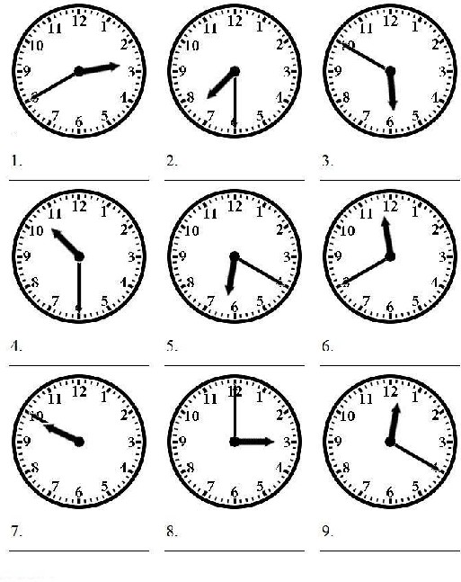
Activity: Telling time
In the activity below write down the time on the clocks
a) Day time

Slide 34
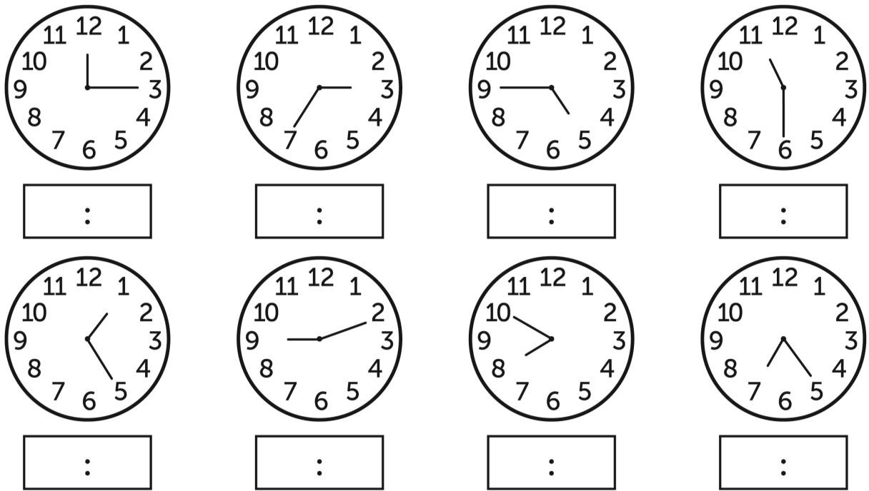
a) Night time

Slide 35
NEW JOB
Lesson 7

Slide 36
Lesson 7. New Job
Listening Practice Story 7: Work at the law firm
Casey is going to work with her uncle at his law firm this summer. She is very excited. She is
visiting her uncle. He is telling her all about the work for that summer. “I will be in charge of several cases. You have to help me keep the files and double check content. I’ll quiz you so that you can prepare for law school,” he says.
“I don’t know if I want to be a lawyer,” Casey says. If she becomes a lawyer, she will follow her uncle’s footsteps. Casey will work on many different cases. Her uncle will be her mentor. “It is important to look before you leap,” her uncle says. Casey nods. “What else do I have to do?” she asks. Her uncle explains that they will have a meeting with clients and Casey will have to take notes. She has to type up the notes for her uncle. He is going to show her a courtroom.
“You’ll do a lot of work and it’ll look good on your resume.” “Sounds like a piece of cake,” says Casey. She’ll be ready to apply for law school by the end of the summer. Law school will be challenging, but she is confident. She is sure that she can learn very quickly. “You’ll do great,” her uncle says. Casey smiles brightly
Reading Practice
For the lesson 7 above, please read through in order to practice reading the vocabulary words in
the “New job” story.
Vocabulary
Law firm | Client | Look before you leap
In charge of | Type up | A piece of cake
Content | Courtroom
Mentor | Challenging

Slide 37
Writing Practice
For questions below, please answer according to the story “New Job” above
  What is Casey going to do this summer?
  Who is Casey going to work with?
  Where is Casey going to work?
  Is Casey going to work at her law firm?
  How does Casey feel?
  When is Casey going to work?
  Who will be in charge of several cases? Casey or Uncle?
  Will he quiz Casey?
  Why will her uncle quiz her?
  Is she sure that she wants to be a lawyer?
  What will happen if she becomes a lawyer?

Slide 38
Will Casey work with a few cases or many cases?
What will her uncle be?
When will Casey take notes?
Who will they have a meeting with?
Conversation Situation 1
Susan: Hey, Casey. What are you going to do this summer?
Casey: I’m going to work at my uncle’s law firm. Susan: That’s interesting. What are you going to do?
Casey: I’m very excited. My uncle will tell me all about the work.
Susan: Great! I hope you enjoy your summer.
Casey: Thank you. What about you? What is your plan?
Susan: I will visit my cousin and we will travel together. Casey: It sounds fun! I think our summer will be very great. Situation 2
Casey: What are you going to do?
Uncle: I will be in charge of several cases and you have to help me.
Susan: I’m ready because you will be my mentor.
Uncle: Of course. We will have a meeting with clients and you have to take notes.

Slide 39
Casey: Where is the court room?
Uncle: I’m going to show you. Casey: I’m very excited.
Uncle: You’ll do a lot of work and it’ll look great on your *resume. Casey: I’ll do my best

Slide 40
FOOD
Lesson 8

Slide 41
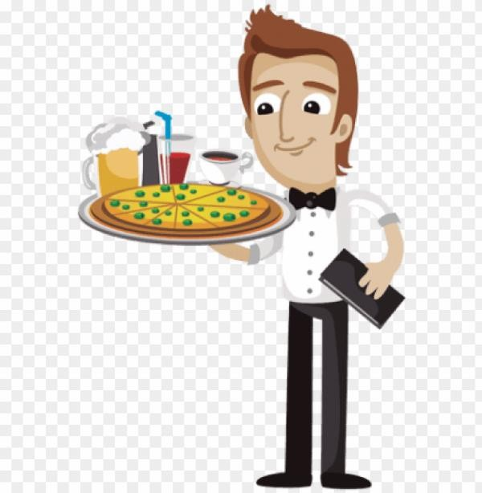
Lesson 8: Food
1. Listening Practice
Story 8: Chloe and Kevin’s food experience
Chloe and Kevin enjoy going out to Italian restaurants. They love to eat pasta, share a dessert, and have espresso coffee. Chloe and Kevin’s anniversary is coming up. Kevin wants to plan a night out at an Italian restaurant in town. He calls a restaurant to make a reservation but they have no tables available. He calls another restaurant, but they have no availability either.
Kevin thinks and walks around the house. He knows that Chloe loves Italian food more than
anything else. He knows that nothing makes her happier. But the only two Italian places in town are too busy. Kevin has an idea. What if he cooks Chloe a homemade Italian meal? Kevin pictures it: he puts down a tablecloth, lights some candles, and plays romantic Italian music.
But there is only one problem. Kevin isn't a good cook.
In fact, Kevin is a very bad cook. When he tries to make breakfast, he burns the eggs, when he tries to make lunch the salad is not delicious, when he tries to make dinner even the neighbors smell how bad it is. Kevin has another idea: if he calls up one of the restaurants before Chloe gets home and orders take-out, he can serve that food instead of his bad cooking! The day arrives. Chloe is still at work while Kevin orders the food, picks it up, and brings it back home.
As he lays down the table mats, lights the candles and puts the music on, Chloe walks in. "Happy Anniversary!" Kevin tells Chloe. He shows off their romantic dinner setting, smiling.
Chloe looks confused. "Our anniversary is tomorrow, Kevin." Kevin pauses, looks at the calendar and realizes she's right. He looks back at her. "I guess it's always good to practice!" he says.

Slide 42
Reading Practice
For the lesson 8 above, please read through in order to practice reading the vocabulary words in
the “Chloe and Kevin’s food experience” story.
Vocabulary
Restaurants | Too busy | Lights | Delicious | Picks it up
Dessert | Walk around | Candles | dinner | Lays down
Anniversary | More than anything else | Table cloths | Neighbors | Table mat
Coming up | Nothing Makes her happier | problem | smell | candles
Plan | Available/availability | Very bad cook | Another idea | Walks in
Night out | What if | Tries to make | Order take out | Showing off
Reservation | Homemade Italian meal | Burns the eggs | Serve | Romantic dinner
Thinks | Plays romantic Italian music | lunch | instead | Confused
Calendar | realizes | practice
4. Writing Practice
For questions below, please answer according to the story “Chloe and Kevin’s food
experience” above
Does Chloe and Kevin enjoy going out?
Does Chloe and Kevin enjoy Chinese or Italian food?
Is Kevin and Chloe’s anniversary coming up?
Does Kevin call a restaurant to make reservations?
Who calls a restaurant to make a reservation?
Does the restaurant Kevin calls have any tables available?

Slide 43
In the story above, who loves Italian food more than anything else?
What is Kevin’s first idea about the anniversary dinner?
Is Kevin a good cook?
What happens when Kevin tries to make breakfast?
What happens when Kevin tries to make lunch?
What is Kevin’s second idea for the anniversary dinner
Is Kevin’s salad delicious?
Where is Chloe when Kevin orders the food?
Why does Chloe look confused when she walks in?
5. Speaking Practice
Dialogue
A: Mary, how have you been?
B: Everything is good. How have you been, James? A: Perfect, couldn't be better.
B: James, I was thinking that we might go to have dinner tonight. Would you rather eat Italian food or eat Indian food?
A: That’s a good question. I like Italian food a lot but I’d rather eat Indian food than Italian food. B: Why?
A: Well, to tell the truth. I know you love Indian food and I would rather have dinner with you
tonight than anyone else. So I would like to go to an Indian restaurant with you.

Slide 44
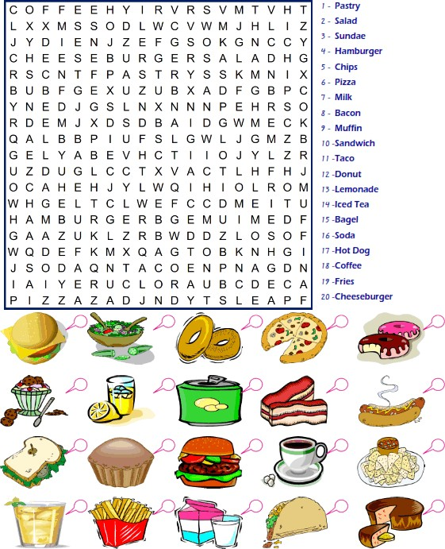
B: Wow. You are so sweet. I think we’d better make a dinner reservation now. I know one of the best Indian restaurants which is not far from here.
A: Great!
Activity: Food dictionary puzzle

Slide 45
TRAVEL
Lesson 9

Slide 46

Lesson 9: TRAVEL
Listening Practice
Story 9: Vacation trip to Chanthaburi province
Everyone was excited, on Friday we were going to go for a vacation trip with everyone working at the labor office in Phitsanulok. I had been to some cities in the East of Thailand like Rayong, Chonburi and Pattaya but had never been to Chanthaburi, I heard a lot about Chanthaburi and was very happy that we were going there.
As early as 5.30 am in the morning we were all in the bus ready to go. We had breakfast in the bus and by 6.00 am we left Phitsanulok. It was a very long trip to Chanthaburi by 10.00am we were in Bangkok we continued to Chonburi and by lunch time we were in Rayong, we hand lunch in Rayong.
It was afternoon already when we got to Chanthaburi, it was very beautiful watching the sea at the Neon Nangphaya view point where we stopped to take photos. We spent the night at Baan Nokook Resort, it was here we met with the rest of the labor officers from the different provinces, we had a big retirement dinner for some officers who retired that year.
On our way back to Phitsanulok, we stopped by the beach and also watched eagles. It was a
fun vacation trip and everyone was happy.
Reading Practice
For the lesson 9 above, please read through in order to practice reading the vocabulary words in
the “Vacation Trip to Chanthaburi province” story.

Slide 47
3. Vocabulary
Excited | Early | Watching | Beach
Vacation | Ready | Sea | Eagles
Trip | Breakfast | View point | Fun
Working | Continued | Spent the night | Retirement
cities | Lunch | Met | Beautiful
East | already | rest | Had never been
4. Writing Practice
For questions below, please answer according to the story “Vacation trip to Chanthaburi province” above.
Why is everyone excited?
Who is excited?
Had the person in the story been to some cities in the East of Thailand?
Which cities in the East of Thailand had he been to?
Who was going for a vacation trip?
Had he been to Chanthaburi before?
Where was everyone going for a vacation?
At what time were they ready at the bus?
Where did they have breakfast?

Slide 48
What time did they leave Phitsanulok?
At what time did they reach Bangkok?
Where did they have lunch?
Did they reach Chanthaburi in the morning?
At what place did they stop to take pictures?
Where did they spend the night?
5. Speaking Practice
Dialogue
A: Jane. I have to go away on business next week. B: Where to?
A: Japan.
B: And what do you need me to do? A: I need you to organize my trip.
B: OK. But I'm going to need some information from you first. A: I have some time now, so let's get started.
B: What day do you want to leave? A: Next Friday the 12th.
B: And which city are you visiting? A: Osaka.
B: And for how many days will you be there? A: 7 days.
B: Is there a budget for your flight and your accommodation? A: Yes, call a travel agent. They will fix everything.

Slide 49
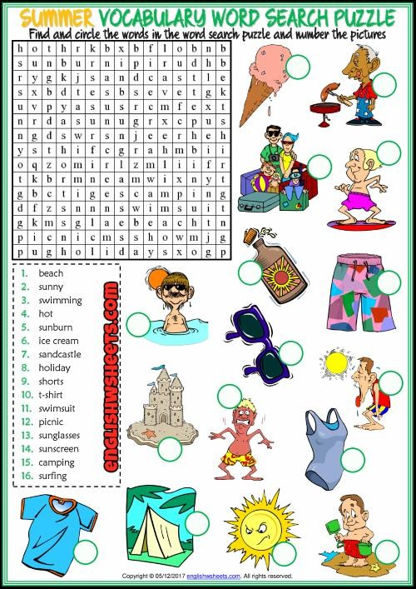
Activity: Vacation vocabulary

Slide 50
PLACES
Lesson 10

Slide 51
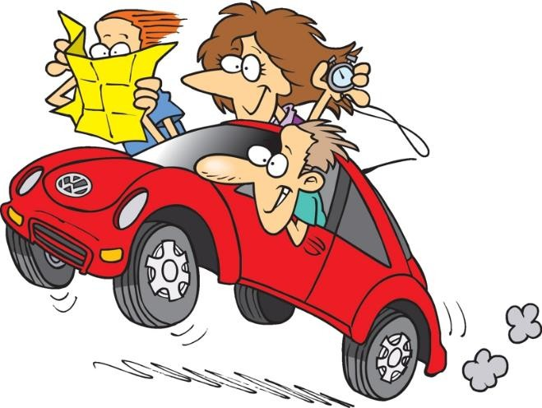
Lesson 10: PLACES
Listening Practice
Story 10: Getting lost in Nakhonsawan
Last year in December we had a worker’s conference with all labor officers all over the country in Nakhonsawan. Nakhonsawan is a two hours’ drive from Phitsanulok. My friend Aof had never been in Nakhonsawan and I had not been to Nakhonsawan for a long time.
The conference was at the River view
conventional center behind Big C and near the traffic lights. We reached Nakhonsawan in the afternoon and the next morning we had to go to the conference. However, we got a little lost on the way. We stood on a street corner with the map, trying to figure out where we had made a wrong turn. A woman stopped to ask us if we needed help.
“At the police station, turn right and go straight make a U-turn near the restaurant and turn left and stop at Big C the conventional center is behind Big C” the woman said giving us directions. We finally arrived and the conference had already started. We took notes, but really looked forward to speaking with the other labor officers at the meet and greet. We had a good time and learnt a lot at the conference.
Reading Practice
For the lesson 10 above, please read through in order to practice reading the vocabulary words in
the “Getting lost in Nakhonsawan” story.
Vocabulary
Conference | Conventional center | However | Turn right | Directions
Traffic lights | All over the country | Got a little lost | Go straight | arrived
two hours’ drive | Reached | Made a wrong turn | u-turn | Already started
Afternoon | Had never been | Needed help | Near | Took notes
Long time | Next morning | Police station | Turn left | Looked forward

Slide 52
4. Writing Practice
For questions below, please answer according to the story “Getting lost in Nakhonsawan” above.
In which province was the conference?
How many hours is it driving from Phitsanulok to Nakhonsawan?
What is the name of his friend?
Had Aof ever been to Nakhonsawan?
At what conventional center was the conference?
What is behind Big C and near the traffic lights?
_
Did they reach Nakhonsawan at night?
What did they do the next morning?
Did they get lost on the way?
Who helped them with directions to the conference, a woman or man?

Slide 53
Did they finally arrive at the conference?
Did they arrive on time or they arrived late?
Did they have a good time at the conference center?
Did they take notes at the conference?
Did they learn a lot from the conference?
5. Speaking Practice
Dialogue
Conversations 1
Jane: Excuse me! Can you tell me the way to the museum?
Mike: It’s this way. Go straight ahead at the traffic lights. Turn right. Go along the street. Walk past the park, and keep going straight until you see the sign for the museum.
Jane: Great! Thanks for your help.
Mike: You’re welcome.
Conversations 2
Kate: Excuse me! How do I get to the post office?
Mary: Sorry, I’m not from around here.
Kate: Do you know where the closest bank is?
Mary: If you cross the street, you’ll find a bank there!
Kate: Thank you.
Mary: Don’t mention it.

Slide 54
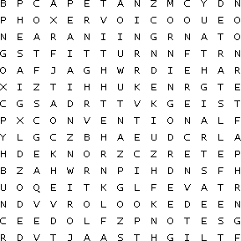
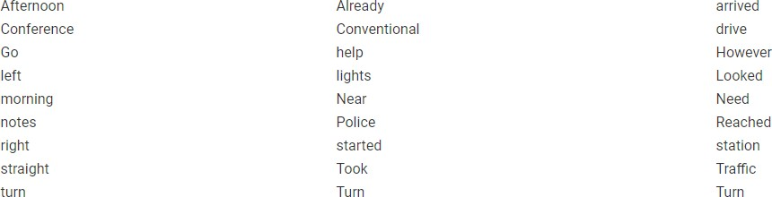
Activity: Places vocabulary

