Slide 1
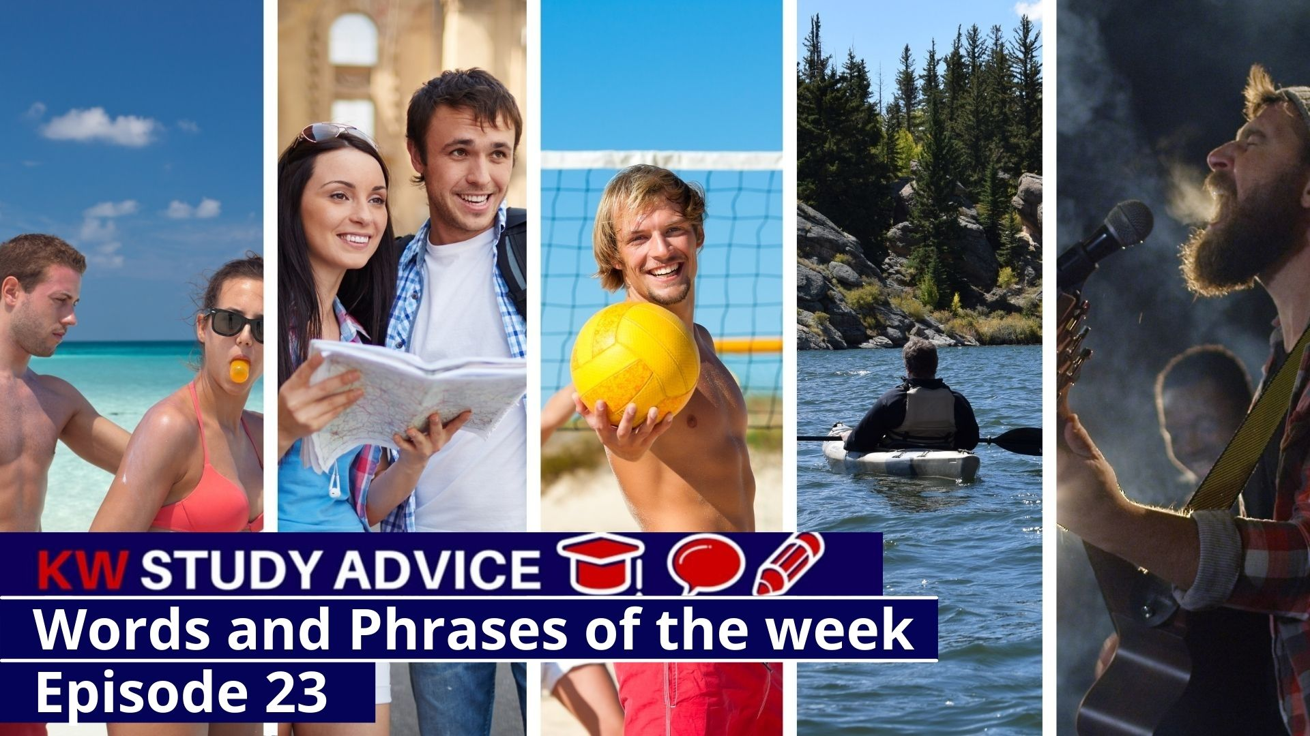
Trunks
Sight Seeing
Suntan Lotion
Canoeing
Recreation
Potential

Slide 2
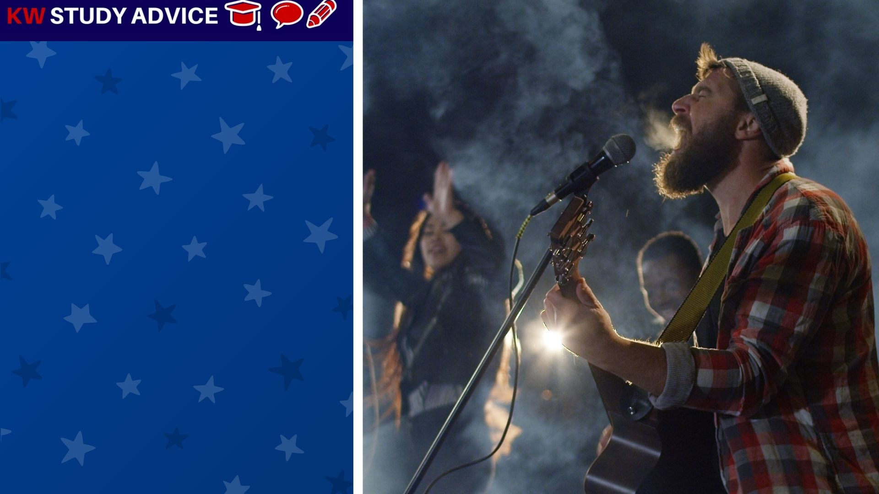
Potential
Someone or a group of people who have the chance to become brilliant at what they do. They could become famous.
The band were so good and loved by their fans that journalists believed they had the potential to be very famous and successful.

Slide 3
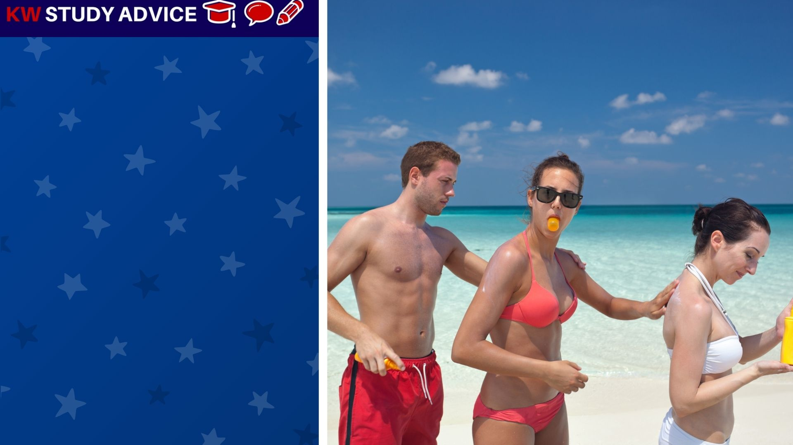
Suntan Lotion
A special cream which is rubbed onto the skin to prevent sunburn. This required during the summer when outdoors.
The friends decided to stay on the beach for several hours. They they took their suntan lotion to stop them from getting sun burn.

Slide 4
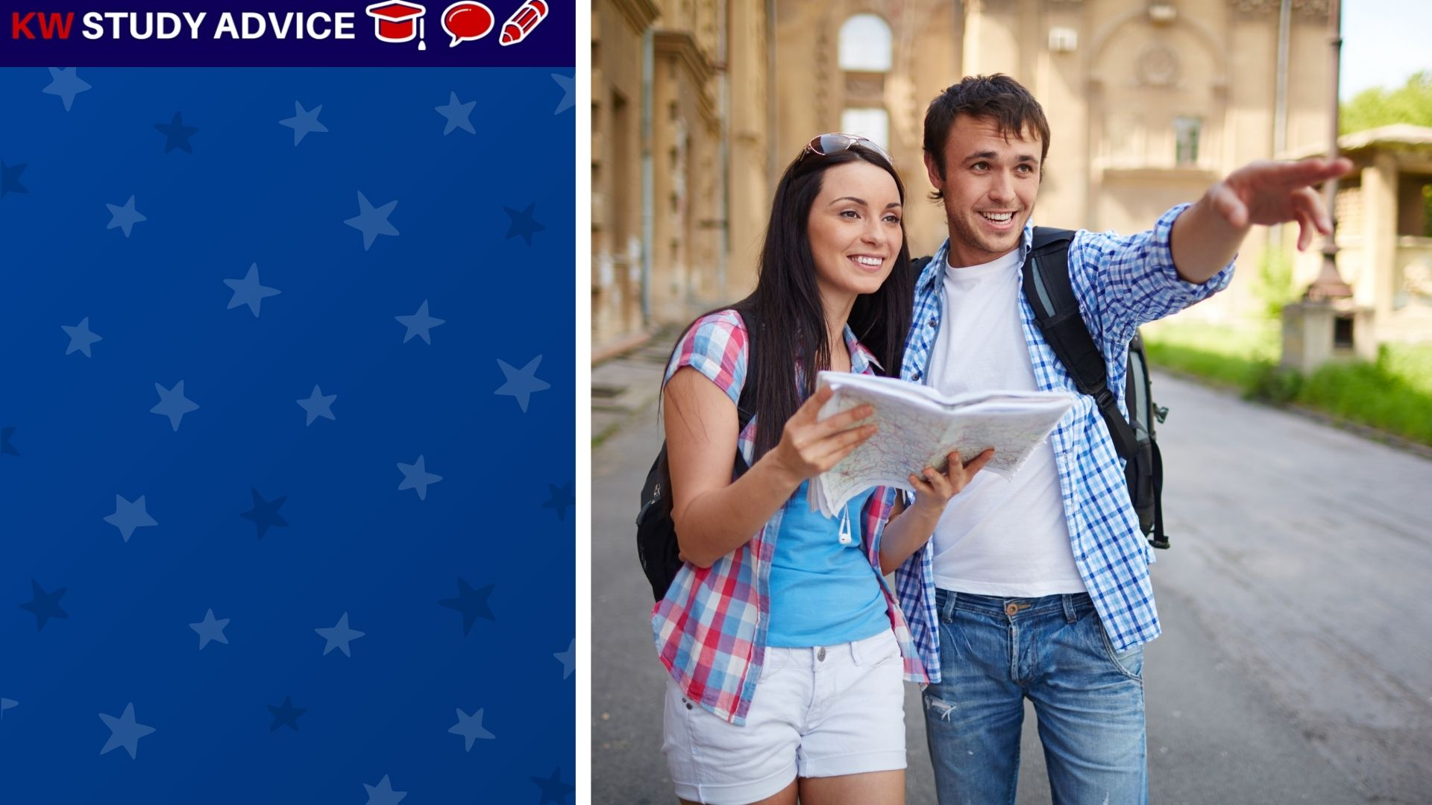
Sight Seeing
This is when people go to see famous and/or popular buildings and attractions. Capital cities are famous for sight seeing.
The couple went sight seeing in the capital city. They wanted to visit many famous and historical building. They took many photos.

Slide 5
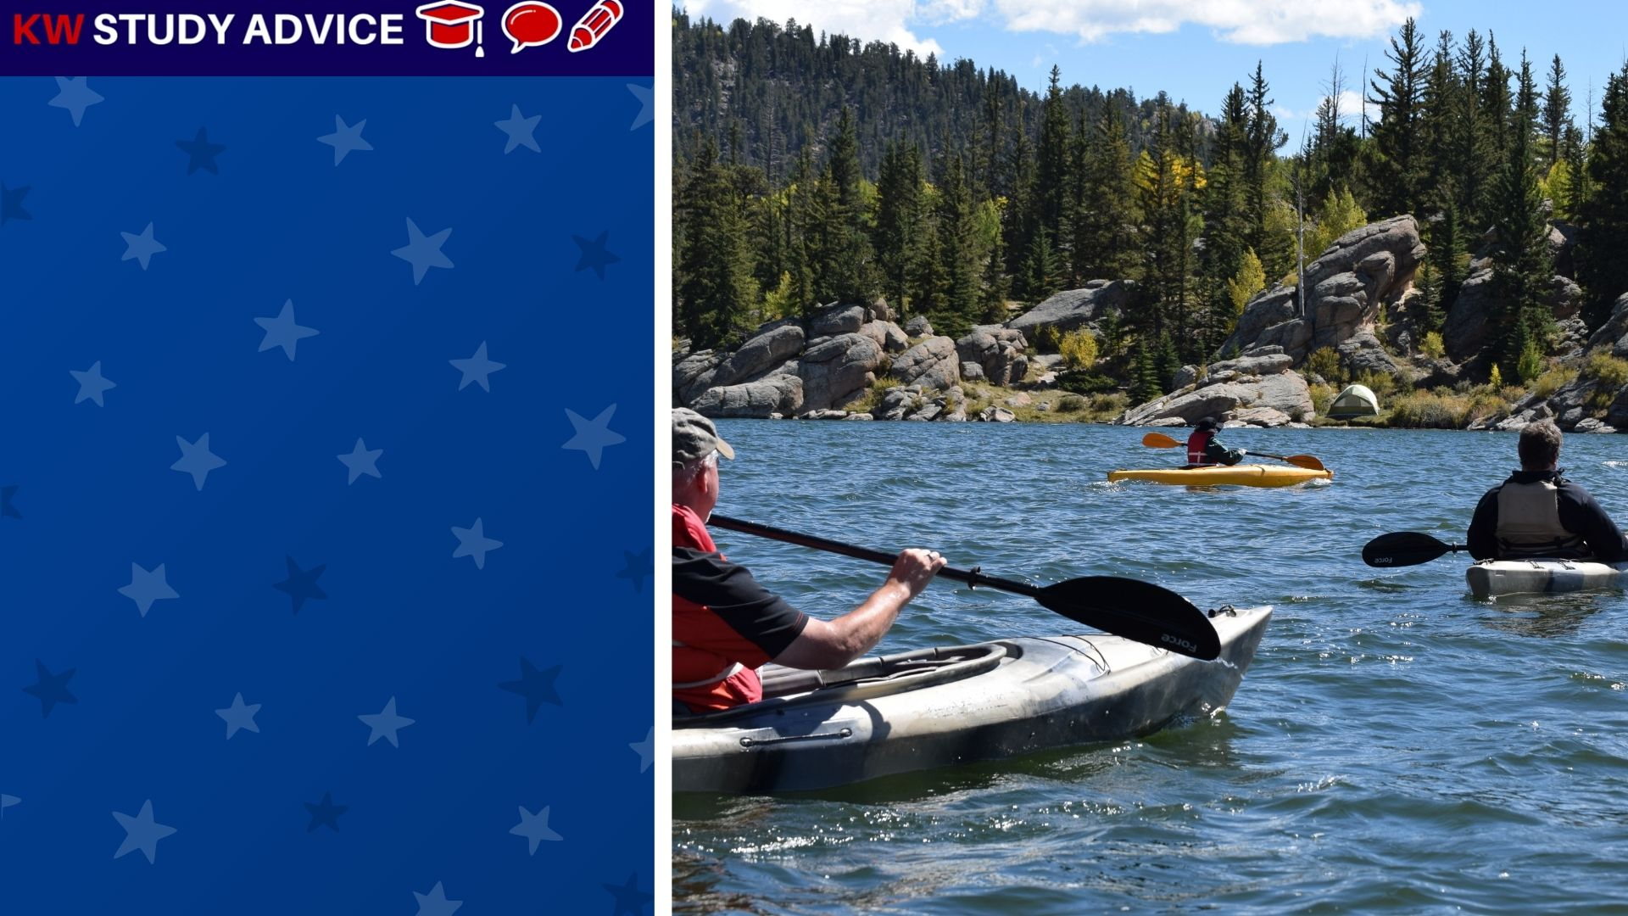
Canoeing
This is the activity of sailing in a light and thin boat. Users have paddles to help them sail faster or change direction.
The family decided to go on a canoeing day in the lake by the forest. The water was calm so it was an enjoyable day on the lakes.

Slide 6
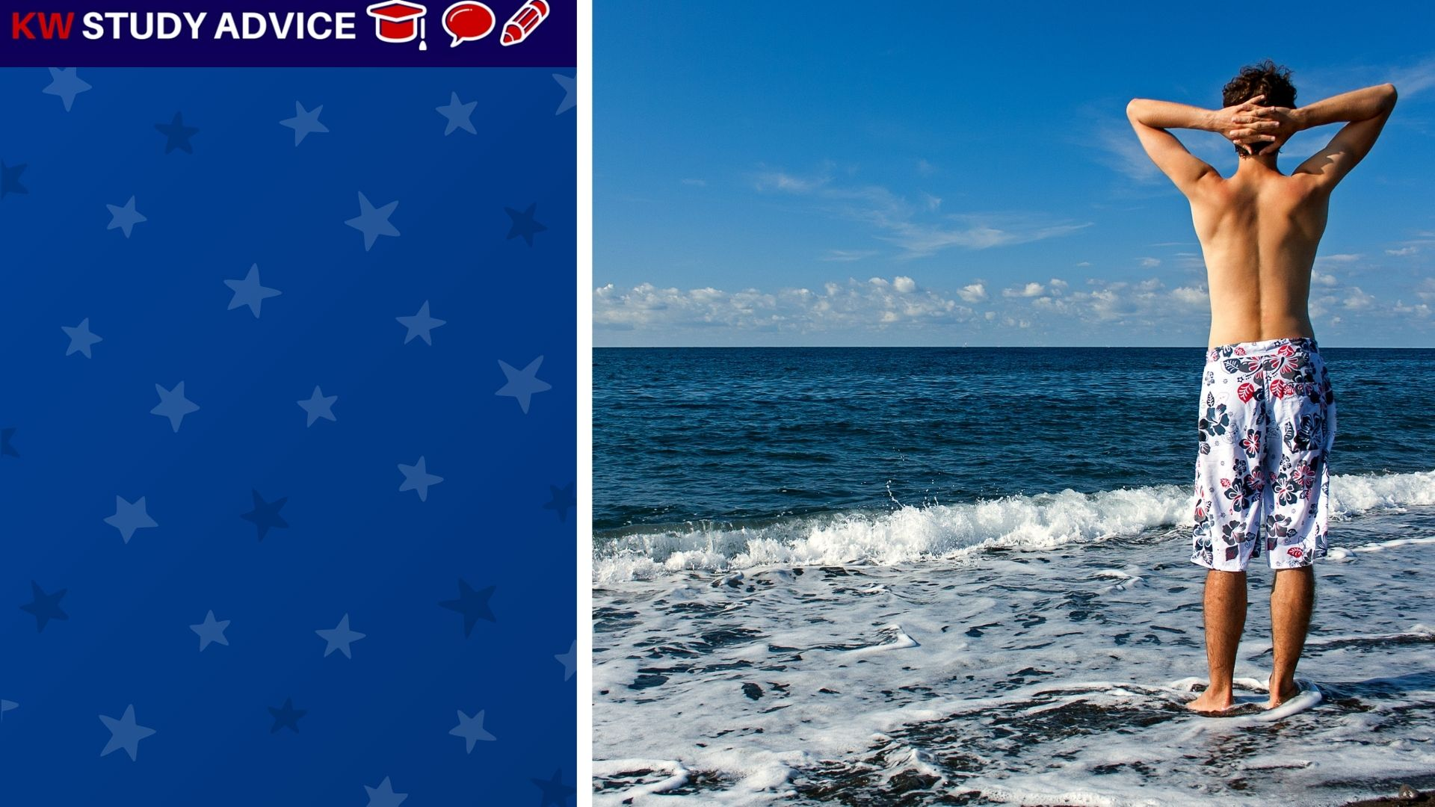
Trunks
These are men’s shorts. They are usually worn when going to the beach or when swimming either in the pool or the sea.
The boy wore his trunks when he went to the beach. He could not decide whether or not to go swimming in the calm sea.

Slide 7
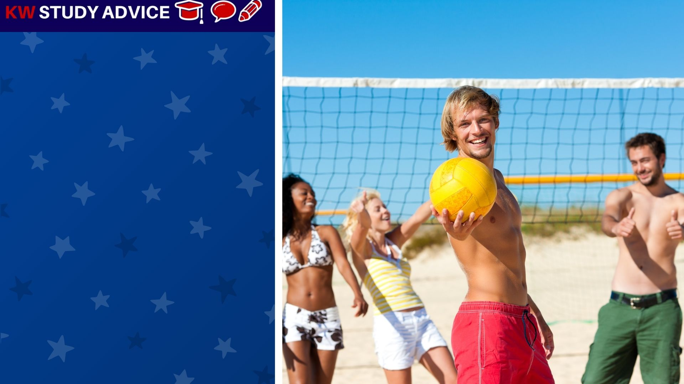
Recreation
This is an activity done by an individual or group for the purpose of fun or entertainment. Having fun is the main part.
The friends decided to go and play volleyball at the beach. To do this they needed to pay each hour for this fun beach recreation.

Slide 8
