Slide 1
Business Writing
Essentials of Business English Communication
Prepared by:
Jeffrey R. De Castro

Slide 2
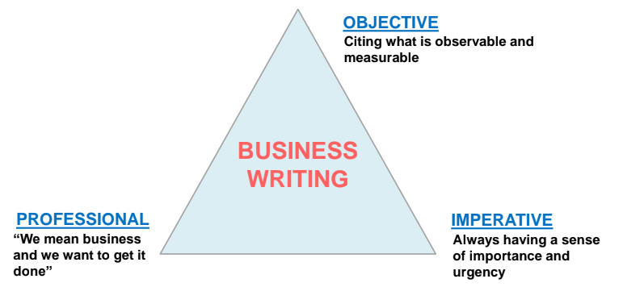
Explain the 3 elements of business writing.

Slide 3
Transform the statement using the three elements of business writing.
In my humble opinion the product is defective.

Slide 4
Transform the statement using the three elements of business writing.
I’m sorry to disturb your time and I know that you are busy. Could you please review this document?

Slide 5
Transform the statement using the three elements of business writing.
We pray that your team will approve this proposal.

Slide 6

In the active voice, the _________ is the subject of the sentence.
Doer
Receiver
All of the above

Slide 7
Convert the statement from passive to active voice.
It has been decided by the management that the bonus will be released to all the employees.

Slide 8
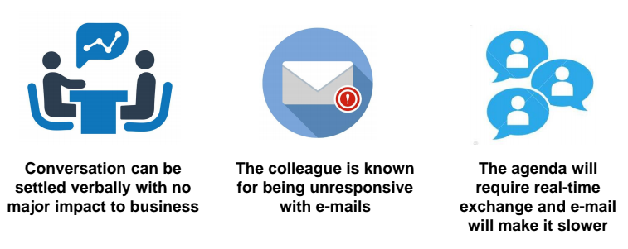
Consider verbal communication as first-line approach (instead of written) when…

Slide 9
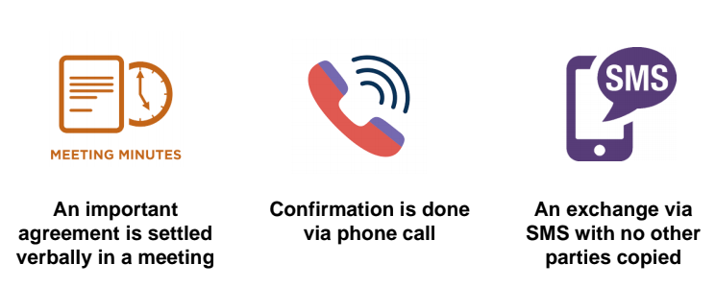
Written documentation can ALSO be your safety net. Consider sending an email AFTER…

Slide 10
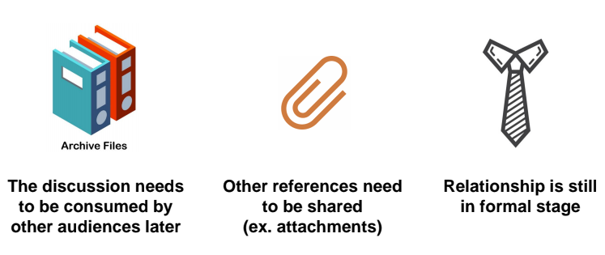
Consider written documentation as “essential” when…

Slide 11
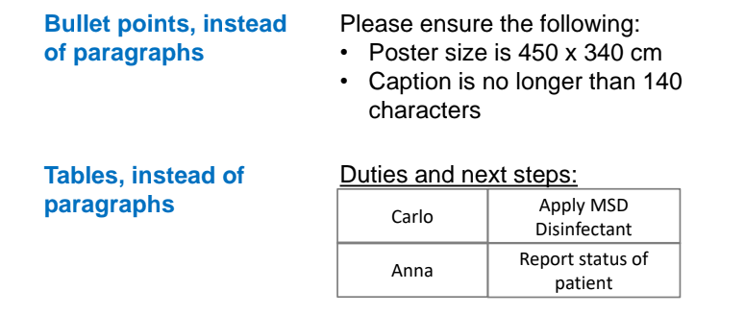
How do I shorten my emails and IMs?

Slide 12
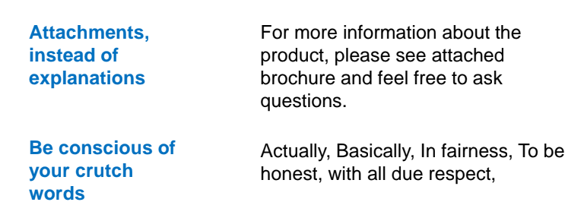
How do I shorten my emails and IMs?

Slide 13
One should be critical in deciding whether a business conversation should be documented on email or be settled verbally.
True
False

Slide 14
Presentation Ends
Thank you!

