Slide 1
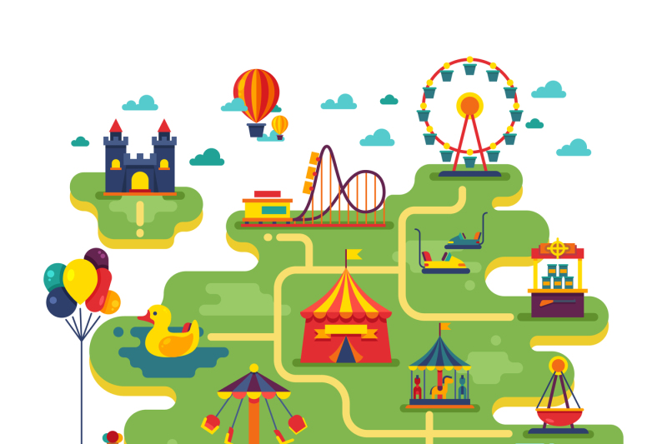
Welcome to the amusement park

Slide 2
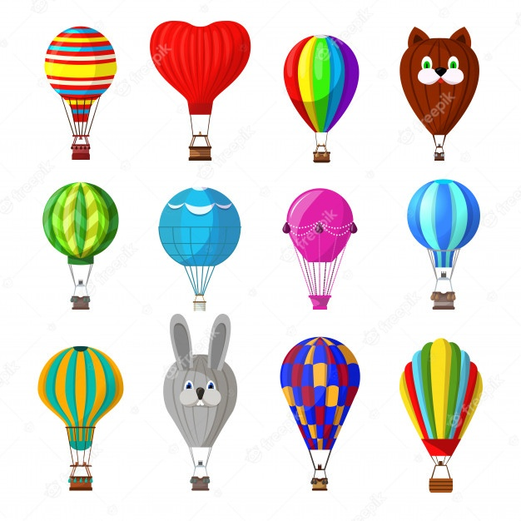
Choose or create your balloon!
Balloon race!

Slide 3


Which is greater? 6x5 or 35-4
I have 2 digits.
My ones digit is between 6 and 8.
Which is lesser? 7 x 7 or 43 + 2
My tens digit is the sum of 2 and 5.
What is the difference of 115 and 86?
I have 2 digits.
What is the sum of 115 and 86?
My ones digit is between 4 and 2.
What is the sum of 100 and 15?
My tens digit is the sum of 3 and 6.
What is the product of 8 and 6?

Slide 4
If one key is equal to 6 points. How many points do you have?

Slide 5
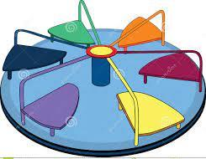

Umbrella roundabout

Slide 6




Pirate ship

Slide 7
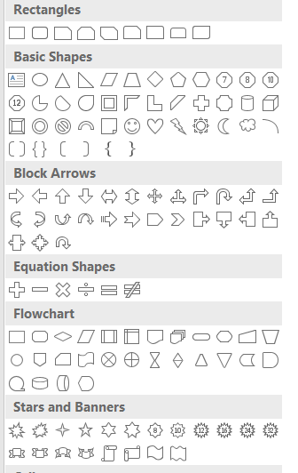
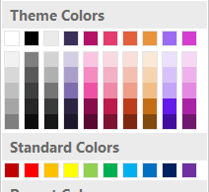
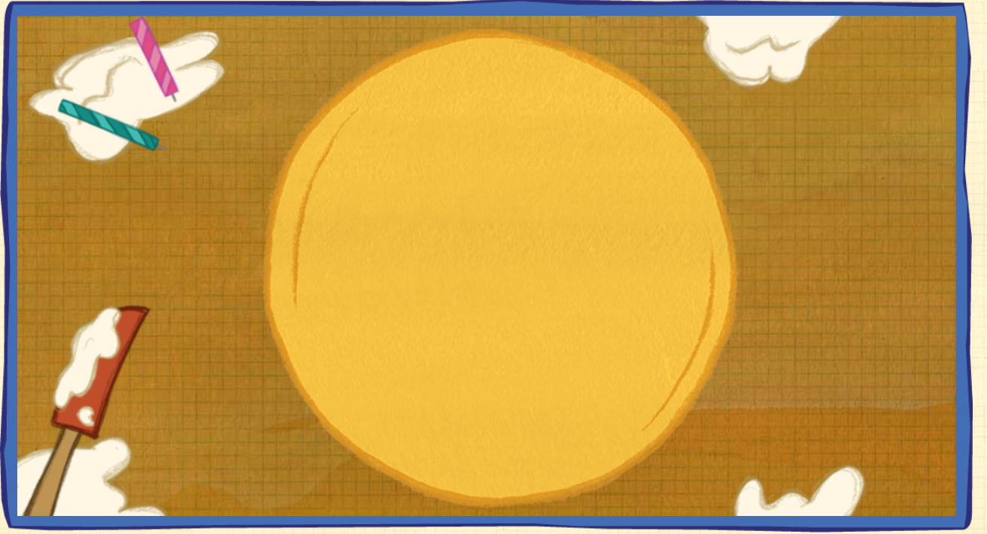
Design your cake

Slide 8







CUPCAKES FOR SALE
 | 4 | 5 | 0
- | 2 | 7 | 5
 |  |  |  | = | 140
 |  |  |  | = | 135
How many cupcakes costs 35 and 45 baht?

