Slide 1
BUSINESS ENGLISH
Writing a CV that stands out
Succeeding in a job interview

Slide 2

How we set goals influence if/how we achieve them.

Slide 3
General and Academic Vocabulary
English for Academic Purposes

Slide 4
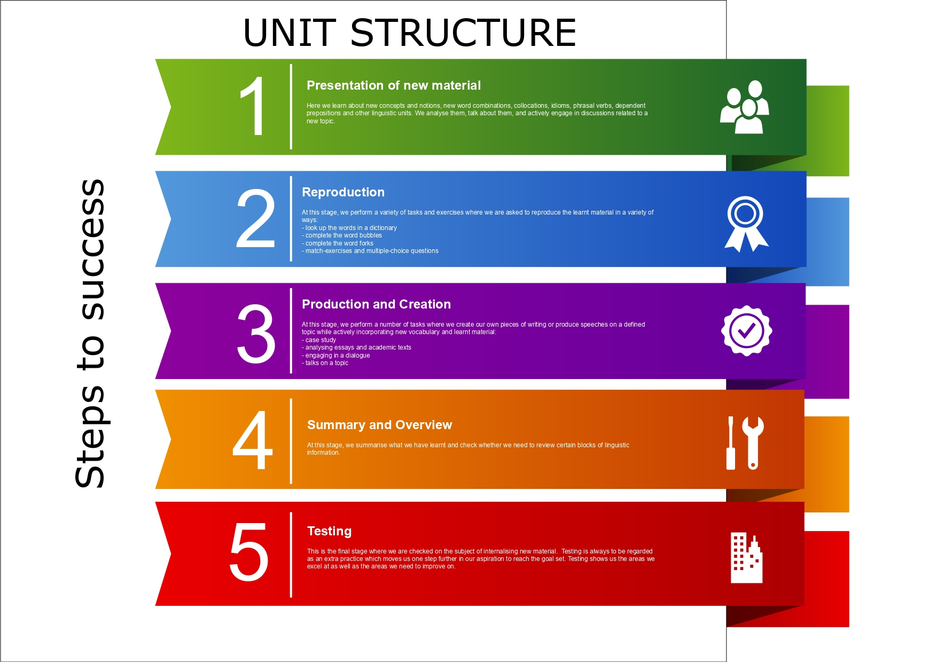

Slide 5
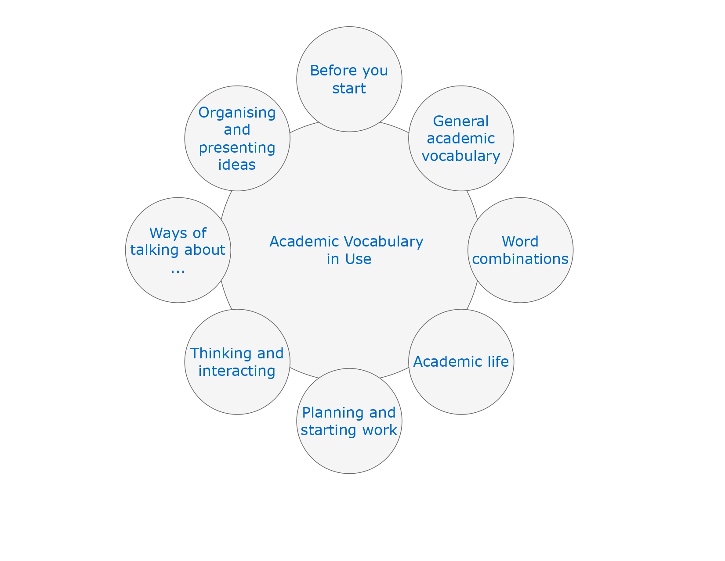
Word of the Day

Slide 6
Conversation and Speaking
English for Academic purposes

Slide 7


Slide 8
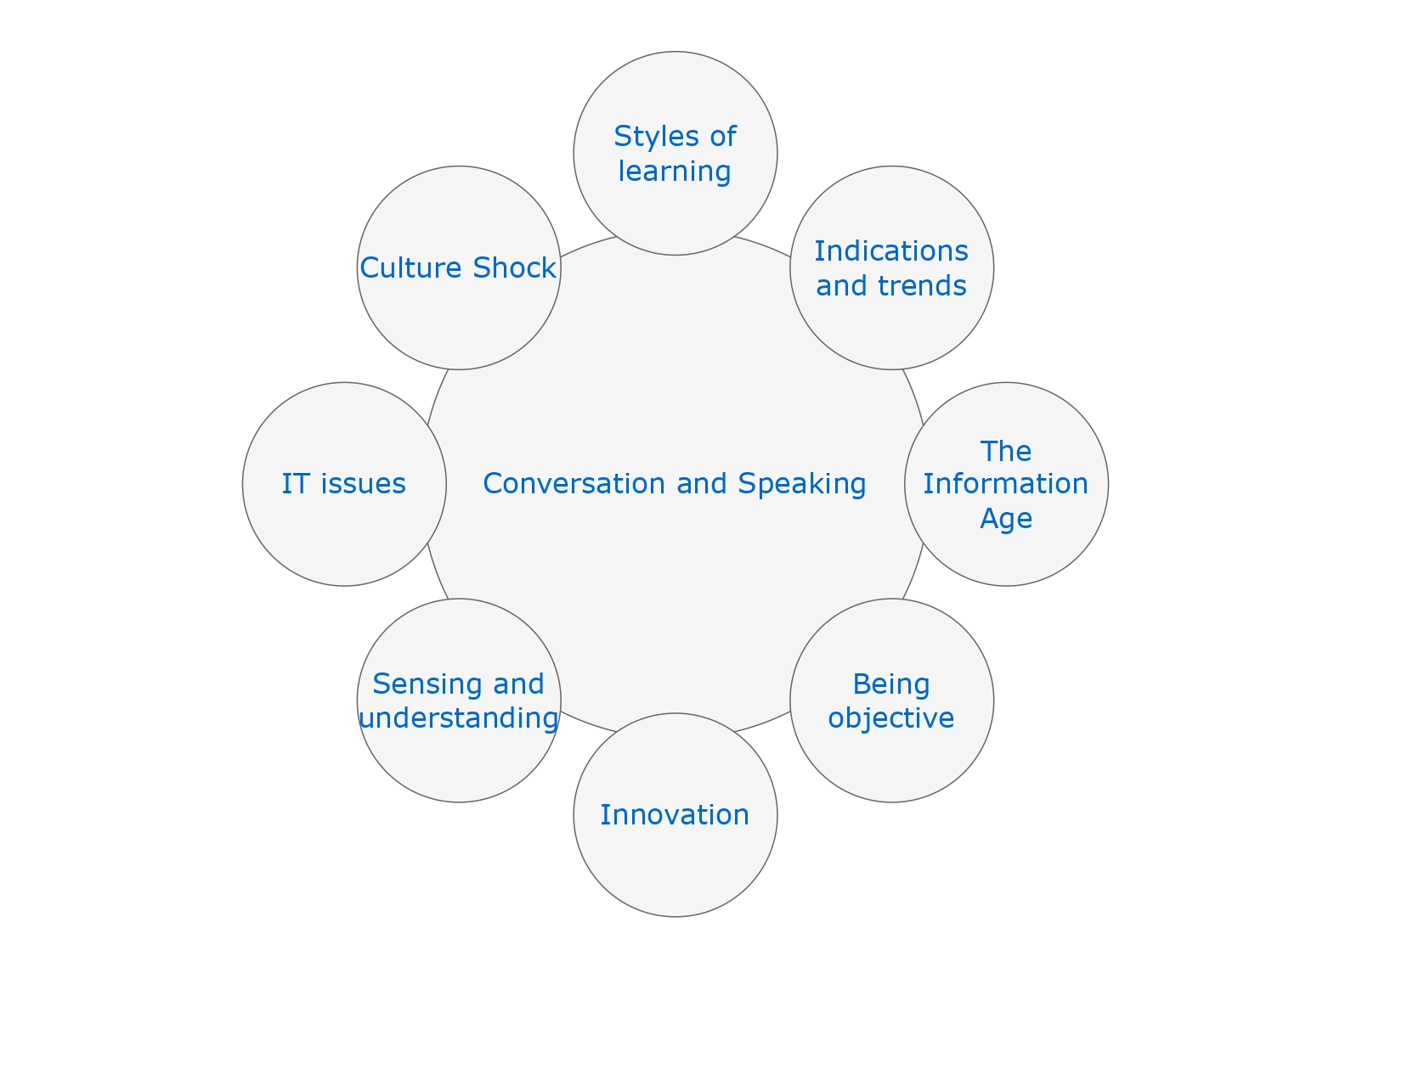

Slide 9

EDUCATION AND LEARNING

Slide 10

EDUCATION AND LEARNING
Everyday words and academic uses
Vocabulary and academic style
Noun phrases
Key nouns
Key verbs

Slide 11
ACADEMIC VOCABULARY: KEY NOUNS | ACADEMIC VOCABULARY. KEY NOUNS
subject | feature
theme | scope
topic | pattern
issue | number
theory | significance
model | identification
nature | approach
principle | assessment
aspect | research

Slide 12
ACADEMIC VOCABULARY: KEY VERBS | GENERAL VOCABULARY. KEY VERBS
to affect | to influence
to assume | to think something is true
to attempt | to try
to assess | to evaluate
to calculate | to count
to examine | to study in detail
to discuss | to talk about
to provide | to give
to demonstrate | to show

Slide 13
ACADEMIC VOCABULARY | GENERAL VOCABULARY
to include, to involve | to have something as its part
to challenge | to question
to conduct a research | to do a research
presented in the textbook | given in the textbook
to classify | to divide things into groups according to their type
to emphasise | to stress the importance or relevance
to explore | to study in detail
to consider | to think about

Slide 14
Work: duties, conditions, and pay
Jobs
Working hours
Pay

Slide 15
KEY VOCABULARY | KEY VOCABULARY
responsibilities | to involve doing a lot of paperwork
a routine | a salary
to be in charge of, to be responsible for | to get holiday pay
to deal with | to get sick pay
to run | an income tax
to manage | a nine-to-five job
to go to meetings, to attend meetings | to work flexi-time
to visit, see, meet clients | to do shiftwork
to advise clients | to work overtime

Slide 16
KEY VOCABULARY | KEY VOCABULARY
medical profession | to treat people
a dentist | to give medical treatment
a vet | to look after
manual jobs | to get sick pay
professional people | an accountant
a designer | a university lecturer
a lawyer | a broker
an architect | a programmer
an engineer | a data analyst

Slide 17
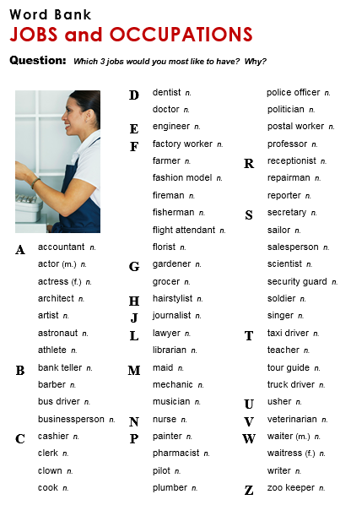

Slide 18
A day in the Life of an Architect
https://www.youtube.com/watch?v=_C5vCGB8Xx0
What does he do?
Where does he live?
What is his schedule like?
What is he saying of the entrepeneurship?
What are his main responsibilities as an architect?
Do you think it is hard to be an architect?

Slide 19
Thank you for your attention!

