Slide 1
Quadratics

Slide 2
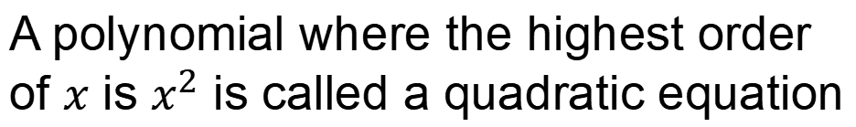
A polynomial where the highest order
of $x$ is $x^{2}$ is called a quadratic equation

Slide 3










These following polynomials
are all quadratic equations:
$$x^{2}$$
$${3−x}^{2}$$
$$x^{2}+x$$
$$x^{2}−5x+6$$
$$x^{2}+3x+2$$
$${−x}^{2}−3x−2$$
$$x^{2}−x$$
$$x(x+1)$$
$${2x}^{2}+2$$
$$(x−2)(x−3)$$

Slide 4




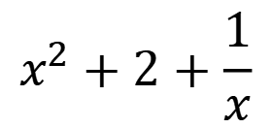




Which of the polynomials
are quadratic equations?
$${−5x}^{2}$$
$$x^{2}+2x+x^{4}$$
$${x−2x}^{2}$$
$${x+3x}^{2}$$
$$x^{3}+x^{2}$$
$$1+2x+x^{2}$$
$$x^{2}+3x+2$$
$$(x+2)(x+7)$$
$$x^{2}+2+\frac{1}{x}$$
$$x(x−1)$$

Slide 5


Quadratic equations can be written as:
$$y=ax^{2}+bx+c$$
$$f(x)=ax^{2}+bx+c$$

Slide 6
























9)
$$y=x(x−2)$$
$$y=(x−2)(x+3)$$
1)
$$y=x^{2}$$
17)
$$y=x(x+3)$$
$$y=(x+2)(x−3)$$
10)
18)
2)
$$y=x^{2}+2$$
11)
$$y=−x(x−2)$$
$$y=(x+3)(1−x)$$
3)
$$y=x^{2}−2$$
19)
$$y=x^{2}−4$$
$$y=−x(x+3)$$
$$y=(x−1)(x+3)$$
4)
12)
20)
$$y={2x}^{2}$$
$$y=(x+1)(x+1)$$
$$y=(x−4)(x+2)$$
5)
13)
21)
$$y={−x}^{2}$$
$$y={(x+1)}^{2}$$
$$y=−(x−4)(x+2)$$
6)
14)
22)
$$y={(−x)}^{2}$$
$$y={(x−2)}^{2}$$
$$y=(x−5)(x+3)$$
7)
15)
23)
$$y={−x}^{2}+2$$
$$y{=−(x−2)}^{2}$$
$$y={2x}^{2}−4x−30$$
8)
16)
124

Slide 7
Factorising Quadratics

Slide 8
This is the co-efficient of x
This is the constant term

Slide 9
It is possible to write
as a product of two factors . . .

Slide 10



Starter
1) $x2 + 6x + 5$
2) $x2 + 10x + 21$
3) $x2 − x − 2$

Slide 11



Starter
1) $x2 + 6x + 5$
=
$$(x + 1)(x + 5)$$
2) $x2 + 10x + 21$
=
$$(x + 3)(x + 7)$$
3) $x2 − x − 2$
=
$$(x − 2)(x + 1)$$

Slide 12
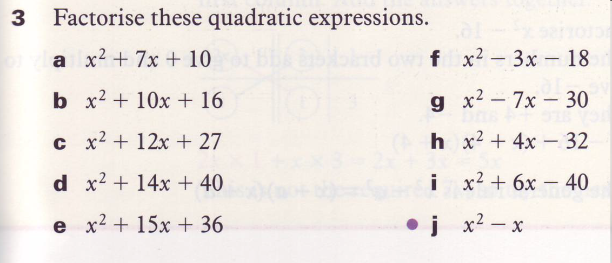

Slide 13
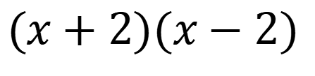
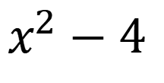
$$x^{2}−4$$
This is x times x
This is 2 times 2
$$(x+2)(x−2)$$

Slide 14










Factorise Quadratics
Examples
$$f(x)=ax^{2}+bx+c$$
$x2 − 4$
$$(x + 2) (x − 2)$$
=
$x2 − 169$
=
$$(x + 13) (x − 13)$$
$x2 − 64$
=
$$(x + 8) (x − 8)$$
$2x2 − 8$
=
$$2(x + 2) (x − 2)$$
$2x2 − 128$
=
$$2(x + 8) (x − 8)$$

Slide 15



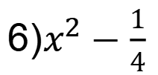




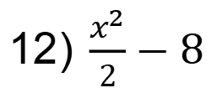



Factorising Quadratic equations
1) $x^{2}−1$
7) $2x^{2}−50$
2) $x^{2}−4$
8) ${3x}^{2}−48$
3) $x^{2}−16$
9) ${2x}^{2}−18$
4) $x^{2}−9$
10) ${10x}^{2}−1000$
5) $x^{2}−0.01$
11) $5x^{2}−125$
6) $x^{2}−\frac{1}{4}$
12) $\frac{x^{2}}{2}−8$

Slide 16

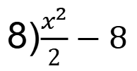

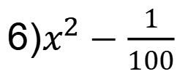




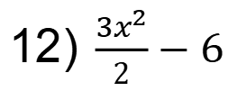
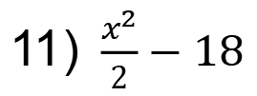


Factorising Quadratic equations
1) $x^{2}−9$
7) $2x^{2}−18$
2) $x^{2}−64$
8) $\frac{x^{2}}{2}−8$
3) $x^{2}−36$
9) ${3x}^{2}−27$
4) $x^{2}−49$
10) ${2x}^{2}−200$
5) $x^{2}−10000$
11) $\frac{x^{2}}{2}−18$
6) $x^{2}−\frac{1}{100}$
12) $\frac{{3x}^{2}}{2}−6$

Slide 17
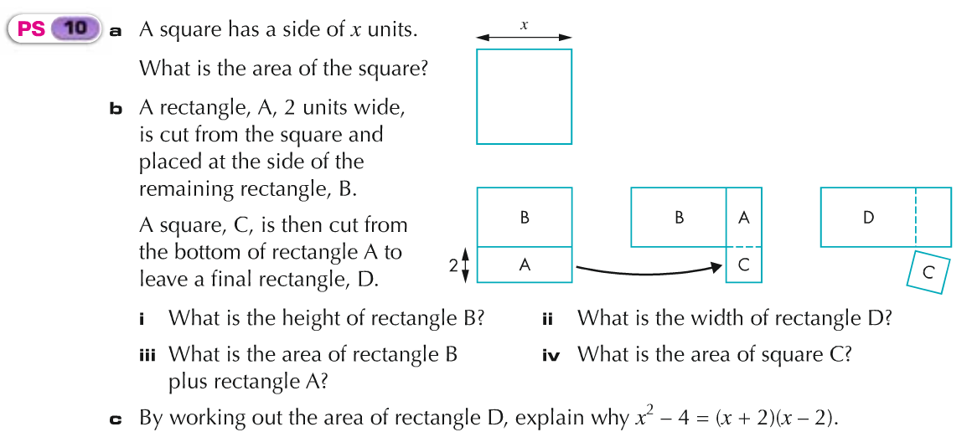
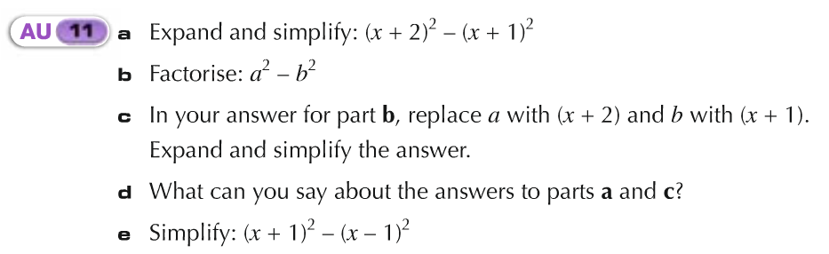

Slide 18










Factorise Quadratics
Examples
$$f(x)=ax^{2}+bx+c$$
$x2 + 5x$
=
$$x (x + 5)$$
$x2 − 10x$
=
$$x (x − 10)$$
$x2 − x$
=
$$x (x − 1)$$
$2x2 − 4 x$
=
$$2x (x − 2)$$
$6x2 − 8 x$
=
$$2x (3x − 4)$$

Slide 19
Factorise Quadratics:
with a calculator
Examples

Slide 20










Factorise Quadratics
$$f(x)=ax^{2}+bx+c$$
1) $x2 + 7x$
6) $2x2 + 4x$
2) $x2 − 8x$
7) $10x2 − 20x$
3) $x − x2$
8) $16x2 + 12x$
4) $x2 – ½ x$
9) $12 x − 12x2$
5) $x − 11 x2$
10) $28x2 − 35 x$

Slide 21







Factorise Quadratics
$$f(x)=ax^{2}+bx+c$$
1) $x2 + 7x$
=
$$x (x + 7)$$
2) $x2 − 8x$
=
$$x (x − 8)$$
3) $x − x2$
=
$$x (1− x)$$
4) $x2 – ½ x$
=
$$x (x − ½)$$
5) $x − 11 x2$
=
$$x (1−11x)$$

Slide 22






Factorise Quadratics
$$f(x)=ax^{2}+bx+c$$
6) $2x2 + 4x$
=
$$2x (x + 2)$$
7) $10x2 − 20x$
=
$$10x (x − 2)$$
8) $16x2 + 12x$
=
$$4x (4x + 3)$$
9) $12 x − 12x2$
=
$$12x (1 − x )$$
10) $28x2 − 35 x$
=
$$7x (4x − 5)$$

Slide 23













Factorise Quadratics
- look for common numerical factors
Examples
$f(x)=d(ax^{2}+bx+c$)
$$2x2 + 12x + 10$$
$$1.5x2 + 9x + 12$$
=
$$2(x2 + 6x + 5)$$
=
$$1.5(x2 + 6x + 8)$$
=
$$2(x + 5)(x + 1)$$
=
$$1.5(x + 2)(x + 4)$$
$$0.5x2 + 2.5x + 3$$
$$3x2 + 15x − 42$$
=
$$0.5(x2 + 5x + 6)$$
=
$$3(x2 + 5x − 14)$$
=
0$.5(x + 2)(x + 3)$
=
$$3(x + 7)(x − 2)$$

Slide 24










Factorise Quadratics
- look for common numerical factors
$f(x)=d(ax^{2}+bx+c$)
1) $2x2 + 6x + 4$
6) $2x2 − 10x + 12$
2) $3x2 + 15x + 12$
7) $4x2 + 32x + 48$
3) $4x2 + 4x − 8$
8) $0.5x2 + 3.5x − 4$
4) $2x2 − 4x − 6$
9) $2.5x2 − 5x − 20$
5) $2x2 − 4x + 2$
10) $1.5x2 + 10.5x − 45$

Slide 25










Factorise Quadratics
- look for common numerical factors
$f(x)=d(ax^{2}+bx+c$)
1) $2x2 + 6x + 4$
=
$$2(x + 1)(x + 2)$$
2) $3x2 + 15x + 12$
=
$$3(x + 1)(x + 4)$$
3) $4x2 + 4x − 8$
=
$$4(x + 2)(x − 1)$$
4) $2x2 − 4x − 6$
=
$$2(x − 3)(x + 1)$$
5) $2x2 − 4x + 2$
=
$$2(x − 1)(x − 1)$$

Slide 26










Factorise Quadratics
- look for common numerical factors
$f(x)=d(ax^{2}+bx+c$)
6) $2x2 − 10x + 12$
=
$$2(x − 3)(x − 2)$$
7) $4x2 + 32x + 48$
=
$$4(x + 6)(x + 2)$$
8) $0.5x2 + 3.5x − 4$
=
$$0.5(x + 8)(x − 1)$$
9) $2.5x2 − 5x − 20$
=
$$2.5(x − 4)(x + 2)$$
10) $1.5x2 + 10.5x − 45$
$$1.5(x + 10)(x − 3)$$
=

Slide 31
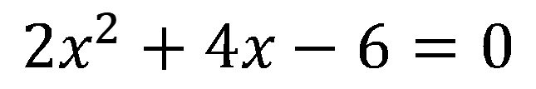
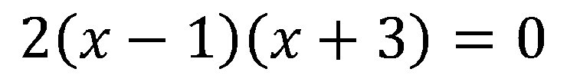
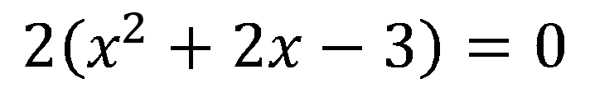
$${2x}^{2}+4x−6=0$$
$$2\left(x^{2}+2x−3\right)=0$$
$$2\left(x−1\right)\left(x+3\right)=0$$

Slide 32
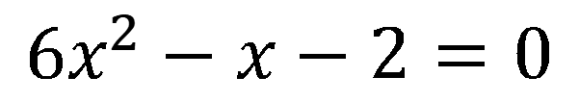
$$6x^{2}−x−2=0$$

Slide 33
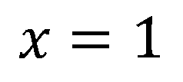
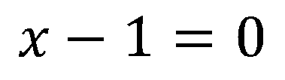
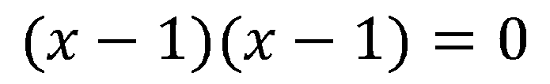
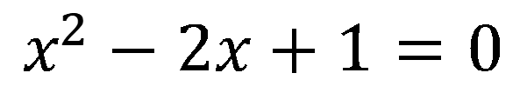
$$x^{2}−2x+1=0$$
$$(x−1)(x−1)=0$$
$$x−1=0$$
$$x−1=0$$
$$x=1$$
$$x=1$$

Slide 34
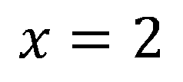
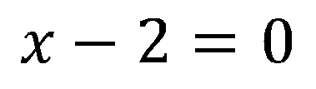
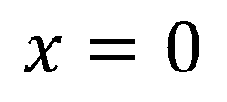
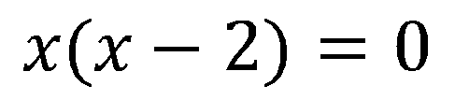
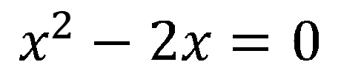
$$x^{2}−2x=0$$
$$x(x−2)=0$$
$$x=0$$
$$x−2=0$$
$$x=2$$

Slide 35
Factorising more complex quadratics

Slide 36
Starter
1)
(2x + 1)(x + 2)
2)
(3x - 2)(x + 3)
3)
(3x - 2)(x - 3)

Slide 37
Starter
1)
(2x + 1)(x + 2)
=
2x² + 5x + 2
2)
(3x - 2)(x + 3)
=
3x² + 7x - 6
3)
(3x - 2)(x - 3)
=
3x² -11 x + 6

Slide 38
This is the co-efficient of x²
This is the constant term

Slide 39
4 x 6 = 24
Factors of 24
12 & 2 or 6 & 4
1 & 24 or 3 & 8
Factorise
(x + 1) is the
common factor

Slide 40




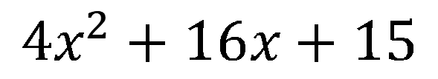
4 x 15 = 60
$$4x^{2}+16x+15$$
Factors of 60
1 & 60 or 2 & 30
3 & 20 or 4 & 15
5 & 12 or 6 & 10
$$4x^{2}+6x+10x+15$$
Factorise
(2x + 3) is the
common factor
$$2x(2x+3)$$
$$+5(2x+3)$$
$$(2x+5)(2x+3)$$

Slide 41


2 x 3 = 6
Factors of 6
2 & 3 or 6 & 1
Factorise
(x + 3) is the
common factor
$$2x\left(x+3\right)$$
$$+1(x+3)$$

