Slide 1

Cox Proportional Hazards Cure Model

Slide 2




or

Slide 3



Slide 4



Slide 5

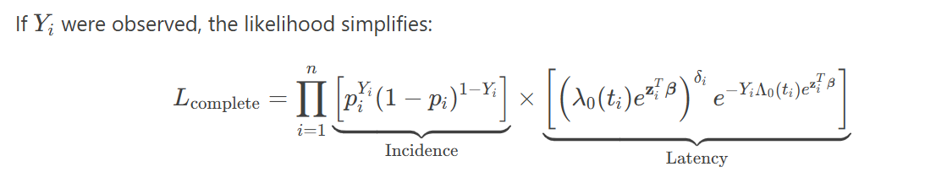
EM Algorithm
E-STEP

Slide 6



&

Slide 7
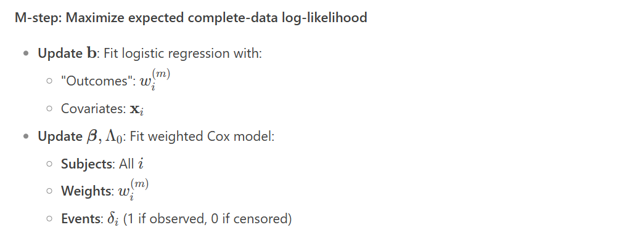
M-STEP

Slide 8




For coefficients - b

Slide 9

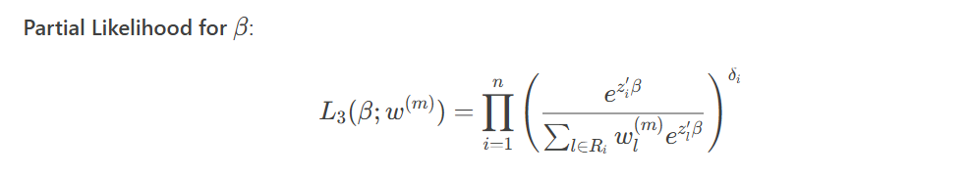





For coefficients - $β, Λ_{0}$(t)
=
=

