Slide 1


Parallel Postulate
WMSU
Crister Joy C. Dela Cruz

Slide 2
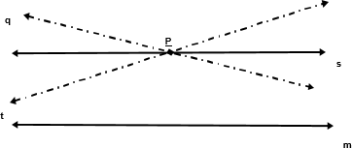
PARALLEL POSTULATE
Given a line and a point not on the given line, there is exactly one line through the given point parallel to the given line.
Given, line m and point P not in m. Only one line
𝒔 ∥ 𝒎. Lines t and q are not parallel to m through P.

Slide 3
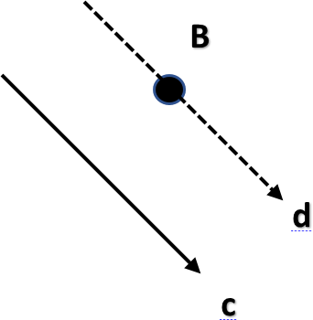
PARALLEL POSTULATE
Given line c and point B not in c. Only one line
𝑑 ∥ 𝑐.

Slide 4

VERTICAL ANGLES
Vertical Angles:
When straight lines Intersect, vertical angles appear.
Vertical Angles are ALWAYS equal in measure,
Whether the lines are parallel or not.

Slide 5
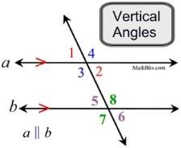
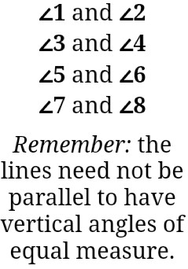

VERTICAL ANGLES

Slide 6
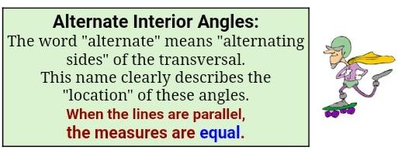
ALTERNATE INTERIOR
ANGLE-PARALLEL POSTULATE
If two lines are cut by a transversal and a pair of alternate interior angles are congruent, then the lines are parallel.

Slide 7
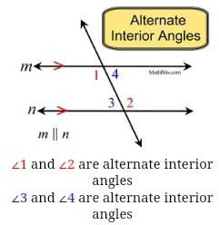
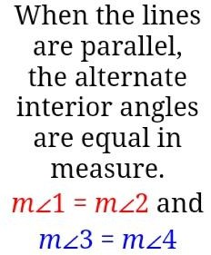
ALTERNATE INTERIOR
ANGLE-PARALLEL POSTULATE
EXAMPLE 1:

Slide 8
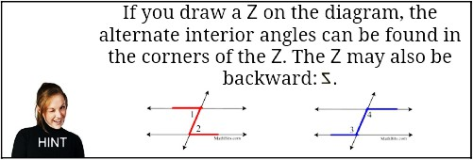
ALTERNATE INTERIOR
ANGLE-PARALLEL POSTULATE
HINT:

Slide 9
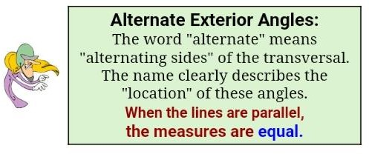
ALTERNATE EXTERIOR ANGLE-PARALLEL POSTULATE
If two lines are cut by a transversal and a pair of alternate exterior angles are congruent, then the lines are parallel.

Slide 10
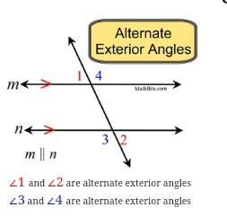
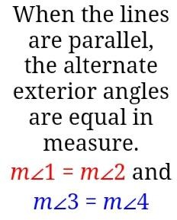
ALTERNATE EXTERIOR ANGLE-PARALLEL POSTULATE
EXAMPLE 2:

Slide 11
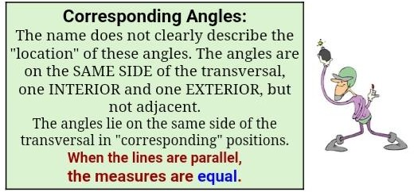
CORRESPONDING ANGLES PARALLEL THEOREM
If two lines are cut by a transversal and a pair of corresponding angles are congruent, then the lines are parallel.

Slide 12
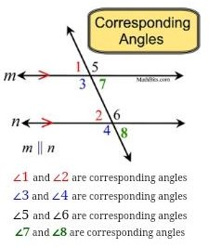
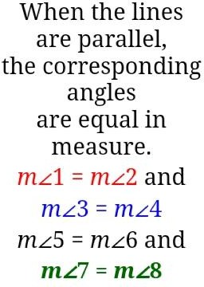
CORRESPONDING ANGLES PARALLEL THEOREM
Example 3:

Slide 13
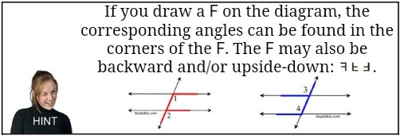
CORRESPONDING ANGLES PARALLEL THEOREM
HINT:

Slide 14












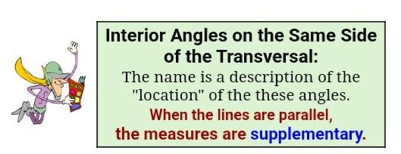
INTERIOR ANGLES SAME SIDE-PARALLEL THEOREM
If two lines are cut by a transversal so that the interior angles on the same side of the transversal are supplementary, then the lines are parallel.

Slide 15
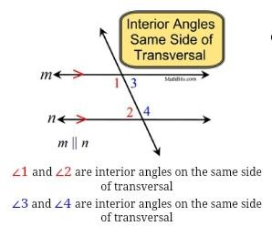
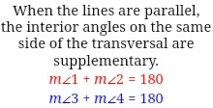
INTERIOR ANGLES SAME SIDE-PARALLEL THEOREM
Example 4:

Slide 16
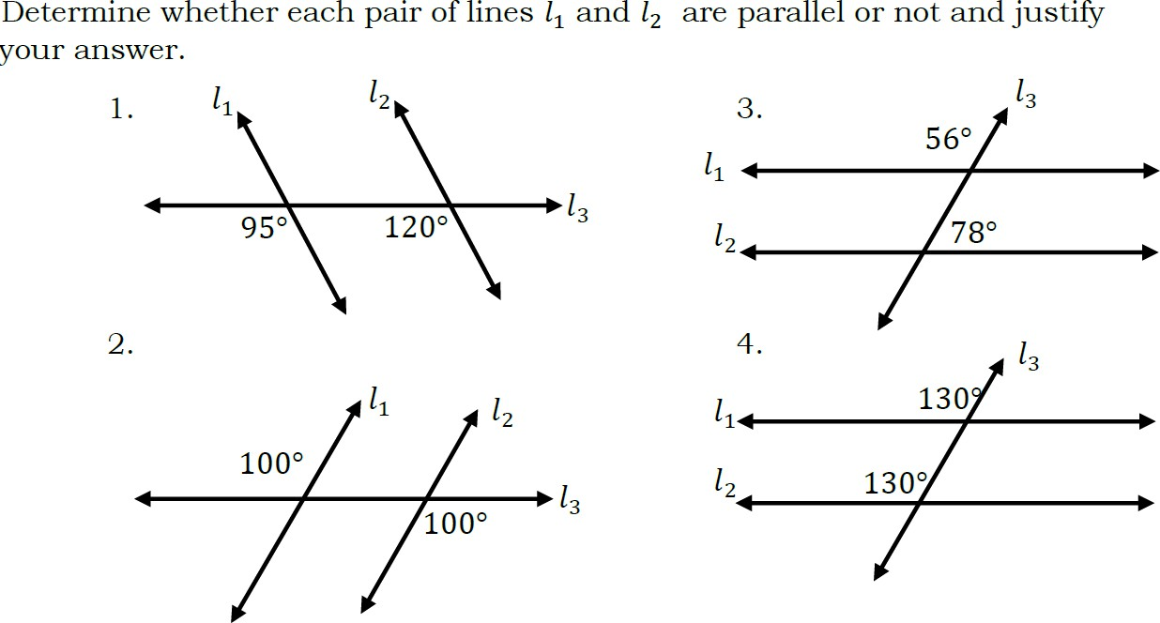
PARALLEL OR NOT?

Slide 17
GENERALIZATION
What are the examples of Parallel Lines that we are using in a real life situation?

