Slide 1

MATHEMATICS

Slide 2
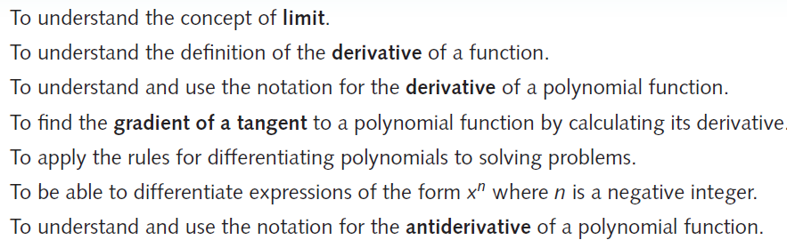
17 Differentiation & Antidifferentiation of Polynomials (P574)
Chapter 17
Objectives

Slide 3
17 Differentiation & Antidifferentiation of Polynomials (P574)
Chapter 17
17E to 17G (End)

Slide 4
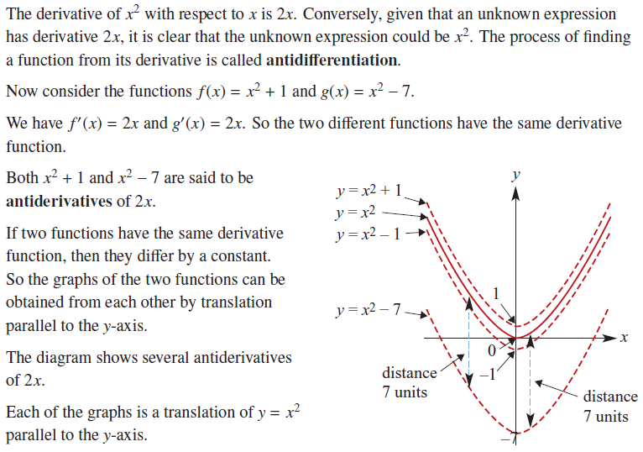
17 Differentiation & Antidifferentiation of Polynomials (page 602)
17E → Antidifferentiation of Polynomial Functions

Slide 5
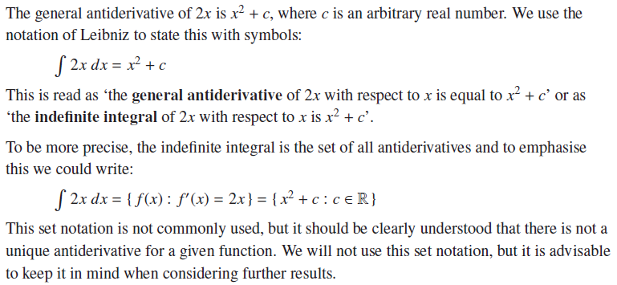
17 Differentiation & Antidifferentiation of Polynomials (page 602)
17E → Notation

Slide 6
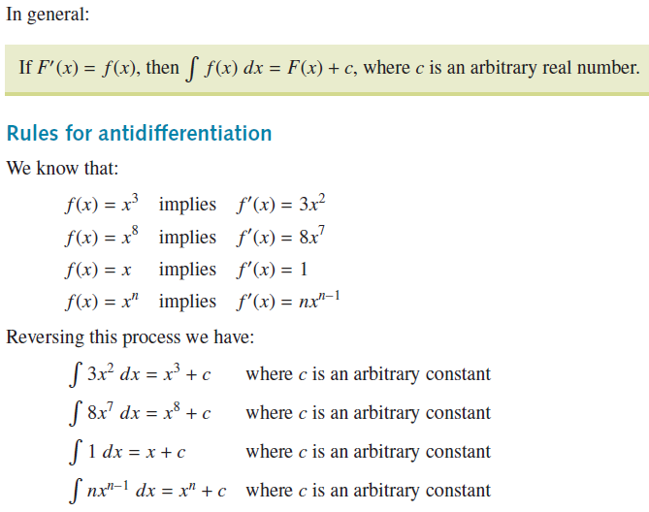
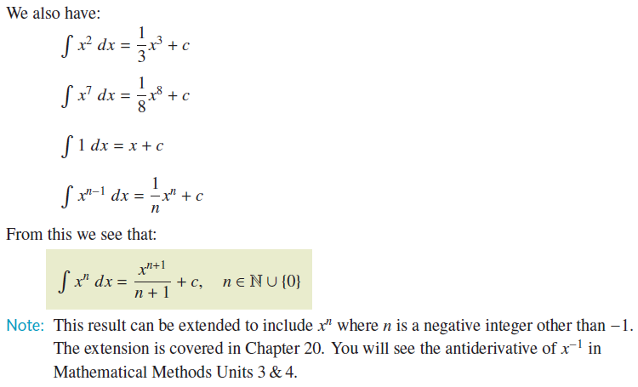
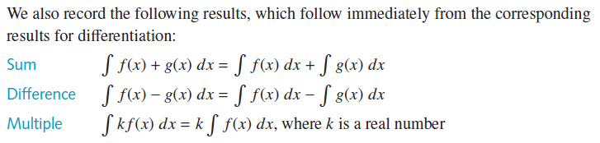
17 Differentiation & Antidifferentiation of Polynomials (page 603)
17E → Notation

Slide 7
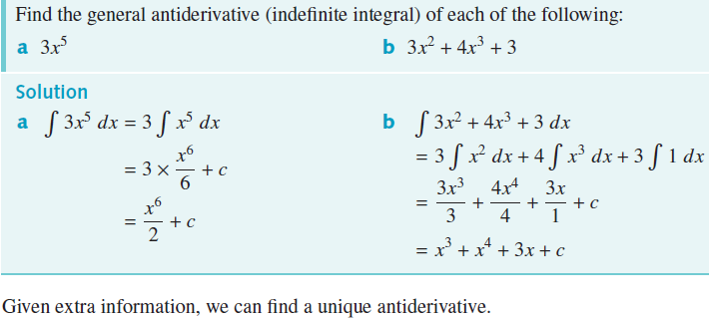
17 Differentiation & Antidifferentiation of Polynomials (page 604)
17E → Example 24

Slide 8
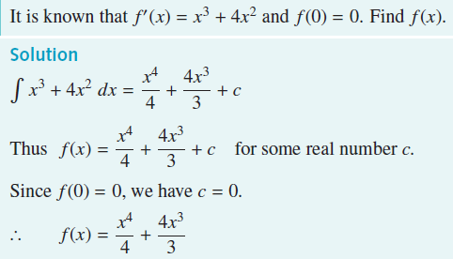
17 Differentiation & Antidifferentiation of Polynomials (page 604)
17E → Example 25

Slide 9
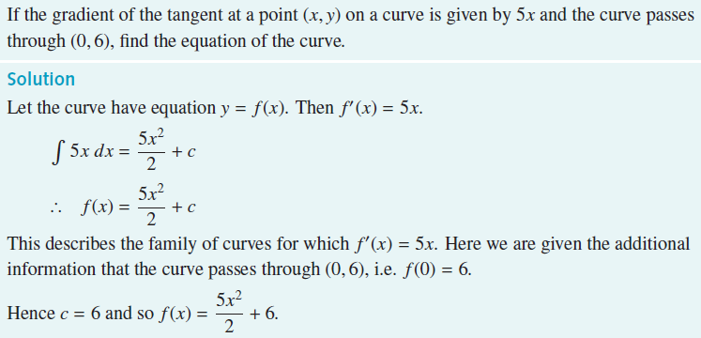
17 Differentiation & Antidifferentiation of Polynomials (page 605)
17E → Example 26

Slide 10
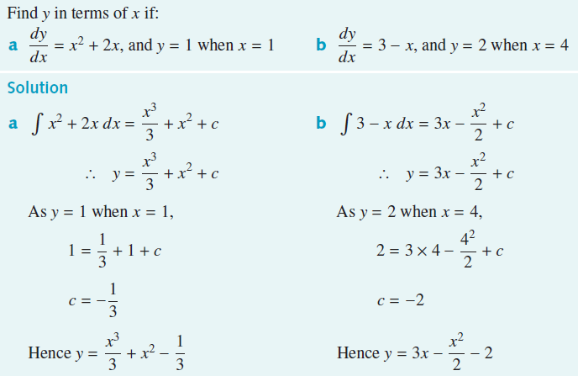
17 Differentiation & Antidifferentiation of Polynomials (page 605)
17E → Example 27

Slide 11
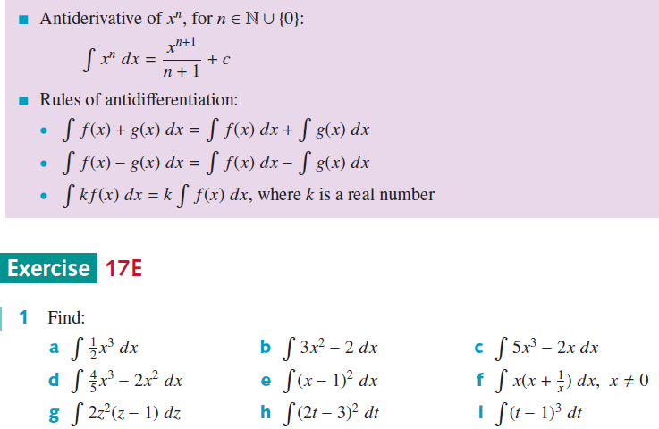
17 Differentiation & Antidifferentiation of Polynomials (page 606)
17E → Section Summary
End of 17E

Slide 12
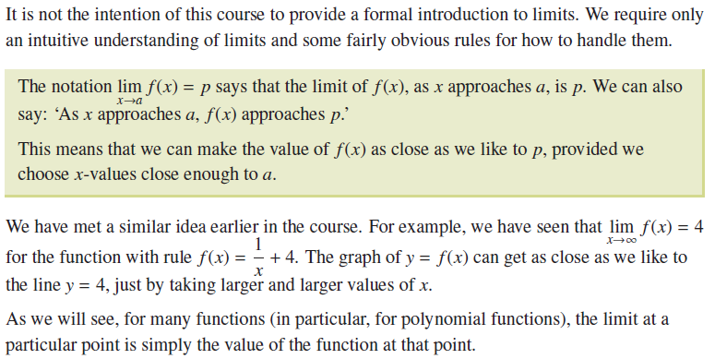
17 Differentiation & Antidifferentiation of Polynomials (page 608)
17F → Limits & Continuity

Slide 13
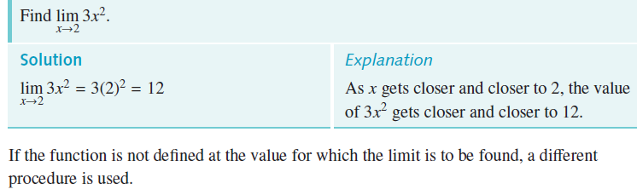
17 Differentiation & Antidifferentiation of Polynomials (page 608)
17F → Example 28

Slide 14
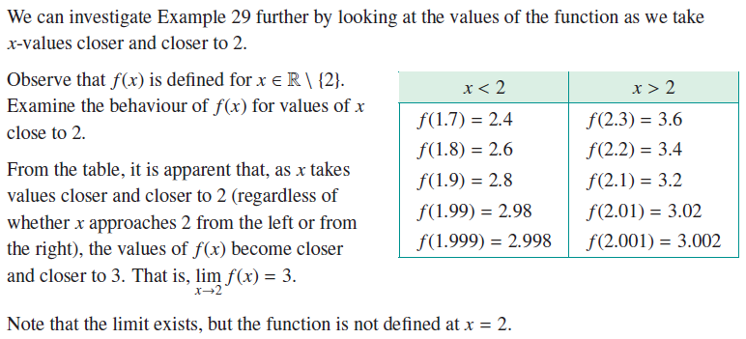
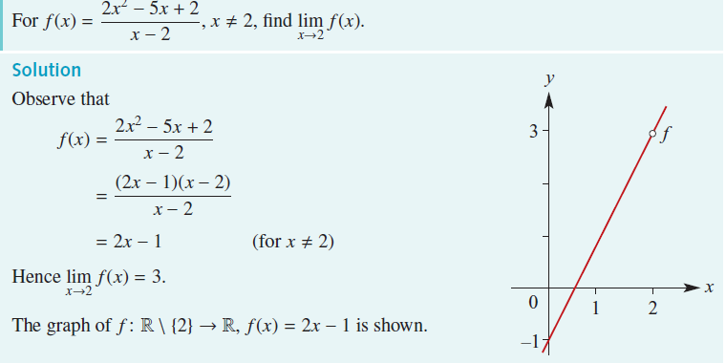
17 Differentiation & Antidifferentiation of Polynomials (page 608 / 609)
17F → Example 29

Slide 15
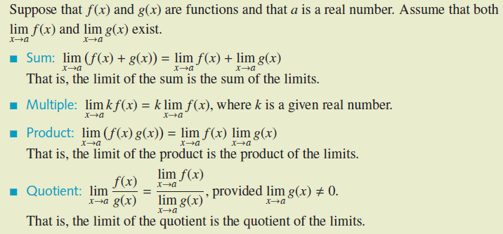
17 Differentiation & Antidifferentiation of Polynomials (page 609)
17F → Algebra of Limits

Slide 16
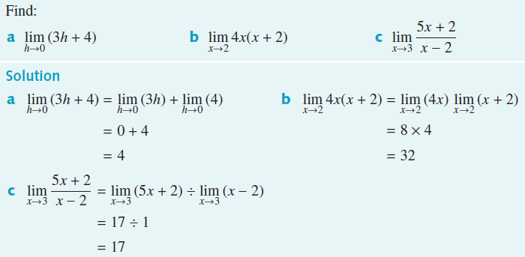
17 Differentiation & Antidifferentiation of Polynomials (page 609)
17F → Example 30

Slide 17
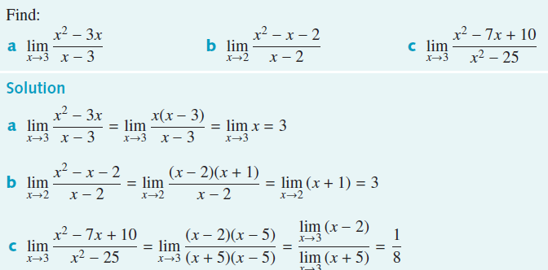
17 Differentiation & Antidifferentiation of Polynomials (page 610)
17F → Example 31

Slide 18
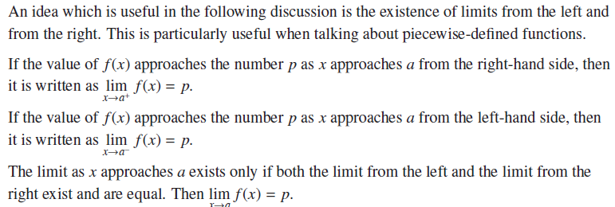
17 Differentiation & Antidifferentiation of Polynomials (page 610)
17F → Left & Right Limits

Slide 19
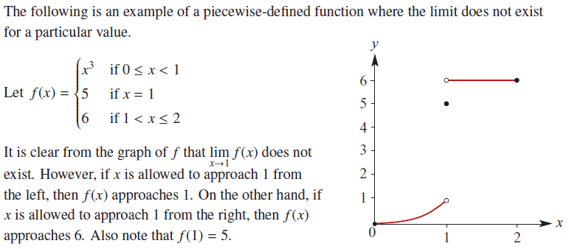
17 Differentiation & Antidifferentiation of Polynomials (page 610)
17F → Piecewise-defined function

Slide 20
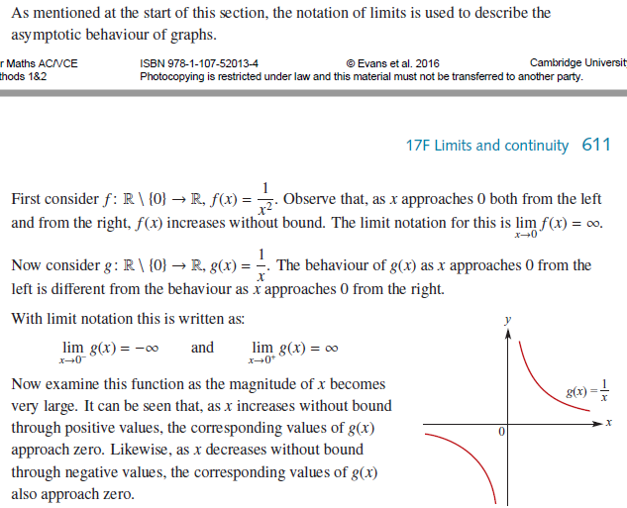
17 Differentiation & Antidifferentiation of Polynomials (page 611 / 612)
17F → Rectangular Hyperbola

Slide 21
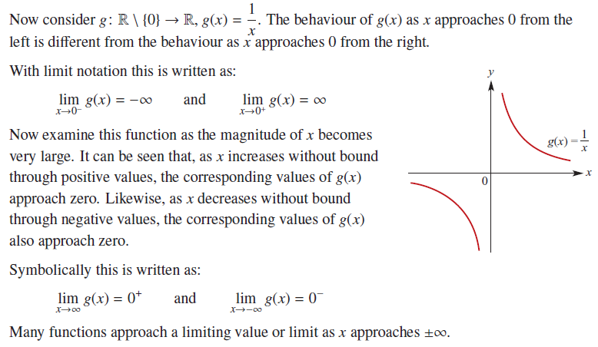
17 Differentiation & Antidifferentiation of Polynomials (page 611)
17F → Rectangular Hyperbola

Slide 22
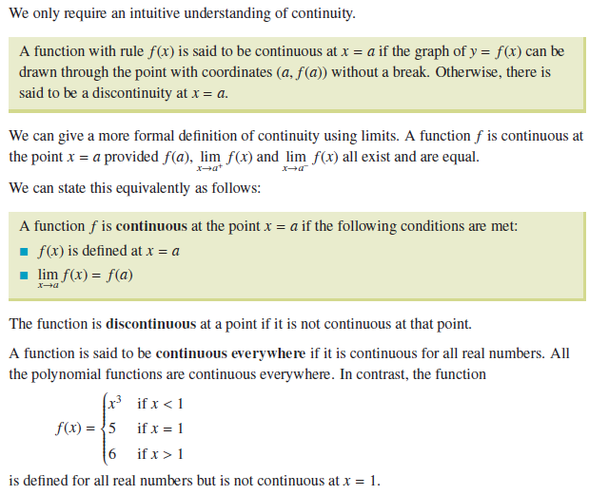
17 Differentiation & Antidifferentiation of Polynomials (page 611)
17F → Continuity at a Point

Slide 23
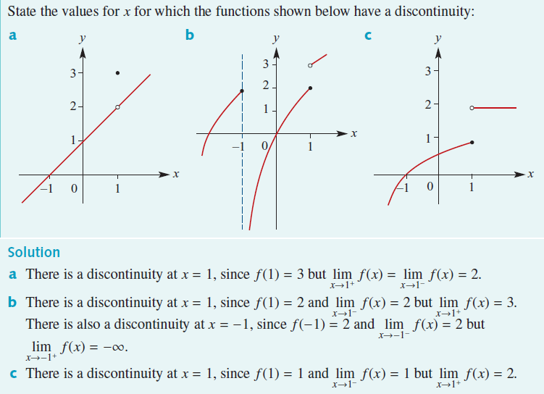
17 Differentiation & Antidifferentiation of Polynomials (page 612)
17F → Example 32

Slide 24
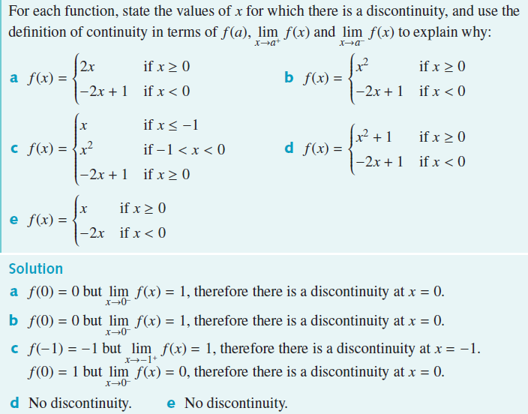
17 Differentiation & Antidifferentiation of Polynomials (page 612)
17F → Example 33

Slide 25
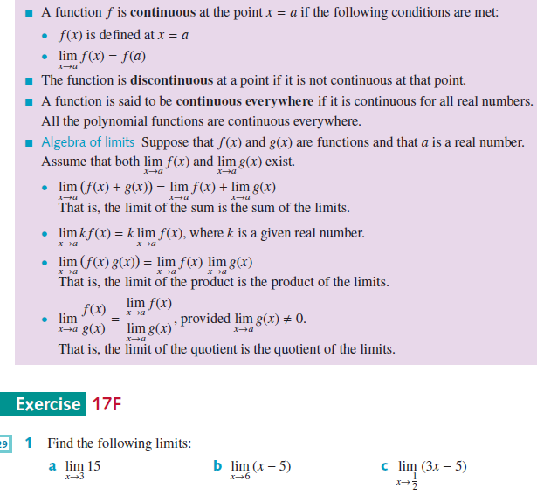
17 Differentiation & Antidifferentiation of Polynomials (page 612)
17F → Section Summary & Exercise 17F
End of 17F

Slide 26
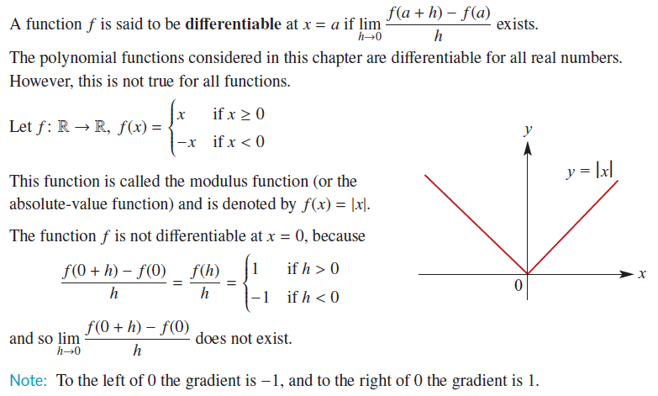
17 Differentiation & Antidifferentiation of Polynomials (page 614)
17G → When is a Function Differentiable?

Slide 27
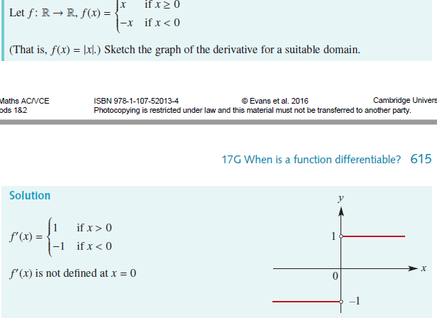
17 Differentiation & Antidifferentiation of Polynomials (page 614 / 615)
17G → Example 34

Slide 28
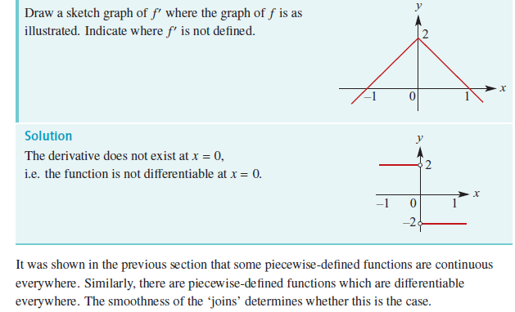
17 Differentiation & Antidifferentiation of Polynomials (page 615)
17G → Example 35

Slide 29
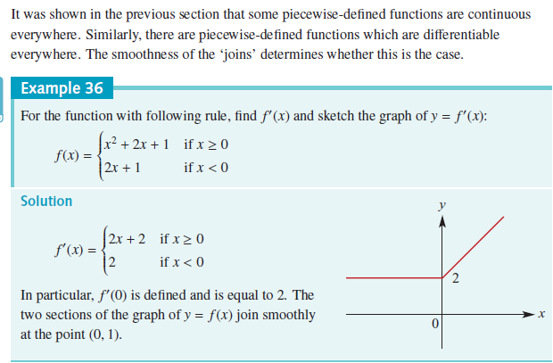
17 Differentiation & Antidifferentiation of Polynomials (page 615)
17G → Example 36

Slide 30
17 Differentiation & Antidifferentiation of Polynomials (page 615)
17G → Example 36
At the point (0, 2)

Slide 31
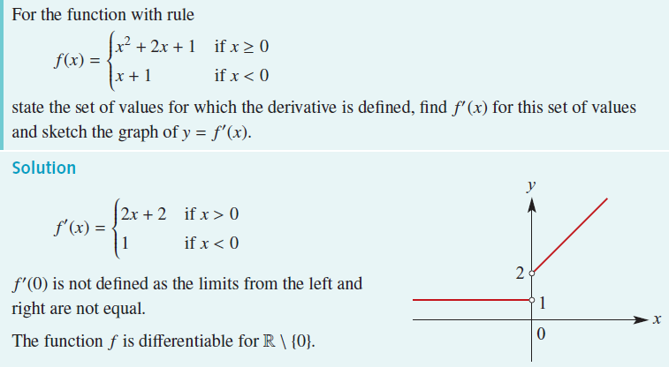
17 Differentiation & Antidifferentiation of Polynomials (page 615)
17G → Example 37

Slide 32
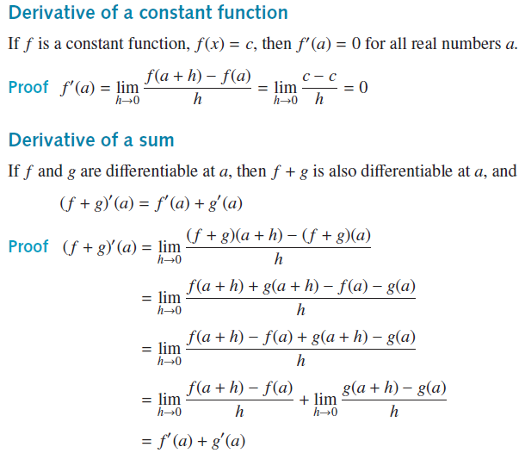
17 Differentiation & Antidifferentiation of Polynomials (page 615)
17G → Proofs of 2 Results for Derivatives

Slide 33

17 Differentiation & Antidifferentiation of Polynomials (page 615)
17G → Section Summary

Slide 34
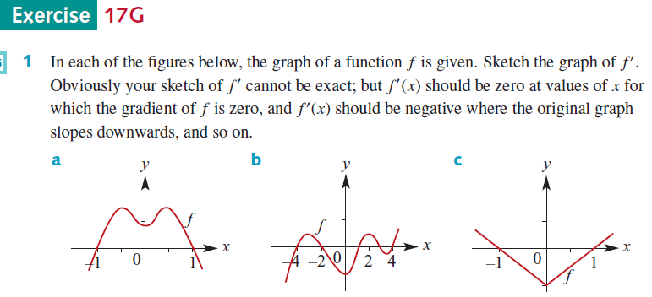
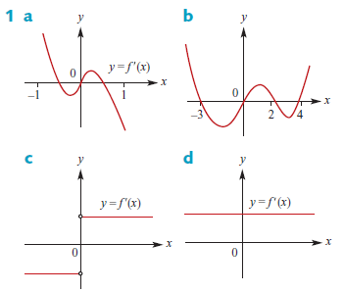
17 Differentiation & Antidifferentiation of Polynomials (page 617)
17G → Exercise 17G
End of 17G

Slide 35
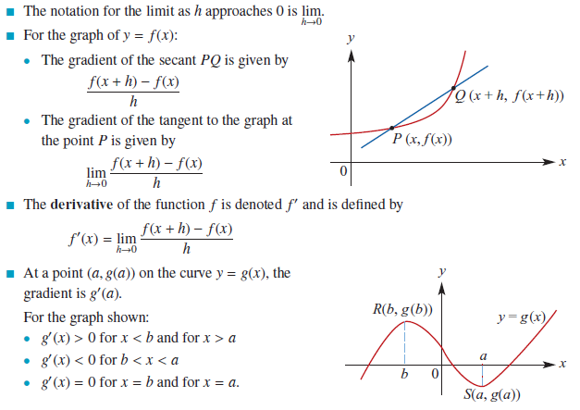
17 Differentiation & Antidifferentiation of Polynomials (page 618)
Chapter Summary
The Derivative

Slide 36
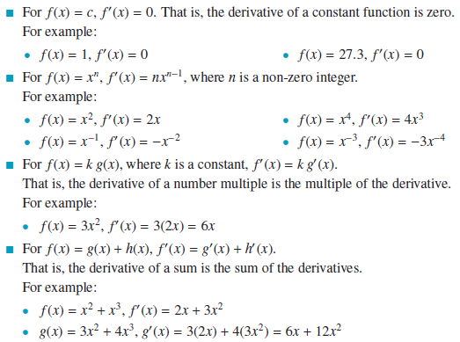
17 Differentiation & Antidifferentiation of Polynomials (page 618)
Chapter Summary
Rules of Differentiation

Slide 37
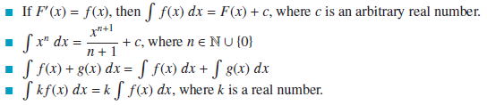
17 Differentiation & Antidifferentiation of Polynomials (page 619)
Chapter Summary
Antiderivatives

Slide 38
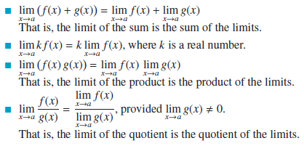
17 Differentiation & Antidifferentiation of Polynomials (page 619)
Chapter Summary
Algebra of Limits

Slide 39
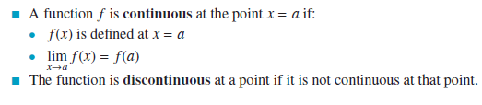
17 Differentiation & Antidifferentiation of Polynomials (page 619)
Chapter Summary
Continuity
THE END

Slide 40
17 Differentiation & Antidifferentiation
Hand in by 18th April
Do:
Technology-Free Questions
(Page 619 to Page 620)
→ Questions 1 to 13.
Extended Response Questions
(Page 622)
→ Questions 1 to 6.

