Slide 1



Let’s Learn

Slide 2

Let’s Learn
To talk about when you learned how to do various things.

Slide 3
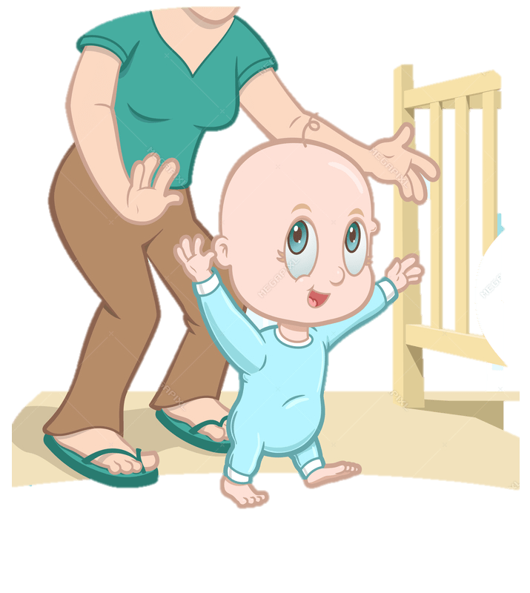
learn how to walk

Slide 4

Anna
learn how to write her name

Slide 5
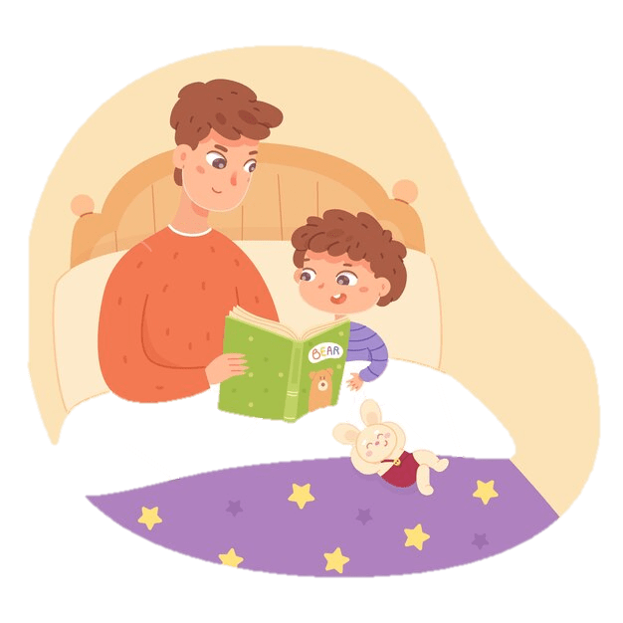
learn how to read

Slide 6
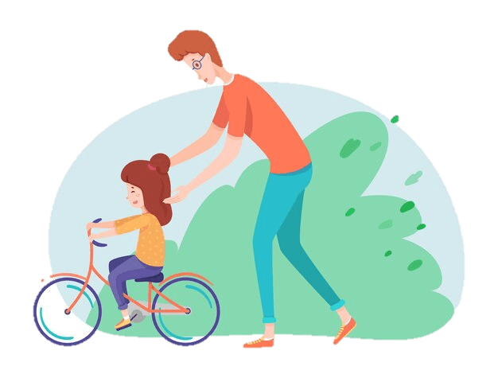
learn how to ride a bicycle

Slide 7
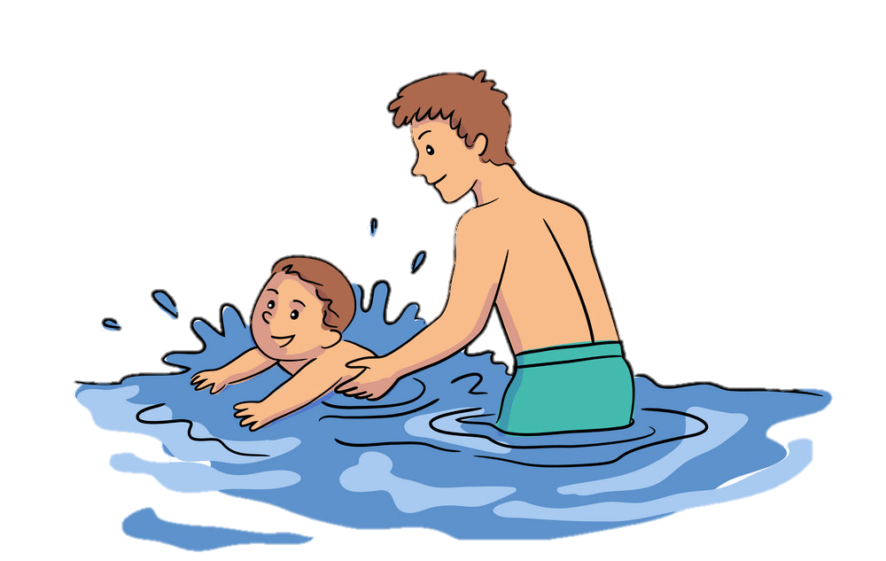
learn how to swim

Slide 8
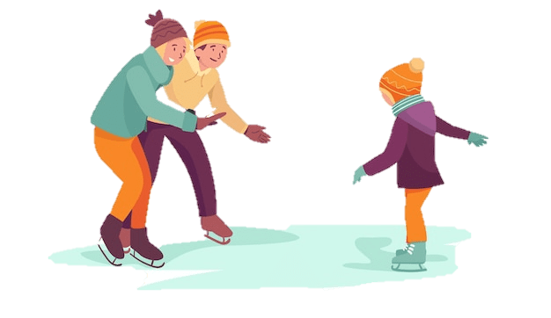
learn how to ice skate

Slide 9
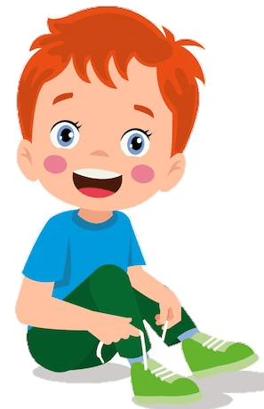
learn how to tie my shoes

Slide 10
Sentence Pattern:
When did she learn how to walk?
She learned how to walk when she was one year old.

Slide 11
When did she learn how to walk?
one year old
She learned how walk when she was one year old.

Slide 12
When did she learn how to write her name?
four years old
Anna
She learned how write her name when she was four years old.

Slide 13
When did he learn how to read?
six years old
He learned how read when he was six years old.

Slide 14
When did she learn how to ride a bicycle?
eight years old
She learned how ride a bicycle when she was eight years old.

Slide 15
When did he learn how to swim?
nine years old
He learned how swim when he was nine years old.

Slide 16
When did she learn how to ice skate?
eleven years old
She learned how ice skate when she was eleven years old.

Slide 17
When did he learn how to tie his shoes?
five years old
He learned how to tie his shoes when he was five years old.

Slide 18

How about you?
When did you learn to do various things?

