Slide 1
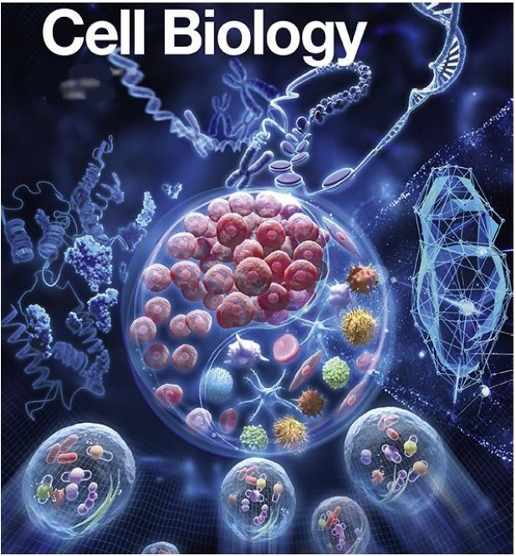
CeU boogy s 11 brra1nch of boogy that studies the strructurrev functlonv andJ betlavmourr of ceHs!l

Slide 2


i C S
U1r1Jtrod!VJJ tiont@ Cats
cua Strru tu1r
JITTFJI l.bJtrJlfl
MJ1m1JlbJtr n
Sttru@tuli
ftrn Plf"
llh 01rtigti1r1J of CUU
Caa Dtivtisti@n
What is a cell?
It is the basic, smallest fundamental structural
and functional unit of all living organisms.
We alllove readingstory books. Every story is made upoflot of sentences. Each sentence is made up of so many words and each word is made up of alphabets which is the smallest basic and fundamentalunit of the book. Likewise cell is the smallest,basic and fundamentalunit of a nd organism's body.

Slide 3
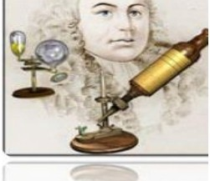
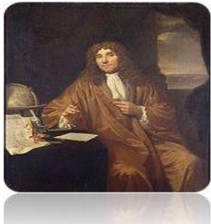
How discovered Cell?
©®Q '0Wfil!S; t'ij!t$J ©J@S;®!tW®©l @!}' @®tr !l=IJ@@l ® ij!llJ 'IJ$; ,, !l=JI ® ©©JU!fl.l@l lii.J® ®!f!f!r1l
''©®Q u®!i' to: l.i® @® QuC
ti:!MJ!t11!11J @I eJ!rliSJ,
t!f!l!J©!i:Y!f !hi® ©l !tW@l w1JUL® wu U!lr .J ©©i!t ti:u Y®
Robert Hooke 1(1665}- English scientist who looked at thin slices of cork (dead oak tree bark} under a light microscope and
noticed tiny "compartments" that he named cells.
Anton van Leeuwenhoek (1700}
- Dutch fabric merchant and amateur scientist developed a better microscope and observed tiny living organisms in pond
water,that he named "animalcules."
The term 'cell' is derived from Latinword 'cella' which means 'small room' or 'compartment.'
Thus all Organisms are made up of cells and these organisms may be one of these two types
•• Unicellular like bacteria, amoeba and paramecium .Where that single cell carries out allthe functions of life in that organism
•• Multicellular like us. Where different types of cells are specialised to perform different functions
•• Cells are also of two types,Prokaryotes and Eukaryotes

Slide 4

In 1838, Matthias Schleiden, a German botanist,examined alarge number of plants underlens and he observed that- All plants are composed of different kinds of cells which form the tissues of the plants.
In 1839,Theodore Schwann,a British Zoologist did same research and observation on animals also, and concluded that allanimals are also made up of cells,
Hefurther stated that the difference between plant cell and animalis
presence of outer most boundarylayer in plant cells called Cellwall,in addition to cell membrane.
Thus Schleiden and Schwann gave Celltheory which stated that
The cell is the fundamental unit of structure and function inliving things.
All organisms are made up of one or more cells.
Note: This theory could not explain as to how new cellswere formed. It was believed till then that the cells might arise from the non-living things.
Thus Rudolf Virchow (1855) first explained that cells divided,and new
cel s are formed from pre-existing cells (Omnis cellu a-e cellu a).
He modified the hypothesis of Schleiden and Schwann to give the cell theory a final shape as
The cell is the fundamental unit of structure and function inliving things.
All organisms are made up of one or more cells.
All cells arise from pre-existing cells.

Slide 5
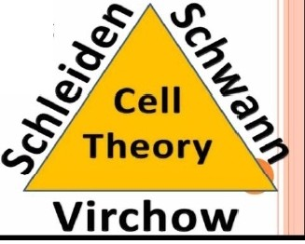

Cell Theory
Proposed by Schleiden
and Schwann
Modified by
Rudolf Virchow
Key Points
Key Points
Cell is the fundamental unit of structure and
function in living organisms
All organisms are composed of cells and products of cel s
All organisms are made
up of one cell or more cells
All cells arise from pre-ex isting cells
(Omnis celiula-e cellula)
Summary of celltheory
CELL THEORY
o Proposed by Matthais Schleiden and Theodor Schwann in 1839:-
-All living things are made up of cells.
-Cells are the smallest working unit of all living things.
-All cells come from pre-existing cells through cell division.
Do a ll Cells satisfy this Cell Theory?
NO, There are some exceptions to Celltheory also

Slide 6
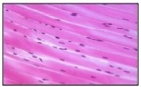
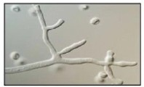
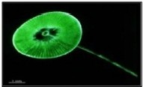

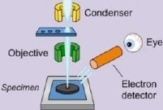
Caveats to th e Cell Theory_
Certaintypes of cellsItissues do not conform to a standard notion of what constitutes a cell:
Striated muscle fibres:
Muscle cells fuse to form fibres that may be verylong (>300mm)
Consequently, they have multiple nuclei despite being surrounded by a single, continuous plasma membrane
Challenges the idea that cells always function as autonomous units
Aseptate fungal hyphae:
Fungi may have filamentous structures called hyphae, which are separated into cells by internal walls called septa Some fungi are not partitioned by septa and hence have a conit nuous cytoplasm along the length of the hyphaa Challenges the idea that living structures are composed of discrete cells
Giant Algae
Certain species of unicellular algae may grnw to very large sizes (e.g. Acetabulafia may exceed 7 cm in length)
Challenges the idea that larger organisms are always made of many microscopic cells
Muscle cells formlong,
multinucleated fibres
Aseptate hyphae have
no cellular panitions
Giant algae can be very
largein size (>70mm)
Mitochondia ia an another excexption to celltheory because it hasits own DNA and it replicates itself
Microscopes
Microscopes are scientific instruments that are used to visualise objects that are too small to see with the naked eye There are two maintypes of microscope: optical (light) microscopes and electron microscopes
Light Microscopes
Uselo bend ligh! and magnify images by a factor of roughly 100-lold
Can be used to view living specimens in natural colour
Chemicaldyes and fluorescent labelling may be applied to resolve specific structures
Electron Microscopes
Use electromagnets to focus electrons resulting in significantly greater magnifications and resolutions
Can be used to view dead specimens in monochrome (although false colour rendering may be applied) Transmission electron microscopes (TEM) pass electrons throughspecimen togenerate a cross-sectjon
  Scanning electron microscopes (SEM) scatter electrons over ast1rface to differentiate depth and lllilR..illlD
]Jght versu9 Electron MicroscoP-e9
Light Microscope
Electron
Microscope
f\ Source
u(t.g!IQ
Condenser
Source
(e/eclroos)
00
Objective <'
,.
PFOJ&COOO
Eye CJ

Slide 7


Who was the first person to see cells under the microscope and give them a name?
0Anton van Leeuwenhoek 0 Robert Hooke
0 Theodor Schwann
0 Matthias Schleiden
He discovered that all plants were made of cells, which contributed to the development of the cell theory:
0Anton van Leeuwenhoek 0 Robert Hooke
0 Theodor Schwann 0 Matthias Schleiden
He advanced the cell theory with his conclusion that cells could only come from other cells:
0Anton van Leeuwenhoek 0 Rudolph Virchow
0 Theodor Schwann
0 Robert Hooke
Which of the following i5 n potentinl exception to cell theory?
Choose 1answer:
©
Fungal spores
® Asexual reproduction
©
Mitochondria
® Amoebas

