Slide 1
's
y
d
a
T
o
y
i
t
i
v
t
A
c
https://quizizz.com/admin/quiz/6073a4550cb3bd001cc835c8

Slide 2
1
3
2
4
5
6
Let's get to work!

Slide 3
1
SIMILARITY
- is a one to one correspondence between the vertices of a polygon such that the following conditions are satisfied:
• corresponding angles are congruent and;
• corresponding sides are proportional.
SIMILARITY POLYGONS
- are polygons in which the corresponding angles are congruent and the ratio of the length of corresponding sides are equal.

Slide 4
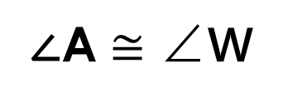
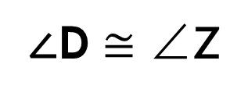

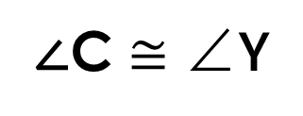
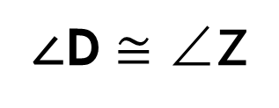
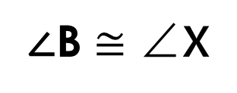
ABCD $\sim$ WXYZ
1
The symbol used for similarity.
Y
C
X
B
A
D
W
Z
∠A $≅$ ∠W
∠B $≅$ ∠X
∠C $≅$ ∠Y
∠D $≅$ ∠Z
∠D $≅$ ∠Z

Slide 5
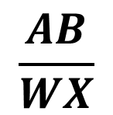

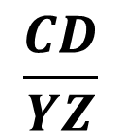
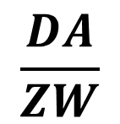
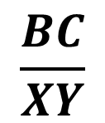
ABCD $\sim$ WXYZ
GO BACK
1
Y
C
X
B
A
D
W
Z
$$\frac{AB}{WX}$$
$$\frac{BC}{XY}$$
$$\frac{CD}{YZ}$$
$$\frac{DA}{ZW}$$
=
=
=

Slide 6
2
SIMILAR TRIANGLES
- Two triangles are similar if and only if
the corresponding angles are congruent
and the lengths of the corresponding sides
are proportional.

Slide 7
Example :
2
If ABC ~ DEF, list all pairs of
congruent angles, and write a proportion
that relates the corresponding sides.
B
E
A
C
D
F

Slide 8

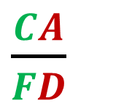

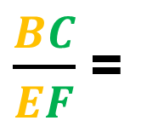
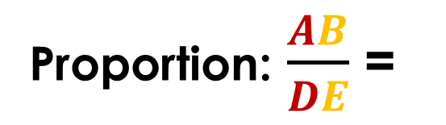

E
B
2
A
C
D
F
Congruent Angles:
∠A$≅$∠D
∠B$≅$∠E
A B C ~ D E F
∠C$≅$∠F
Proportion: $\frac{AB}{DE}$ =
$\frac{BC}{EF}$ =
$\frac{CA}{FD}$

Slide 9
Angle-Angle (AA)
Postulate of Similarity
2
Two triangles are similar if two angles of one triangle are congruent to the corresponding angles of the other triangle.
E
B
▲ABC ~ ▲DEF
A
C
D
F

Slide 10
Triangle
Similarity Theorems
2
Side-Angle-Side (SAS) Similarity
- If the lengths of two pairs of
corresponding sides of two triangles are in
proportion
and their included angles are congruent,
then the triangle are similar.

Slide 11
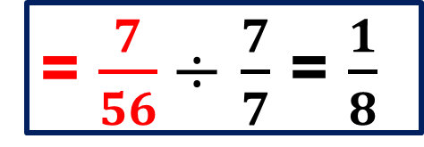
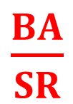
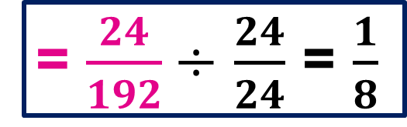
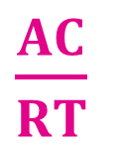
U
N
2
24
47°
7
7
47°
192
56
A
D
O
T
$\frac{BA}{SR}$
= $\frac{7}{56}$ $÷$ $\frac{7}{7}$ = $\frac{1}{8}$
$\frac{AC}{RT}$
= $\frac{24}{192}$ $÷$ $\frac{24}{24}$ = $\frac{1}{8}$

Slide 12
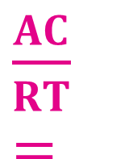


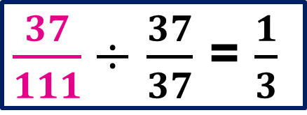
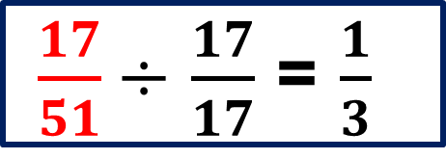
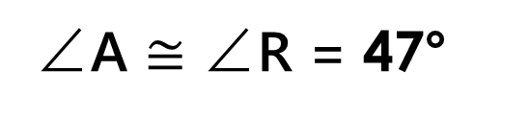
Let’s Practice
2
A
R
$\frac{BA}{SR}=$
$\frac{17}{51}$ $÷$ $\frac{17}{17}$ = $\frac{1}{3}$
17
37
60°
60°
$\frac{AC}{RT}=$
$\frac{37}{111}$ $÷$ $\frac{37}{37}$ = $\frac{1}{3}$
51
111
B
C
∠A $≅$ ∠R = 47°
S
T
▲BAC $≅$ ▲SRT

Slide 13
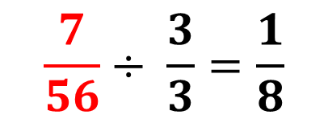
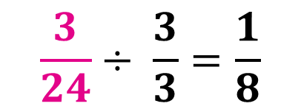
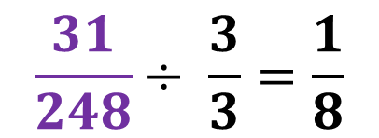
Side-Side-Side (SSS) Similarity
2
- If the lengths of corresponding sides of two
triangles are proportional, then the triangle
are similar.
I
A
24
56
3
7
R
H
T
P
248
31
$$\frac{3}{24}÷ \frac{3}{3}=\frac{1}{8}$$
$$\frac{7}{56}÷ \frac{3}{3}=\frac{1}{8}$$
$$\frac{31}{248}÷ \frac{3}{3}=\frac{1}{8}$$

Slide 14
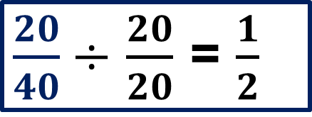
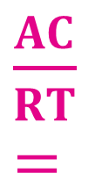
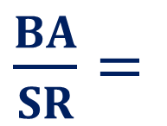
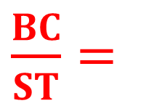

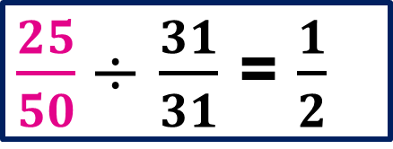
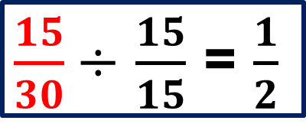
Let’s Practice
2
A
R
$\frac{BC}{ST}=$
$\frac{15}{30}$ $÷$ $\frac{15}{15}$ = $\frac{1}{2}$
$\frac{BA}{SR}=$
$\frac{20}{40}$ $÷$ $\frac{20}{20}$ = $\frac{1}{2}$
20
25
40
50
$\frac{AC}{RT}=$
$\frac{25}{50}$ $÷$ $\frac{31}{31}$ = $\frac{1}{2}$
B
C
15
S
T
30
▲BAC $≅$ ▲SRT

Slide 15
3
Right Triangle Similarity
- the altitude to the hypotenuse
divides the
triangles
into two triangles each of which
is similar to the original triangle.
B
B
B
A
C
A
D
C
D
D
▲ADB ~ ▲ABC
▲BDC ~ ▲ABC
, ▲ADB ~ ▲BDC

Slide 16
3
Corollary
Geometric Mean (Altitude) Theorem
- the altitude is the geometric mean to the segments into which it divides the hypotenuse.
B
▲ADB ~ ▲BDC
▲ABC ~ ▲ABD
▲ABC ~ ▲CBD
h
x
y
A
C
D

Slide 17
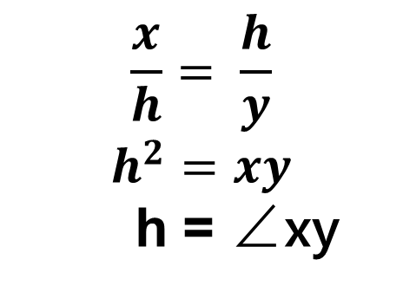
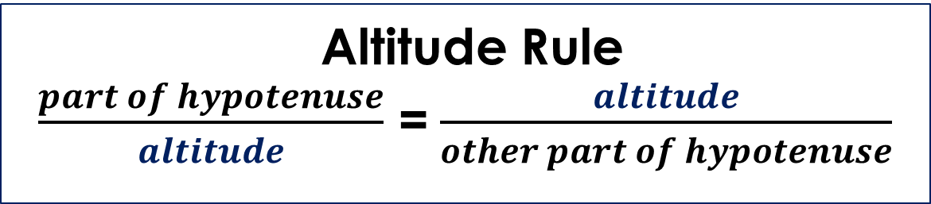
3
Geometric Mean (Altitude) Theorem
- the altitude is the geometric mean to the segments into which it divides the hypotenuse.
Altitude Rule
$\frac{part of hypotenuse}{altitude}$ = $\frac{altitude}{other part of hypotenuse}$
B
$$\frac{x}{h}= \frac{h}{y}$$
$$h^{2}=xy$$
h = ∠xy
h
x
y
A
C
D

Slide 18
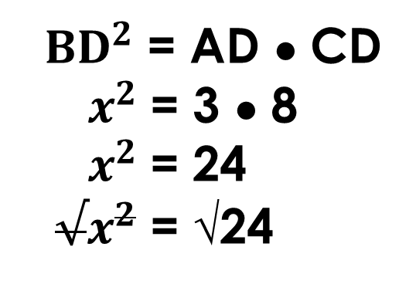
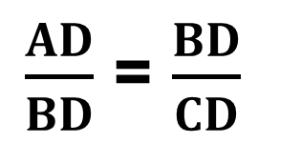
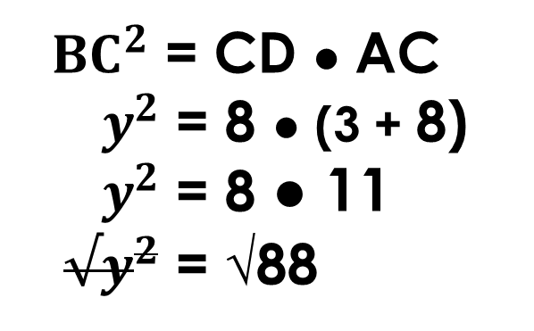
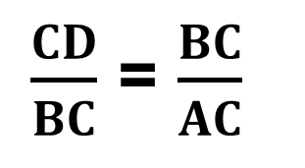
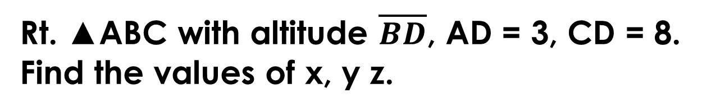
3
Example:
Rt. ▲ABC with altitude $\overline{BD}$, AD = 3, CD = 8. Find the values of x, y z.
SOLUTIONS:
$\frac{AD}{BD}$ = $\frac{BD}{CD}$
$\frac{CD}{BC}$ = $\frac{BC}{AC}$
B
${ BD}^{2}$ = AD ● CD
${ x}^{2}$ = 3 ● 8
${ x}^{2}$ = 24
${ √x}^{2}$ = √24
${ BC}^{2}$ = CD ● AC
${ y}^{2}$ = 8 ● (3 + 8)
${ y}^{2}$ = 8 ● 11
${ √y}^{2}$ = √88
y
z
x
x = 2√6
y = 2√22
A
C
3
D
8

Slide 19
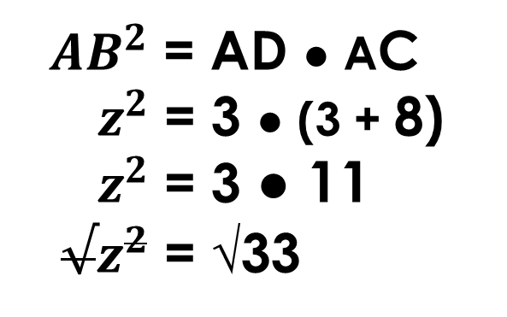
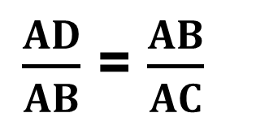
3
Example:
Rt. ▲ABC with altitude $\overline{BD}$, AD = 3, CD = 8. Find the values of x, y z.
SOLUTIONS:
$\frac{AD}{AB}$ = $\frac{AB}{AC}$
B
${ AB}^{2}$ = AD ● AC
${ z}^{2}$ = 3 ● (3 + 8)
${ z}^{2}$ = 3 ● 11
${ √z}^{2}$ = √33
y
z
x
z = √33
A
C
2
D
8

Slide 20
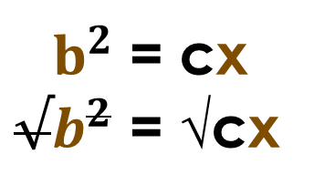
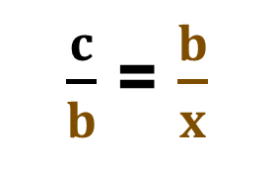
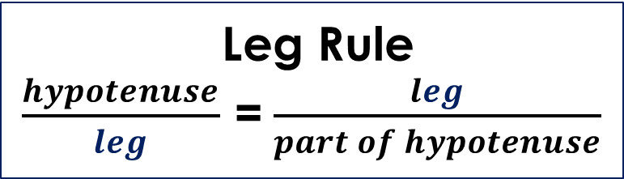
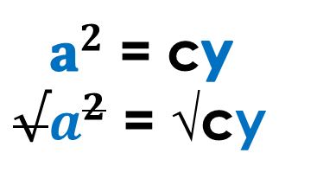
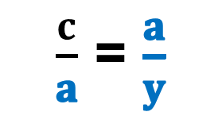
3
Geometric Mean (Leg) Theorem
each leg is the geometric mean of the
hypotenuse and the segment of the hypotenuse adjacent to the leg.
Leg Rule
$\frac{hypotenuse}{leg}$ = $\frac{leg}{part of hypotenuse}$
C
$\frac{c}{b}$ = $\frac{b}{x}$
$\frac{c}{a}$ = $\frac{a}{y}$
b
a
${ b}^{2}$ = cx
${√b}^{2}$ = √cx
${ a}^{2}$ = cy
${√a}^{2}$ = √cy
A
B
b = √ cx
a = √ cy
x
D
y
c

Slide 21
3
Example:
GO BACK
If BA = 12 and FA = 8 find a, b and x.
SOLUTIONS:
BA = BF + FA
12 = x + 8
12 – 8 = x
x = 4
b = √cy
b = √12(8)
b = √96
C
a = √cx
a = √12(4)
a = √48
b
a
b = 4√6
a = 4√3
x
y = 8
B
A
F
c = 12

Slide 22

SPECIAL RIGHT TRIANGLES
4
30° - 60°- 90°
Right Triangle Theorem
- The shorter leg is the side opposite the
30° angle
and is one – half the length of the hypotenuse.
The longer leg is the side opposite the 60° angle
B
and is √3 times the length of the shorter leg.
60°
BC = $\frac{1}{2}$(AB)
AC =BC √3
30°
A
C

Slide 23
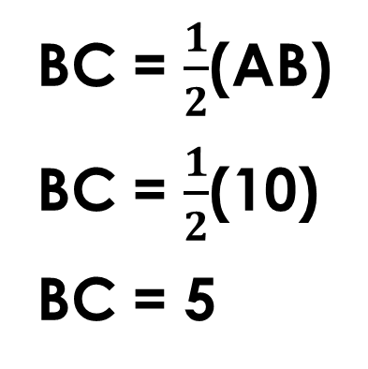
4
30° - 60°- 90°
Right Triangle Theorem
Example:
If AB = 10, find BC and BA.
SOLUTION:
BC = $\frac{1}{2}$(AB)
BC = $\frac{1}{2}$(10)
BC = 5
AC =BC √3
AC = 5 √3
B
60°
30°
A
C

Slide 24
SPECIAL RIGHT TRIANGLES
4
45° - 45°- 90°
Right Triangle Theorem
- The hypotenuse is √2 times the length of either leg.
AC = BC
BA = AC √2
BA = BC √2
B
Example:
45°
hypotenuse
If AC = 9, find BC and BA.
leg
SOLUTION:
BC = AC
BC = 9
BA = AC√2
BA = 9√2
45°
A
GO BACK
C
leg

Slide 25
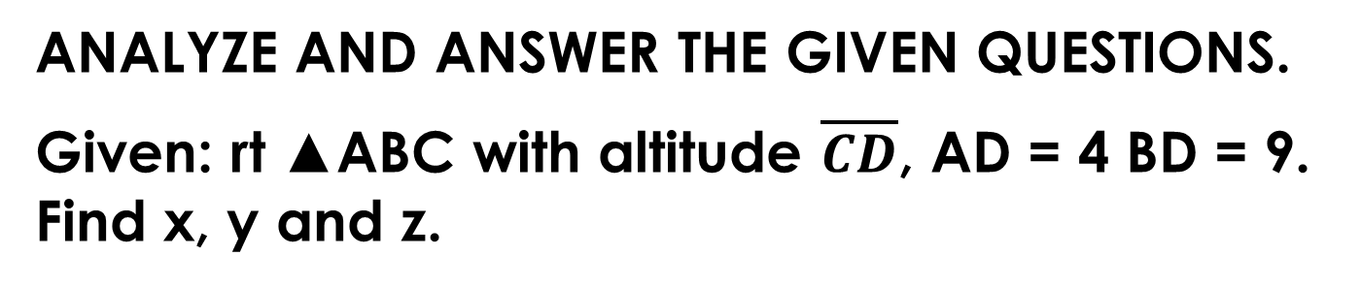
GO BACK
ACTIVITY
RIGHT TRIANGLE SIMILARITY
5
ANALYZE AND ANSWER THE GIVEN QUESTIONS.
Given: rt ▲ABC with altitude $\overline{CD}$, AD = 4 BD = 9. Find x, y and z.
C
y
z
x
GOOGLE CLASSROOM
A
B
4
D
9

Slide 26
FIND THE MISSING SIDES OF THE GIVEN RIGHT TRIANGLES.
5
1.
5 cm
2.
60°
a = ?
16 cm
b = ?
30°
60°

