Slide 1
1) How are news article structured?

Slide 2
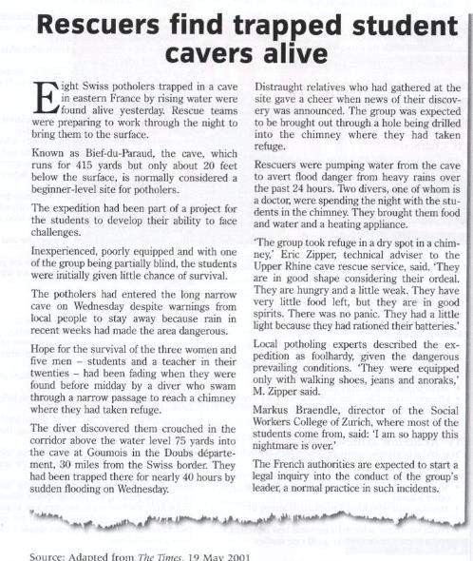
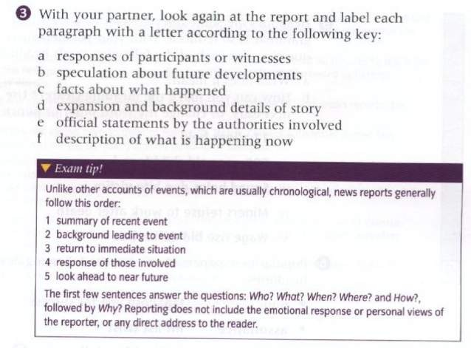
Potholer = explorer of cave
1
2
3
4
5

Slide 3
2) How to write news headline

Slide 4
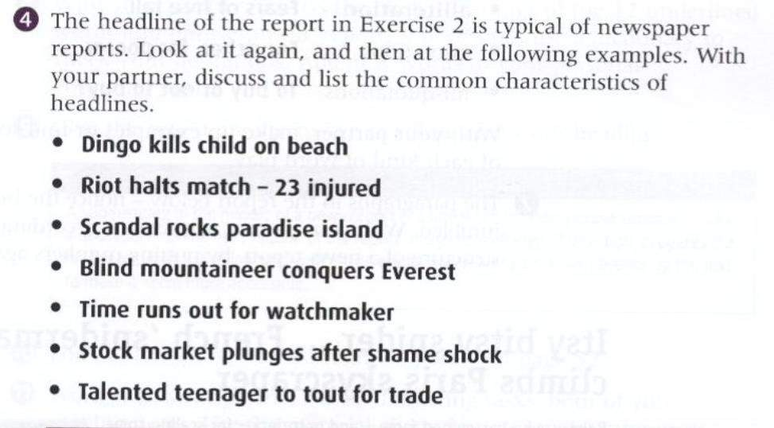
Famous name
Tense - Present
Short sentences

Slide 5
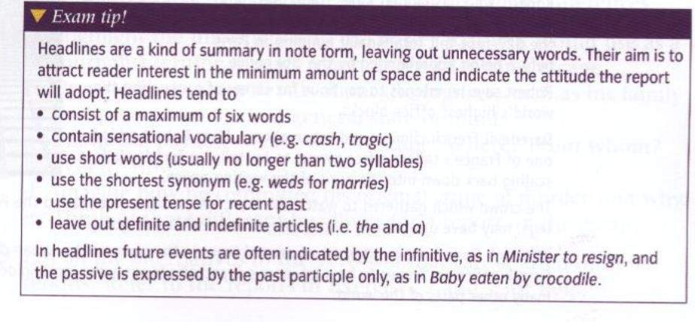
Baby eaten by crocodile (past)
Present tense
…to +v (future)

Slide 6
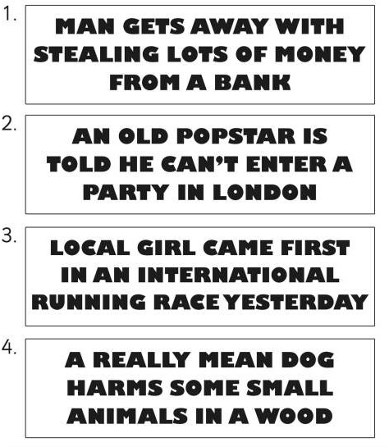
Exercise writing a headline

Slide 7
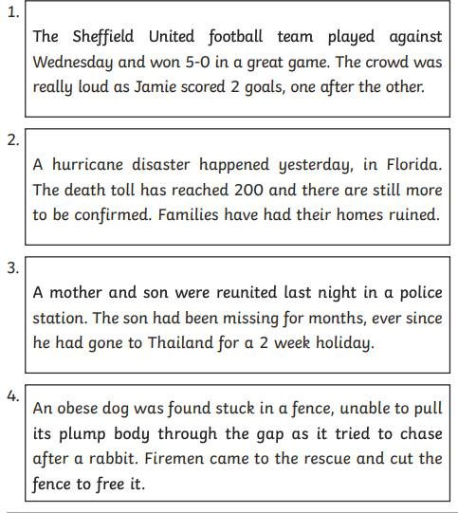

Slide 8
3) Past Paper exercise

Slide 9
Exercise from past paper
Read the following question and text, they will request you to write a newspaper article, make sure you find
An appropriate title
A structure as described in Slide 1
Include elements as requests by the questions

Slide 10
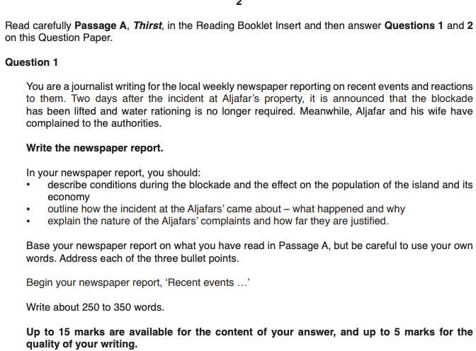

Slide 11
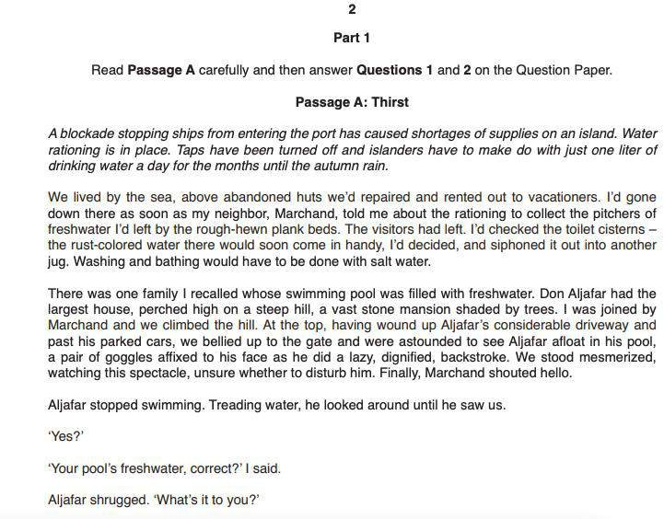

Slide 12
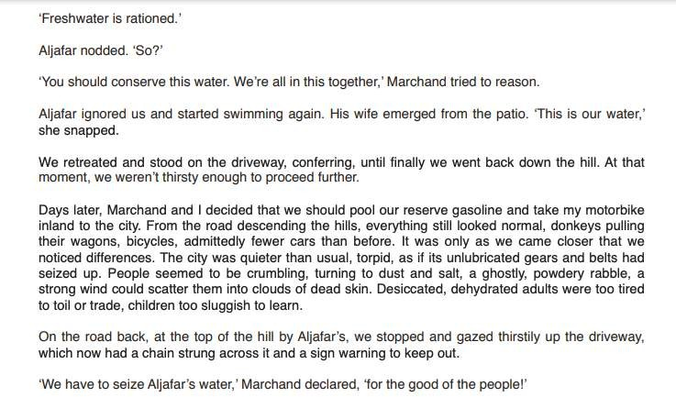

Slide 13
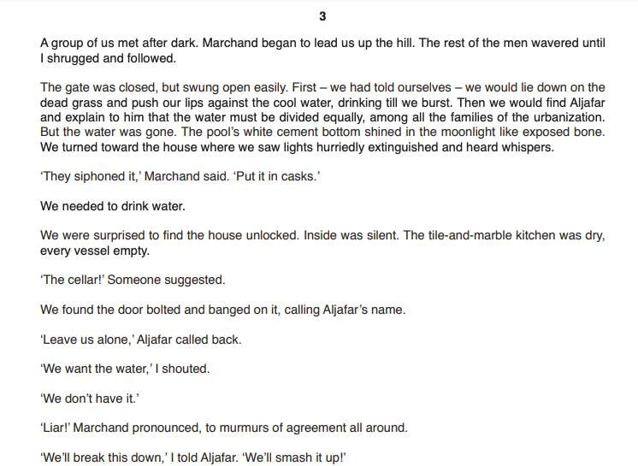

Slide 14
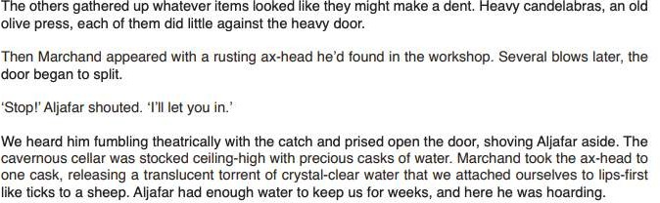

Slide 15
Example plan
Title:Villagers discover hoarded water by rich family
The complaint by the Aljafa’s ( they were under attacked, that water was their’s) was unjustified
Because 1) water is not theirs, at time of drought, they should use water smartly, and be generous to the villagers
2) hoarding water is an act of selfishness.
Summary 1 para
Background blockade, effects to life, abandon of tourists Opinions /reactions by others quoting the villagers Future police is under investigation

