Slide 1
Looping
Notes:
https://www.cambridgeinternational.org/Images/697167-2026-2028-syllabus.pdf

Slide 2
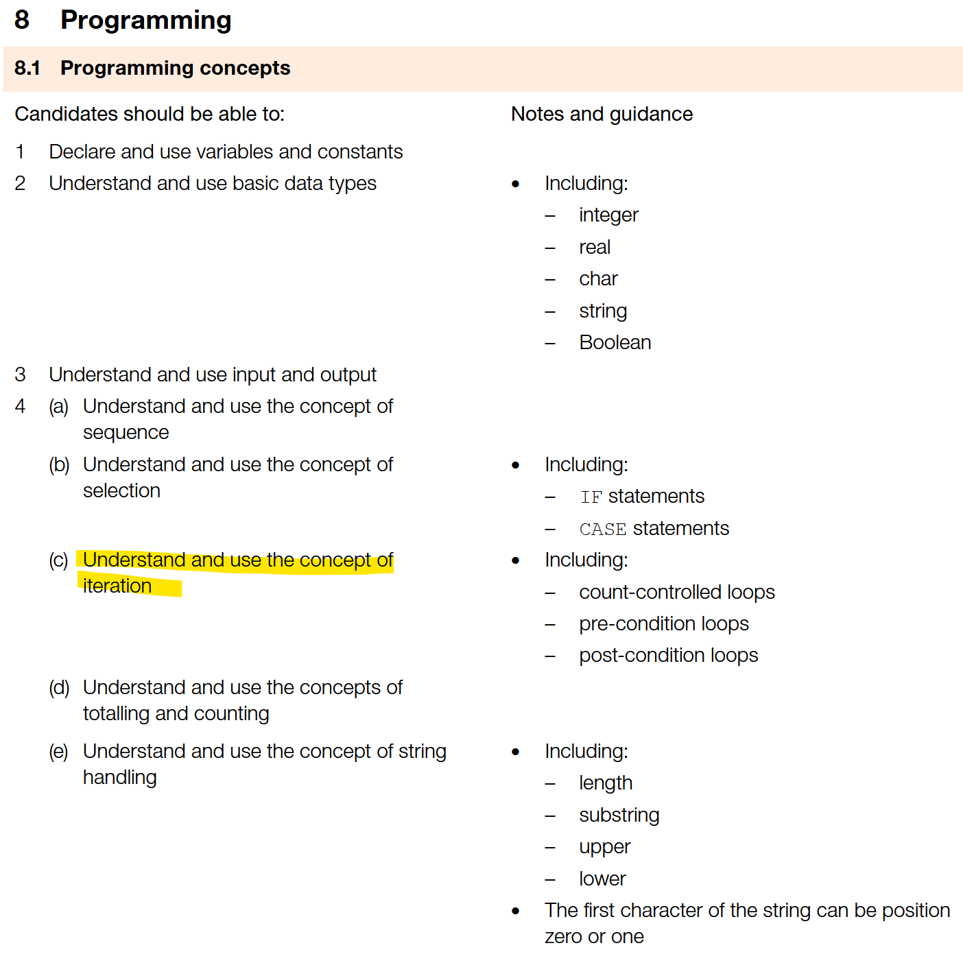
Syllabus

Slide 3
Looping intro
https://www.geeksforgeeks.org/loops-programming/

Slide 4
Recap: different loop types
While loop = Pre-condition loop
For loop = Count-controlled loop
Do-while/Repeat = Post-condition loop

Slide 5
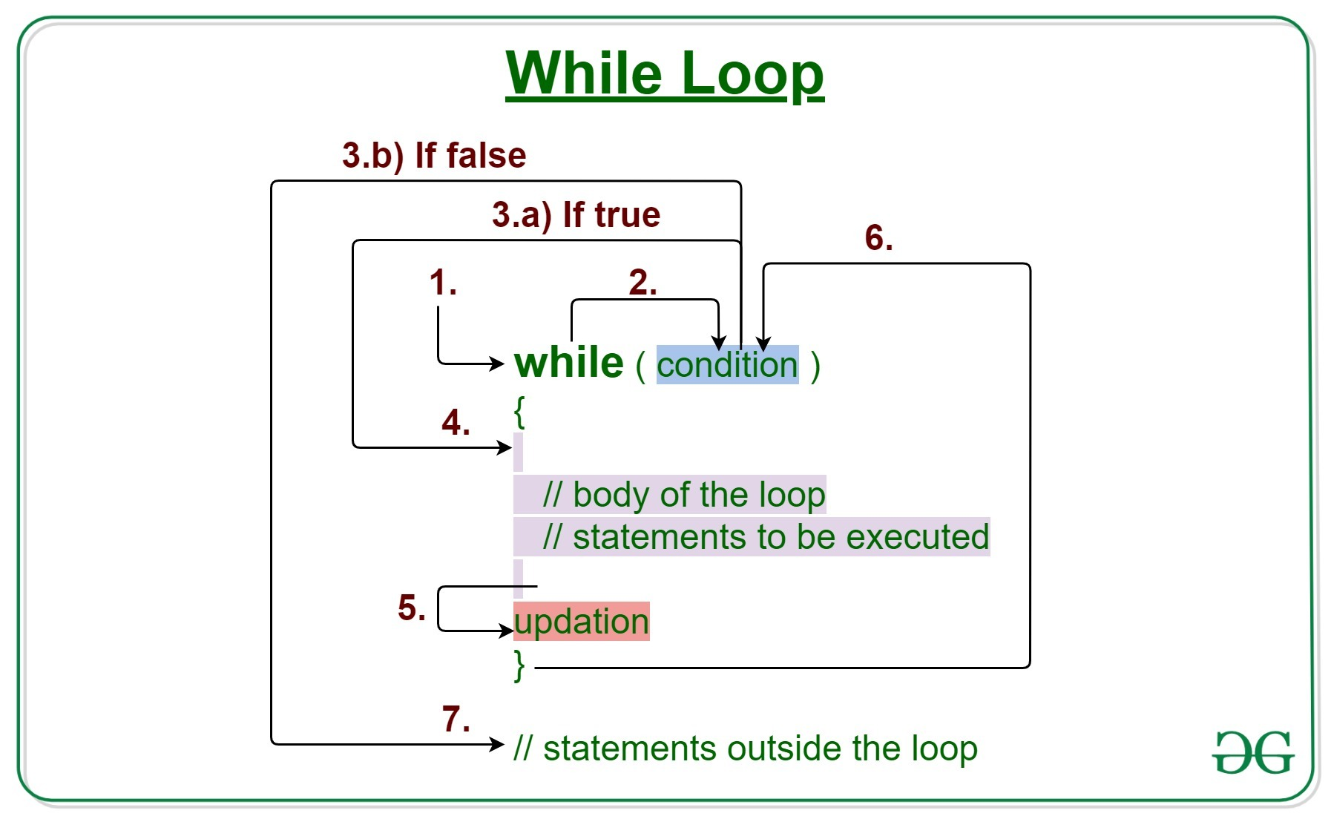
Pre-condition (While) loop

Slide 6
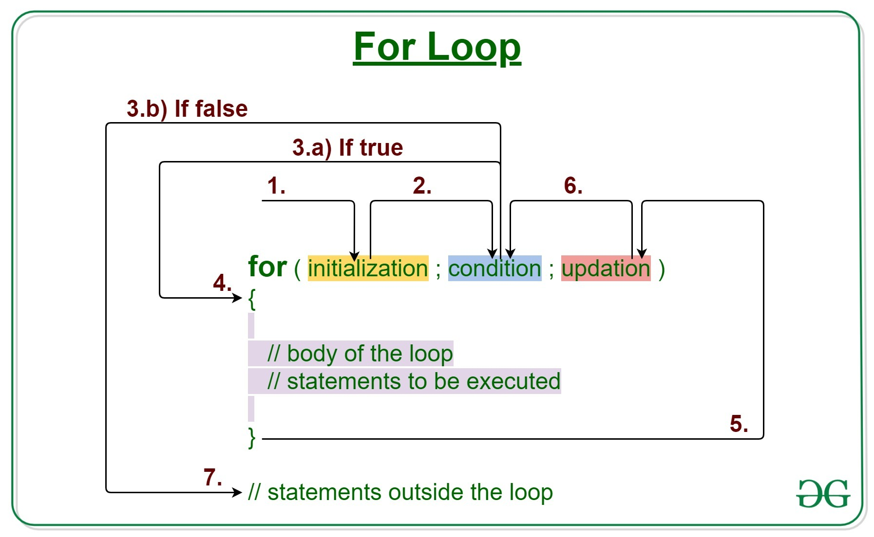
Count-controlled (For) loop

Slide 7
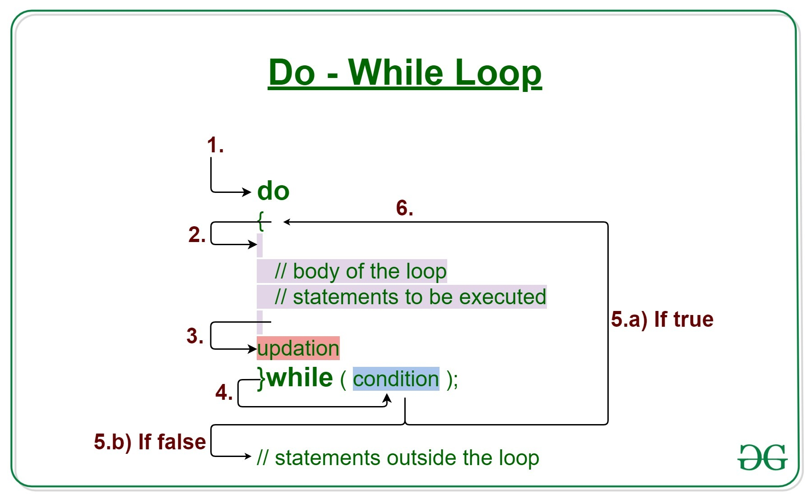
Post-condition (Do-While/Repeat) loop

Slide 8
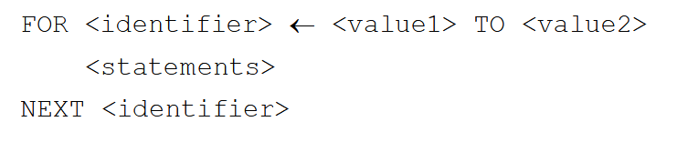
Pseudocode: Count-controlled

Slide 9
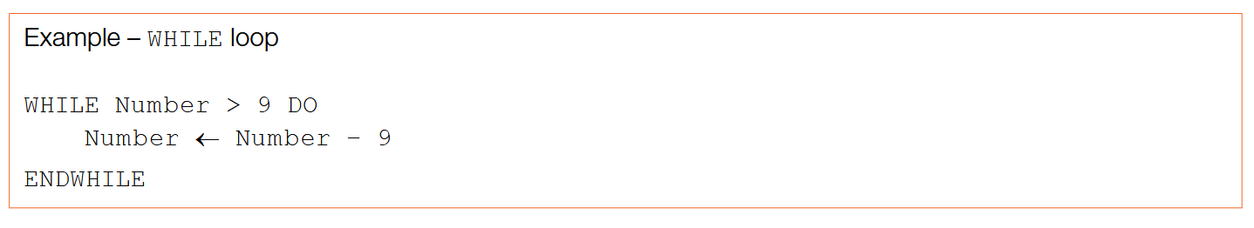
Pseudocode: Pre-condition

Slide 10
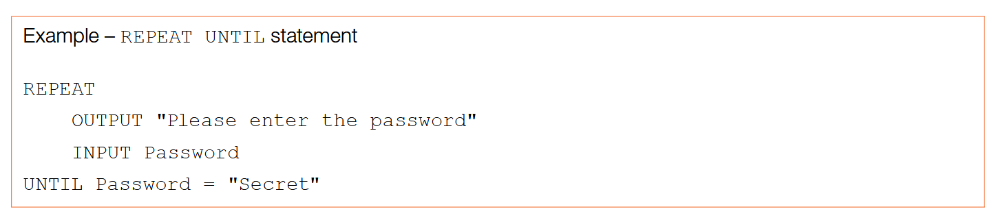
Pseudocode: Post-condition

Slide 11
Task 1: Bricks delivery
You work for a construction company that needs bricks to build a house.
You already have 25 bricks already. You need at least 100 bricks to build the house. You can only carry 6 bricks at a time from the brick shop. How many visits to the brick shop do you need to have enough bricks to build the house?

Slide 12
Task 2: Coffee run
You have been tasked to grab 10 coffees in the morning for your colleagues. You have to buy the coffee before you commute to work.
You ride the MTR into work at rush hour, and you have 15 stops until you get there. At each stop, you sip 0.4 cups of coffee to keep you going.
How many cups of coffee should you have bought so you would arrive with enough coffee for your colleagues?

Slide 13
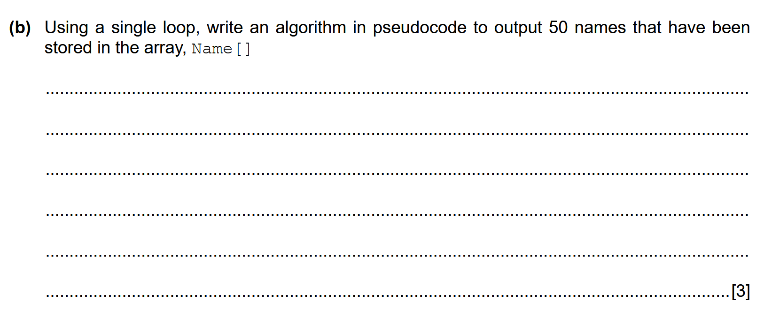
Q1

Slide 14
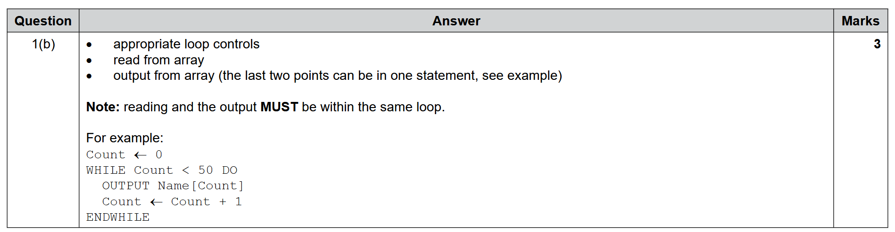
Q1

Slide 15
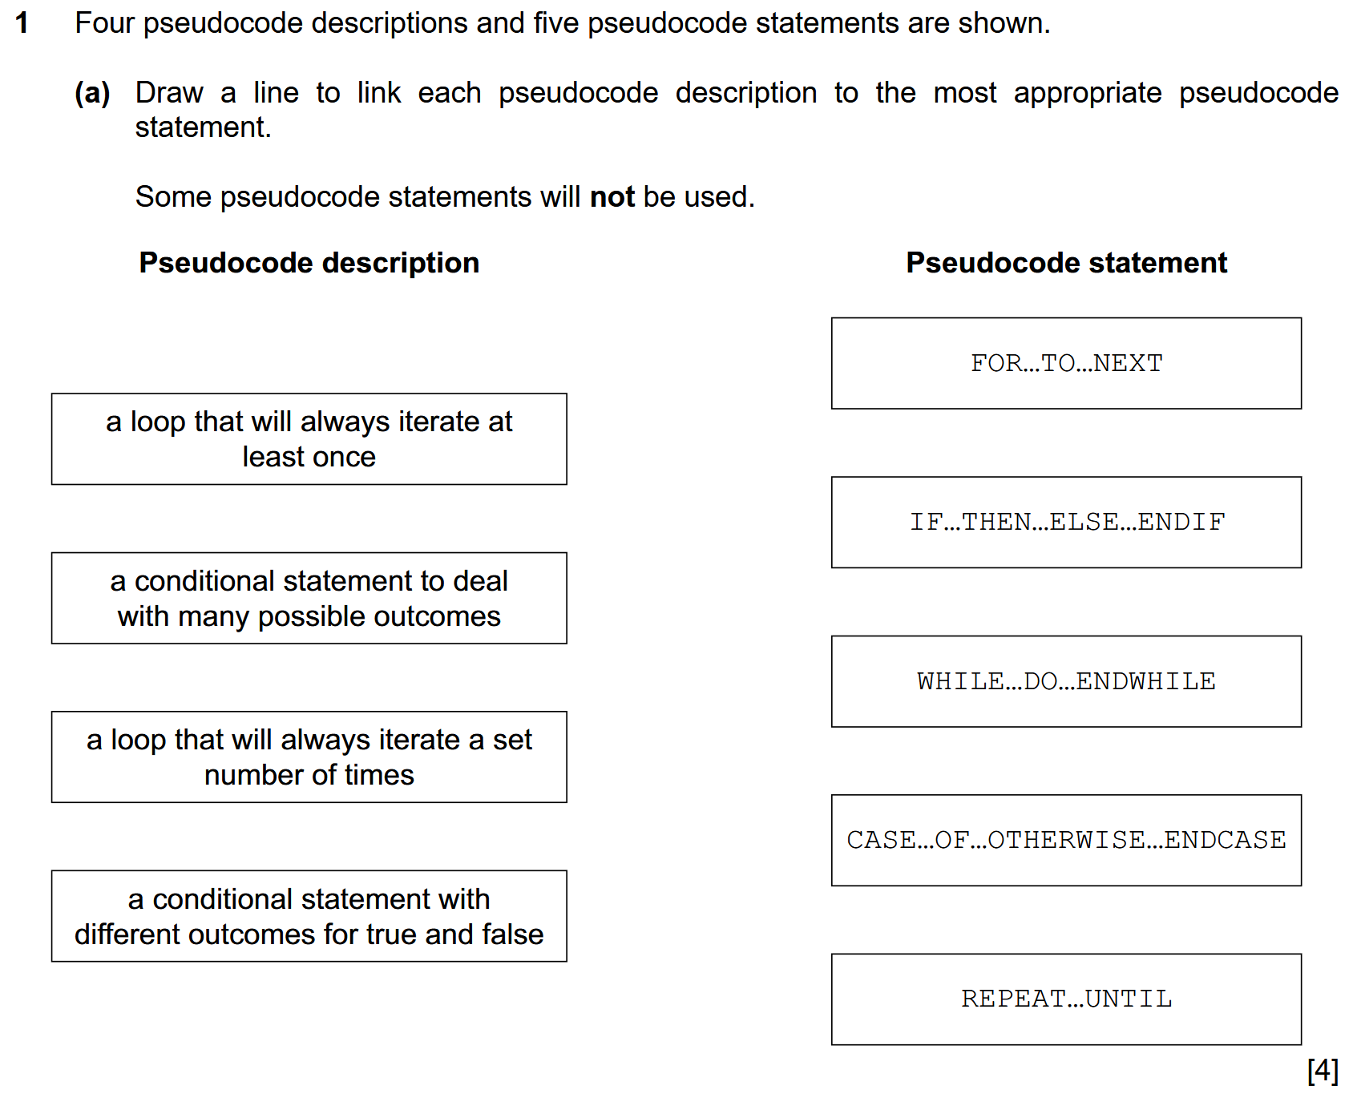
Q2

Slide 16
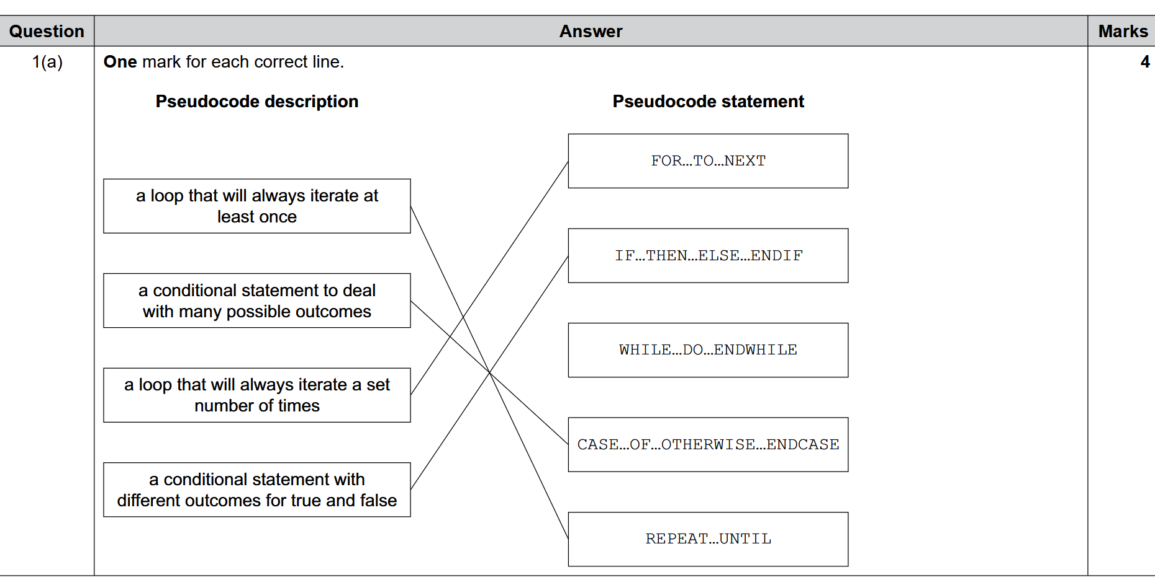
Q2

Slide 17
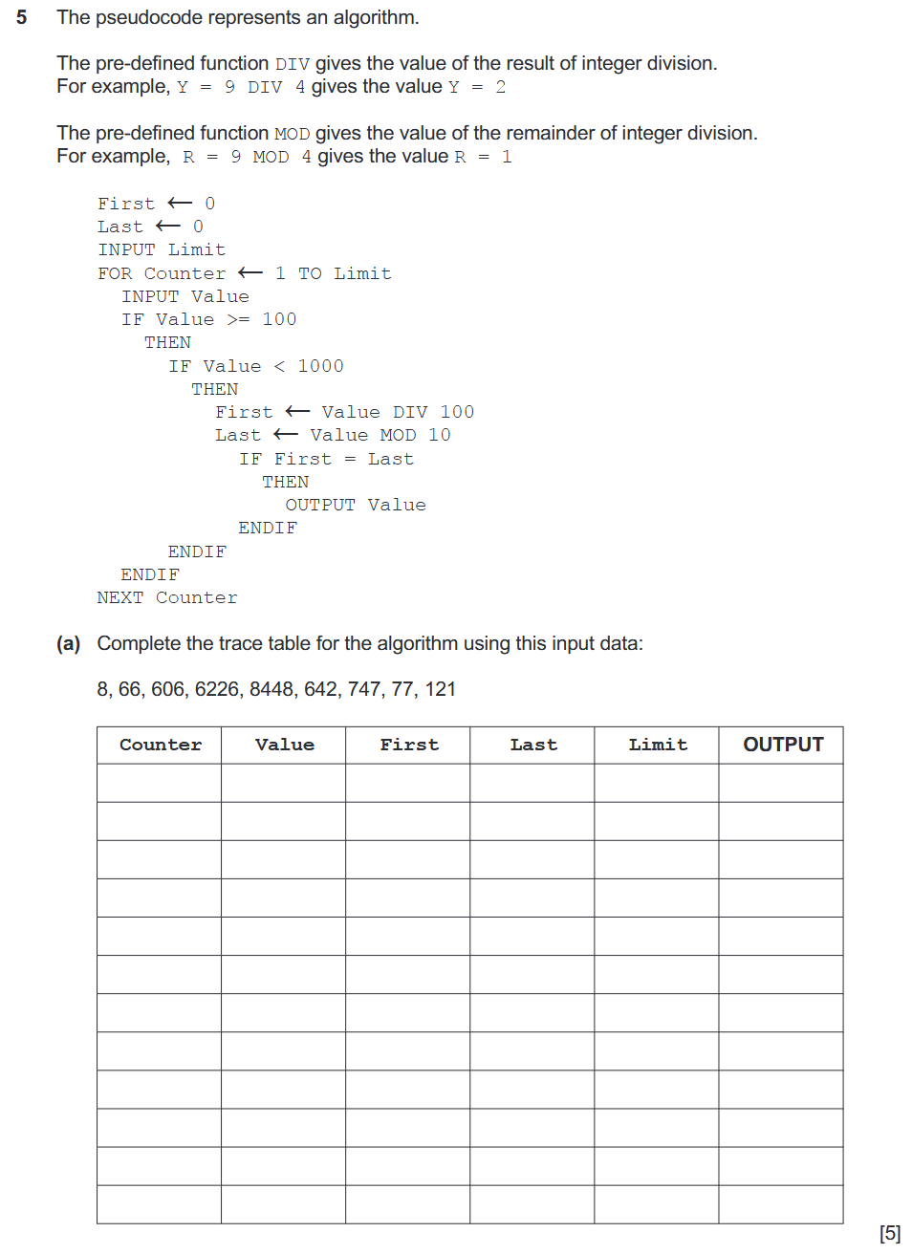
(Hard) Explain pseudocode

Slide 18
Condition question
You need to cook 10 portions of eggs and toast
In the kitchen, you have: 7 eggs, 3 toasts
2 eggs for 1 toast makes a portion

