Slide 1
Chapter 17DIVIDENDS AND PAYOUT POLICY
DIVIDENDS AND PAYOUT POLICY
Corporate Fin – FIN420
Spring 2024

Slide 2
Learning objectives
Define dividend types and how dividends are paid
Explain the issues surrounding dividend policy decisions
Describe the difference between cash and stock dividends
Explain why share repurchases are an alternative to dividends

Slide 3
Chapter Outline
Cash Dividends and Dividend Payment
Does Dividend Policy Matter?
Real-World Factors Favoring a Low Dividend Payout
Real-World Factors Favoring a High Dividend Payout
A Resolution of Real-World Factors
Stock Repurchases: An Alternative to Cash Dividends
What We Know and Do Not Know about Dividend and Payout Policies
Stock Dividends and Stock Splits

Slide 4
Cash Dividends and dividend payment
Dividend is a payment made out of a firm’s earnings to its owners, in the form of either cash or stock
Distribution is a payment made by a firm to its owners from sources other than current or accumulated retained earnings
Dividends come in several different forms, but the basic types of cash dividends are the following:
  Regular cash dividends
  Extra dividends
  Special dividends
  Liquidating dividends

Slide 5
Cash Dividends
Regular cash dividends are cash payments made by a firm to its owners in the normal course of business, usually paid four times per year
  Extra cash dividends may or may not be repeated in the future
  Special dividends are often one-time events that will not be repeated
  Liquidating dividends are paid when some or all of the business has been liquidated (i.e., sold off)
Decision to pay a dividend rests with the board of directors
When dividends are paid, the amount of the cash dividend is usually expressed in terms of dollars per share (dividends per share)
  Could also be expressed as percentage of market price (dividend yield) or percentage of net income or earnings per share (dividend payout)

Slide 6
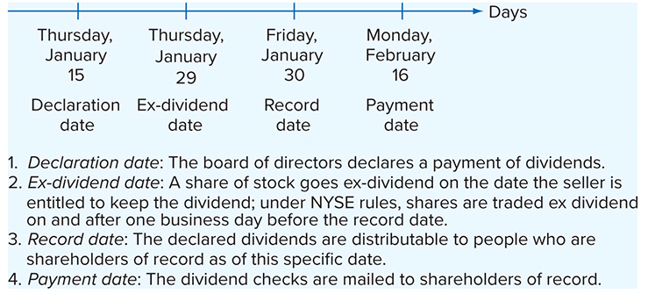
Dividend payment: a chronology
Declaration date is the date on which the board of directors passes a resolution to pay a dividend
Ex-dividend date is the date one business day before the date of record, establishing those individuals entitled to a dividend
Date of record is the date by which a holder must be on record to be designated to receive a dividend
Date of payment is the date on which dividend checks are mailed

Slide 7
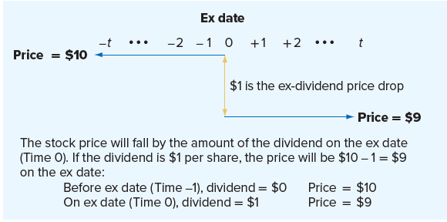
More about the ex-dividend date
Suppose we have a stock that sells for $10 per share. The board of directors declares a dividend of $1 per share, and the record date is set to be Monday, June 11. Therefore, the ex date will be one business (not calendar) day earlier, on Friday, June 8.
  If you buy the stock on Thursday, June 7, just as the market closes, you’ll get the $1 dividend because the stock is trading cum dividend
  If you wait and buy it just as the market opens on Friday, you won’t get the $1 dividend

Slide 8
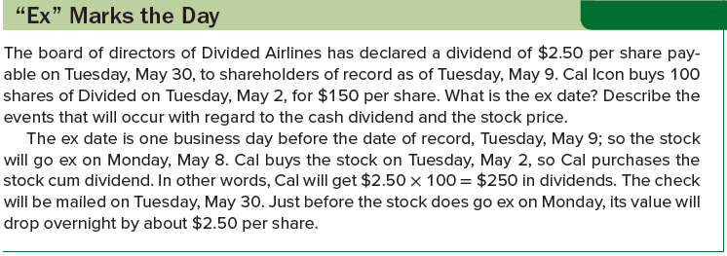
“ex” marks the day

Slide 9
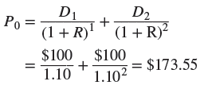
Does dividend policy matter?: CURRENT POLICY
Dividend policy is the time pattern of dividend payout
  Should the firm pay out a large percentage of its earnings now or a small (or even zero) percentage?
Wharton is an all-equity firm that has existed for 10 years. The current financial managers plan to dissolve the firm in two years. The total cash flows the firm will generate, including the proceeds from liquidation, will be $10,000 in each of the next two years.
At the present time, dividends at each date are set equal to the cash flow of $10,000. There are 100 shares outstanding, so the dividend per share is $100.
  Assuming a 10% required return, the value of a share of stock today, P₀, is:
The firm as a whole is worth 100 × $173.55 = $17,355

Slide 10
Does dividend policy matter?: ALTERNATIVE POLICY
Several members of the board of Wharton have expressed dissatisfaction with the current dividend policy and have asked you to analyze an alternative policy, wherein the firm pays a dividend of $110 per share on the first date (Date 1), which is, of course, a total dividend of $11,000. Because the cash flow is only $10,000, an extra $1,000 must somehow be raised.
  One way to do this is to issue $1,000 worth of bonds or stock at Date 1. Assume that stock is issued.
  The new stockholders will desire enough cash flow at Date 2 so that they earn the required 10% return on their Date 1 investment
What is the value of the firm with this new dividend policy? The new stockholders invest $1,000. They require a 10% return, so they will demand $1,000 × 1.10 = $1,100 of the Date 2 cash flow, leaving only $8,900 to the old stockholders.

Slide 11


Does dividend policy matter?: ALTERNATIVE POLICY 2
The dividends to the old stockholders will be as follows:
Present value of the dividends per share is the same as we found before:
Value of stock is unaffected by switch in dividend policy, even though we must sell some new stock to finance the new dividend
For the Wharton Corporation, dividend policy makes no difference
  Any increase in a dividend at some point in time is exactly offset by a decrease at some other time; so the net effect, once we account for time value, is zero

Slide 12
Homemade dividends
Suppose individual Investor X prefers dividends per share of $100 at both Dates 1 and 2. Would she be disappointed if informed that the firm’s management was adopting the alternative dividend policy (dividends of $110 and $89 on the two dates, respectively)?
  Not necessarily; she could easily reinvest the $10 of unneeded funds received on Date 1 by buying more Wharton stock
  At 10%, this investment would grow to $11 by Date 2; investor X would receive her desired net cash flow of $110 − 10 = $100 at Date 1 and $89 + 11 = $100 at Date 2
Imagine Investor Z, preferring $110 of cash flow at Date 1 and $89 of cash flow at Date 2, finds that management will pay dividends of $100 at both Dates 1 and 2
  This investor can sell $10 worth of stock to boost his total cash at Date 1 to $110; because this investment returns 10%, Investor Z gives up $11 at Date 2 (= $10 × 1.1), leaving $100 − 11 = $89
Our two investors can transform the corporation’s dividend policy into a different policy by buying or selling on their own, resulting in a homemade dividend policy

Slide 13
A test
True or false: Dividends are irrelevant
  False
  Investors prefer higher dividends to lower dividends at any single date if the dividend level is held constant at every other date
True or false: Dividend policy is irrelevant
  True, at least in the simple case
  Dividend policy by itself cannot raise the dividend at one date while keeping it the same at all other dates; rather, dividend policy merely establishes the trade-off between dividends at one date and dividends at another date

Slide 14
Real-world factors favoring a low dividend payout
Taxes
  Beginning in 2003, tax rates on dividends and long-term capital gains were lowered from a maximum in the 35–39% range to 15%, giving corporations a much larger tax incentive to pay dividends
  In 2020, the tax rate on dividends was 0%, 15%, or 20%, depending on the individual’s marginal tax rate.
    Fact that capital gains tax can be deferred still means that the effective tax rate on dividends will be higher for many investors
Flotation costs
  If we include flotation costs in our argument, then we will find that the value of the stock decreases if we sell new stock
Dividend restrictions
  In some cases, a corporation may face restrictions on its ability to pay dividends (e.g., bond indenture forbids dividend payments)
  Corporation may be prohibited by state law from paying dividends if the dividend amount exceeds the firm’s retained earnings

Slide 15
Real-world factors favoring a high dividend payout
Why might a firm might pay its shareholders higher dividends even if it means the firm must issue more shares of stock to finance the dividend payments?
  Benjamin Graham, David Dodd, and Sidney Cottle argue that firms should generally have high dividend payouts because:
    “The discounted value of near dividends is higher than the present worth of distant dividends.”
    Between “two companies with the same general earning power and same general position in an industry, the one paying the larger dividend will almost always sell at a higher price.”
Two additional factors favoring a high dividend payout are the following:
  Desire for current income
  Resolution of uncertainty

Slide 16
Real-world factors favoring a high dividend payout 2
Many individuals desire current income, and it is argued that this group is willing to pay a premium to get a higher dividend yield
Current income argument may be relevant in the real world:
  Sale of low-dividend stocks would involve brokerage fees and other transaction costs; these direct cash expenses could be avoided by an investment in high-dividend securities
  Expenditure of stockholder’s own time in selling securities and the natural (though not necessarily rational) fear of consuming out of principal might further lead many investors to buy high-dividend securities
Remember that financial intermediaries can (and do) perform these “repackaging” transactions for individuals at very low cost
  Such intermediaries could buy low-dividend stocks and, through a controlled policy of realizing gains, they could pay their investors at a higher rate

Slide 17
Real-world factors favoring a high dividend payout 3
Recall dividends have been taxed unfavorably for individual investors (at least until very recently); other investors do not receive unfavorable tax treatment from holding high-dividend yield, rather than low-dividend yield, securities:
Corporate investors receive significant tax break on dividends if they own stock in another corporation
  Corporate stockholder receiving either common or preferred dividends is granted a 50% (or more) dividend exclusion (reduced from 70% or more by the 2017 Tax Cuts and Jobs Act)
  Because the 50% exclusion does not apply to capital gains, this group is taxed unfavorably on capital gains
  High-dividend, low-capital gains stocks may be more appropriate for corporations to hold
Tax-exempt investors include pension, endowment, and trust funds

Slide 18
Information content of dividends
Previously, we examined three different positions on dividends:
  Based on the homemade dividend argument, dividend policy is irrelevant
  Because of tax effects for individual investors and new issue costs, a low-dividend policy is best
  Because of the desire for current income and related factors, a high-dividend policy is best
Information content effect is the market’s reaction to a change in corporate dividend payout
  Generally, stock prices rise when the current dividend is unexpectedly increased, and they fall when the dividend is unexpectedly decreased
  The fact that dividend changes convey information about the firm to the market makes it difficult to interpret the effect of the dividend policy of the firm

Slide 19
The clientele effect
Companies with high payouts will attract one group, and low-payout companies will attract another
  Some groups (e.g., wealthy individuals) have an incentive to pursue low-payout (or zero-payout) stocks
  Other groups (e.g., corporations) have an incentive to pursue high-payout stocks
Clientele effect argument states that stocks attract particular groups based on dividend yield and the resulting tax effects

Slide 20
Stock repurchases: an alternative to cash dividends
A stock repurchase (i.e., buyback) is the purchase, by a corporation, of its own shares of stock
Repurchases have exploded in the last two decades
  Peaked in 2007 at about 2.5 times the size of aggregate dividends
  Plunged in the 2008–2009 recession as firms conserved cash, but rebounded in 2010
Share repurchases are typically accomplished in one of three ways
  Open market purchases occur when a firm purchases its own stock, just as anyone would buy shares of a particular stock, and the firm does not reveal itself as the buyer
  Firm could institute a tender offer, where the firm announces to all its stockholders that it is willing to buy a fixed number of shares at a specific price
  Firms may repurchase shares from specific individual stockholders (i.e., a targeted repurchase)

Slide 21
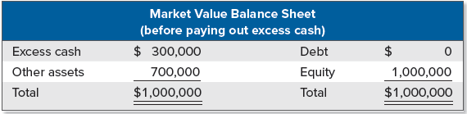
Cash dividends versus repurchase
Imagine an all-equity company with excess cash of $300,000. The firm pays no dividends, and its net income for the year just ended is $49,000. The market value balance sheet at year end is below:
There are 100,000 shares outstanding. The total market value of the equity is $1 million, so the stock sells for $10 per share. Earnings per share (EPS) are $49,000/100,000 = $.49, and the price-earnings ratio (PE) is $10/$.49 = 20.4.
One option the company is considering is a $300,000/100,000 = $3 per share extra cash dividend. Alternatively, the company is thinking of using the money to repurchase $300,000/$10 = 30,000 shares of stock.
  If commissions, taxes, and other imperfections are ignored in our example, the stockholders shouldn’t care which option is chosen

Slide 22
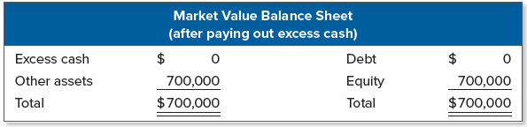
Cash dividends versus repurchase 2
The new balance sheet is represented here:
If the cash is paid out as a dividend, there are still 100,000 shares outstanding, so each is worth $7
Consider a stockholder who owns 100 shares
  At $10 per share before the dividend, the total value is $1,000
  After the $3 dividend, this same stockholder has 100 shares worth $7 each, for a total of $700, plus 100 × $3 = $300 in cash, for a combined total of $1,000
Because total earnings and the number of shares outstanding haven’t changed, EPS is still 49 cents, so the price-earnings ratio falls to $7/$.49 = 14.3

Slide 23
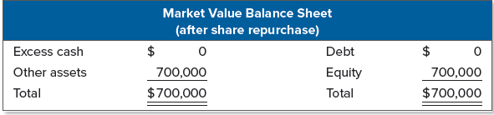
Cash dividends versus repurchase 3
Alternatively, if the company repurchases 30,000 shares, there are 70,000 shares left outstanding. The balance sheet looks the same:
The company is worth $700,000 again, so each remaining share is worth $700,000/70,000 = $10
  Our stockholder with 100 shares is obviously unaffected (e.g., she could sell 30 shares and end up with $300 in cash and $700 in stock, just as she has if the firm pays the cash dividend)
  This is another example of a homemade dividend
In this second case, EPS goes up because total earnings remain the same while the number of shares goes down
  New EPS is $49,000/70,000 = $.70, but notice the PE ratio is $10/$.70 = 14.3, as it was following the dividend

Slide 24
Real-world considerations in a repurchase
There are some accounting differences between a share repurchase and a cash dividend, but the most important difference is in the tax treatment
Under current tax law, a repurchase has a significant tax advantage over a cash dividend
  A dividend is taxed, and a shareholder has no choice about whether to receive the dividend
  In a repurchase, a shareholder pays taxes only if the following are true:
    Shareholder actually chooses to sell; and
    Shareholder has a capital gain on the sale
Note a share repurchase reduces the number of outstanding shares, but it has no effect on total earnings
  As a result, EPS rises

Slide 25
Dividends and dividend payers
In the United States, aggregate dividends paid are quite large, but the number of companies that pay dividends has declined
  This is because dividend payments are heavily concentrated in a relatively small set of large firms
    In 2000, about 80% of aggregate dividends were paid by 100 firms
Why has the percentage of dividend-paying firms declined?
  Population of firms has changed
    Huge increase in the number of newly listed firms over the last 25 or so years, which tend to be younger and less profitable
  Firms appear to be more likely to begin making payouts using share repurchases, which are flexible, rather than committing to making cash distributions

Slide 26
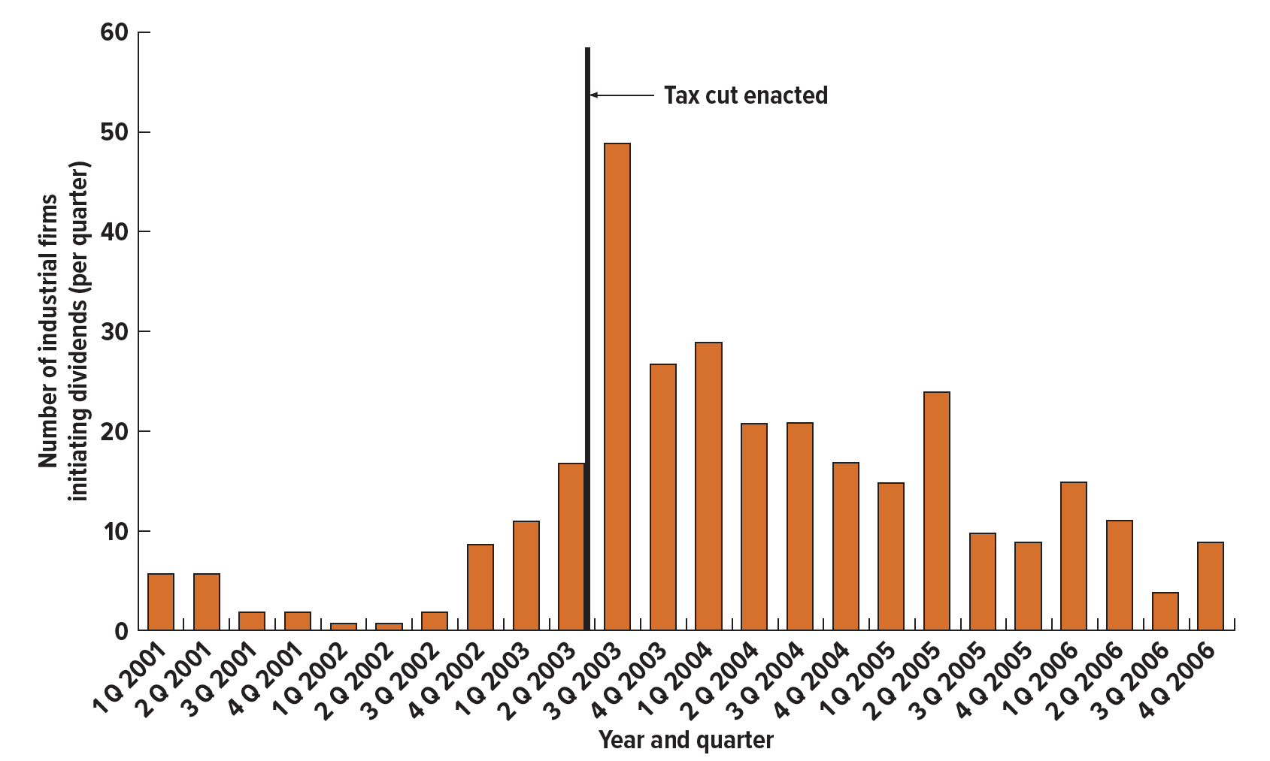
Dividends and dividend payers 2
Evidence suggests the trend of dividend-paying firms declining may be reversing itself for the following reasons:
  Reduction in personal tax rates led to increases in dividends in May 2003, but note that tax rates are not primary determinant of dividend policy
  Newly listed firms (mentioned on previous slide) are maturing
  Due to the “dot-com” crash and major scandals surrounding the year 2000 and shortly after, many companies initiated dividends to signal to investors they were stable

Slide 27
Corporations smooth dividends
Dividend cuts are frequently viewed as very bad news by market participants, and as a result:
  Companies only cut dividends when there is no other acceptable alternative
  Companies are also reluctant to increase dividends unless they are sure the new dividend level can be sustained
Dividend-paying companies tend to raise dividends only after earnings have risen, and they don’t increase or cut dividends in response to temporary earnings fluctuations
To summarize:
  Dividend growth lags earnings growth
  Dividend growth will tend to be much smoother than earnings growth

Slide 28
Putting it all together
The following observations summarize much of what we have discussed in this chapter:
  Aggregate dividend and stock repurchases are massive, and they have increased steadily in nominal and real terms over the years
  Dividends are heavily concentrated among a relatively small number of large, mature firms
  Managers are very reluctant to cut dividends, normally doing so only due to firm-specific problems
  Managers smooth dividends, raising them slowly and incrementally as earnings grow
  Stock prices react to unanticipated changes in dividends

Slide 29
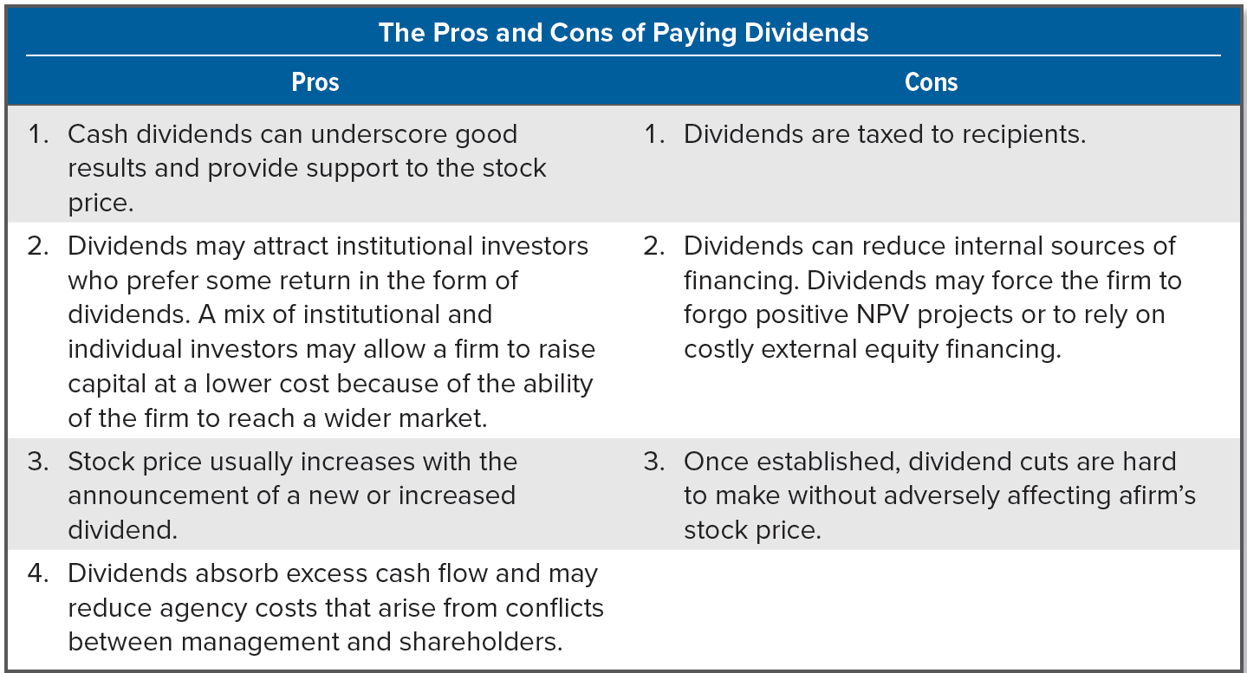
The pros and cons of paying dividends

Slide 30
Stock dividends and stock splits
A stock dividend is a payment made by a firm to its owners in the form of stock, diluting the value of each share outstanding
  Commonly expressed as a percentage (e.g., 20% stock dividend means a shareholder receives one new share for every five currently owned, or a 20% increase)
A stock split is an increase in a firm’s shares outstanding without any change in owners’ equity
  Expressed as a ratio instead of a percentage (e.g., a three-for-one stock split means each old share is split into three new shares)
Stock splits and stock dividends have essentially the same impacts on the corporation and the shareholder, in that they increase the number of shares outstanding and reduce the value per share
  Accounting treatment is not the same; depends on two things:
    Whether the distribution is a stock split or a stock dividend
    Size of the stock dividend (if it is called a dividend)

Slide 31
POPULAR TRADING RANGE
Proponents of stock dividends and stock splits frequently argue that a security has a proper trading range, the price range between the highest and lowest prices at which a stock is traded
  When the security is priced above this level, many investors do not have the funds to buy the common trading unit of 100 shares (i.e., a round lot)
  Although securities can be purchased in odd-lot form (fewer than 100 shares), the commissions are greater, so firms will split the stock to keep the price in this trading range
Validity of this argument is questionable for several reasons:
  Institutional traders, such as mutual funds, pension funds, and others, buy and sell in huge amounts, so the individual share price is of little concern
  In some cases, quite large share prices do not cause problems
  Evidence suggests stock splits may decrease the liquidity of the company’s shares

Slide 32
Reverse splits
A reverse split is a stock split in which a firm’s number of shares outstanding is reduced
The following are potential explanations for reverse splits:
  Transaction costs to shareholders may be less after the reverse split
  Liquidity and marketability of a company’s stock might be improved when its price is raised to the popular trading range
  Stocks selling at prices below a certain level are not considered respectable, meaning that investors underestimate these firms’ earnings, cash flow, growth, and stability
  Stock exchanges have minimum price per share requirements; a reverse split may bring the stock price up to such a minimum
  Companies sometimes perform reverse splits and, at the same time, buy out any stockholders who end up with less than a certain number of shares

