Slide 1
C E L L
THE FUNDAMENTAL UNIT OF LIFE
Prepared by: Mr. Jomar B. Encinareal

Slide 2
WHAT IS A CELL
Cell is the basic, structural and functional unit of all living organisms.
Cell make up living things and carry out activities that keep a living thing alive

Slide 3
WHAT IS A CELL
The Origins Of The Word 'Cell' In the 1660s, Robert Hooke looked through a primitive microscope at a thinly cut piece of cork.
He saw a series of walled boxes that reminded him of the tiny rooms, or cellula, occupied by monks.

Slide 4
CELL THEORIES
All organisms are made of cells
All existing cells are produced by other living cells
The cell is the basic unit of life.
Cell theory is a collection of ideas and conclusions from many different scientists over time that describes cells and how cells operate.

Slide 5
STRUCTURE OF CELL
1

Slide 6
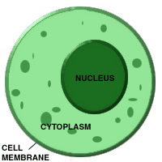
THREE MAIN PARTS OF CELL
If we study a cell under a microscope, we would come across three features in almost every cell.

Slide 7
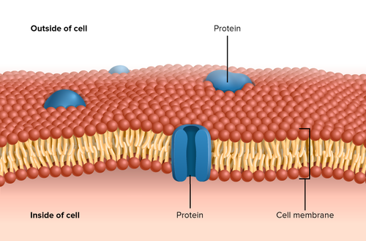
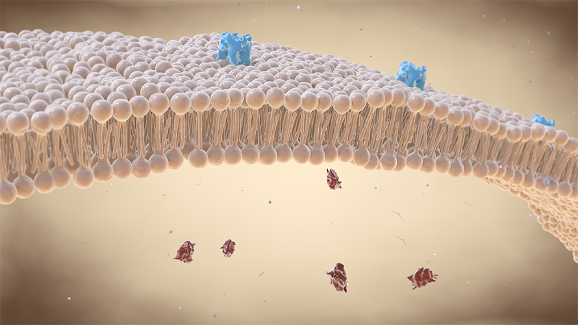
PLASMA/CELL MEMBRANE
STRUCTURE:
  Extremely delcicate, thin, elastic, living and semi-permeable membrane.
  Made up of two layers of two lipid molecules in which protein molecules are floating
FUNCTION:
  Maintain shape and size of the cell
  Protect internal content of the cell
  Regulates entry and exit of the substances in and out of the cell
  Maintain homeostasis

Slide 8
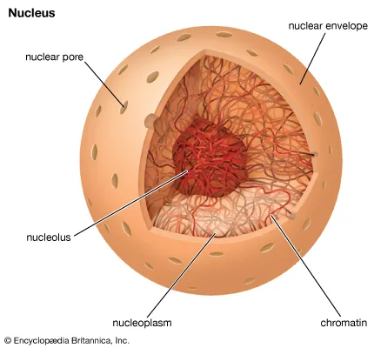
NUCLEUS
STRUCTURE:
  Dense spherical body near the center of the cell
  Nucleus has a double membrane called nuclear membrane
  Contains the genetic material called DNA
FUNCTION:
  Control all cell activities like metabolism, growth, cell division and protein synthesis.
  Store hereditary information in genes

Slide 9
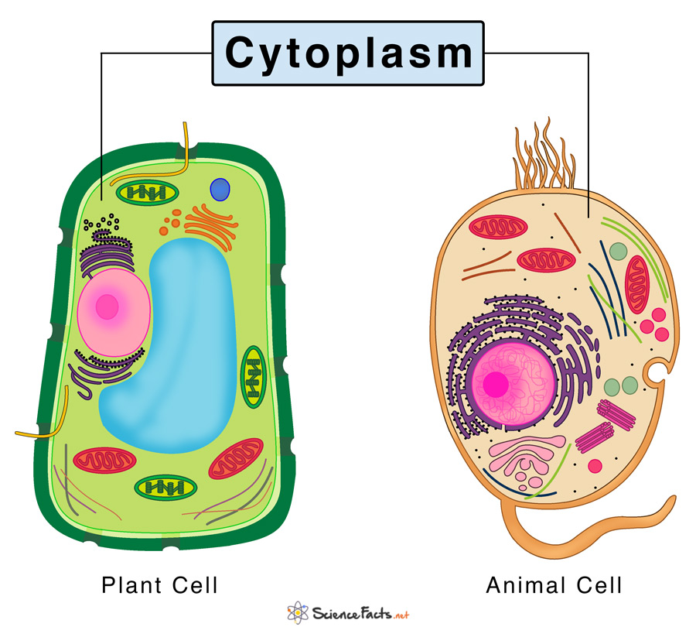
CYTOPLASM
STRUCTURE:
  Jelly-like material formed by 80% of water
  Present between the plasma membrane and nucleus
  Contains the liquid portion called cytosol (protein, carbohydrates, lipids, etc..)
FUNCTION:
  Provides shape to the cell.
  It fills up the cells thus enabling the organelles to remain in their position. The cells, without cytoplasm, would deflate and substances will not permeate easily from one to the other organelle.

Slide 10
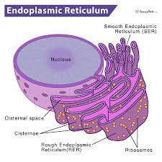
ENDOPLASMIC RETICULUM
STRUCTURE:
  Network of vesicular and tubular structures which are interconnected with one another
  Some parts are connected to the nuclear membrane , some are to cell membrane
  Two types (smooth and rough ER)
FUNCTION:
  Gives internal support to the cytoplasm
  RER synthesize proteins
  SER synthesize lipids for cell membrane
  Its function is to produce proteins for the rest of the cell to function.
Notes:
The rough endoplasmic reticulum has on it ribosomes, which are small, round organelles whose function it is to make those proteins

Slide 11
GOLGI BODIES/APPARATUS
STRUCTURE:
  Discovered by Camilo Golgi
  made up of a series of flattened, stacked pouches called cisternae.
FUNCTION:
  is a cell organelle that helps process and package proteins and lipid molecules, especially proteins destined to be exported from the cell
Notes:
While many types of cells contain only one or several Golgi apparatus, plant cells can contain hundreds.

Slide 12
LYSOSOMES
STRUCTURE:
  Small spherical single membrane sac
  Found throughout the cytoplasm
FUNCTION:
  Help in digesting large molecules
  Protect cells by destroying foreign invaders like bacteria and viruses
  Degradation of worn-out organelles
  In dead cells, it perform autolysis
Notes:
Occur in most animal cell and few in plant cell

Slide 13
VACUOLE
STRUCTURE:
  Single cell membrane sac filled with liquid or sap (water, sugar and ion)
  In animals, vacuoles are small in size and few numbers.
  In plants, vacuoles are large
FUNCTION:
  Store various substances including waste products
  Provides turgidity and rigidity to plant cells., maintain water balance
  store nutrients and water on which a cell can rely for its survival

Slide 14
MITOCHONDRIA
STRUCTURE:
  Small rod shape organelle bounded by two membranes
FUNCTION:
  Synthesize energy rich compound ATP
  ATP (Adenosine Triphosphate) molecules provide energy for the vital activities of the cell.

Slide 15
CHLOROPLAST
STRUCTURE:
  Double-membrane bound organelles found in plant cells
  Thylakoids contains chlorophyll which are responsible for photosynthesis
FUNCTION:
  Convert light energy into chemical energy in the form of food.
  Provide green colors to leaves, stems and vegetables .

Slide 16
RIBOSOMES
STRUCTURE:
  A ribosome is an intercellular structure made of both RNA and protein
FUNCTION:
  The site of protein synthesis
  The ribosome reads the messenger RNA (mRNA) sequence and translates that genetic code into a specified string of amino acids, which grow into long chains that fold to form protein

