Slide 1
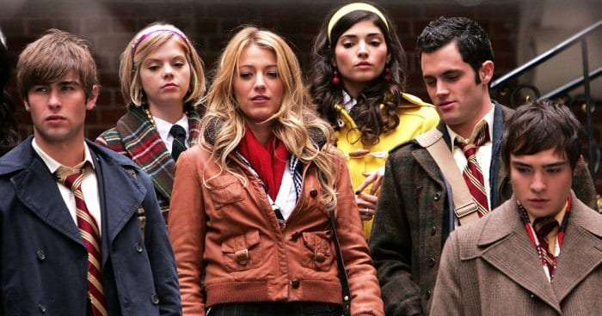


Slide 2
Gossip Girl - Introduction
Who is your favourite character?
What do you like about them?
Favourite memorable scene

Slide 3
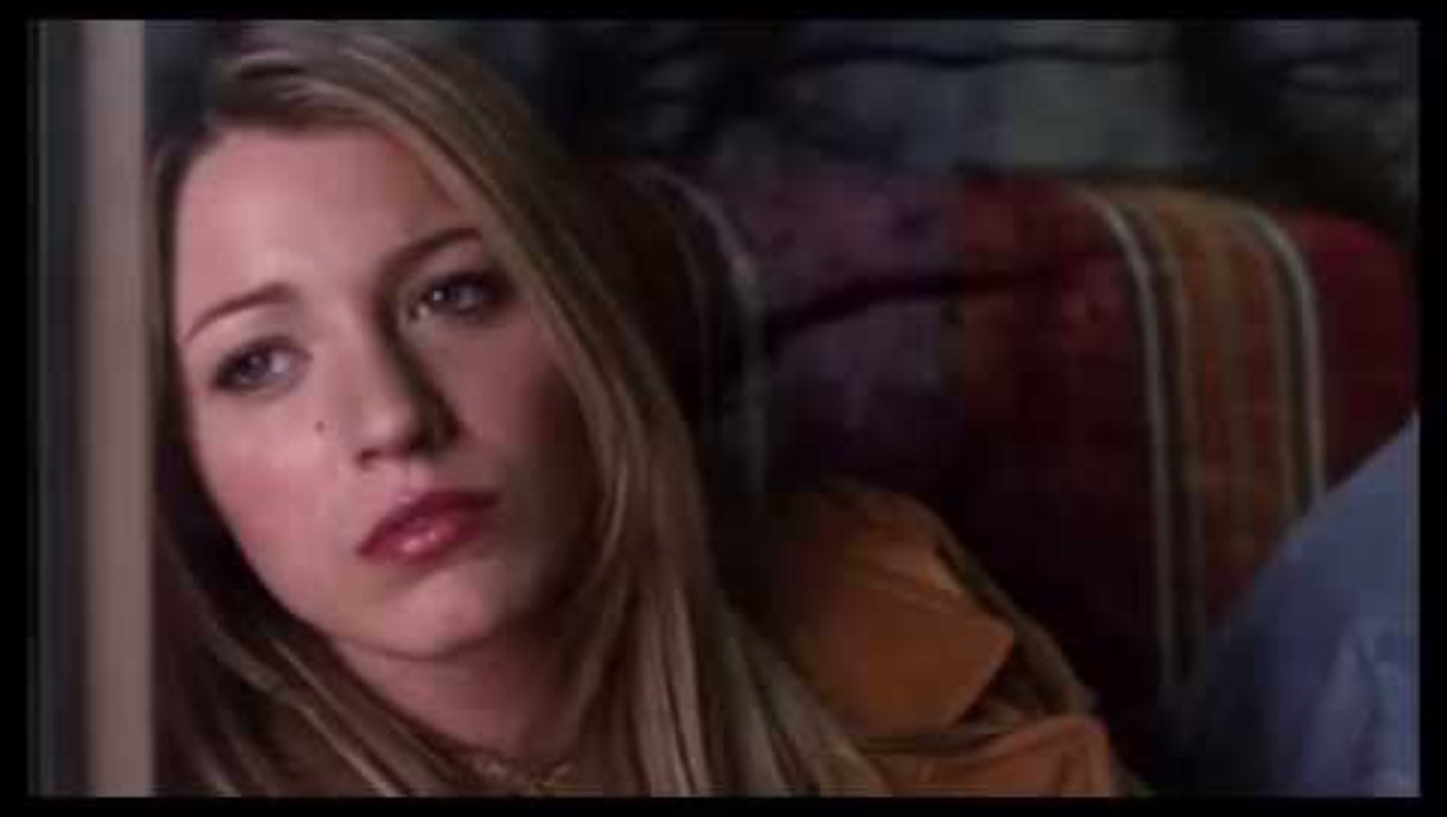
Pilot S1 Ep 1 – Opening Scene

Slide 4
What Are Prepositions?
Prepositions are words that show the relationship between a noun (or pronoun) and other words in a sentence
They often indicate place, time, direction or manner
Place | Time | Direction | Manner
In On At By | At On In Before After | To From | By With
Notes:
In– in a specific place, in a month (august)
On – specific date, location
At – specific location, used in place
By – at the side of, next to
Before/After – before a time, after (a time)
To – direction of the movement, something ends
From – direction of movement, something starts
With – being together

Slide 5
Which is the preposition?
She is at the café.
He is at the train station.
Blair is on the bus.
He walked from Central to Admiralty.
Serena returns after a mysterious absence.
I take photos with my camera.
She prefers to travel by train rather than by car.

Slide 6
Listen for the Specific Words –
In, On, At, Before, After, From, To
Which prepositions do you hear?
How do they help make the dialogue clearer?

Slide 7
Pilot S1 Ep 1 – Opening Scene

Slide 8
Gap Fill: By, In, On, After, At, To, From
She arrived ______ the party _______ 7 PM.
He likes to travel ______ bus instead of the car.
The dog ran outside ______ the rain stopped.
I will meet you ____ the coffee shop ____ our usual time.
She borrowed a book _____ her friend.
We had a picnic ______ the beach ____ the summer.
She called her mom ______ the evening.
The painting was done _____ a famous artist.
Notes:
To, At
By
After
By/In, At
From
At/On, In
In
By

Slide 9

In Detail Analysis Questions:
Use Prepositions In Your Answers
What is happening in the background?
Where are people rushing to?
What are they waiting for?
Where does Serena walk in?
Who does Rufus call over?
What does Gossip Girl say Serena is spotted at?
What does Rufus put his arms around?
What does Gossip Girl say everyone is talking about?
Where does Rufus say he is cooking?
What does Rufus ask about Dan and Jenny’s weekend?
Notes:
What is happening in the background?
Answer: People are rushing in the background.
Where are people rushing to?
Answer: People are rushing to their trains.
What are they waiting for?
Answer: They are waiting for friends.
Where does Serena walk in?
Answer: Serena walks in at Grand Central Station.
Who does Rufus call over?
Answer: Rufus calls over Dan and Jenny.
What does Gossip Girl say Serena is spotted at?
Answer: Serena is spotted at Grand Central.
What does Rufus put his arms around?
Answer: Rufus puts his arms around Jenny.
What does Gossip Girl say everyone is talking about?
Answer: Everyone is talking about Serena.
Where does Rufus say he is cooking?
Answer: Rufus says he is cooking at home.
What does Rufus ask about Dan and Jenny’s weekend?
Answer: Rufus asks about their weekend.

Slide 10

Read And Highlight The Prepositions
SETTING: [INT GRAND CENTRAL STATION, Serena walks in, a girl watches her and takes a photo with her cell phone]
Gossip Girl (Voice Over): Hey Upper East Siders, Gossip Girl here... and I have the biggest news ever. One of my many sources, Melanie91, sends us this: Spotted at Grand Central, bags in hand: Serena van der Woodsen. Was it only a year ago our It-Girl mysteriously disappeared for quote 'boarding school'? And just as suddenly she's back. Don't believe me? See for yourselves: Lucky for us, Melanie91 sent proof. Thanks for the photo, Mel!
[Rufus takes a look around the station and finds his son and daughter, he walks up and hugs them]
Rufus: Dan, Jenny! Over here!
Jenny: Hey, dad!
Rufus: Hey, hey! You made it. Welcome back! How was your weekend? How was your mom?
Dan: She's fine.
Jenny: Good... fine, I guess.
Dan: She's good and fine.
Rufus: Like 'Maybe I should never have left Manhattan' fine or 'Taking a time-out from my marriage was the best idea I've ever had' fine?
Dan: Dad, you know… I'm starving.
Rufus: Let's go home. I'm cooking. Caprese salad with a little mozzarella di Bufala... yeah, I'm gonna make you guys...
[Rufus puts an arms around Jenny and they walk off, Dan turns around and notices Serena]

Slide 11
Read And Highlight The Prepositions
Gossip Girl (Voice Over): Spotted: Lonely Boy… can't believe the love of his life has returned. If only she knew who he was. But everyone knows Serena. And everyone is talking.
SETTING: [EXT NEW YORK - Several people are standing in the streets, looking at the newest 'Gossip Girl' entry on their cell phones]
Gossip Girl (Voice Over): Wonder what Blair Waldorf thinks. Sure, they're BFFs but we always thought Blair's boyfriend Nate had a thing for Serena.
SETTING: [INT HOME OF THE WALDORFS - BATHROOM - Blair takes a look at a new text message: 'Serena is Back!!', she leaves the bathroom and rejoins a party, her mother, Eleanor, is talking to a friend]
Eleanor: ...I have to design a dress for this woman.
[Eleanor turns to Blair]
Eleanor: Blair, if you're gonna to wear one of my designs tell me about it so we can at least get it properly fitted.
[Blair looks down at her outfit and grimaces at the slight jab at her weight, but doesn't let her mother know it.]
Blair: Thanks, mom. I’ll keep that in mind. Great party.

Slide 12

Writing Task
Write a short paragraph about your favourite scene from Gossip Girl
Use at least 6 different prepositions
Describe what happens in the scene, who the characters are, where the characters are and what are they doing.

Slide 13
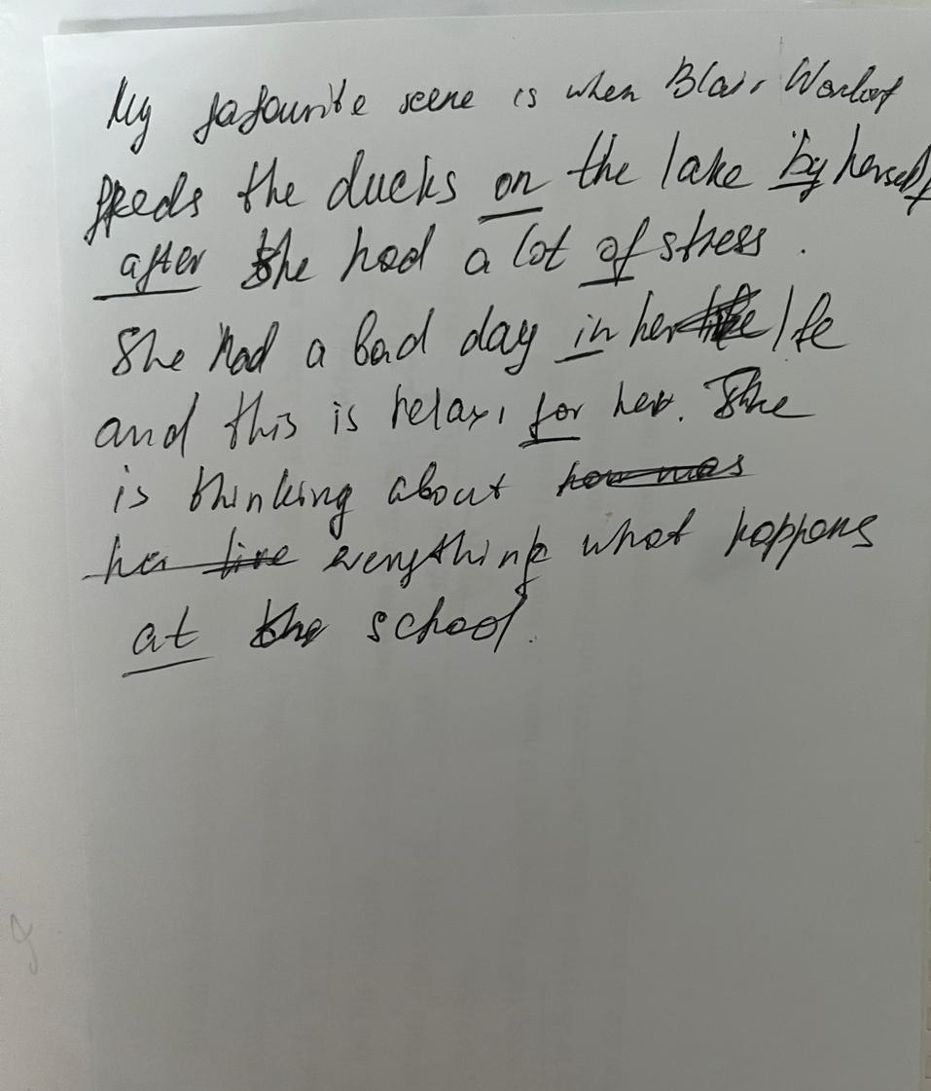
Scene – Blair feeds the ducks

Slide 14

Present Your Paragraph

