Slide 1
The Science of Biology
By teacher Vicky
“Science is a way of thinking much more than it is a body of knowledge.”
- Louis Pasteur
Notes:
Template: Cordelia by SlidesCarnival.com

Slide 2
Biology is the scientific study of life.
All living organisms share a set of properties:
Order
An hierarchy of coordinated structures: cells, tissues organs, organ systems.
Response to Stimuli
Alter growth or behavior based on environmental conditions.
Reproduction
Passing genes to healthy, fertile offspring.
Adaptation
Traits that maximize success in an environment.

Slide 3
Biology is the scientific study of life.
All living organisms share a set of properties:
Homeostasis
Stable internal environment inside cells and organisms.
Temperature, pH, electrolytes, etc.
Energy Processing
Gather energy from the environment for metabolic activities.
Sunlight or consuming other organisms.
Growth and Development
Develop in a planned sequence, eventually becoming physically similar to parents.
Evolution
Change in the gene pool of a population over time.

Slide 4
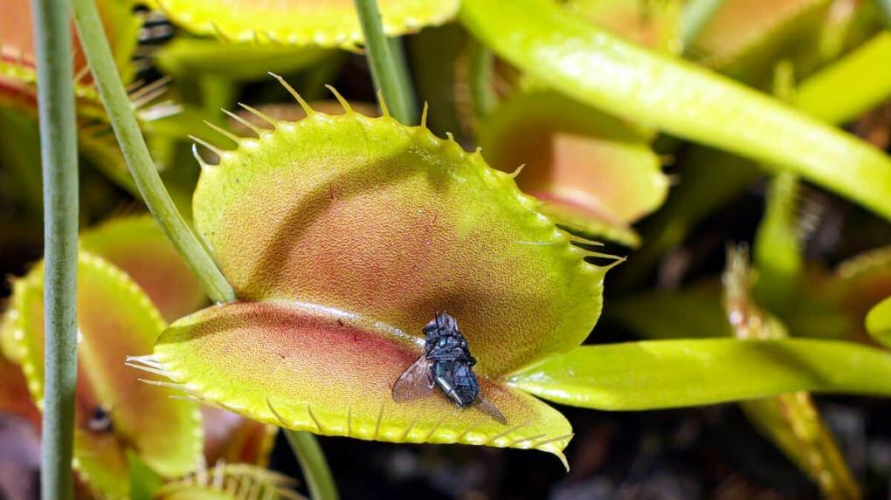
What characteristic(s) of life is/are demonstrated here?

Slide 5
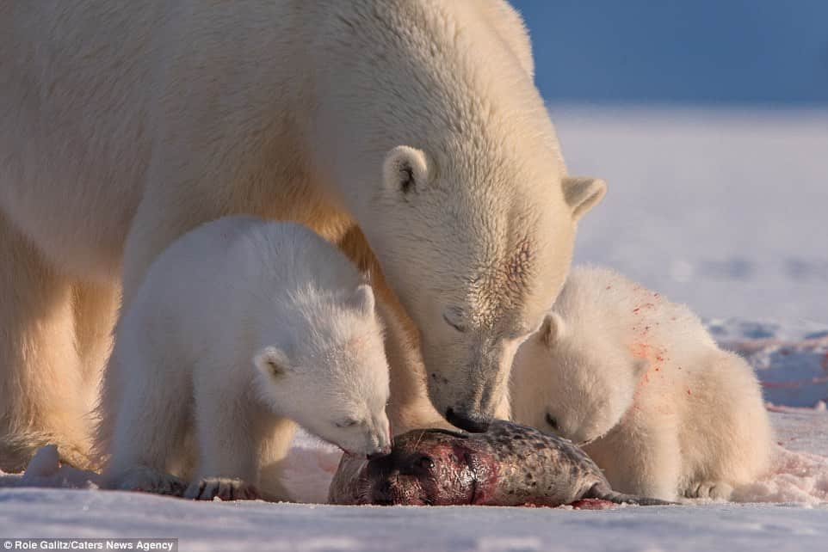
What characteristic(s) of life is/are demonstrated here?

Slide 6
1.
Organization of Life
Biosphere to cells.

Slide 7
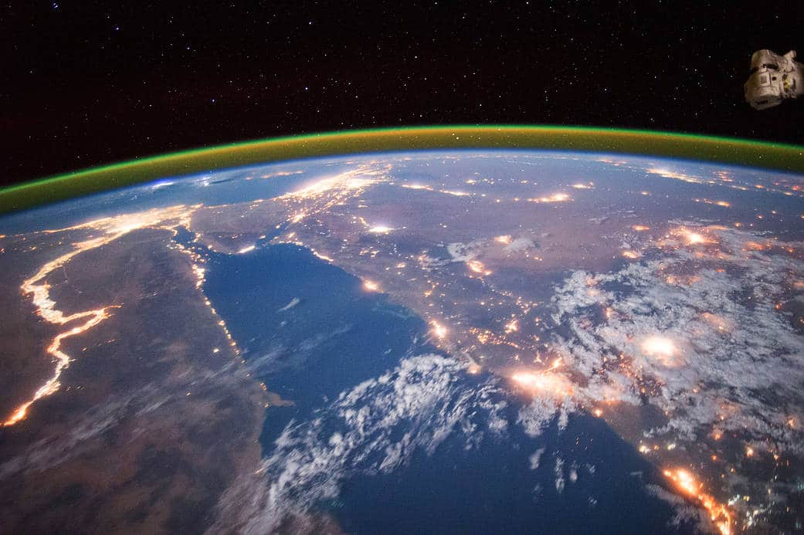
The biosphere includes all parts of the Earth – surface, atmosphere, and oceans, occupied by life.

Slide 8
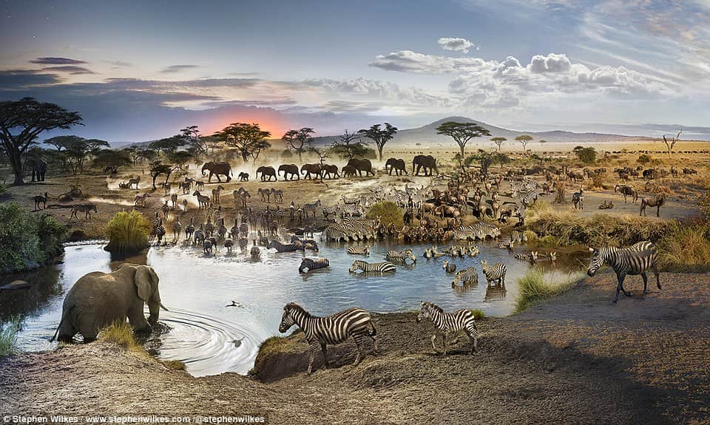
The ecosystem includes the biological community and surrounding physical environment.

Slide 9
The biological community is made of all the populations living and interacting in one area.

Slide 10
A population includes all members of a species that live in the same area at the same time.

Slide 11
An organism is an individual life form.
Notes:
This is actually a composite of 50 photographs taken by Stephen Wilkes at the Serengeti National Park in Tanzania.

Slide 12
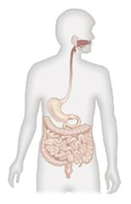
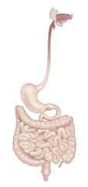
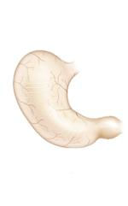
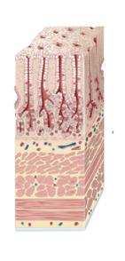

Organism
Individual life form.
Organ System
Group of organs that work together to perform a task.
Organ
A self-contained structure with a vital function.
Tissue
A group of cells that work together.
Cell
Smallest unit that can perform all the functions of life.

Slide 13
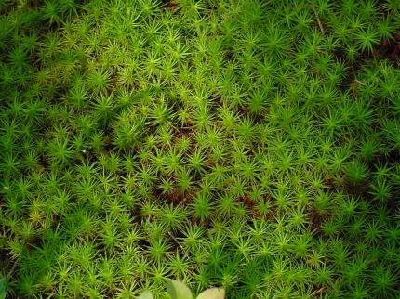
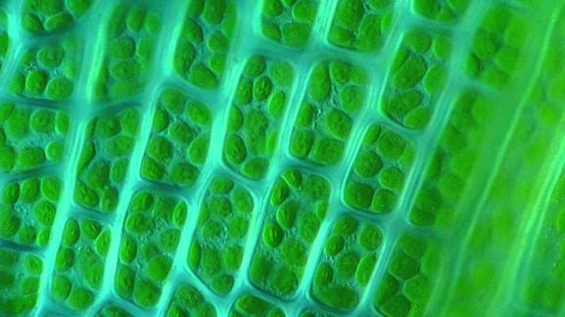
What levels of organization are shown in these pictures?

Slide 14
2.
Scientific Method
Process of gathering evidence to answer questions about the world.

Slide 15
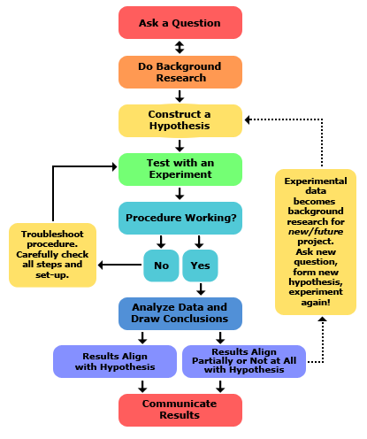
Scientific Method
The scientific method is the sequence of steps that scientists follow, when attempting to answer a question or explain an observation.
  Has been used for some of the most famous discoveries.

Slide 16
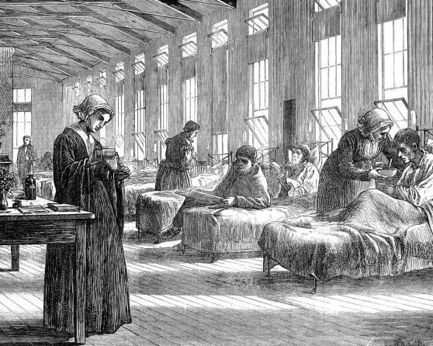
Discovery of the First Vaccine
Smallpox was a deadly, contagious disease with a 30% fatality rate.
The disease is now eradicated, thanks to a doctor who employed the scientific method.

Slide 17
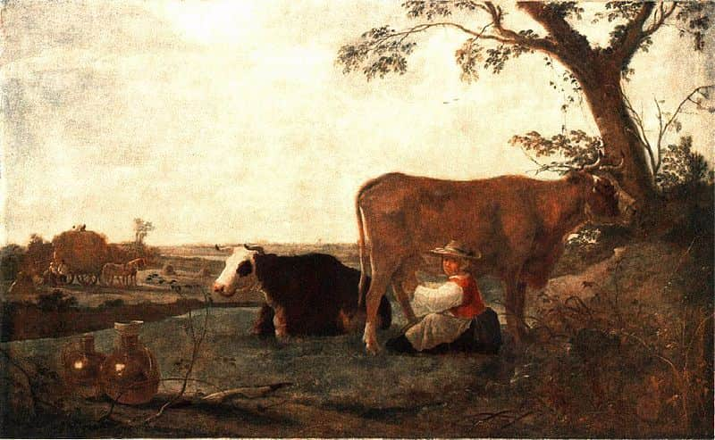
An observation is the act of viewing or noting a detail, fact, or occurrence.
  Dr. Jenner observed that dairymaids who caught cowpox seemed to be protected from smallpox.

Slide 18
A hypothesis is a testable explanation or prediction based on the observation and the scientist’s prior knowledge.
  Preliminary – may be supported or rejected.
Dr. Jenner’s hypothesis:
if a person was exposed to cowpox , they would become immune to smallpox.

Slide 19
An experiment tests the hypothesis under controlled conditions, with defined variables:
Independent Variable
New factor that is to be introduced and tested.
Dependent Variable
The measured result that is influenced by the independent variable.
Controlled Variables
Kept constant so they do not influence the dependent variable.
Dr. Jenner inoculated an 8-year old child with cowpox, then, weeks later, smallpox.

Slide 20
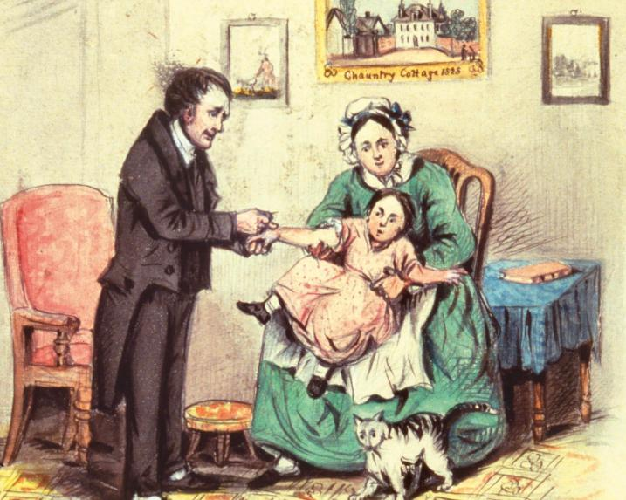
Independent variable:
The vaccine
Dependent variable:
Vulnerable or immune to smallpox
Constants:
Only unexposed children used

Slide 21
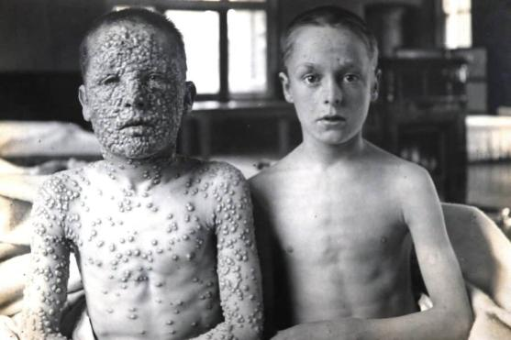
Many experiments use two or more groups for comparison.
The control group does not receive the independent variable.
The experimental group receives the independent variable.

Slide 22
Data includes all of the measurements and observations made during the experiment.
  The boy was inoculated 20 times with smallpox without catching it!
The conclusion states whether the hypothesis is supported by the experiment.
  Jenner concluded his hypothesis was supported.

Slide 23
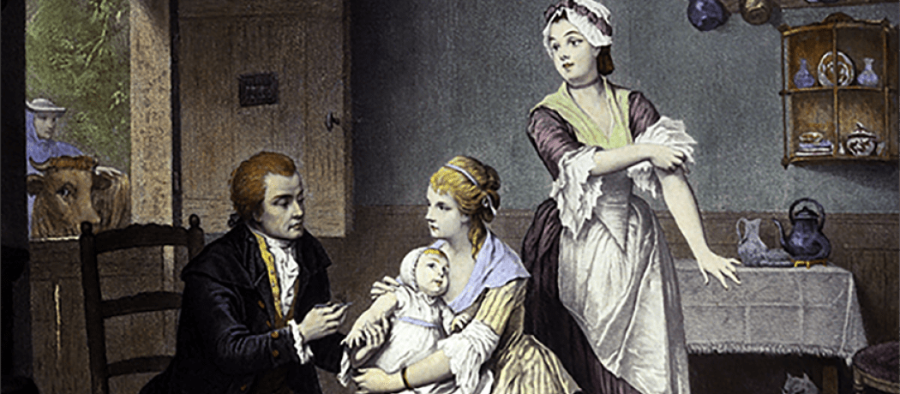
Peer review involves publishing the results for other scientists to review and check for error, bias, or uncontrolled variables.
  Dr. Jenner submitted his study to the Royal Society for Medicine, but was told he needed more proof.

Slide 24
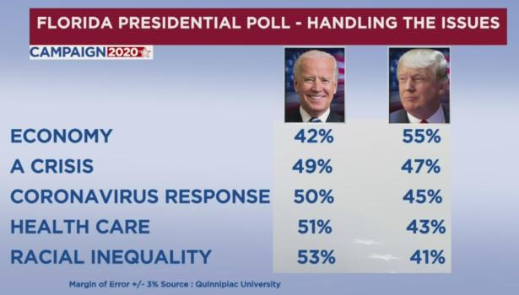
Margin of error is an estimate of how different a result is from the actual value.
  All experiments have errors in measurement, design, or other factors.
Margin of error can
be reduced by
increasing the
sample size, or
number of
observations used
in an experiment or
study.
A 3% margin of error correlates with about a 1000-person sample size.

Slide 25
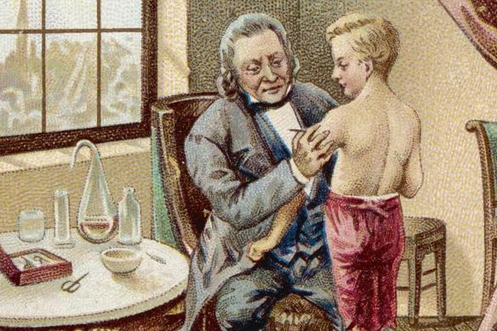
Dr. Jenner was able to locate several other parents who were willing to volunteer their children.
The results were finally published. Jenner called his technique vaccination after the Latin word for cow “vacca”.

Slide 26
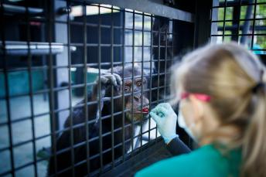
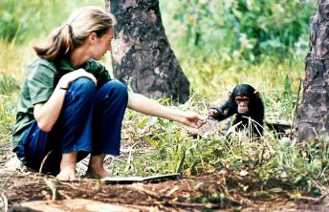
Experimental Design
Controlled
Take place in labs or artificial environments.
Pro: Allow for full control of all variables.
Con: Some environments are difficult or impossible to recreate or simulate.
Natural
Take place in the real-world without manipulation.
Pro: Environment is more accurate and realistic.
Con: Some natural phenomena are hard to find.

Slide 27
Bias
Bias is the preference for an experiment to turn out in a certain way.
  Bias can be caused by a desire for fame, money, or simply protecting your job.
Blind experiments reduce bias by ensuring the test subjects do not know whether they in the experimental or control group.
  Eliminates the placebo effect.
Double-blind experiments prevent both scientists and subjects from knowing which is the experimental group.

Slide 28
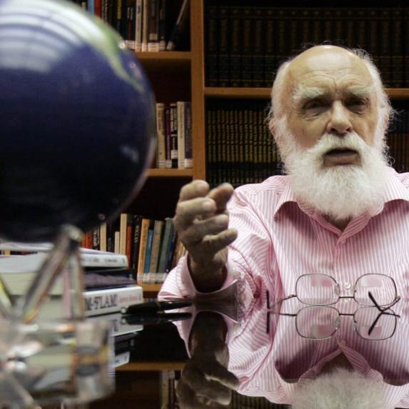
Watch this experiment from Secrets of the Psychics and identify the following:
  Dependent and independent variables.
  Control and experimental groups.
  Sample size.
  Probability of success due to random chance.

Slide 29

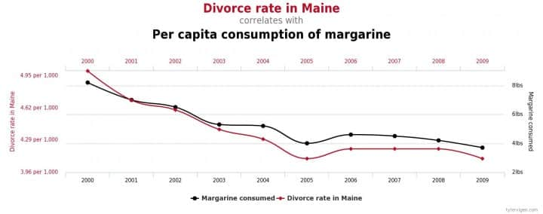
Correlation and Causation
Correlation is observed when there is are statistical variables have a relationship that not be expected by chance alone.
Correlation suggests, but does not always mean causation, which occurs when one variable directly influences the other.

Slide 30

Pseudoscience
“False science”
Appears or claims to be scientific, but does not follow scientific practices.

Slide 31
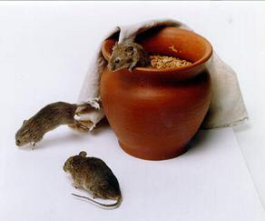
Historical Pseudoscience
Spontaneous generation proposed
that life can arise from non-living matter,
based on observations such as:
  Beetles will appear in piles of animal dung.
  Maggots will grow out of rotting meat.
  Mice will generate from jars containing
  dirty garments and husks of wheat.
  Fleas will arise from dust.
Considered pseudoscience because…
  No formal experimental evidence.
  No alternative hypotheses considered or tested.

Slide 32
3.
Fields of Biological Study
Branches and disciplines of biology.

Slide 33
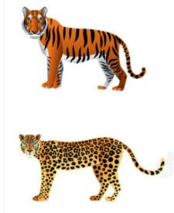
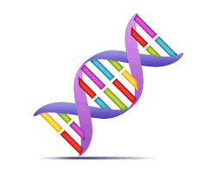
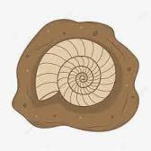
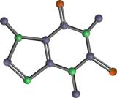
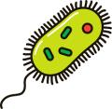
Biochemistry
Life at the molecular level.
Microbiology
Structure and function of single-celled organisms.
Paleontology
Study of fossils and evolutionary history.
Genetics
Patterns of heredity.
Taxonomy
Classification of organisms based on DNA and traits.

