Slide 1
CIE Maths
Igcse exams (0580)
All about the papers

Slide 2
Contents
Differences between core and extended
COre (aiming grade G-c)
Extended (aiming grade D-A*)
IMPORTance (calculators, answer formats, value of π
Tips for preparation

Slide 3
Core papers
All papers require a Scientific calculator (models as allowed)
Answer with
-three significant figures for numbers
- 1 decimal place for angle
π value is 3.142

Slide 4
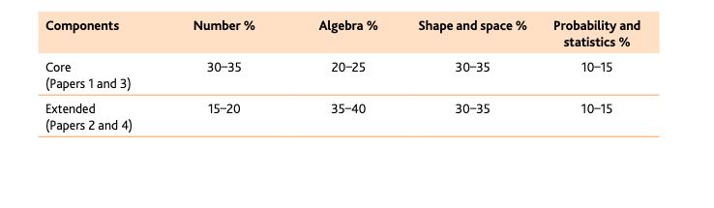
About the Core exam content
COre (aiming grade G-c)
Paper 1 (1 hr) and Paper 3 (2 hr)

Slide 5
CORE PAper 1 ( 1Hr) 35% of total GRADE
56 marks
Short-answer questions
Externally assessed

Slide 6
CORE PAper 3 ( 2 Hr) 65% of total GRADE
104 marks
Structured questions
Externally assessed

Slide 7
extended papers
All papers require a Scientific calculator (models as allowed)
Answer with
-three significant figures for numbers
- 1 decimal place for angle
π value is 3.142

Slide 8
About the Extended exam content
Extended (aiming grade D-A*)
Paper 2 (1:30 hr) and Paper 4 (2:30 hr)

Slide 9
Extended PAPER 2 (1:30 hr) 35% of total grade
70 marks
Short-answer questions
Externally assessed

Slide 10
Extended PAPER 4 (2:30 hr) 65% of total grade
130 marks
Structured questions
Externally assessed

Slide 11
2. Important
All papers require a Scientific calculator (models as allowed)
Answer with
-three significant figures for numbers
- 1 decimal place for angle
π value is 3.142

Slide 12
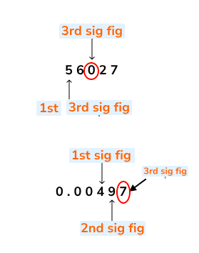
What does 3 significant figures mean?
Significant figures are the digits in a number that contribute to the accuracy of it.
We start counting significant figures at the first non-zero digit of a number

Slide 13
3. TIPS
1. revise how to solve the questions (find where you tend to make mistakes, note down formulae, make a list of essential things to memorise)
2. Practice past papers (timed) Is Essential
3. Utilize Your Mock Exam

