Slide 1

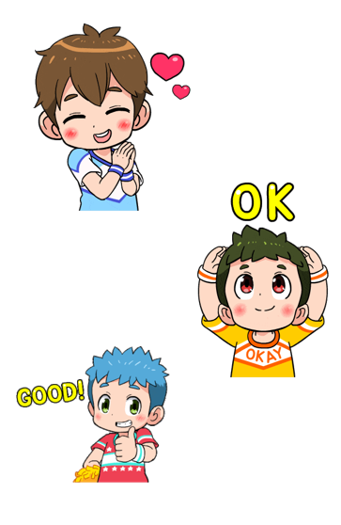
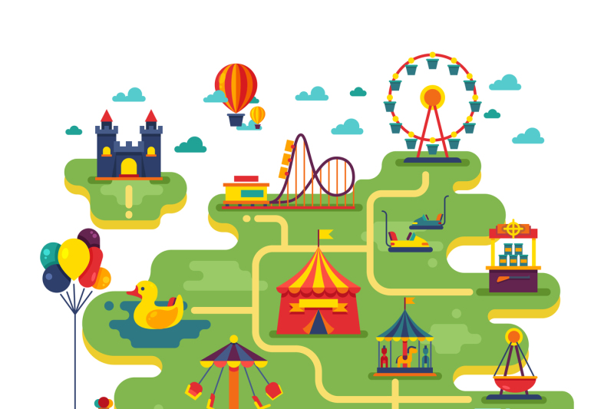
Let’s go to amusement park

Slide 2
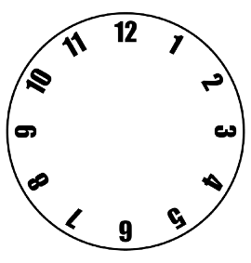
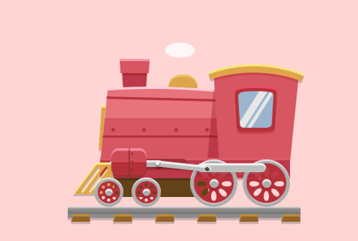
The friends are two hours away from the park, If they want to reach the amusement park at 8:00 in the morning. What time should they leave the station?

Slide 3
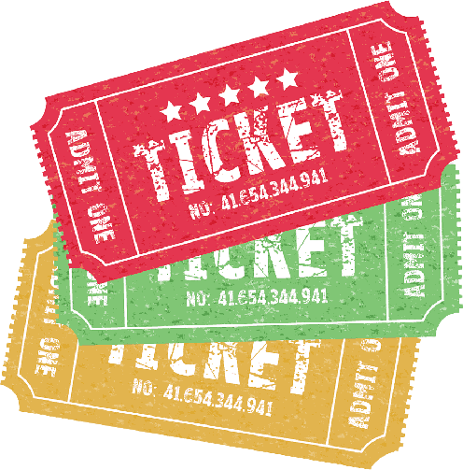
The driver said that they need to pay 15 baht to have a ride. How much do they need to pay?
If they have 100 baht, how much is their change?
The friends are two hours away from the park, If they want to reach the amusement park at 8:00 in the morning. What time should they leave the station?

Slide 4

The operator said that one cabin can only have 2 person. How many cabins do they need?
They also need to pay 5 baht for 1 rotation. How much do they all need to pay for 1 rotation?
How about if they will ride for 2 rotations?

Slide 5

The operator said that one ride is only for 10 minutes. What time will they end if they start at 8:30?

Slide 6
If one ride is 10 baht per person, how much do they need to pay?

Slide 7
How about if they want to ride it 3 times, how much do they need to pay?

Slide 8
How much is their exchange if they have 200 baht?

Slide 9
Welcome to the amusement park

Slide 10
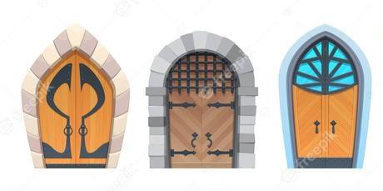

Slide 11
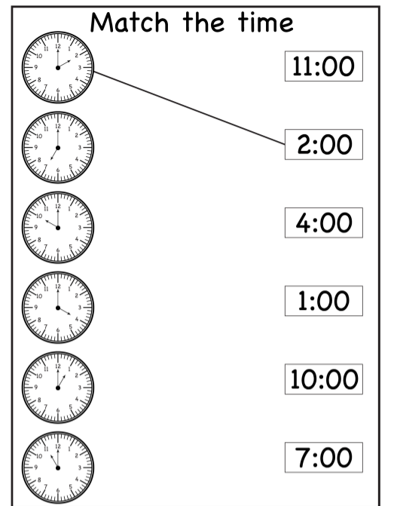
Match my time

Slide 13
What is my missing letter?
F i _ s t
F _ _ r t h
S _ c o n d
F _ f _ h
T h _ r d
S _ _ t h

Slide 15
Who am I?
I have 2 digits. My first digit is between 3 and 5. My second digit is equal to the sum of 3 and 5.
I have 2 digits. The product of my digits is 12. My first digit is 4.
I have 2 digits. The difference of my digits is 1. The product of my digits is 6.

Slide 16
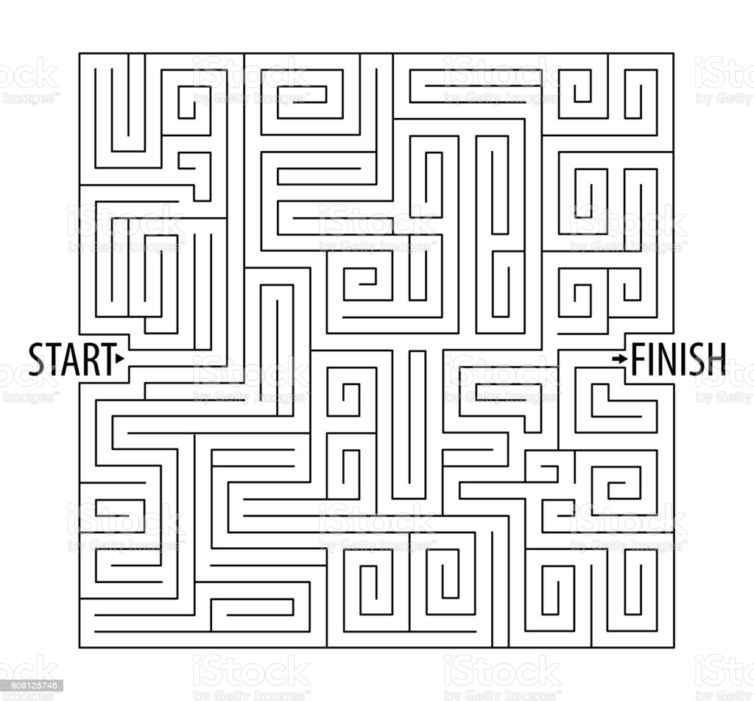



Slide 17
Welcome to the amusement park

Slide 18
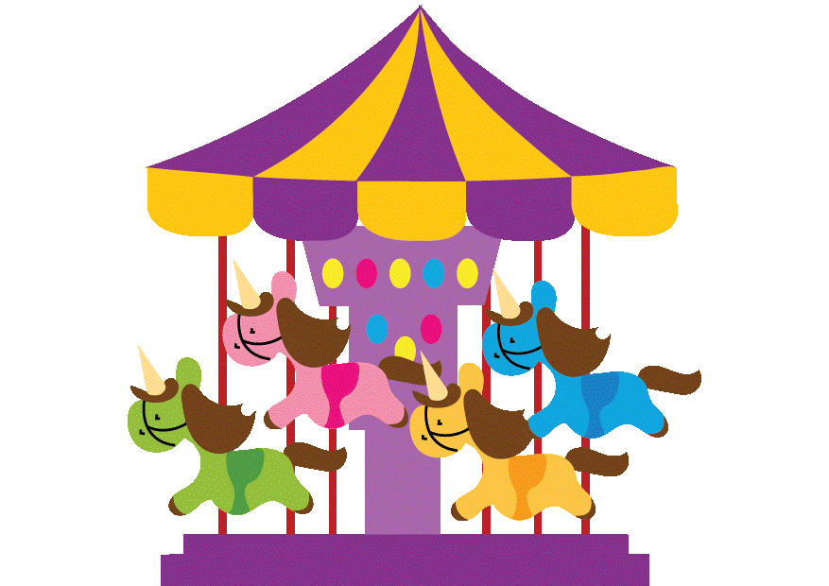

The operator said that you need to pay 25 Baht every person. How much do they all need to pay?
The operator said that a ride will take 45 minutes. How many minutes will they have for 3 rides?
How much they will have to pay for 3 rides?

Slide 19
