Slide 1
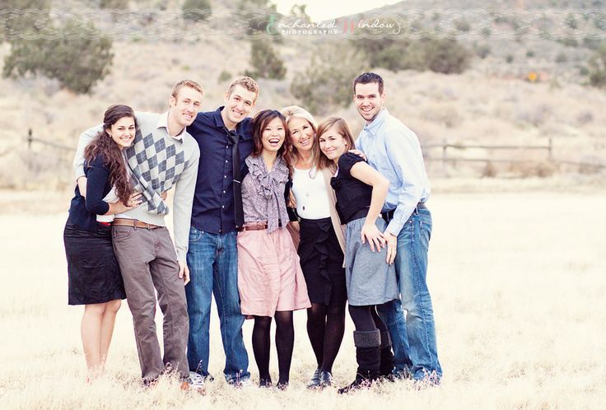
Giving Basic Information About Ourselves

Slide 2

Introducing ourselves
Complete the sentence about you
My name is Pingla.
I am 47 years old.
I am from South Africa
My birthday is on November 24th .
  My name is ________.
  I am _______ years old.
  I am from __________ (Country).
  My birthday is on __________ (month and date).

Slide 3
Let’s Practice!
Match to complete the sentence.
Where do you ___________ ?.
What do you_______ ?.
Do you _________ any pets?
Do you__________ any other languages?
What kind of music do you_________to?
listen
live
speak
do
have

Slide 4
More Practice!
1. Which sentence is correct?
  a) My Joe is name.
  b) My name Joe is.
  c) My name is Joe.
2. Which sentence is incorrect?
  a) I am from Kenya.
  b) I from Malaysia.
  c) I live in India.
3. Which sentence is correct?
  a) I 28 years old.
  b) I am 28 old.
  c) I am 28 years old.
4. Which sentence is incorrect?
  a) My birthday is June 3rd.
  b) My birthday is on June 3rd.
  c) My birthday is on July 7th.

Slide 5

Giving more information
My name is West.
I live in the United States of America.
My favorite colour is blue.
I have one brother and two sisters.
My favorite sport is Volleyball.

Slide 6
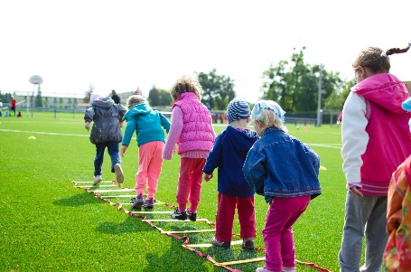
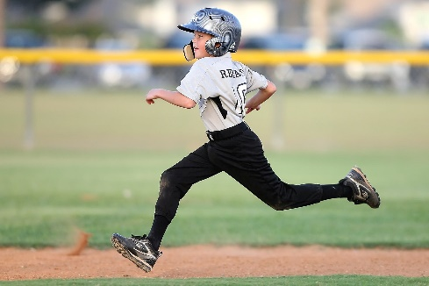
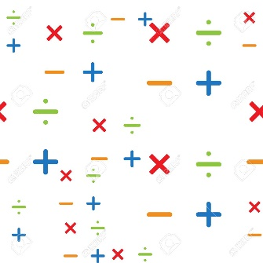
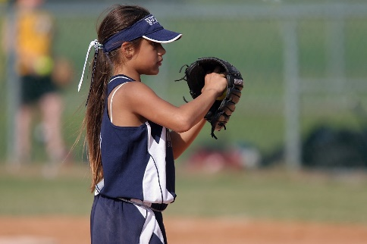
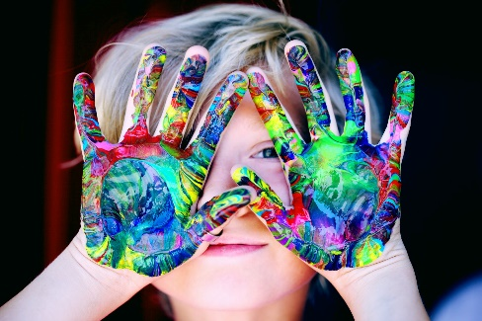

Your Turn!
I live in ______.
My favorite colour is _______.
I have _______ sister(s)/brother(s).
My favorite sport is _____________.

Slide 7
Read the text and answer the questions.
Choose the correct answer.
1. Joe is from __________
  Spain
  England
  America
2. Joe is ___ years old.
  19
  8
  9
3. Joe’s favorite color is _____
  Red
  Green
  Blue
4. Joe’s favorite sport is ______
  Soccer
  Volleyball
  Tennis
5. Joe’s favorite subject is ______
  English
  Math
  Science
My name is Joe and I am from England. I have two sisters and one brother. I am 9 years old. I was born on April 3rd.
My favorite colour is red and I have a lot of red t-shirts. I also like playing sports. My favorite sport is soccer and I love playing with my friends but my mom only lets me play after I finish doing my homework. Science is the easiest homework for me because it’s my favorite subject but I don’t like Math very much.

Slide 8
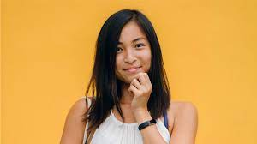
Answer her questions:
Hello! My name is Liz.
What’s your name?
_______________________________
How old are you?
_______________________________
Where are you from?
_______________________________
When is your Birthday?
_______________________________
What is your favorite colour?
______________________________
What is your favorite sport?
______________________________
How many brothers and sisters do you have?
_____________________________
What is your favorite clothes?
_____________________________

