Slide 1

Fruit Salad
Furnished
Enthusiastic
Tribute
Aspire
Anorak

Slide 2
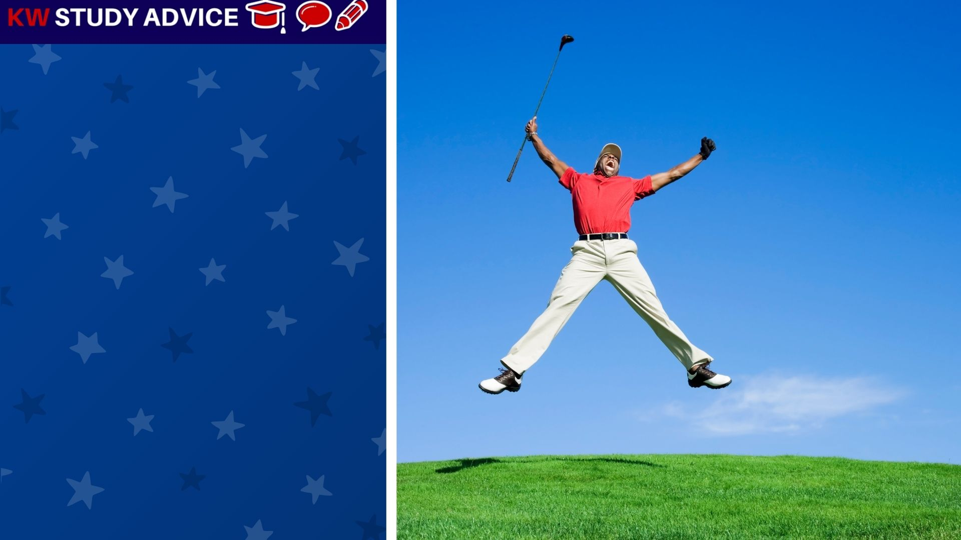
Enthusiastic
This is when someone shows a lot of excitement about an activity. They tend to work hard and enjoy the activity.
The man was very enthusiastic about playing golf. As soon as he got onto the golf course he was jumping and dancing around.

Slide 3
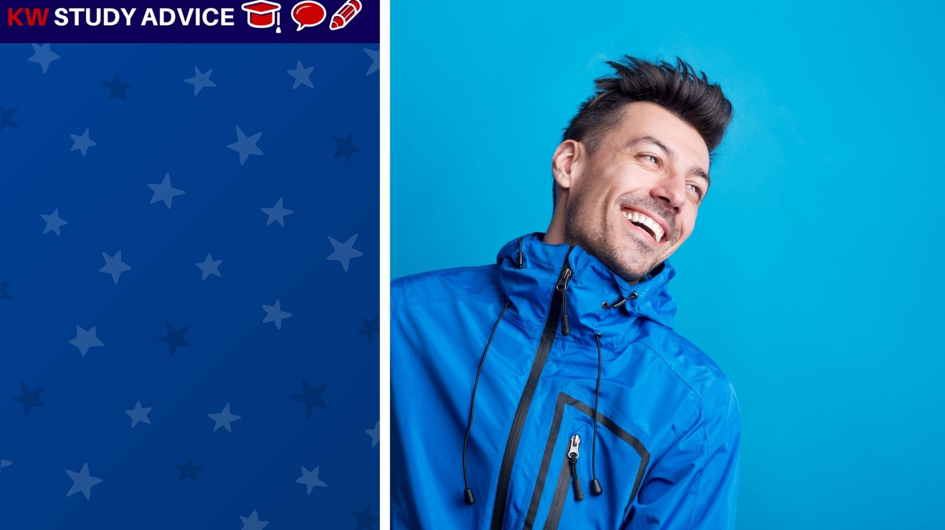
Anorak
A jacket which is waterproof and often comes with a hood. They are worn in the rain when temperatures are not low.
The man had to walk out to the shops. He saw that it was going to rain, but wasn’t cold. He decided to wear his anorak.

Slide 4
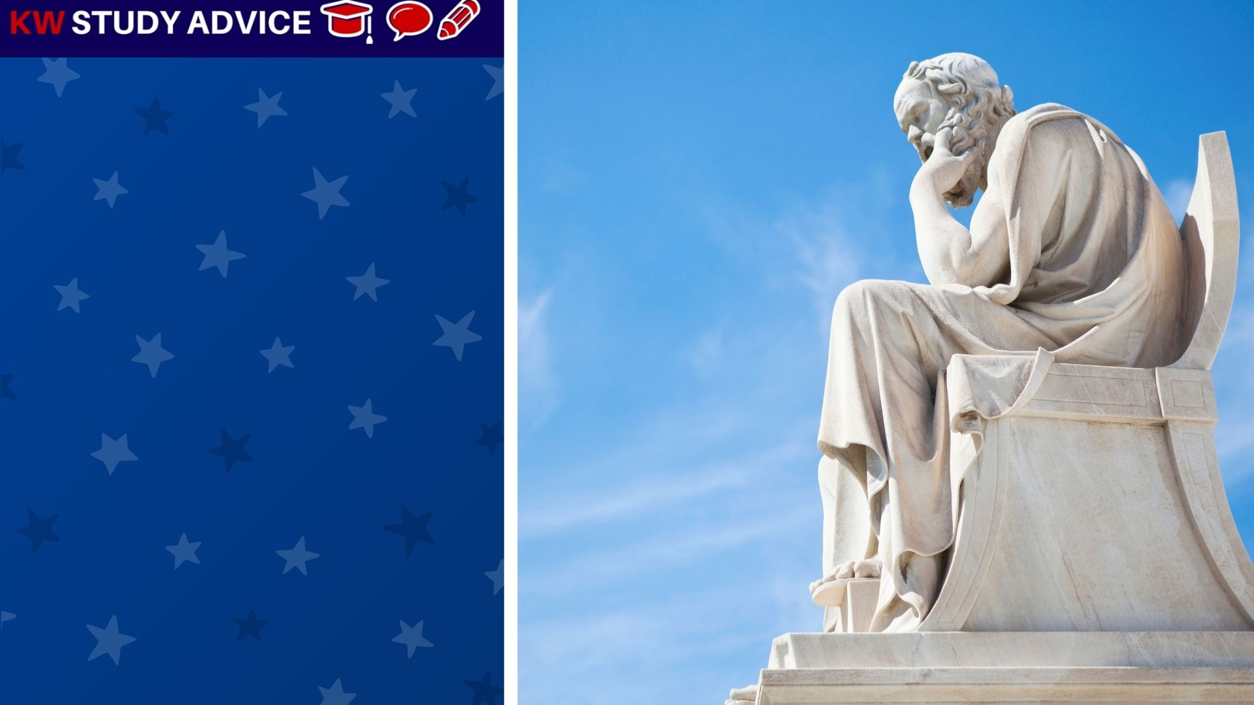
Tribute
A thing that helps us to remember and pay our respects to someone or something. They may be living or have passes away.
The city put up a new statue to help the public pay tribute to one of the most famous people. Many people visited the statue.

Slide 5
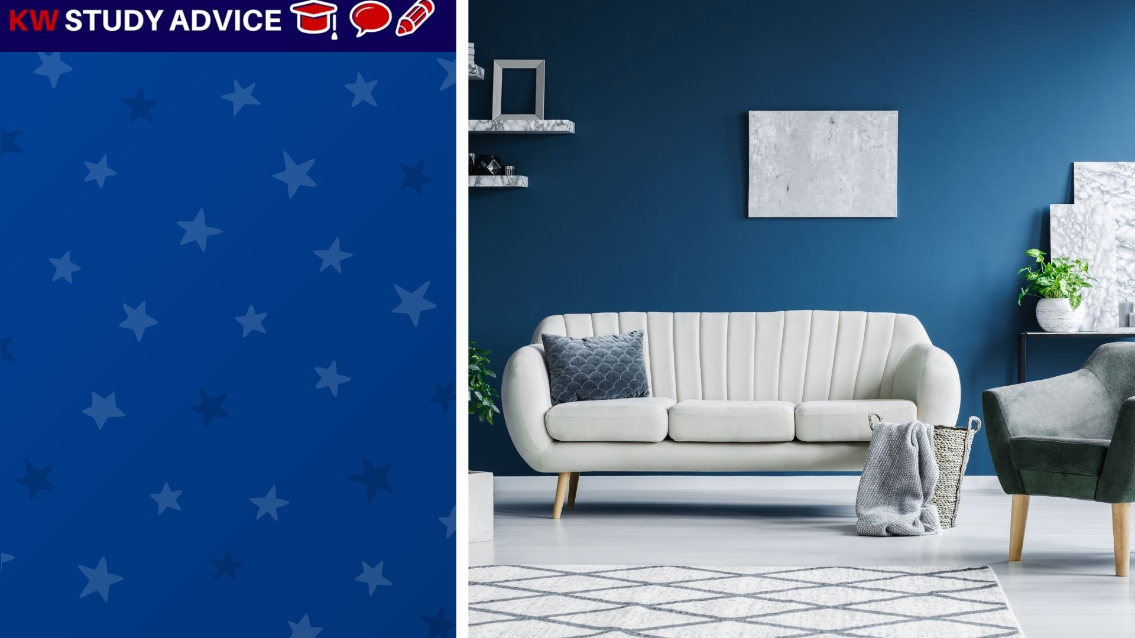
Furnished
An accommodation which is rented and has the furniture left behind by the previous tenant for the next one.
The family were delighted that their new apartment was going to be furnished. They saw the photos and thought it looked nice.

Slide 6
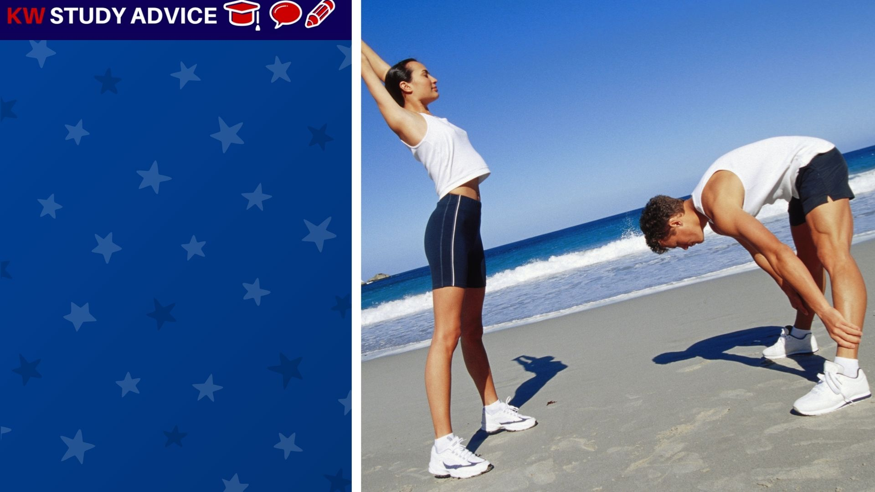
Aspire
When people work hard in order to achieve something very special. Those who work hard often achieve their goals.
The couple aspired to run a marathon in the autumn, therefore they had to start training in early summer in order to be fit enough.

Slide 7
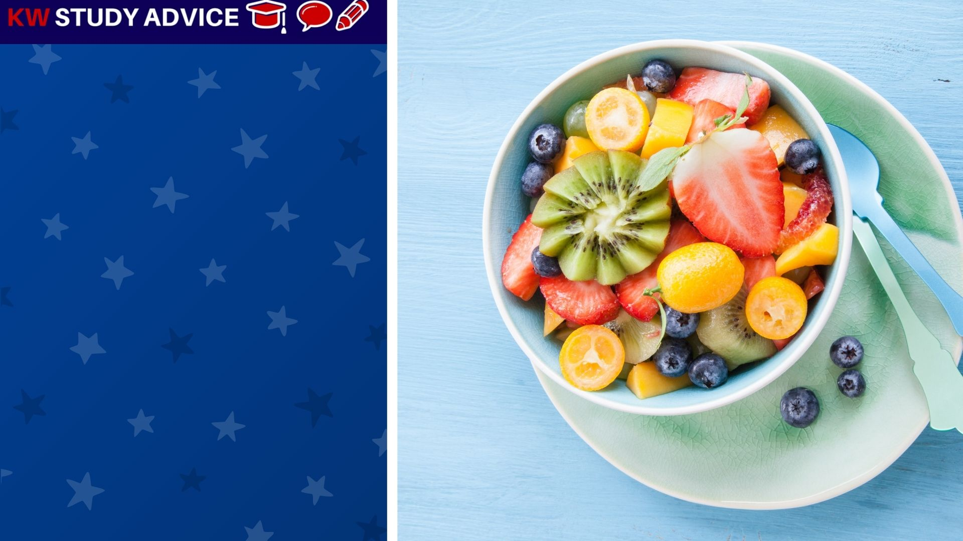
Fruit Salad
This is a bowl of mixed, chopped fruits which are served in juice or syrup. This is delicious all year round, especially summer.
The woman loved fruit so she decided to make a big fruit salad. She had plenty left so she gave fruit salad to all her friends to eat.

Slide 8


