Slide 1
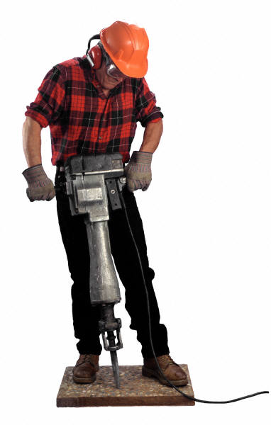
Holland Career Interest Areas
RIASEC model
REALISTIC INVESTIGATIVE
ARTISTIC SOCIAL
ENTERPRISING CONVENTIONAL

Slide 2
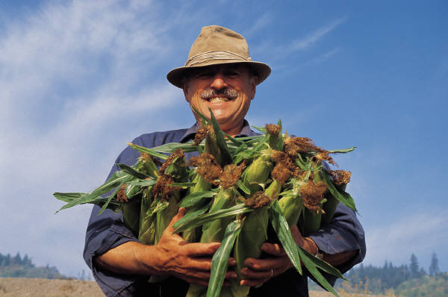
REALISTIC
People who have athletic or mechanical ability, prefer to work with objects, machines, tools, plants or animals, or to be outdoors.

Slide 3
REALISTIC : The "Do-ers"
ARE YOU:
Practical, athletic,
straightforward/frank,
mechanically inclined,
a nature lover, thrifty,
curious about the physical world, stable, concrete, reserved, self-controlled,inde- pendent, ambitious,
systematic, persistent
CAN YOU:
Fix electrical things
solve electrical problems
pitch a tent
play a sport
read a blueprint
plant a garden
operate tools and machinery

Slide 4
REALISTIC : The "Do-ers"
LIKE TO:
Tinker with machines/vehicles
work outdoors
use your hands
be physically active
build things
tend/train animals
work on electronic equipment
HOBBIES:
Refinishing furniture
Growing plants/flowers
Playing sports, hunting, fishing, Woodworking,
Coaching team sports,
Building models,
Repairing cars, equipment,
Target shooting, Landscaping
Taking exercise classes

Slide 5
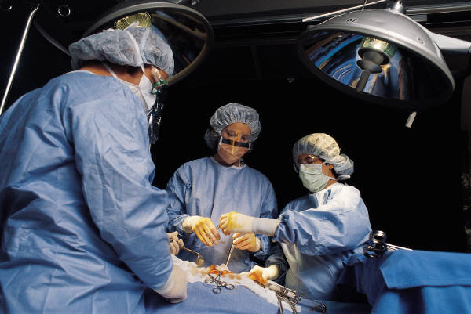
INVESTIGATIVE
People who like to observe, learn, investigate, analyze, evaluate or solve problems.

Slide 6
INVESTIGATIVE : The "Thinkers"
ARE YOU:
Inquisitive, analytical,
scientific, observant,
precise, scholarly,
cautious, intellectually self-confident,
introspective, reserved,
broad-minded,
independent, logical,
complex,
curious
CAN YOU:
Think abstractly
solve math problems
understand scientific theories
do complex calculations
use a microscope or computer
interpret formulas

Slide 7
INVESTIGATIVE : The "Thinkers"
LIKE TO:
Explore a variety of ideas
use computers
work independently
perform lab experiments
read scientific or technical journals
analyze data
deal with abstractions
do research
be challenged
HOBBIES:
Book club
Astronomy
Crossword puzzles/board games
Preservation of endangered species
Computers
Visiting museums
Collecting rocks, stamps, coins, etc.
Amateur Radio
Recreational flying

Slide 8

ARTISTIC
People who have artistic, innovating or intuitional abilities and like to work in unstructured situations using their imagination and creativity.

Slide 9
ARTISTIC :The "Creators"
ARE YOU:
Creative, intuitive,
imaginative, innovative,
unconventional,
emotional, independent,
expressive, original,
introspective,
impulsive, sensitive,
courageous, open,
complicated,
idealistic,
nonconforming
CAN YOU:
Sketch, draw, paint
play a musical instrument
write stories, poetry, music
sing, act, dance
design fashions or interiors

Slide 10
ARTISTIC :The "Creators"
LIKE TO:
Attend concerts, theatres, art exhibits
read fiction, plays, and poetry
work on crafts
take photographs
express yourself creatively
deal with ambiguous ideas
HOBBIES:
Photography, Performing,
Writing stories, poems, etc.
Desktop publishing
Sewing
Taking dance lessons
Visiting art museums
Designing sets for plays
Travel
Playing a musical instrument
Homemade crafts
Painting
Speaking foreign languages

Slide 11
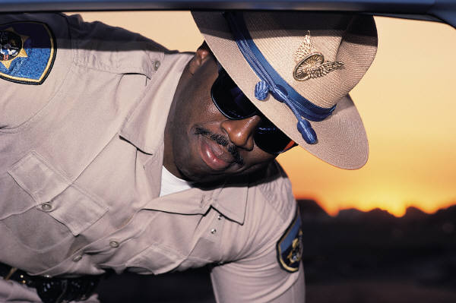
SOCIAL
People who like to work with people to enlighten, inform, help, train, or cure them, or are skilled with words.

Slide 12
SOCIAL: The "Helpers"
ARE YOU:
Friendly, helpful,
idealistic, insightful,
outgoing, understanding,
cooperative, generous,
responsible, forgiving,
patient, empathic,
kind, persuasive
CAN YOU:
Teach/train others
express yourself clearly
lead a group discussion
mediate disputes
plan and supervise an activity
cooperate well with others

Slide 13
SOCIAL: The "Helpers"
LIKE TO:
Work in groups
help people with problems
participate in meetings
do volunteer work
work with young people
play team sports
serve others
HOBBIES:
Volunteering with social action groups
Writing letters
Joining campus or community organizations
Helping others with personal concerns
Meeting new friends
Attending sporting events
Caring for children
Religious activities
Going to parties
Playing team sports

Slide 14
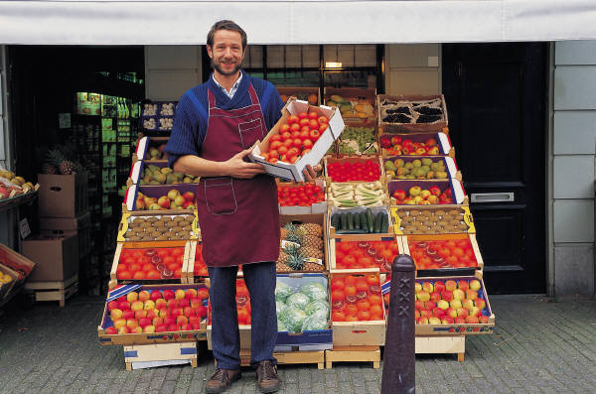
ENTERPRISING
People who like to work with people, influencing, persuading, performing, leading or managing for organizational goals or economic gain.

Slide 15
ENTERPRISING: The "Persuaders"
ARE YOU:
Self-confident, assertive,
sociable, persuasive,
enthusiastic, energetic,
adventurous, popular,
impulsive, ambitious,
inquisitive, agreeable,
talkative, extroverted,
spontaneous, optimistic
CAN YOU:
Initiate projects
convince people to do things your way
sell things or promote ideas
give talks or speeches
organize activities
lead a group
persuade others

Slide 16
ENTERPRISING: The "Persuaders"
LIKE TO:
Make decisions affecting others
be elected to office
win a leadership or sales award
start your own service or business
campaign politically
meet important people
have power or status
HOBBIES:
Discussing Politics
Reading Business Journals
Watching the Stock Market
Attending Meetings and Conferences
Selling Products
Leading Campus of Community Organizations
Operating a Home Business

Slide 17
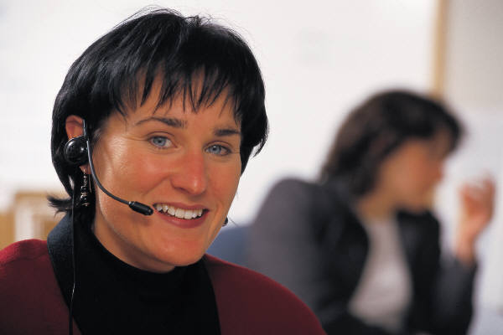
CONVENTIONAL
People who like to work with data, have clerical or numerical ability, carry out tasks in detail or follow through on others' instructions.

Slide 18
CONVENTIONAL: The "Organizers"
ARE YOU:
Well-organized, accurate,
numerically inclined,
methodical, conscientious,
efficient, conforming,
orderly, practical,
thrifty, systematic,
structured, polite,
ambitious, obedient,
persistent
CAN YOU:
Work well within a system
do a lot of paper work in a short time
keep accurate records
use a computer terminal
write effective business letters

Slide 19
CONVENTIONAL: The "Organizers"
LIKE TO:
Follow clearly defined procedures
use data processing equipment
work with numbers
type or take shorthand
be responsible for details
collect or organize things
HOBBIES:
Collecting memorabilia
Arranging and organizing household or workshop, etc.
Playing computer or card games
Collecting any related objects
Keeping club or family records and files
Reading home magazines
Studying tax laws
Practicing Clutter's Last Stand
Writing family history

