Slide 1

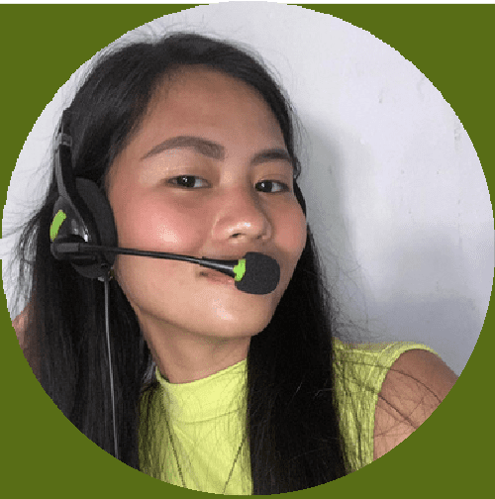
WELCOME TO OUR
ENGLISH CLASS
Presented by: Teacher Alea
Learn_With_Teacher_Alea | 2025
Teacher Alea
ARE YOU READY?

Slide 2
Everyday English Conversations:
Presented by: Teacher Alea
Learn_With_Teacher_Alea | 2025
Speak Naturally and Confidently in Real Situations
UNIT
1
LESSON 1
NEXT

Slide 3
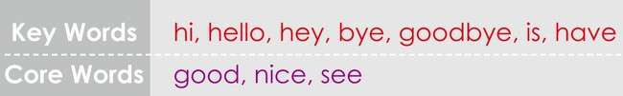


YOU SHOULD LEARN:

Slide 4

ENGLISH GREETINGS
you will say greetings;
say greetings correctly for morning, afternoon, and evening;
say more greetings.

Slide 5


Presented by: Teacher Alea Learn_With_Teacher_Alea | 2025
WWAARRMM--UUPP AACCTTIIVVIITTYY
ARE YOU READY?

Slide 6
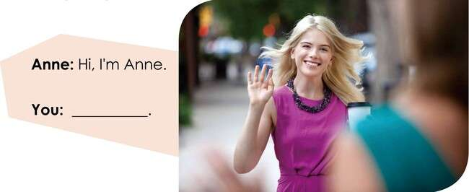
WARM-UP
What can you say to Anne?

Slide 7

WARM-UP
Look at the pictures. Choose the correct titles for each name
Ms.
Mrs.
Mr.

Slide 8
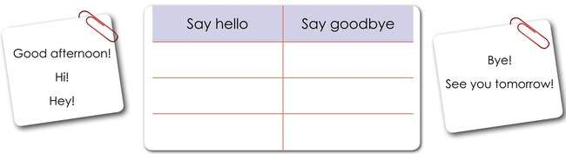
WARM-UP
Write the greetings in the correct table.

Slide 9
Presented by: Teacher Alea
Learn_With_Teacher_Alea | 2025
LLEETT’’SS TTAALLKK
ARE YOU READY?

Slide 10
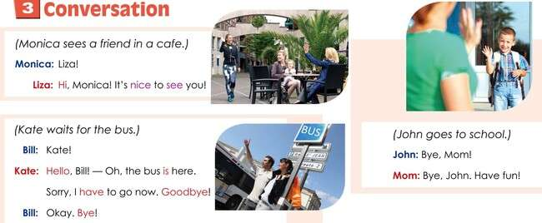
REAL LIFE CONVERSATIONS

Slide 11
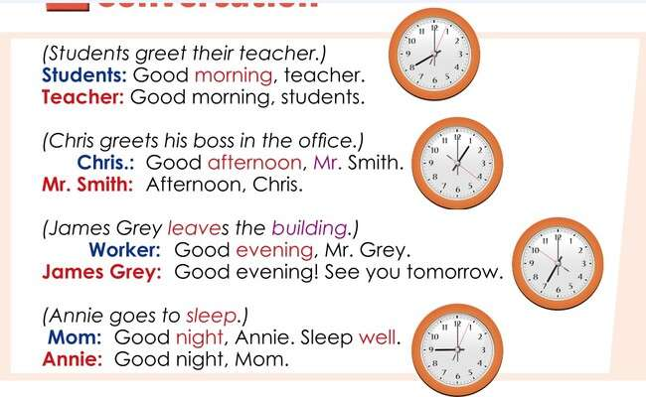
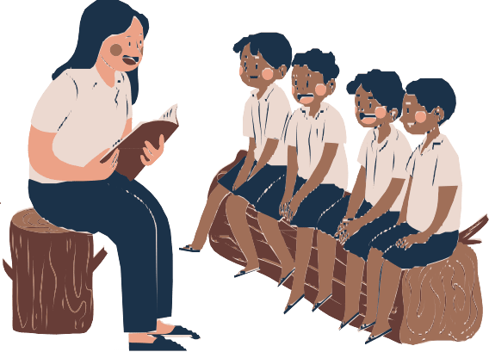
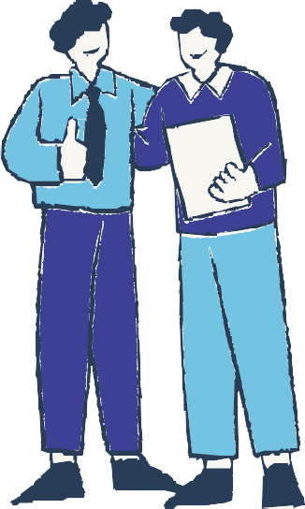
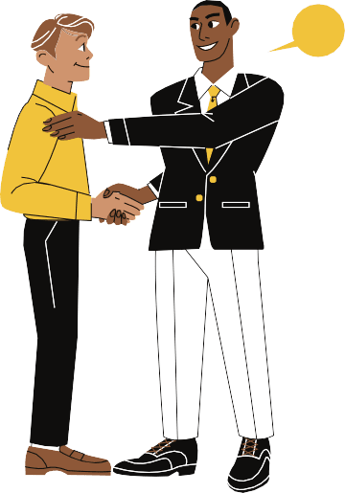
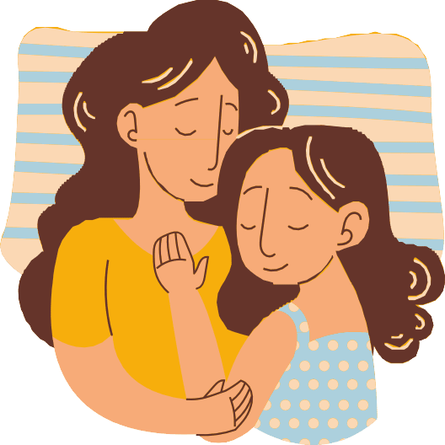
REAL LIFE CONVERSATIONS

Slide 12
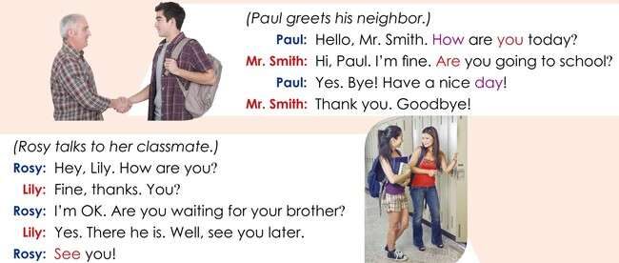
REAL LIFE CONVERSATIONS

Slide 13
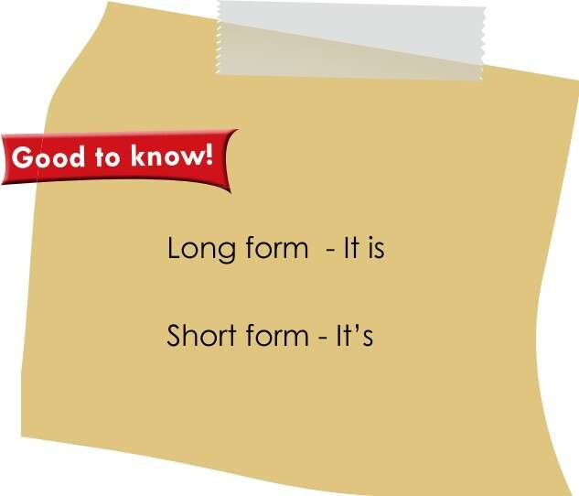
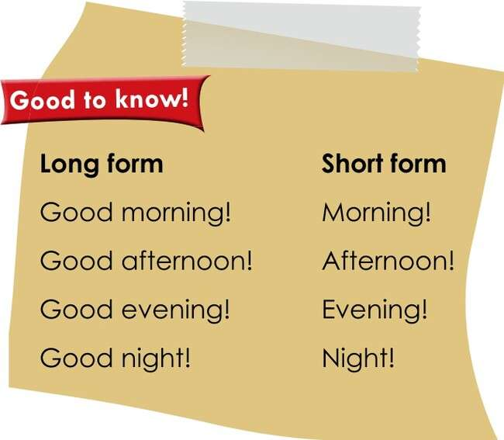
REMEMBER!

Slide 14
Presented by: Teacher Alea Learn_With_Teacher_Alea | 2025
LLEETT’’SS PPRRAACCTTIICCEE
ARE YOU READY?

Slide 15
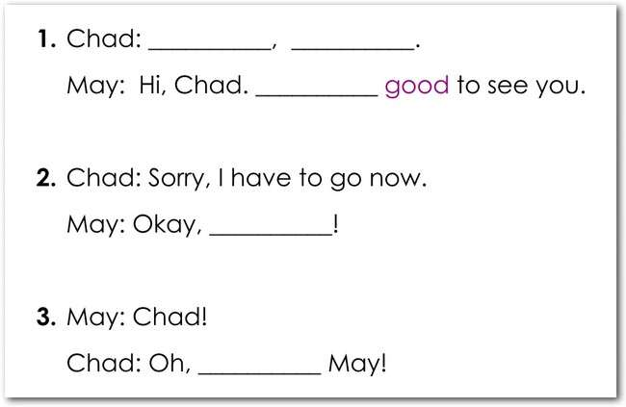
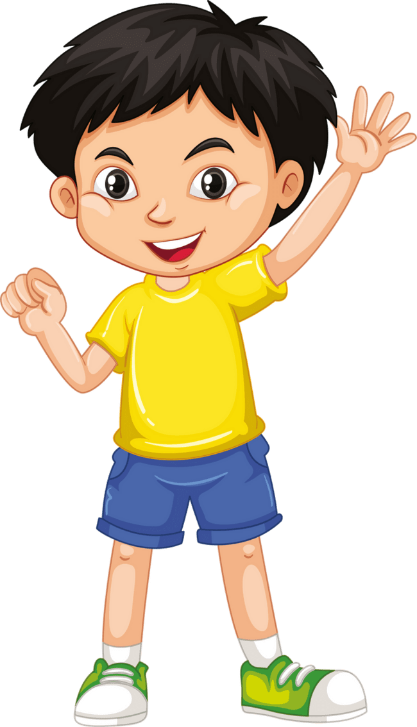
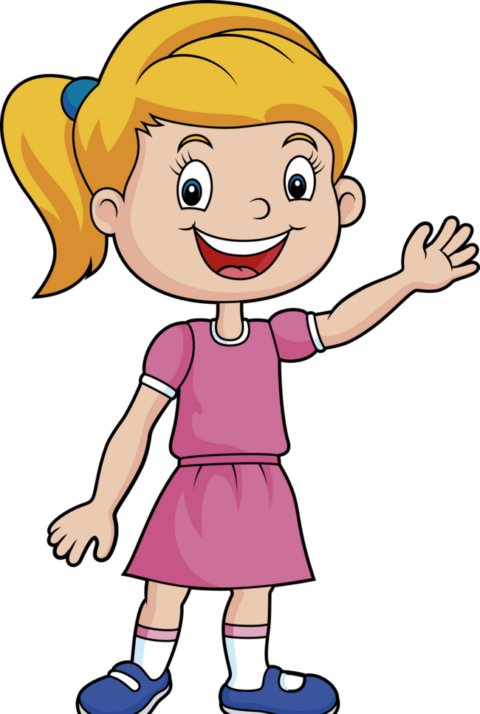
PRACTICE
1
What can Chad and May say?

Slide 16

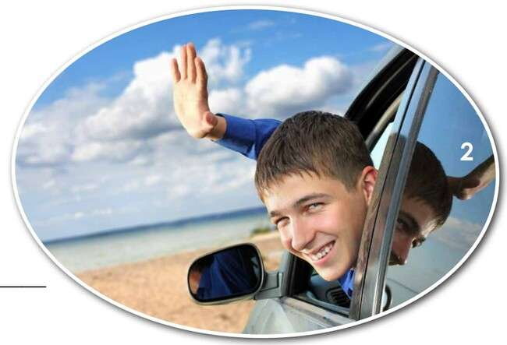
PRACTICE
2
What is the right greeting for each picture ?

Slide 17
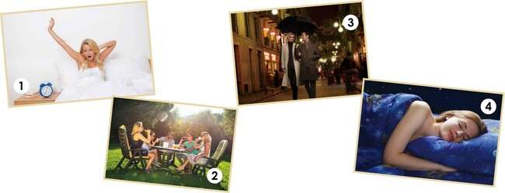
PRACTICE
3
What greetings do we use for these pictures ?

Slide 18

REMEMBER!
Greeting
Good morning Good afternoon Good evening Good night
Meaning
Hello in the morning Hello after lunch time Hello in the evening
Goodbye before going to sleep
Used When
From sunrise to 12:00 noon
From 12:00 noon to around 5:00 or 6:00 p.m.
From around 6:00 p.m. until bedtime When leaving at night or going to bed
Good evening is used when meeting someone in the evening (not when going to bed).
Good night is used when you are leaving or going to sleep.

Slide 19
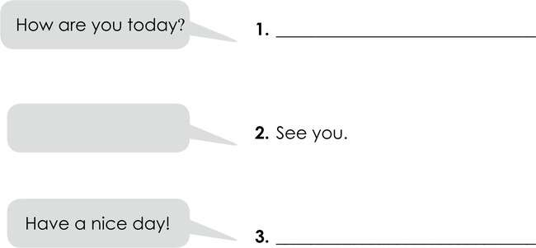
PRACTICE
4
Give the correct question or answer for each number.

Slide 20
REMEMBER!
1. How are you today?
2. See you.
3. Have a nice day!
✅ Possible answers:
I’m great, thanks! How about you? I’m doing well, thank you for asking.
I’m feeling wonderful today. I’m pretty good, just a bit busy.
I’m doing fantastic — couldn’t be better!
💬 Advanced Synonyms:
I’m in good spirits today. I’m feeling quite energized. I’m doing splendidly, thanks.
✅ Possible responses:
See you later! See you soon! Take care!
Catch you later! Talk to you soon!
💬 Advanced Synonyms:
Until next time!
I’ll be seeing you around. Let’s catch up soon.
Farewell for now.
✅ Possible responses:
You too!
Thanks, you as well! Same to you!
Appreciate it — enjoy your day too!
💬 Advanced Synonyms:
Wishing you a wonderful day ahead. Hope your day goes smoothly.
Enjoy the rest of your day!
May your day be filled with good vibes.

Slide 21
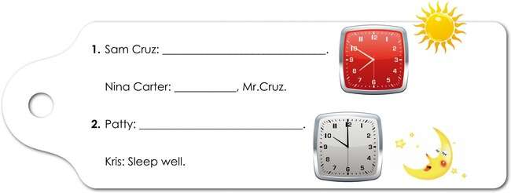
PRACTICE
5

Slide 22
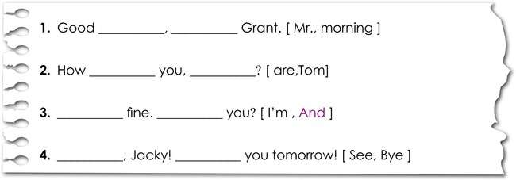
PRACTICE
6

Slide 23
Grammar Construction Rules
A. Be Verbs: am, is, are
The verb “to be” changes depending on the subject.
Meaning: “Be” verbs tell us who someone is, how they feel, or what/where something is.
Subject
I
You / We / They He / She / It
Be Verb
am are is
Example
I am fine. / I’m OK. You are my friend.
He is my teacher. / It is nice to see you.

Slide 24

Grammar Construction Rules
B. Forming Statements
Pattern: [ Subject + am / is / are + complement ]
Rule:
Use is with he, she, it, singular nouns Use are with you, we, they
Use am with I
Examples from the dialogues:
She is my mom.
It is nice to see you. The bus is here.
I am fine.

Slide 25


Grammar Construction Rules
C. Forming Questions
Yes / No Questions
Pattern: [ Am / Is / Are + subject + complement + ? ]
Examples:
Are you going to school? Is he your brother?
Are you OK?
Answers:
Yes, I am. / No, I’m not. Yes, he is. / No, he isn’t.
Wh-Questions (Information Questions)
Wh-word + am / is / are + subject + complement + ?
Examples:
How are you today? Where is your bus? Who is your teacher?
✅ “How” asks about condition or feeling.
✅ “Who” asks about a person.
✅ “Where” asks about a place.

Slide 26


HOMEWORK
Short Writing Task
Write a short conversation (3–5 lines or more) using greetings and be verbs.
Example:
Johan: Good morning! How are you today?
Alexa: I’m fine, thank you. How are you?
Johan: I’m OK. See you later! Alexa:
MAKE YOUR OWN!
Johan:

Slide 27
WRAP - UP & REFLECTION
Presented by: Teacher Alea
Learn_With_Teacher_Alea | 2025
“What did you learn today?” “How was the lesson today?
“Is there anything you would like me to improve or add next time?”
UNIT
1
LESSON 1
END

Slide 28
THANK YOU
See you next class!

