Slide 1

Creative Thinking and Problem-Solving

Slide 2

Invent a business idea combining the objects
Book + Magnets + Keychain

Slide 3
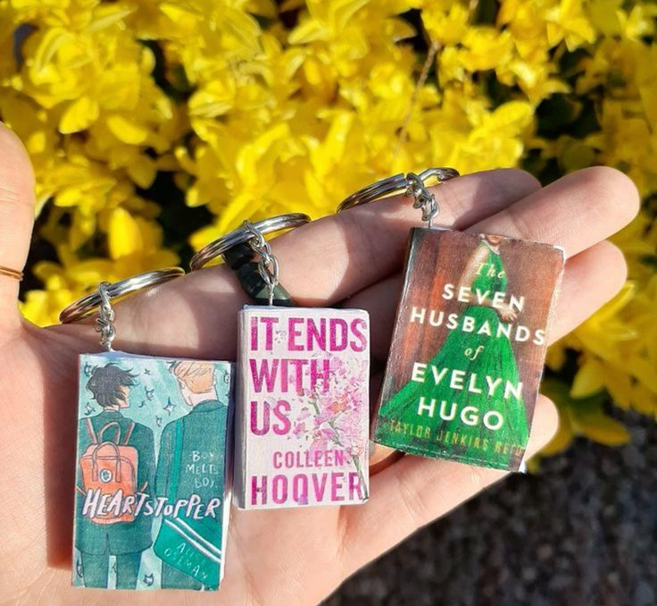
Creative thinking is the first step in problem solving.

Slide 4

WHAT IS CREATIVE THINKING
Creative thinking involves the process of generating innovative and imaginative ideas.
It is the ability to see something in a new way.
It is also about being able to think of unique ideas or new approaches to solve problems.

Slide 5
The advantages/benefits of creative thinking in the workplace
New, innovative, and better ideas and solutions are generated.
Creativity is key to staying one step ahead of competitors.
Complex business problems may be solved.
It leads to increased productivity of the entire business.

Slide 6

WHAT IS PROBLE-SOLVING
Problem solving is the process of finding solutions to difficult or complex issues. It is a process that requires creative thinking.

Slide 7
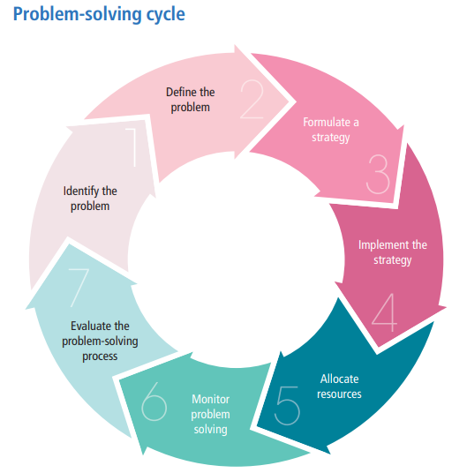
The problem-solving cycle

Slide 8

Problem-solving techniques
Force Field Analysis
Delphi Technique
Nominal Group Technique
Mind mapping
Brainstorming
SCAMPER

Slide 9
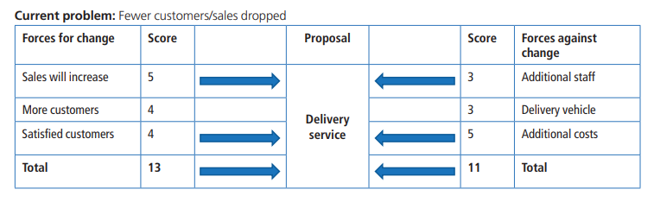
FORCE FIELD ANALYSIS
Describe the current situation/problem and the desired situation.
List all the driving forces and restraining forces that will support and resist change.
Allocate a score to each force using a numerical scale, where 1 is weak and 5 is strong.

Slide 10
The Delphi Technique
The Delphi Technique is a method that relies on a panel of experts to find solutions to a problem.
Experts do not have to be in the same place.
This technique uses a series of questionnaires to obtain feedback from experts. The questionnaires are summarised to bring about the agreement from the different views.

Slide 11
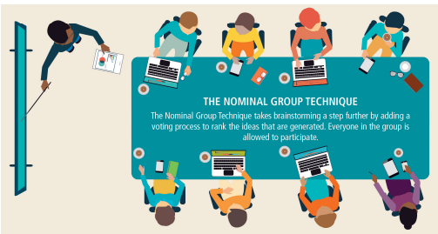
The Nominal Group Technique
Nominal Group technique requests each employee to silently brainstorm and generate many ideas on their own and to write them down.
A voting process is added to rank the ideas that are generated.
Everyone in the group is expected to participate in silence.

Slide 12
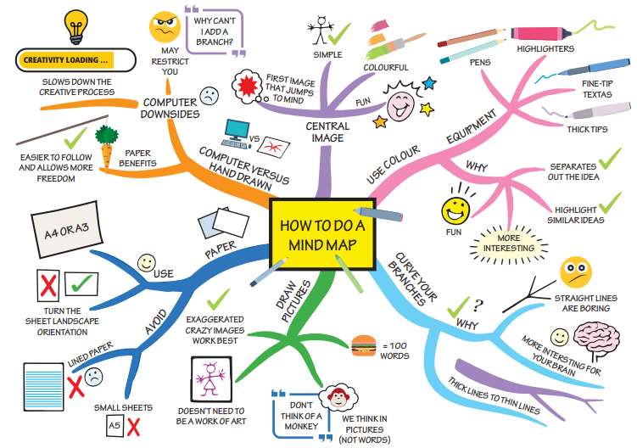
Mind mapping
Mind maps are diagrams that represent ideas that are connected to a central theme.
It is a way of linking key concepts using images, lines, and links.
A central concept is linked via lines to other concepts, which in turn are linked with other associated ideas.

Slide 13

Brainstorming
Brainstorming is a group activity to find a solution for a specific problem by gathering a list of ideas spontaneously.
It is a method for inspiring creative problem solving by encouraging group members to come up with thoughts and ideas.

Slide 14
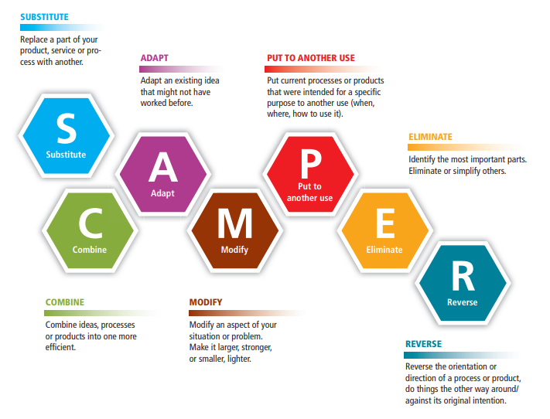
SCAMPER
The name SCAMPER is an acronym that helps teams explore ideas from seven different perspectives.
It involves lateral thinking that helps team members explore new possibilities.
The SCAMPER method helps generate diverse ideas for new products and services that will help innovate and improve existing products, services, problems, and ideas.

Slide 15
DECISION-MAKING
Decision-making is the process of choosing from several alternatives.
Problem-solving is the process of finding a solution to a problem.
Various alternatives are considered before deciding on the best one.
Alternative solutions are identified and evaluated.
It is part of the problemsolving process where a solution is chosen.
It involves analysing the problem to identify solutions.
Decisions are usually made by one person.

Slide 16
ACTIVITY
+
Timer: 2 minutes per station → Rotate
At each poster:
Read the technique & scenario.
Use the technique exactly as instructed.
Write down your findings.

Slide 17
Reflection
“Which technique gave the most creative solution?”
“Which technique was best for decision-making?”
“How can businesses choose the right technique for different problems?”

