Slide 1
Welcome to English Class!
Hello! I’m Teacher Shing👋
Today we will learn
about Daily Routine.
Don't worry about mistakes 😊

Slide 2
Daily Routine Vocabulary
  Wake up
Eat breakfast
Go to school/work
Study
Sleep

Slide 3
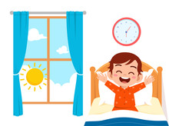
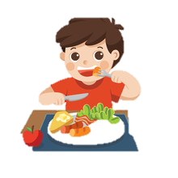
Repeat After Me
  Wake up
Eat breakfast

Slide 4
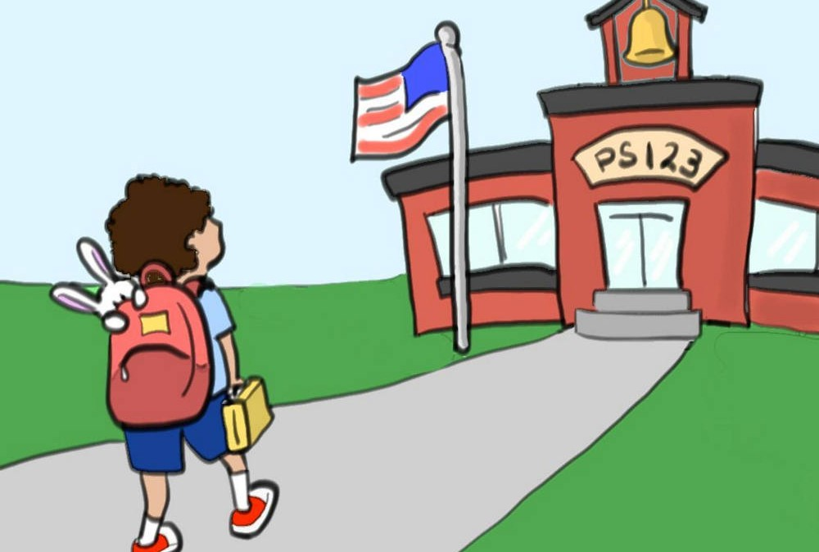

Repeat After Me
Go to school
Go to work

Slide 5

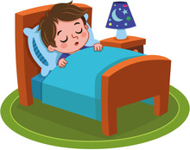
Repeat After Me
Study
Sleep

Slide 6
One more time Repeat After Me
Wake up
Eat breakfast
Go to school
Study
Sleep

Slide 7
Sentence Pattern
I + verb + time
    Example:
I wake up at 7 AM
I eat breakfast at 8 AM

Slide 8
Practice Time
What time do you wake up?
Example:
I wake up at 7 AM

Slide 9
Correction
Say:
I wake up at 7 AM
(Remember to use 'at’ to express a precise time)

Slide 10
More Practice
What do you do in the evening?
Example:
I study in the evening
I watch TV in the evening
Remember to use ‘IN’ to indicate longer, general periods of time, such as parts of the day, months, years, seasons, decades, and centuries,

Slide 11
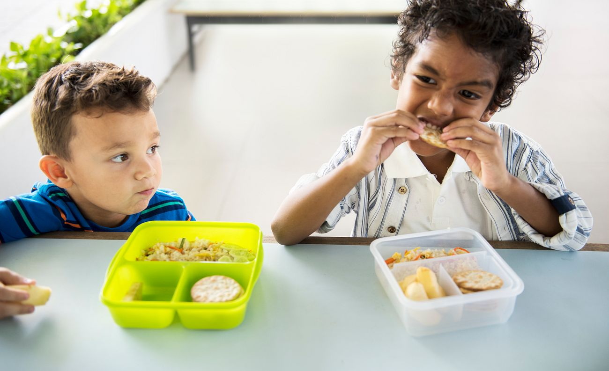
Fun Game!
What is this?
(Sleep 😴)
(Eat 🍽️)

Slide 12
Great Job!
You did an amazing today! 👏

Slide 13
Lesson Summary
You learned:
✔ Daily routine words
✔ Simple sentences

Slide 14
Good bye!
See you next time 😊
Bye-bye! 👋

