Slide 1
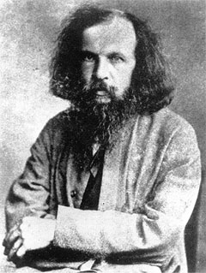
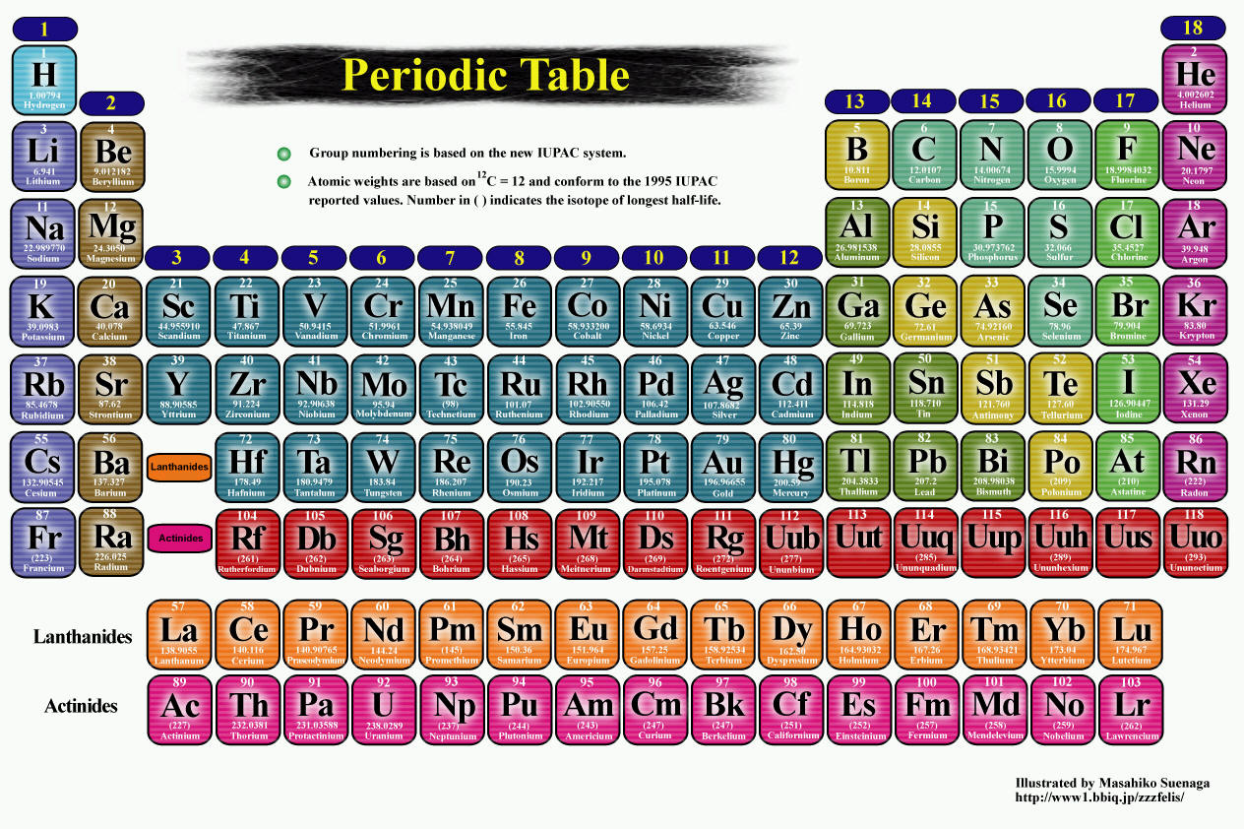
I am Dmitri Mendeleev!
I made the PERIODIC TABLE !

Slide 2
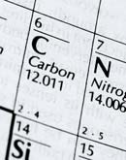
What is the PERIODIC TABLE?
Shows all known elements in the universe.
Organizes the elements by chemical properties.

Slide 3
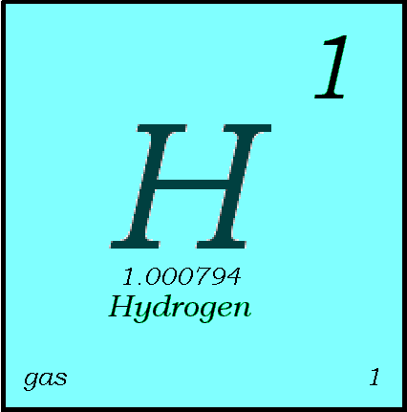
Key to the Periodic Table
Elements are organized on the table according to their atomic number.

Slide 4


Atomic Number
This refers to how many protons an atom of that element has.
No two elements, have the same number of protons.
Bohr Model of Hydrogen Atom
Wave Model

Slide 5
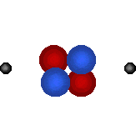
Atomic Mass
Atomic Mass refers to the “weight” of the atom.
It is derived at by adding the number of protons with the number of neutrons.
This is a helium atom. Its atomic mass is 4 (protons plus neutrons).
What is its atomic number?
H

Slide 6
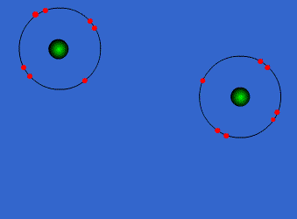
Valence Electrons
Valence electrons are the electrons in the outer energy level of an atom.
These are the electrons that are transferred or shared when atoms bond together.

Slide 7
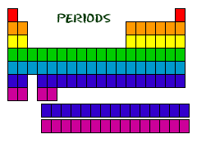
Periods = rows
From left to right
What do elements in a row have in common?
  the same number of electron shells
Every element in Period 1 (1st row) has 1 shell for its electrons (H & He)
All of the elements in period 2 have two shells for their electrons.
It continues like this all the way down the table

Slide 8
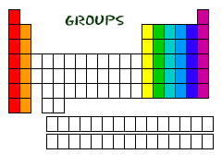
Column = group = families
What do elements in a group have in common?
  same number of valence electrons (electrons in the outer shell)
They share similar characteristics with the other elements in their family.
Group 1: 1 valence electron
Group 2: 2 valence electrons
Group 13: 3 valence electrons
Group 14: 4 valence electrons
Group 15: 5 valence electrons
Group 16: 6 valence electrons
Group 17: 7 valence electrons
Group 18: 8 valence electrons except He who has 2

Slide 9
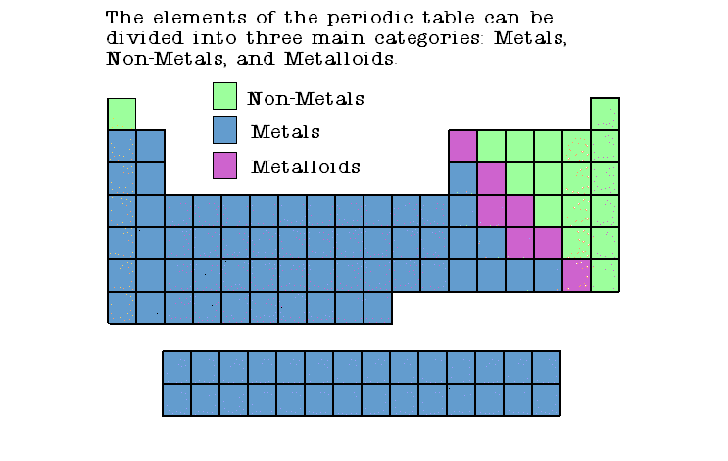

Slide 10
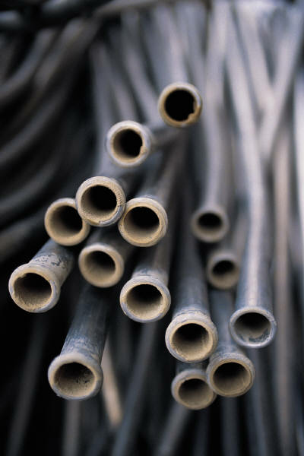
Properties of Metals
Good conductors of heat and electricity
Shiny.
Ductile (can be stretched into thin wires)
Malleable (can be pounded into thin sheets)
A chemical property of metal is its reaction with water which results in corrosion.

Slide 11
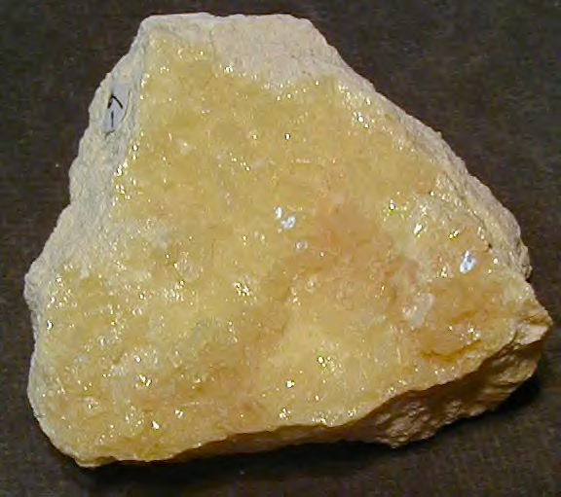
Properties of Non-Metals
Poor conductors of heat and electricity
Not ductile or malleable
Brittle and break easily
Dull
Many non-metals are gases.
Sulfur

Slide 12
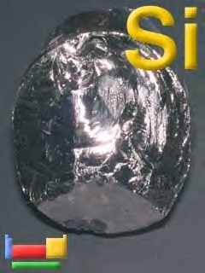
Properties of Metalloids
Have properties of both metals and non-metals
Solids that can be shiny or dull.
Conduct heat and electricity better than non-metals but not as well as metals.
They are ductile and malleable.
Silicon

Slide 13
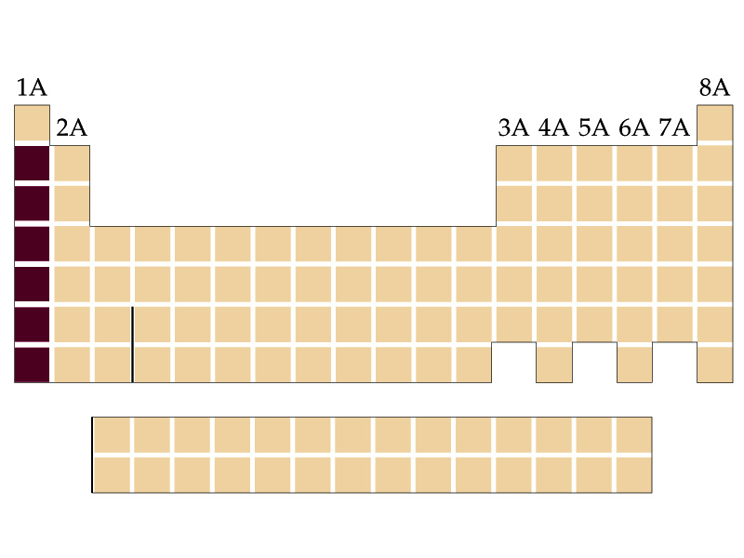
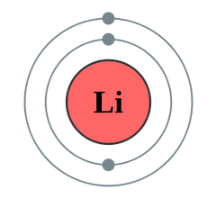
Group1: Alkalai Metals
1 valence electron
Very Reactive

Slide 14
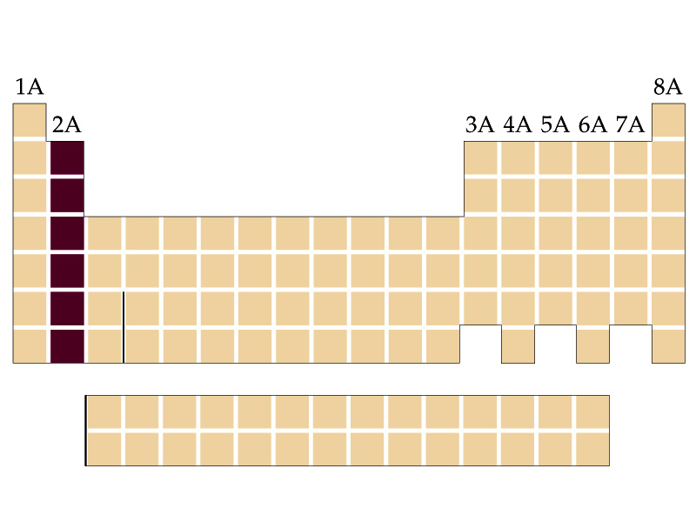
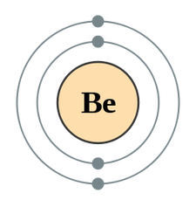
Group 2: Alkaline Earth Metals
2 valence electrons
Very reactive, but less than alkali metals

Slide 15
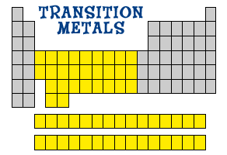
Groups 3 – 12: Transition Metals
1-2 valence electrons
Less reactive than alkaline earth metals because they don’t give away their electrons as easily
Bottom 2 row are the Lanthanide & Actinide series

Slide 16
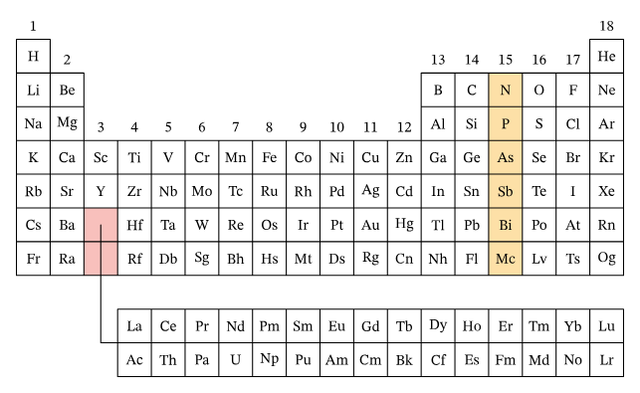
Group 15-Nitrogen Family
5 Valence Electron
Elements in this group are diverse, including nonmetals, metalloids, and metals.
They have five valence electrons.

Slide 17
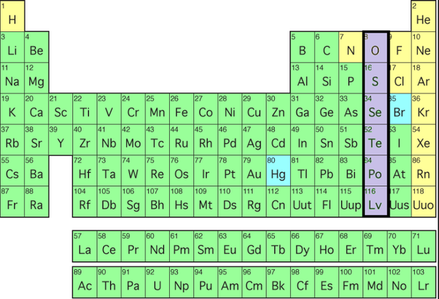
Group 16 – Oxygen Group/Chalcogens
6 Valence Electron
Elements in this group are nonmetals,
except for polonium,
which is a metal.

Slide 18
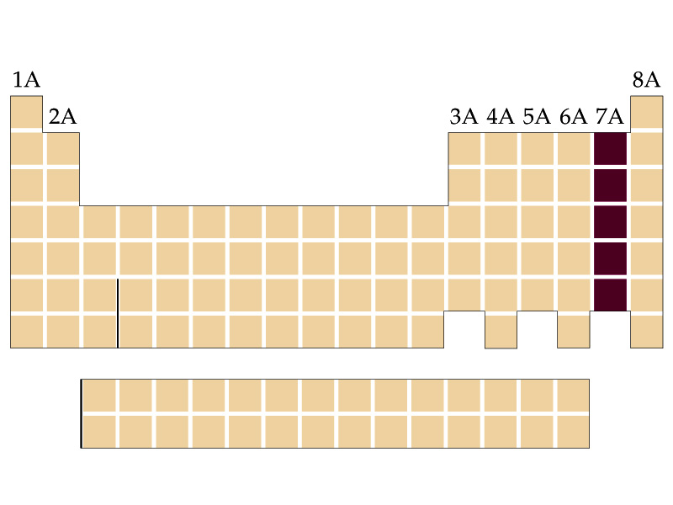
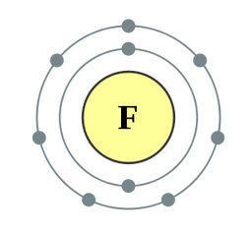
Group 17: Halogens
7 valence electrons
Very reactive
Nonmetals

Slide 19
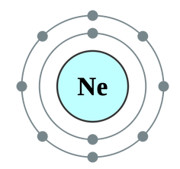
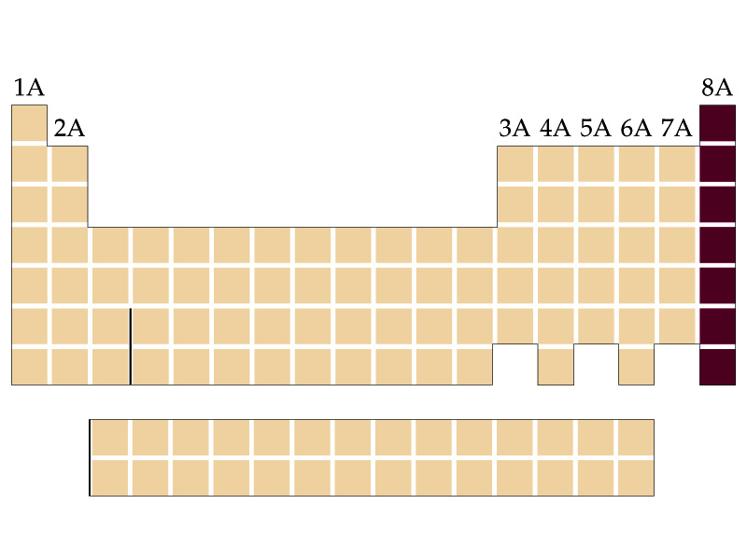
Group 18: Noble Gases
8 valence electrons (except He which only has 2)
“Happy” because their outer electron shell is filled!
NON REACTIVE (inert)
gases
Nonmetals

