Slide 1
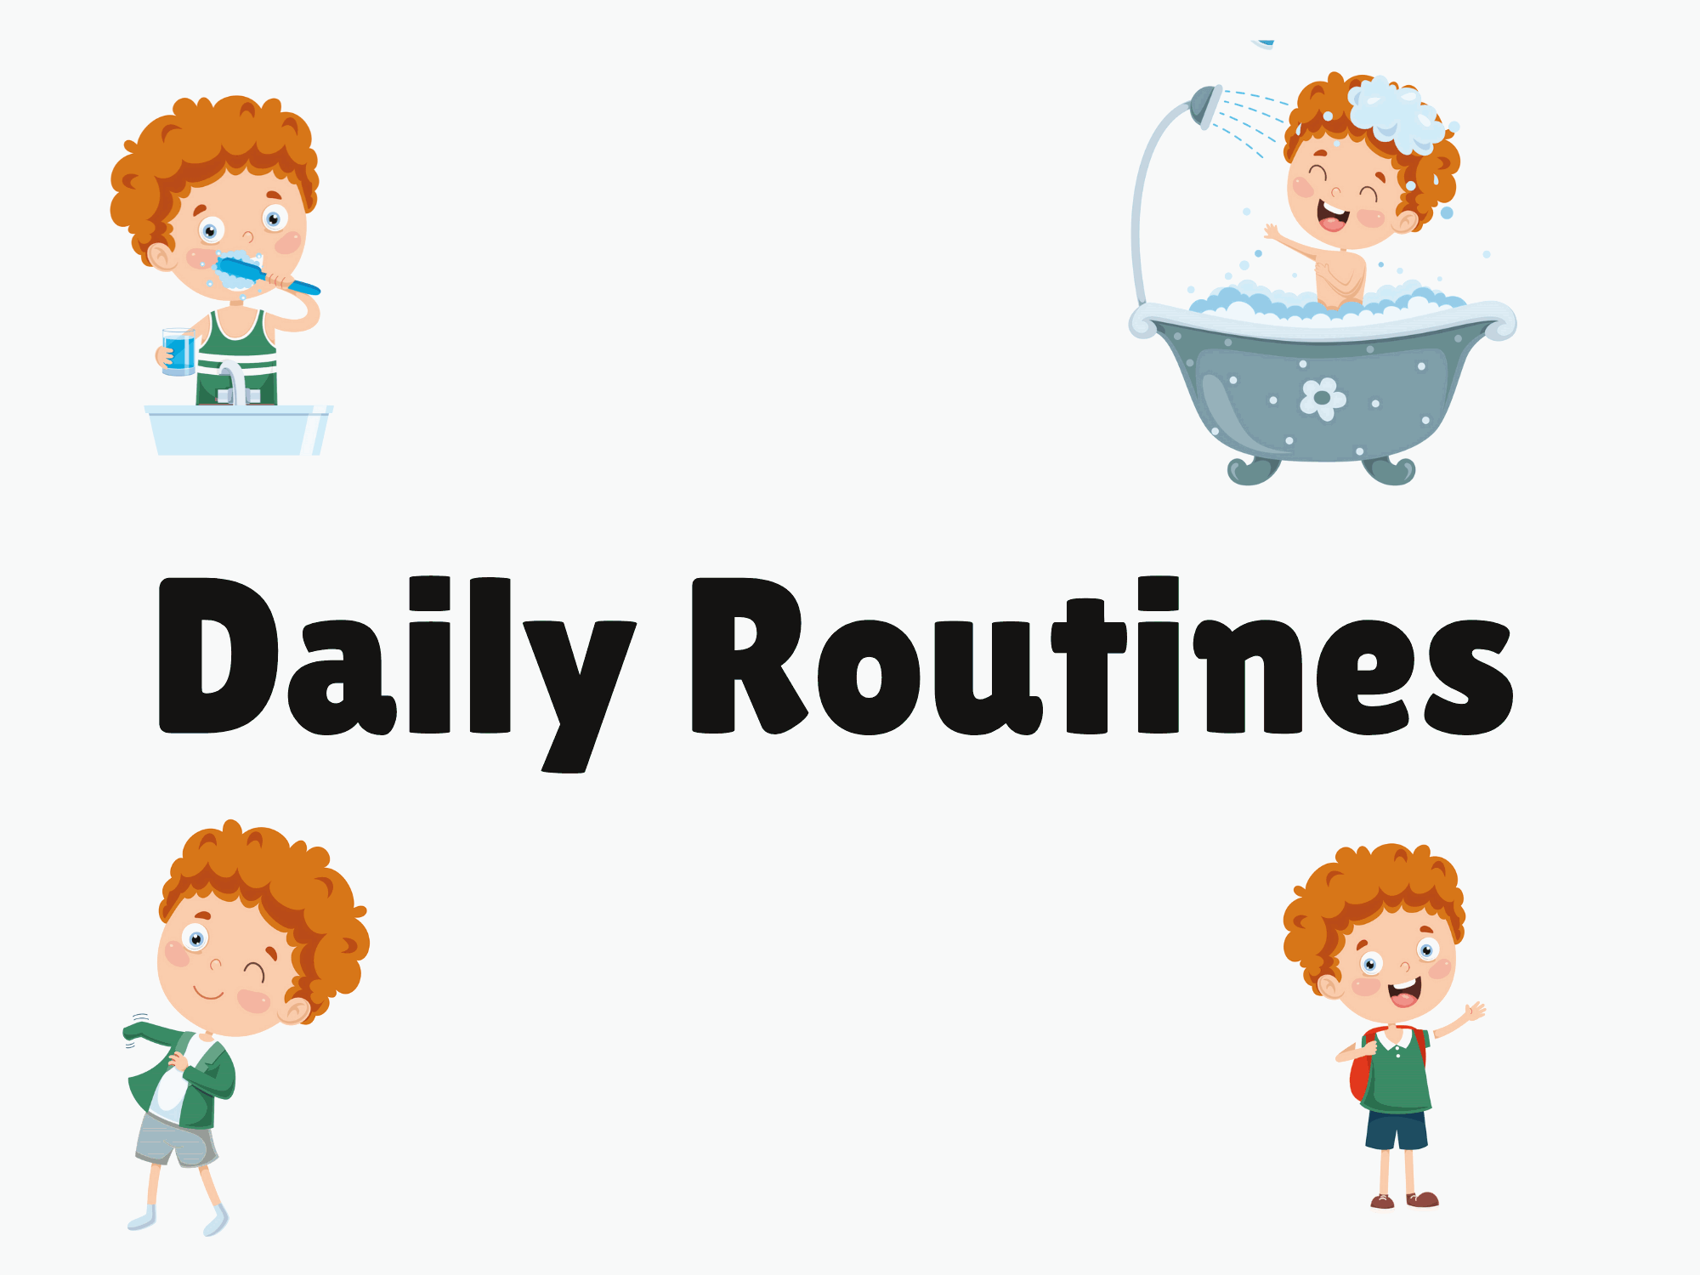
Presented by: Teacher Emma

Slide 2
vocabulary words
Presented by: Teacher Emma

Slide 3
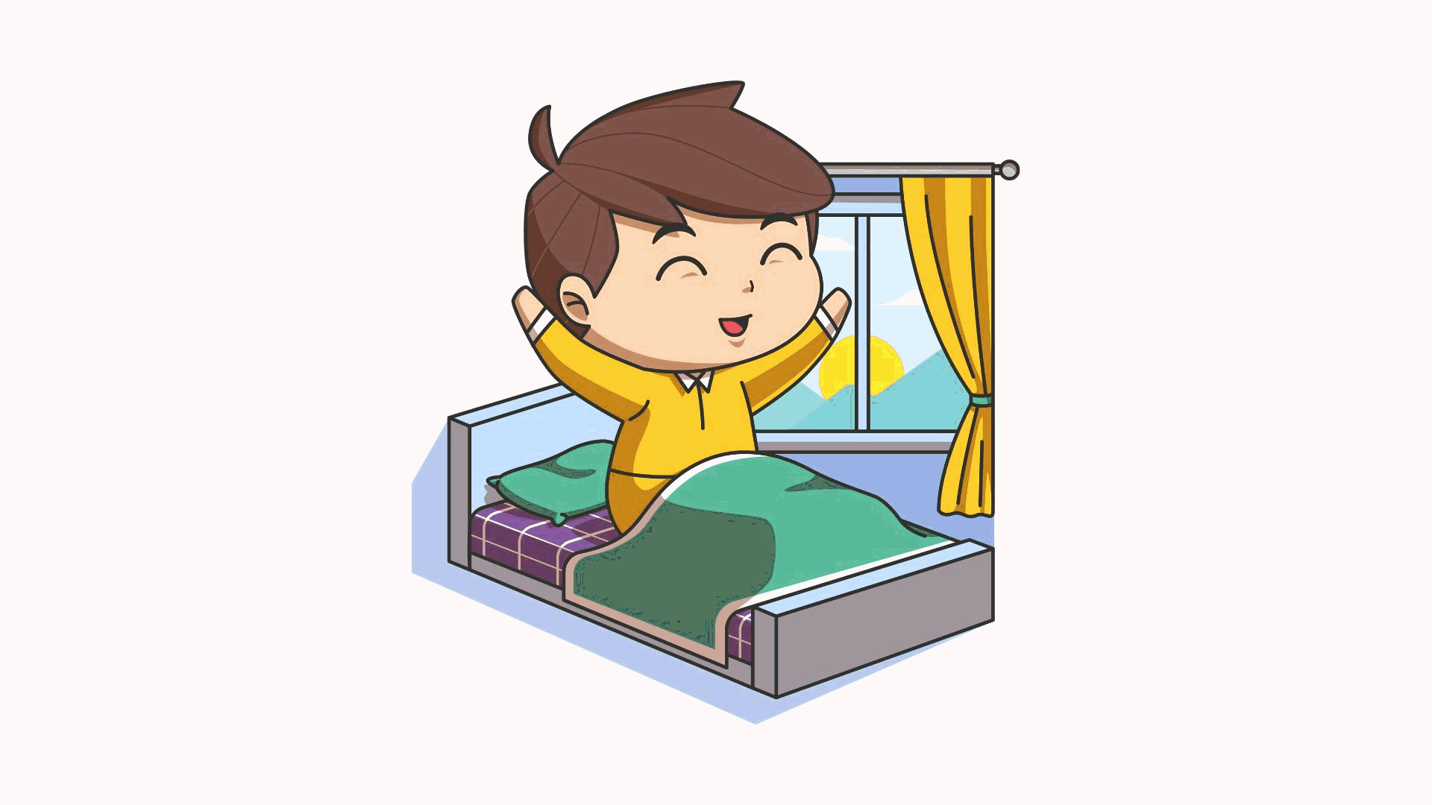
wake up
Presented by: Teacher Emma

Slide 4
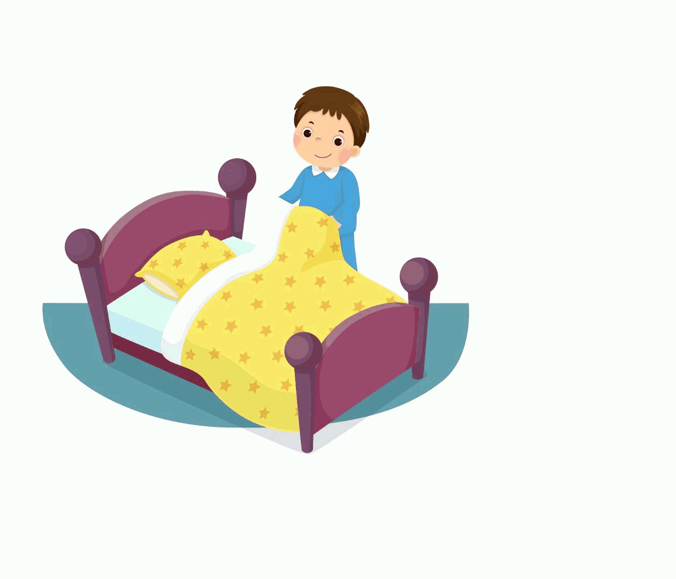
get up
Presented by: Teacher Emma

Slide 5
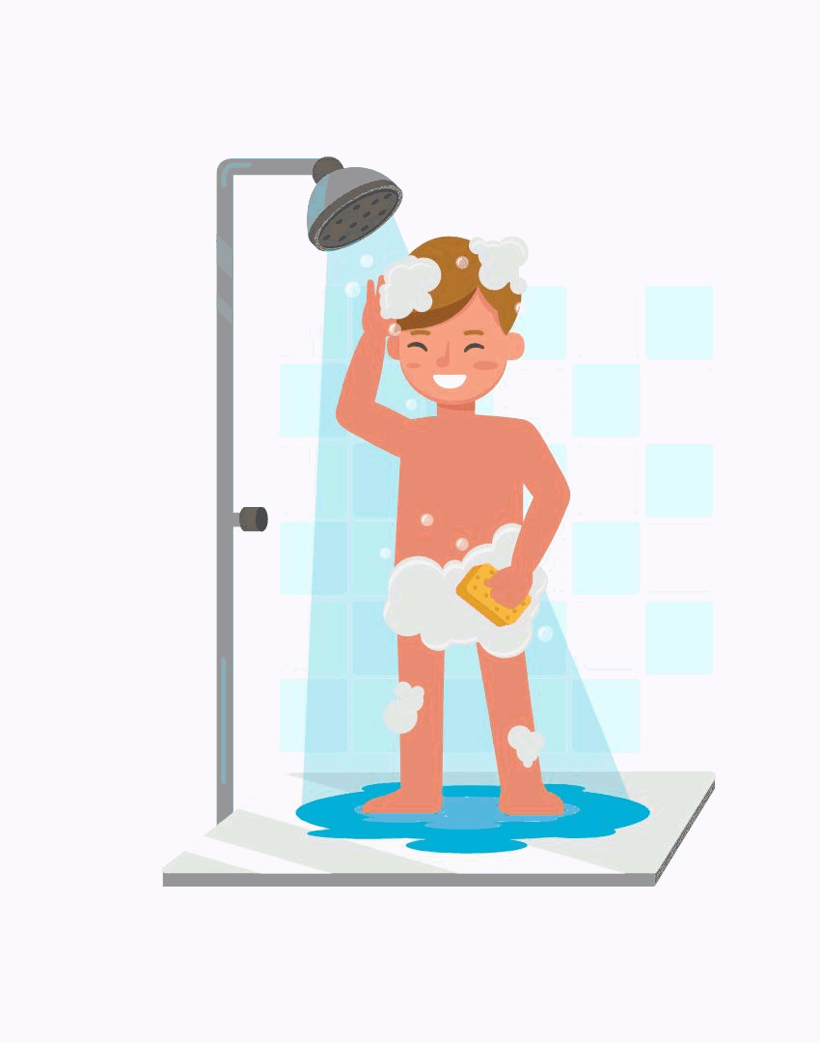
take shower
Presented by: Teacher Emma

Slide 6
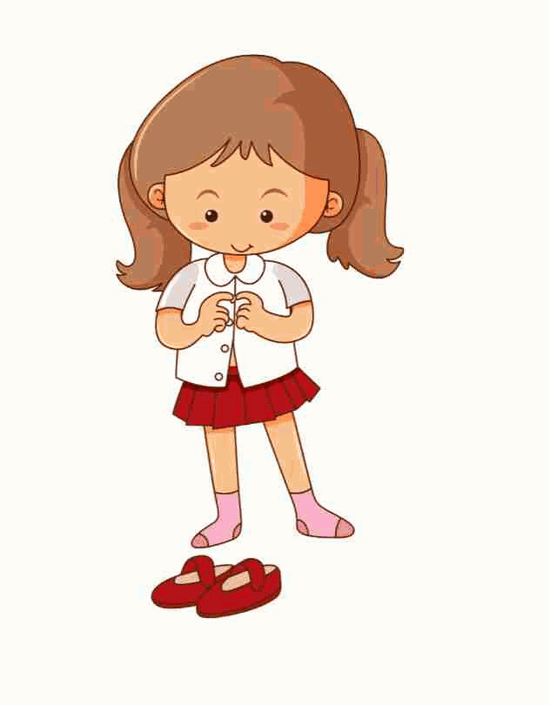
get dressed
Presented by: Teacher Emma

Slide 7
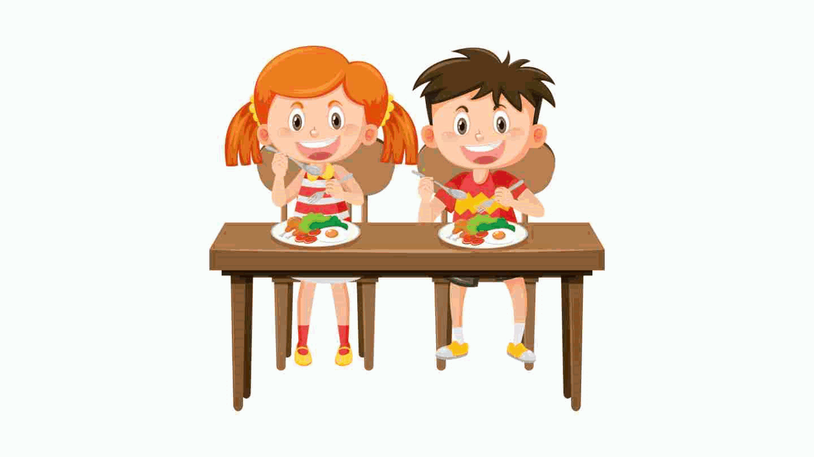
have breakfast
Presented by: Teacher Emma

Slide 8
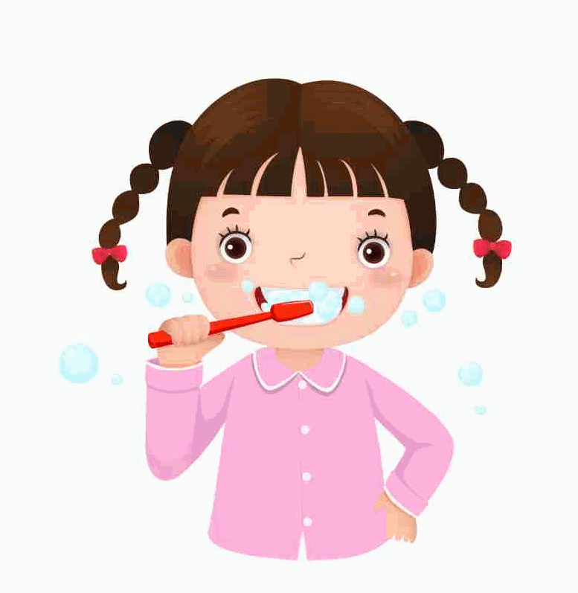
brush your teeth
Presented by: Teacher Emma

Slide 9
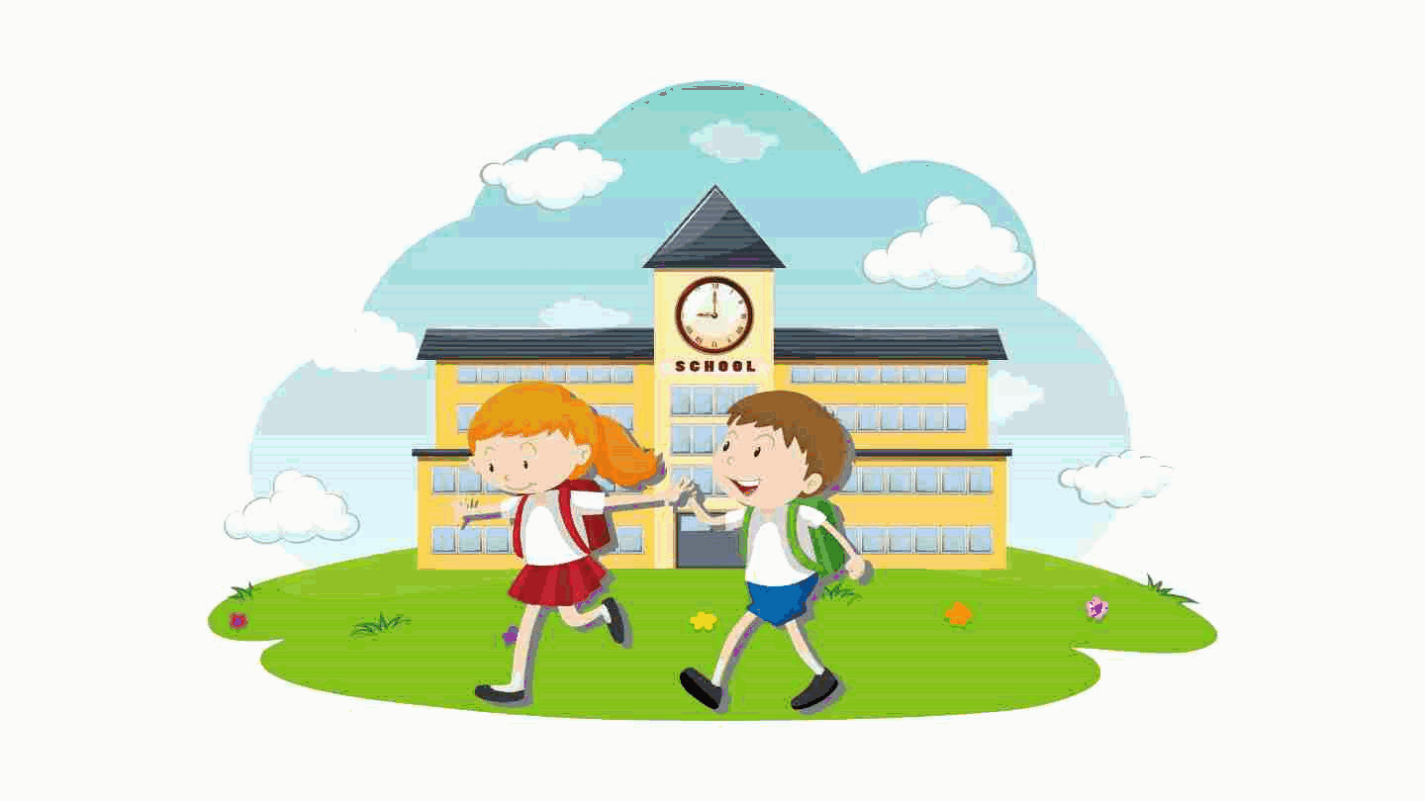
go to school
Presented by: Teacher Emma

Slide 10
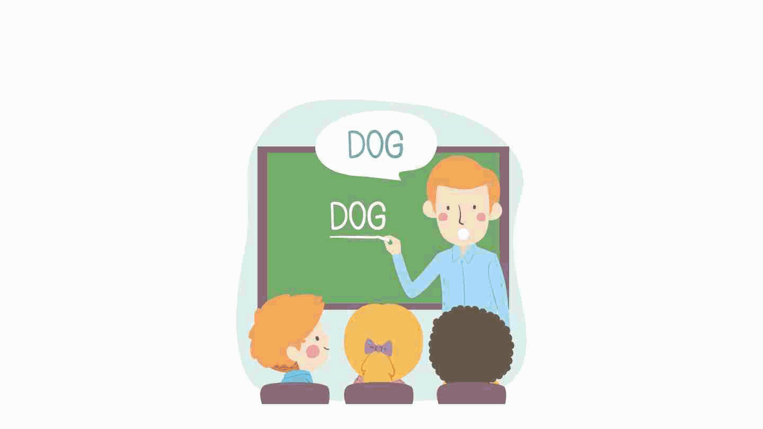
study English
Presented by: Teacher Emma

Slide 11
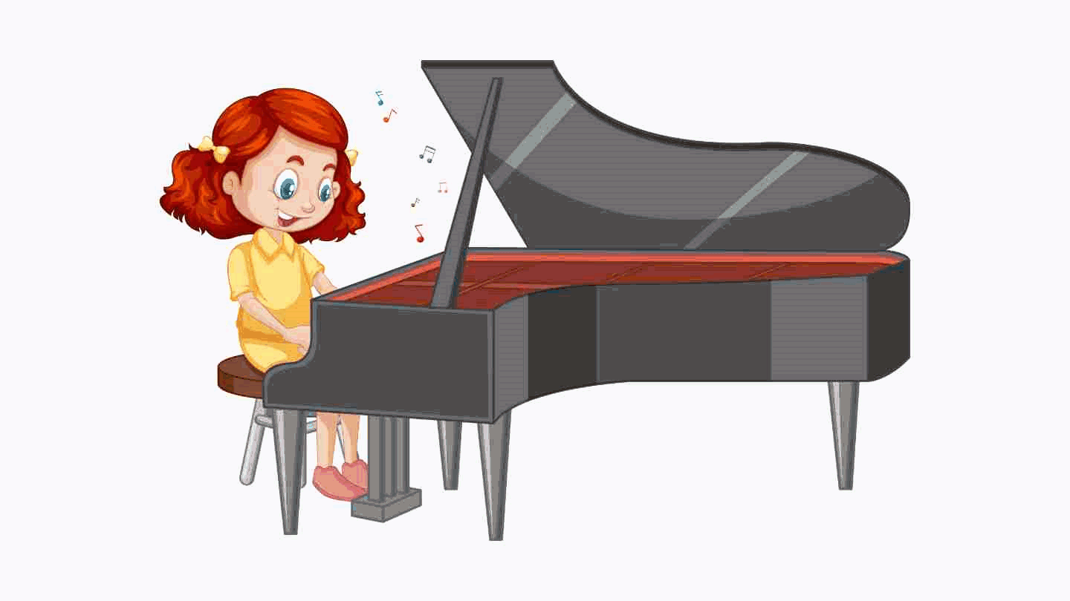
practice piano
Presented by: Teacher Emma

Slide 12
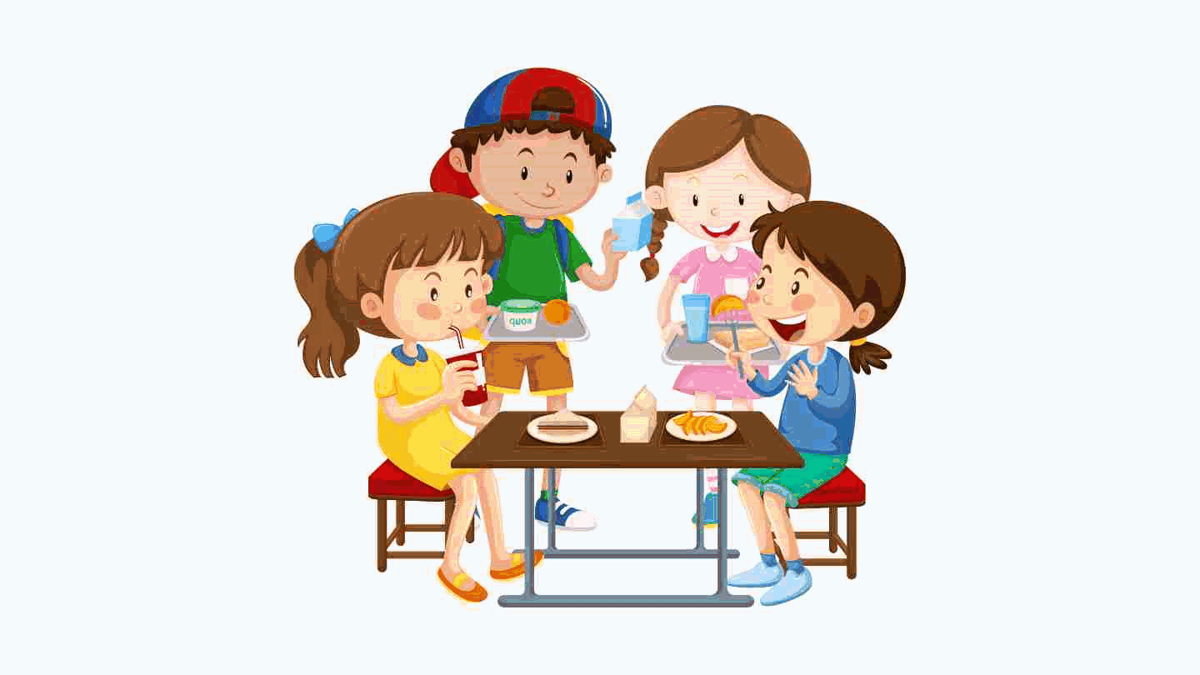
have lunch
Presented by: Teacher Emma

Slide 13
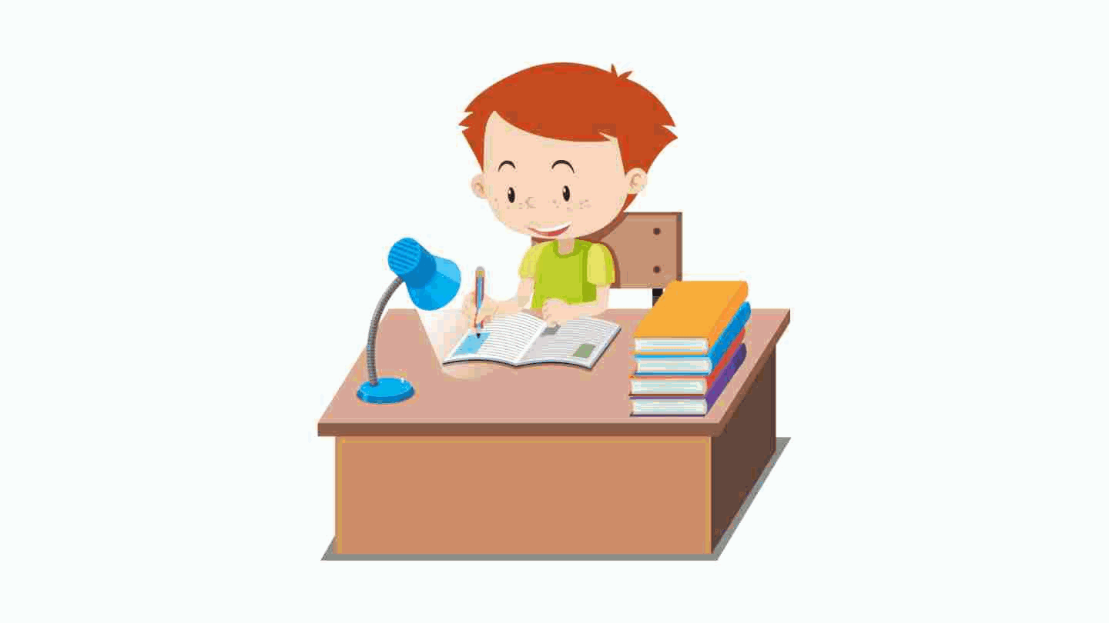
do homework
Presented by: Teacher Emma

Slide 14
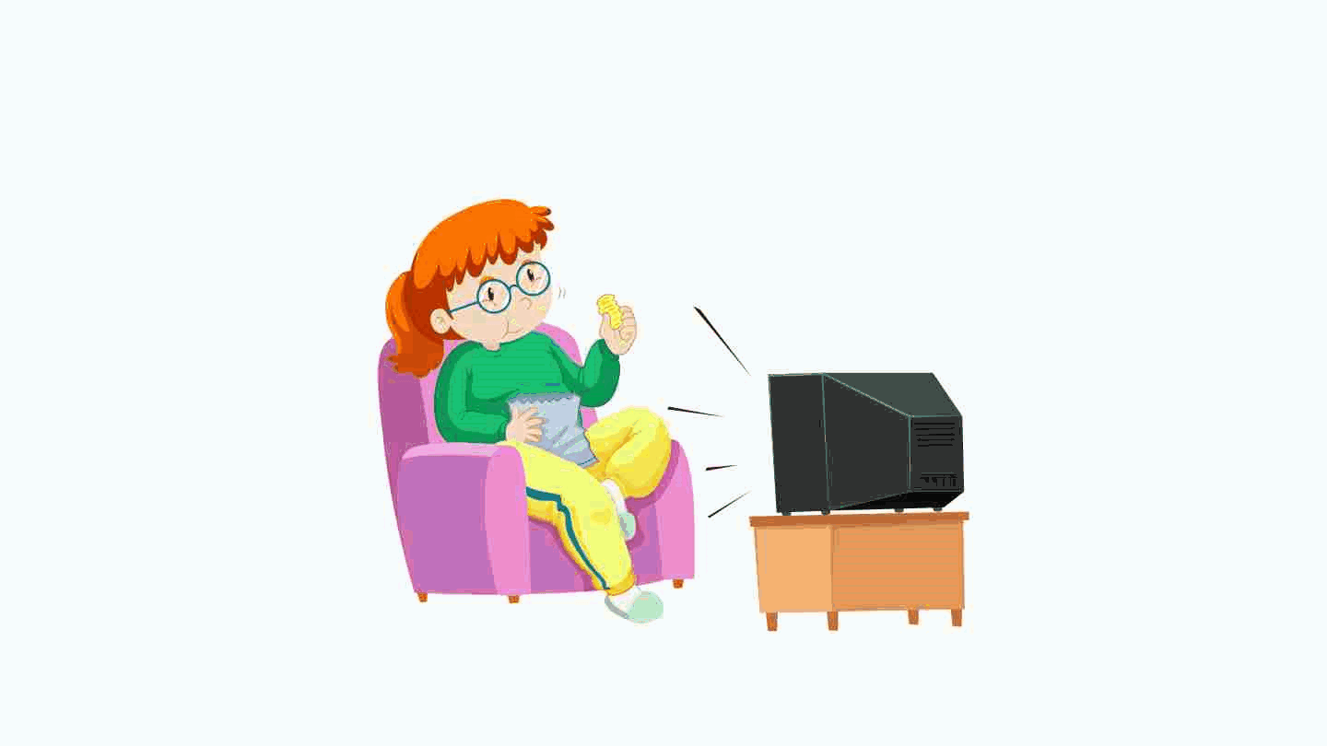
watch TV
Presented by: Teacher Emma

Slide 15
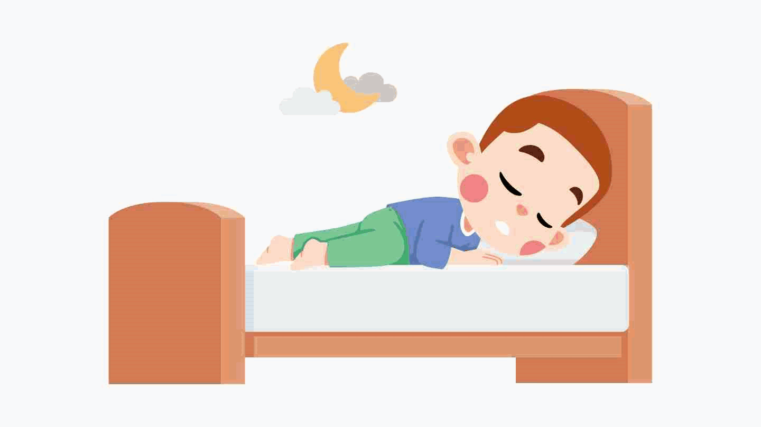
go to sleep
Presented by: Teacher Emma

Slide 16

Presented by: Teacher Emma

