Slide 1


Maths
Review
Teacher Luke

Slide 2





Let’s start with a question; what is your favourite shape?

Slide 3


My favourite shape is ______________.

Slide 4

Okay, let’s start the review!

Slide 5
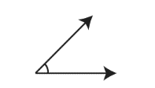
Can you tell me the special name of these angles?
An acute angle!
Acute angles are always below 90 degrees.

Slide 6
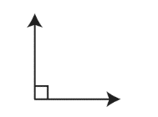
Can you tell me the special name of these angles?
A right-angle!
Right-angles are always 90 degrees.

Slide 7
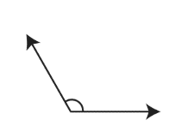
Can you tell me the special name of these angles?
An obtuse angle!
Obtuse angles are always more than 90 degrees, but less than 180 degrees.

Slide 8
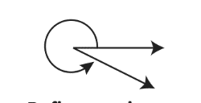
Can you tell me the special name of these angles?
A reflex angle!
Reflex angles are always more than 180 degrees.

Slide 9

Great work!

