Slide 1
Between 1348-1351, ⅓ to ½ of the population of Europe died from the Black Death

Slide 2
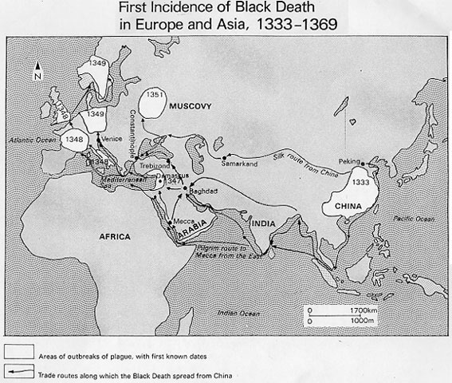

Slide 3
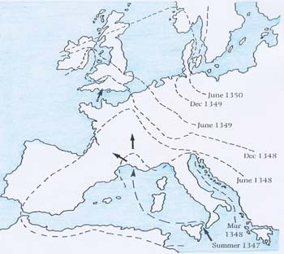

Slide 4
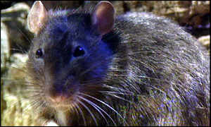

Slide 5
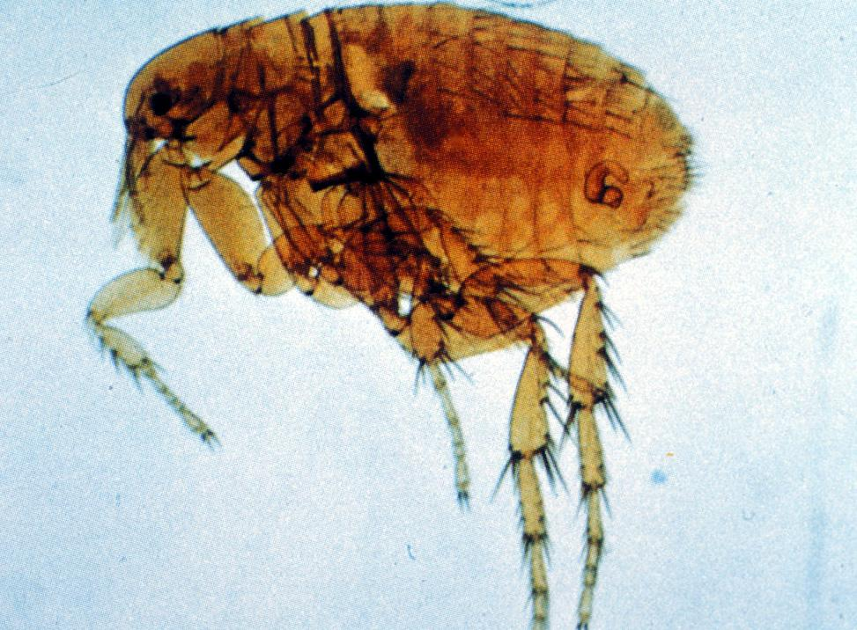

Slide 6
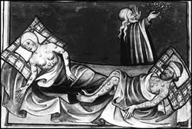

Slide 7
“There appeared certain swellings in the groin and under the armpit, the victims spat blood, and in three days they were dead.”
- An Italian diarist in 1348

Slide 8
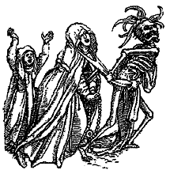

Slide 9
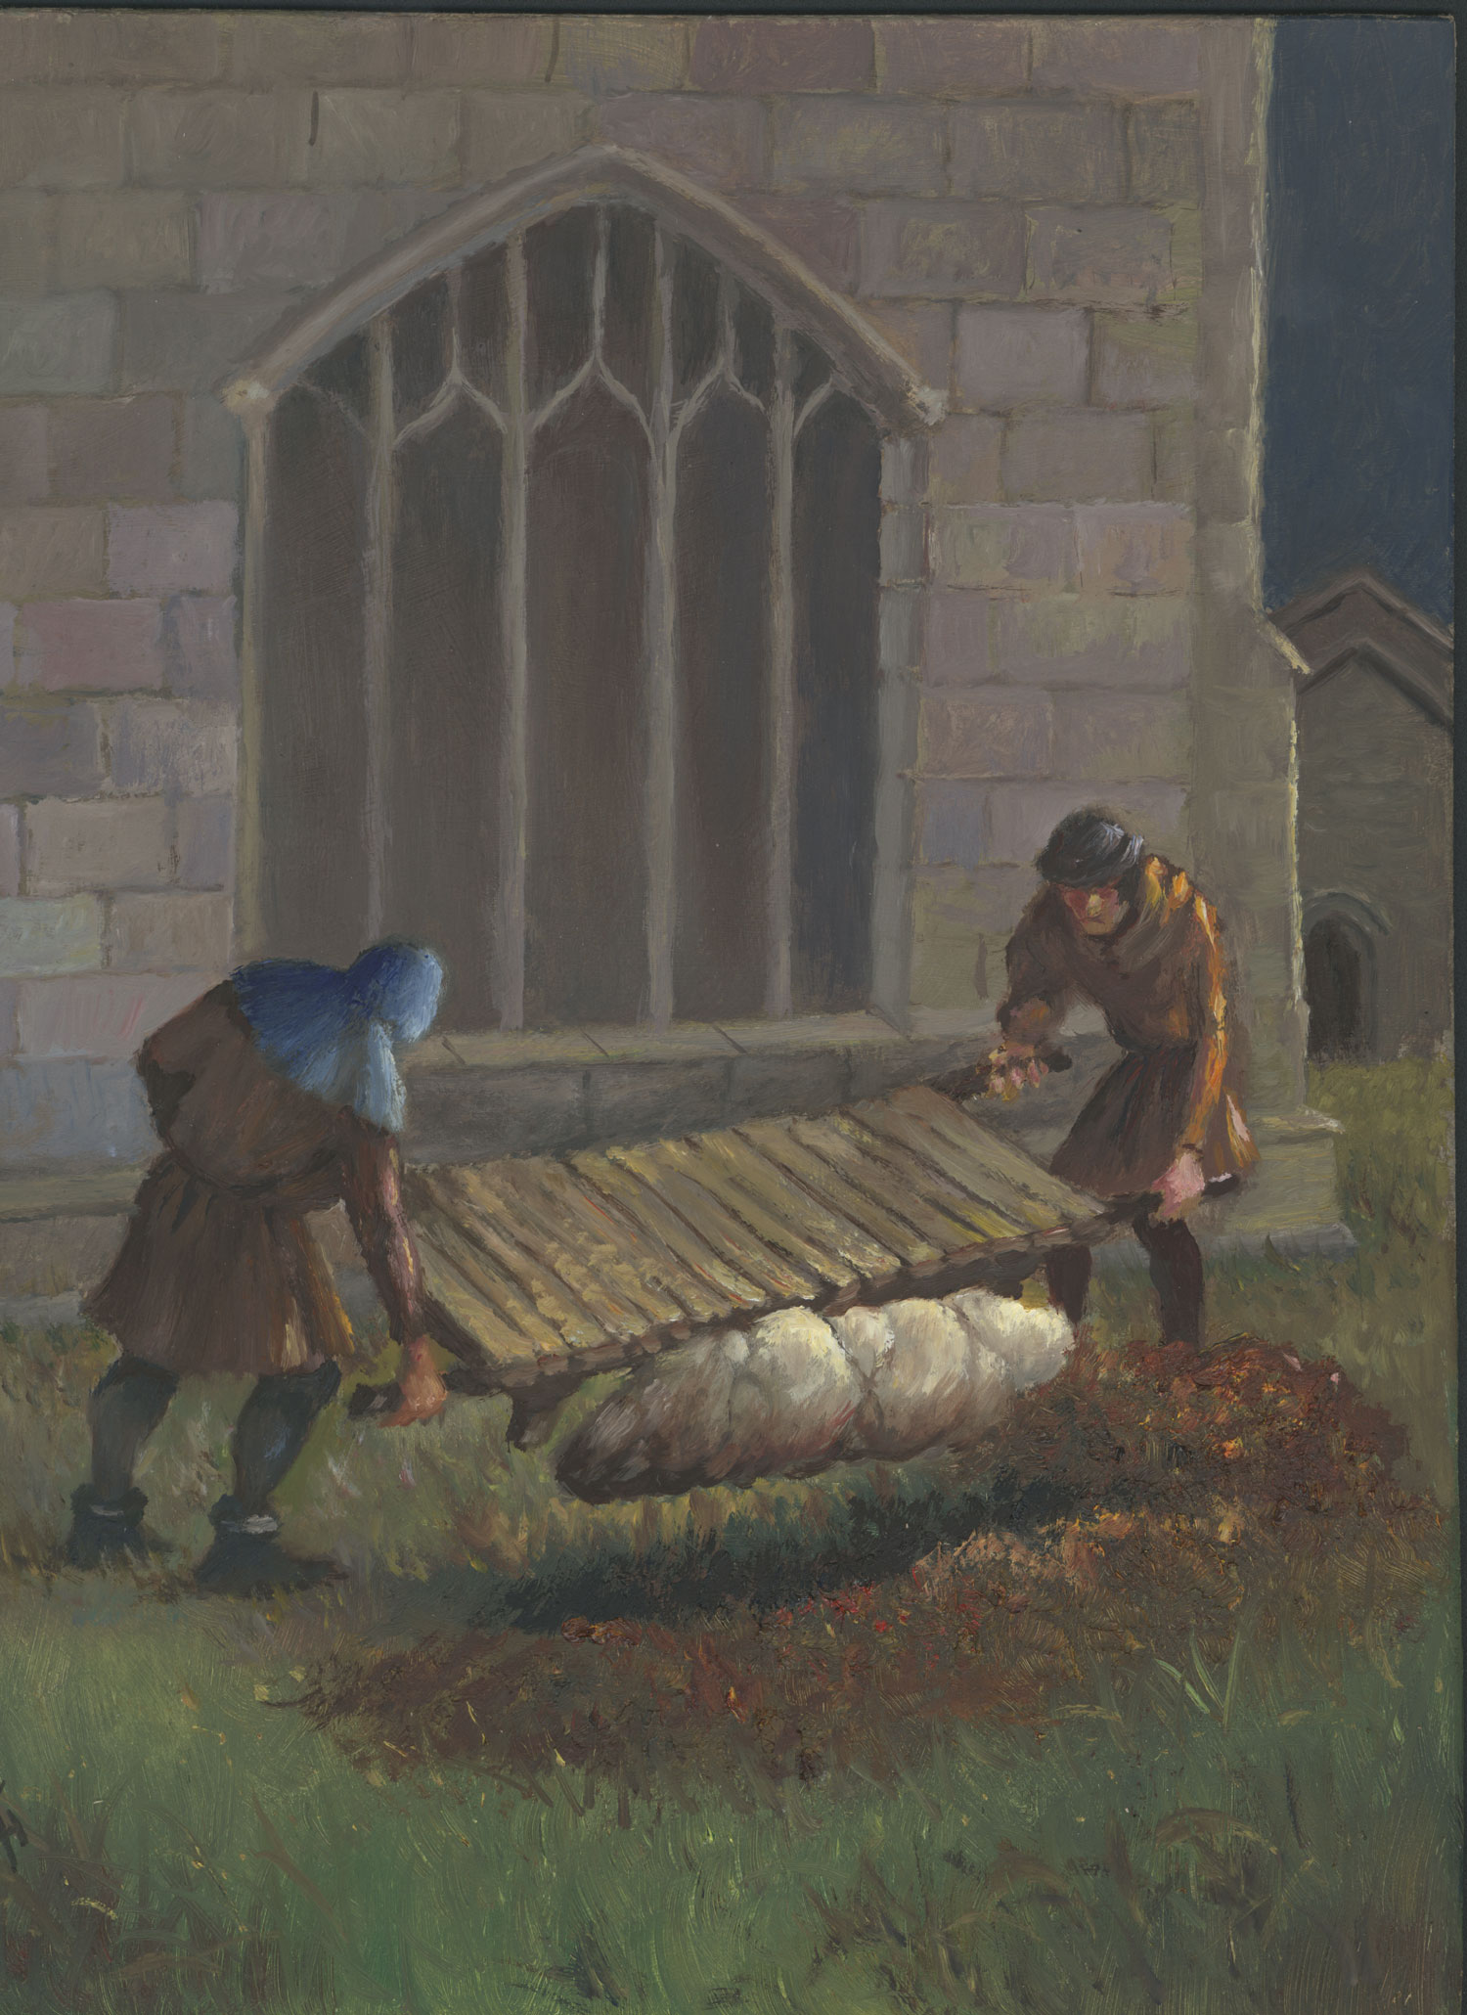

Slide 10
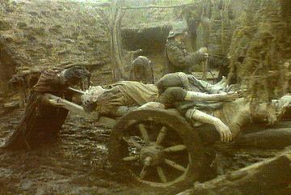
Bring out your dead!

Slide 11

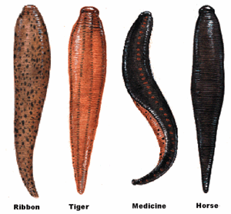
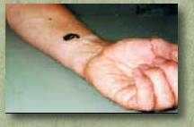
Cures?

Slide 12
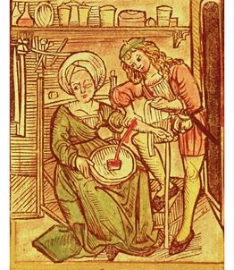
Blood-letting

Slide 13
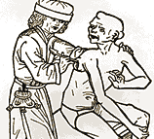
Lancing a buboes

Slide 14
Cures?
Swallow powders of crushed emeralds
Eat arsenic powder (poison)
Sit in a sewer so bad the air of the plague is driven off by the worse air of the drains
Shave a chicken’s bottom and strap it to the plague sore

Slide 15
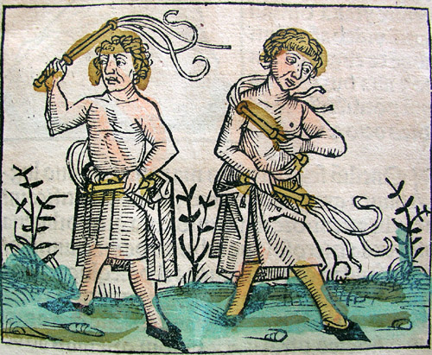
Flagellants

