Slide 1
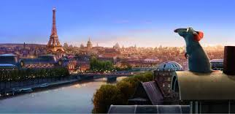
FRENCH FOR KIDS
CONTENT & METHODOLOGY
olivier cerejo meneses
Private tutor oliviermeneses@gmail.com

Slide 2

LETS SPEAK FRENCH WITH PI-O
Hello, I'm Olivier, and I was born in Paris, not far from the iconic Eiffel Tower. I have a deep love for sharing my knowledge, especially about the French language.
In my tutoring sessions, whether online or offline, I focus on more than just teaching the language; I aim to ignite a passion for learning. I believe that building confidence is key to achieving your goals, whether you're an adult learner or seeking support for your child. Together, we will explore various subjects that are meaningful to you, allowing you to write, read, listen, and speak about topics that excite you.
My special power is been able to increase your confidence when you need to interact with French speakers Let's take the first step together towards reaching your learning objectives and uncovering the wonders of the French language and culture! À bientôt!

Slide 3
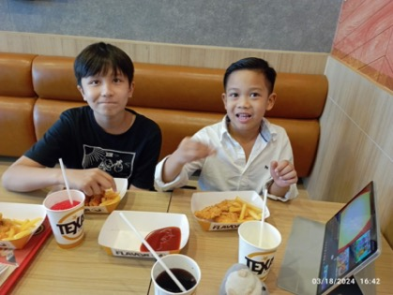
5. WHY LEARNING FRENCH
There are plenty of good reasons to learn French: to work, to travel, to communicate, to learn, to have fun! This is why more and more parents want their children to know several foreign languages, including French, which is the only language, alongside English, to be spoken on 5 continents!
We don't learn French in the same way when we are an adult who is just starting out or a child who is between 3 and 12 years old! Teaching French to children requires a specific approach.
We know, for example, that it is much easier for young children to reproduce the sounds of a foreign language than for adults. If your child has better French pronunciation than you, that’s normal! :-

Slide 4

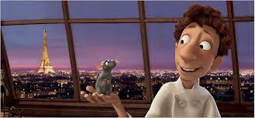
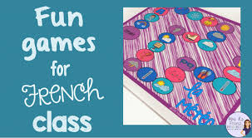
2. IMERSION & PRACTICE
Create an immersive environment where French is used extensively during lessons. This could involve speaking only in French, using French books, videos, songs, and games.
Visual Aids: Use colorful flashcards, pictures, and posters to help kids associate words with images. Visual aids can be particularly useful for vocabulary building.
Interactive Games: Incorporate fun and educational games into your lessons. Games like language puzzles, memory games, or language learning apps can make learning French enjoyable for kids.
Storytelling: Engage kids in French storytelling sessions. You can use simple and engaging stories to introduce new vocabulary and sentence structures in a context that children can relate to.

Slide 5

2. IMERSION & PRACTICE
Role-Playing: Encourage kids to participate in role-playing exercises where they can practice conversational French in real-life scenarios. This can boost their confidence in using the language.
Songs and Rhymes: Introduce French songs and rhymes to help kids learn pronunciation and rhythm. Music is a powerful tool for language retention and can make learning more engaging.
Cultural Activities: Explore French culture through activities like cooking French dishes, celebrating French holidays, or learning about French traditions. This can enrich the learning experience and make it more interactive.
Individualized Learning: Tailor your teaching methods to suit each child's learning style and pace. Some kids may learn better through visual aids, while others may prefer hands-on activities.

Slide 6

3. L’ATELIER A1,A2,B1,B2 FOR SMALL GROUPS
L'atelier is a beginner course that encourages students to work together as they learn French.
The course is designed for learners to cooperate to construct meaning from the exercises and to solve specific tasks, to discuss together and think about how the language works, step by step and in a spiral progression.
In addition to the exercises, there are cultural discoveries to be made and games to play.

Slide 7
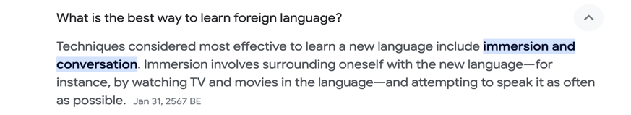
4. IMMERSION & CONVERSATION

Slide 8
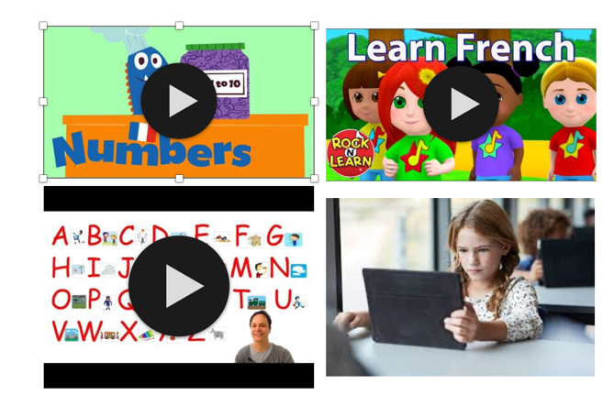
4. IMMERSION
Your private tutor will provide digital or physical teaching tools allowing the student to learn by himself if he/she needs to.
Materials can be written articles, video links, audio files chosen by the student in function of his/her personal taste and goals.

Slide 9

6. SPEAKING, WRITING, LISTENING, PLAYINg
During out cessions I will pay a special attention to bring variety, in the teaching, switching from reading, listening, writing, and of course speaking.

Slide 10

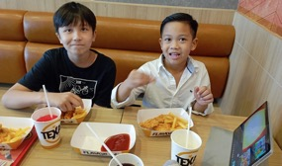
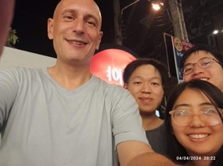
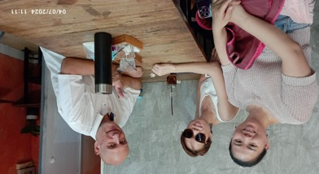
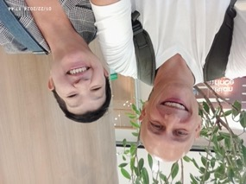
5. CONVERSATION
The best way to boost your French conversational skills is to spend as much time as possible speaking and hearing the target language; so, as well as finding a learning partner to speak French regularly with and watching plenty of subtitled French TV, do as much as you can to make the language an integral part of your everyday life
A bientot
Olivier

