Slide 1






Geometric
IB Math AI SL
Topic 1: Number and Algebra (Part 2)
by @TUTORIO.MATH

Slide 2



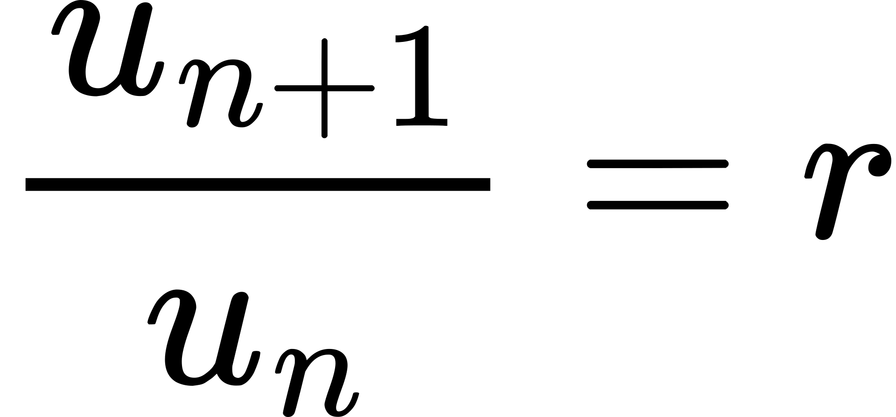
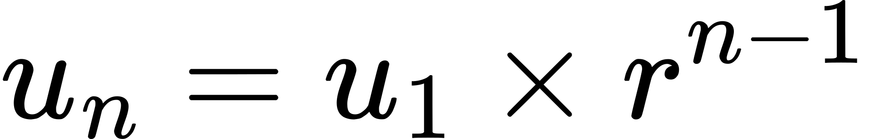
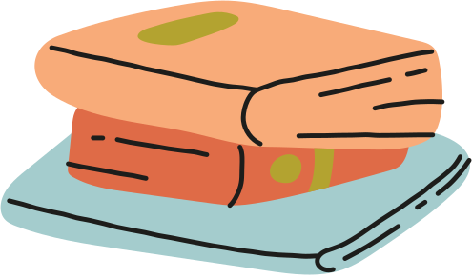
Geometric Sequence
Each term is obtained by multiplying same non-zero constant with common ratio (r)

Slide 3
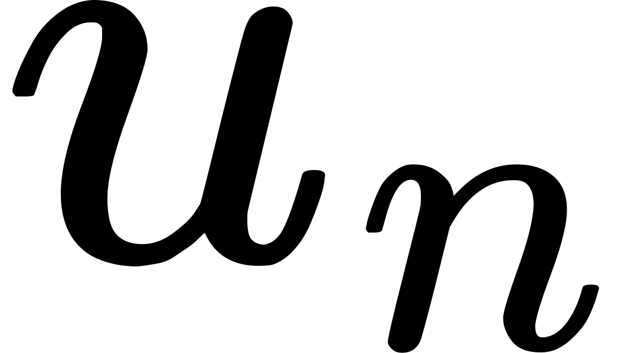
Practice 1
Find the general term of the geometric sequence which has:
(a)
(b)

Slide 4
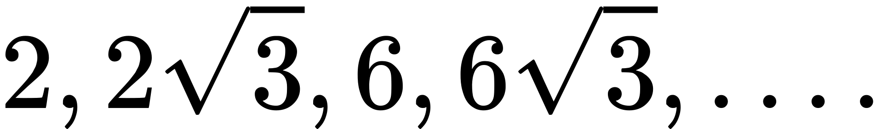
Practice 2
Consider the sequence
(a) Show that the sequence is geometric
(b) Find the formula for its general term
(c) Find the 10th term
(d) Find the first term which exceeds 1000

Slide 5


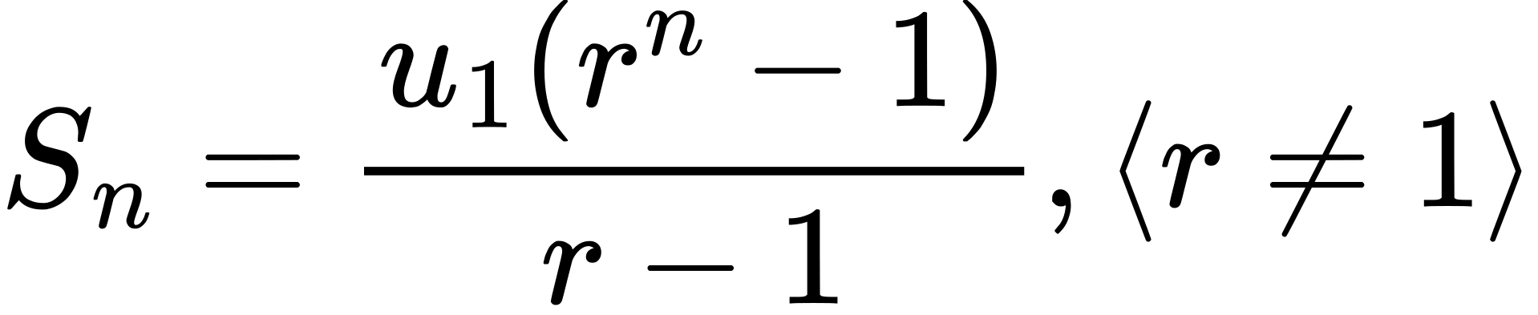


Geometric SERIES

Slide 6
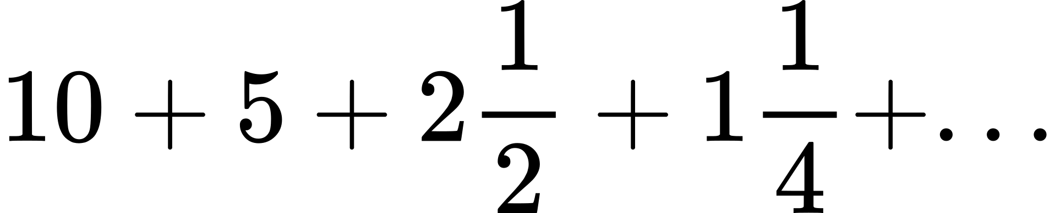
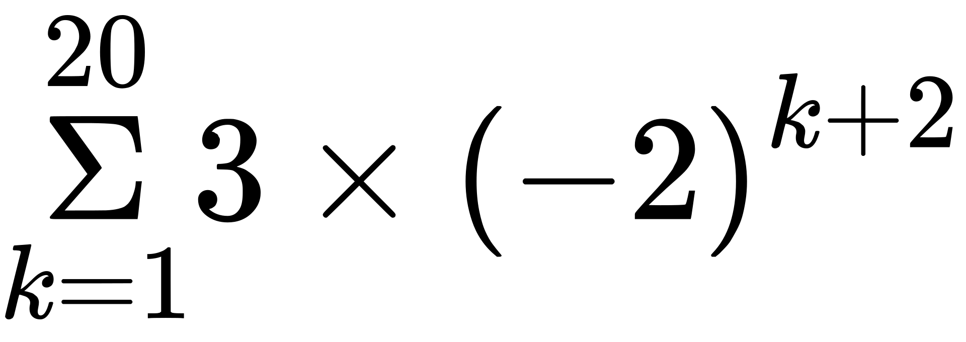
Practice 1
Find the sum of:
(a)
(b)
(c)
to 8 terms
to 10 terms

