Slide 1
Speaking Test Prep
3A - Sample
With Teacher Amanda

Slide 2
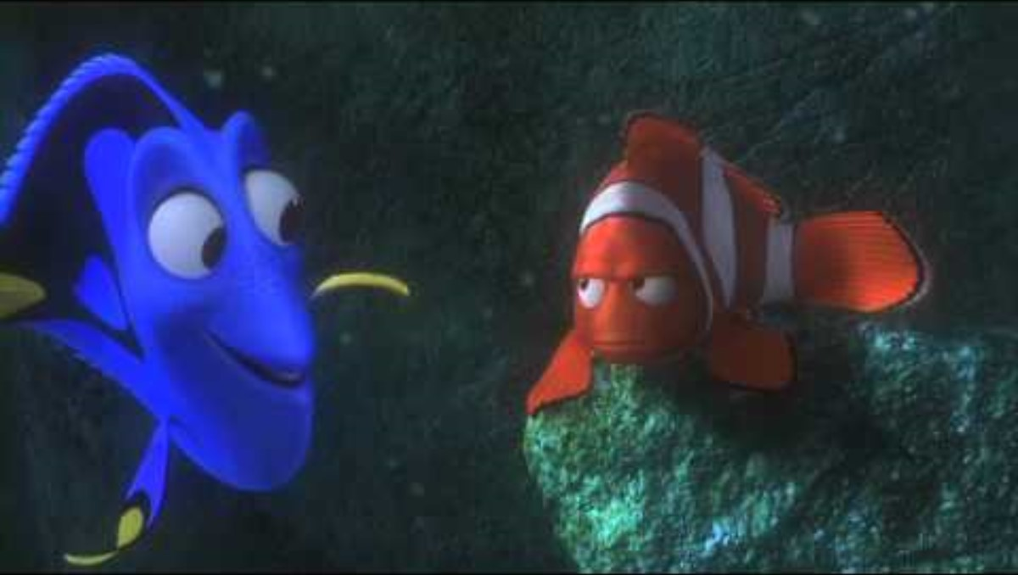
Dramatic Quotables
"Just keep swimming!"
– Dory
Finding Nemo

Slide 3
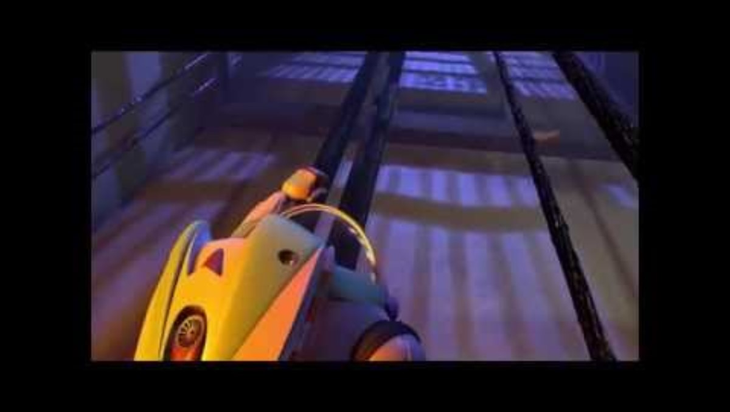
Dramatic Quotables
"To infinity and beyond!"
– Buzz Lightyear
Toy Story
Notes:
https://www.youtube.com/watch?v=Dnl4b6RA5vw

Slide 4
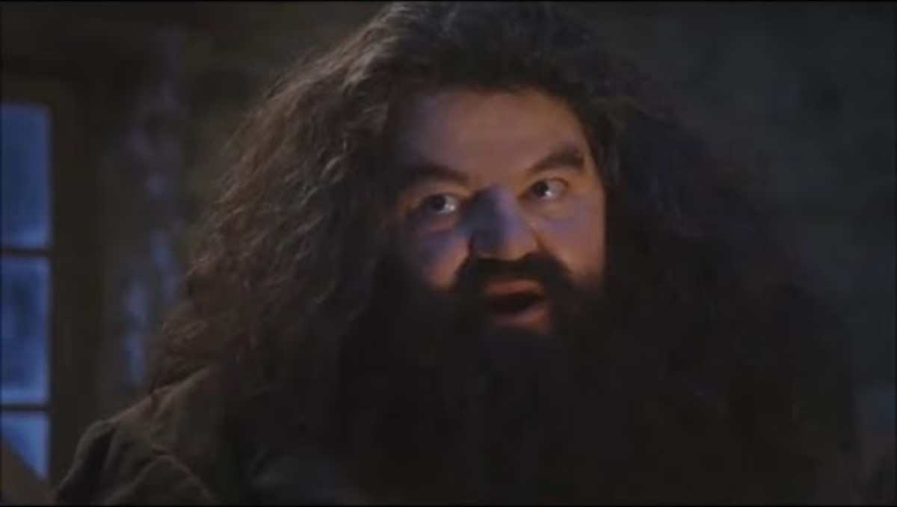
Dramatic Quotables
"You're a wizard, Harry!"
– Hagrid
Harry Potter

Slide 5
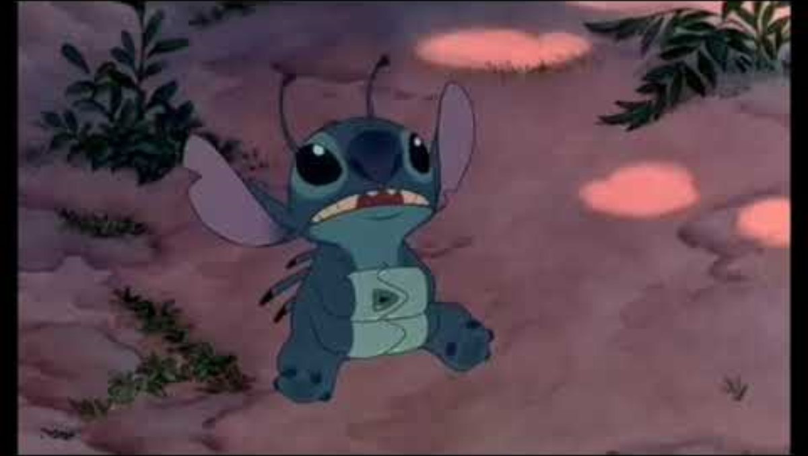
Dramatic Quotables
"Ohana means family. Family means nobody gets left behind."
– Lilo
Lilo & Stitch

Slide 6
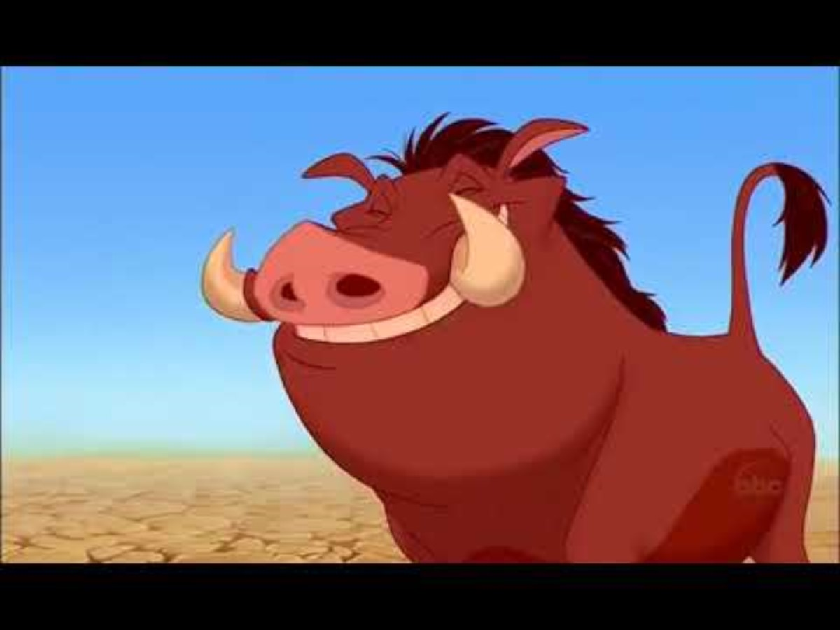
Dramatic Quotables
"Hakuna Matata! It means no worries."
– Timon and Pumbaa
The Lion King

Slide 7

Dramatic Quotables
"Adventure is out there!"
– Ellie
Up

Slide 8
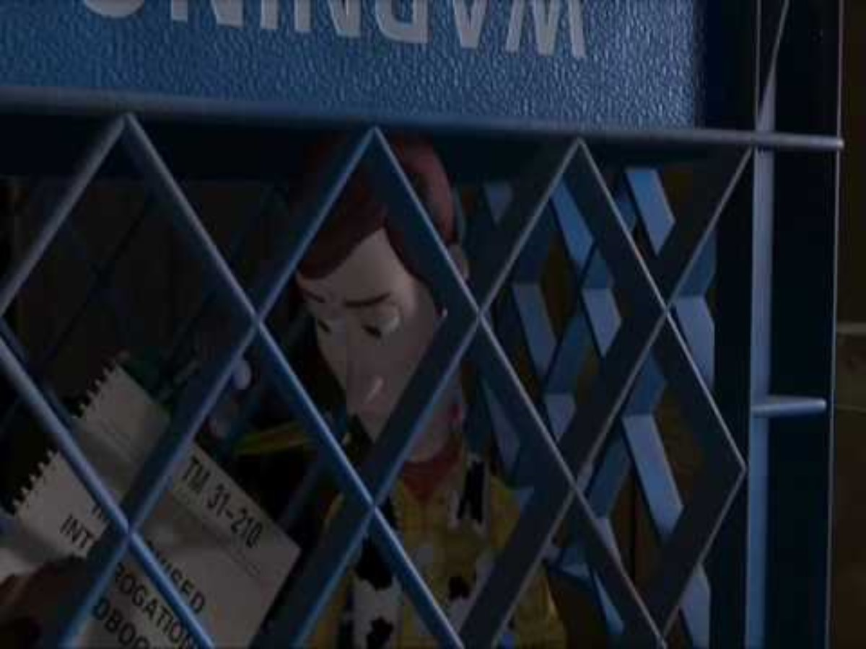
Dramatic Quotables
"There's a snake in my boot!"
– Woody
Toy Story

