Slide 1

An Overview
of General
Statistics
CARMAN ZYRE A. BAUTISTA

Slide 2

Statistics is all about analyzing of data through
research using various methods.
Basically, a researcher collects a sample from a
population and analyze results.
The researcher must have a step-by-step plan
on how to get the best conclusion. Generally,
that is how statistics must work.

Slide 3

Statistics is made up of two things,
Descriptive – The summary of descriptive
results from a collection of data regardless if
sample or population.
Inferential – The summary of inferential results
from a subset of data known as the sample,
where the population of that sample has an
underlying probability distribution.

Slide 4
Say we have a population of a standard deck
of card. Numerically, that is 52 and we draw 2
cards from the top of the deck. Thus, our
sample is 2.
Sometimes data do not provide finite number of
population but instead only provides
hypothetical proportion given a finite number of
sample known as sample units.

Slide 5
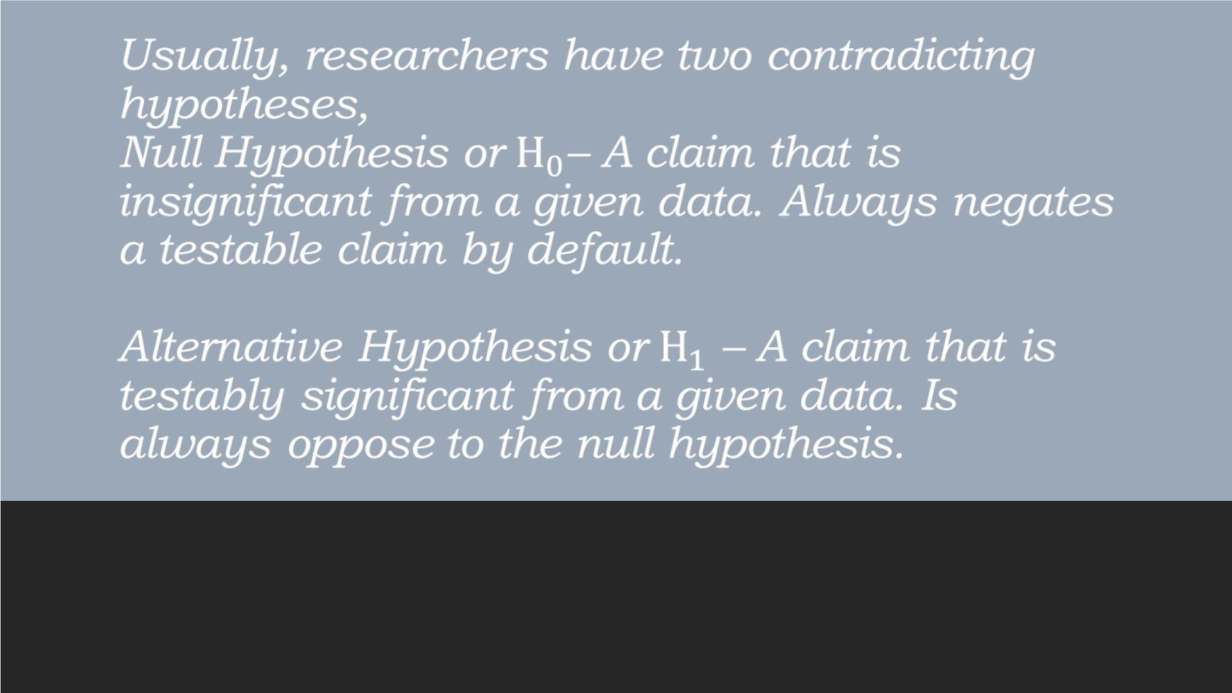

Slide 6
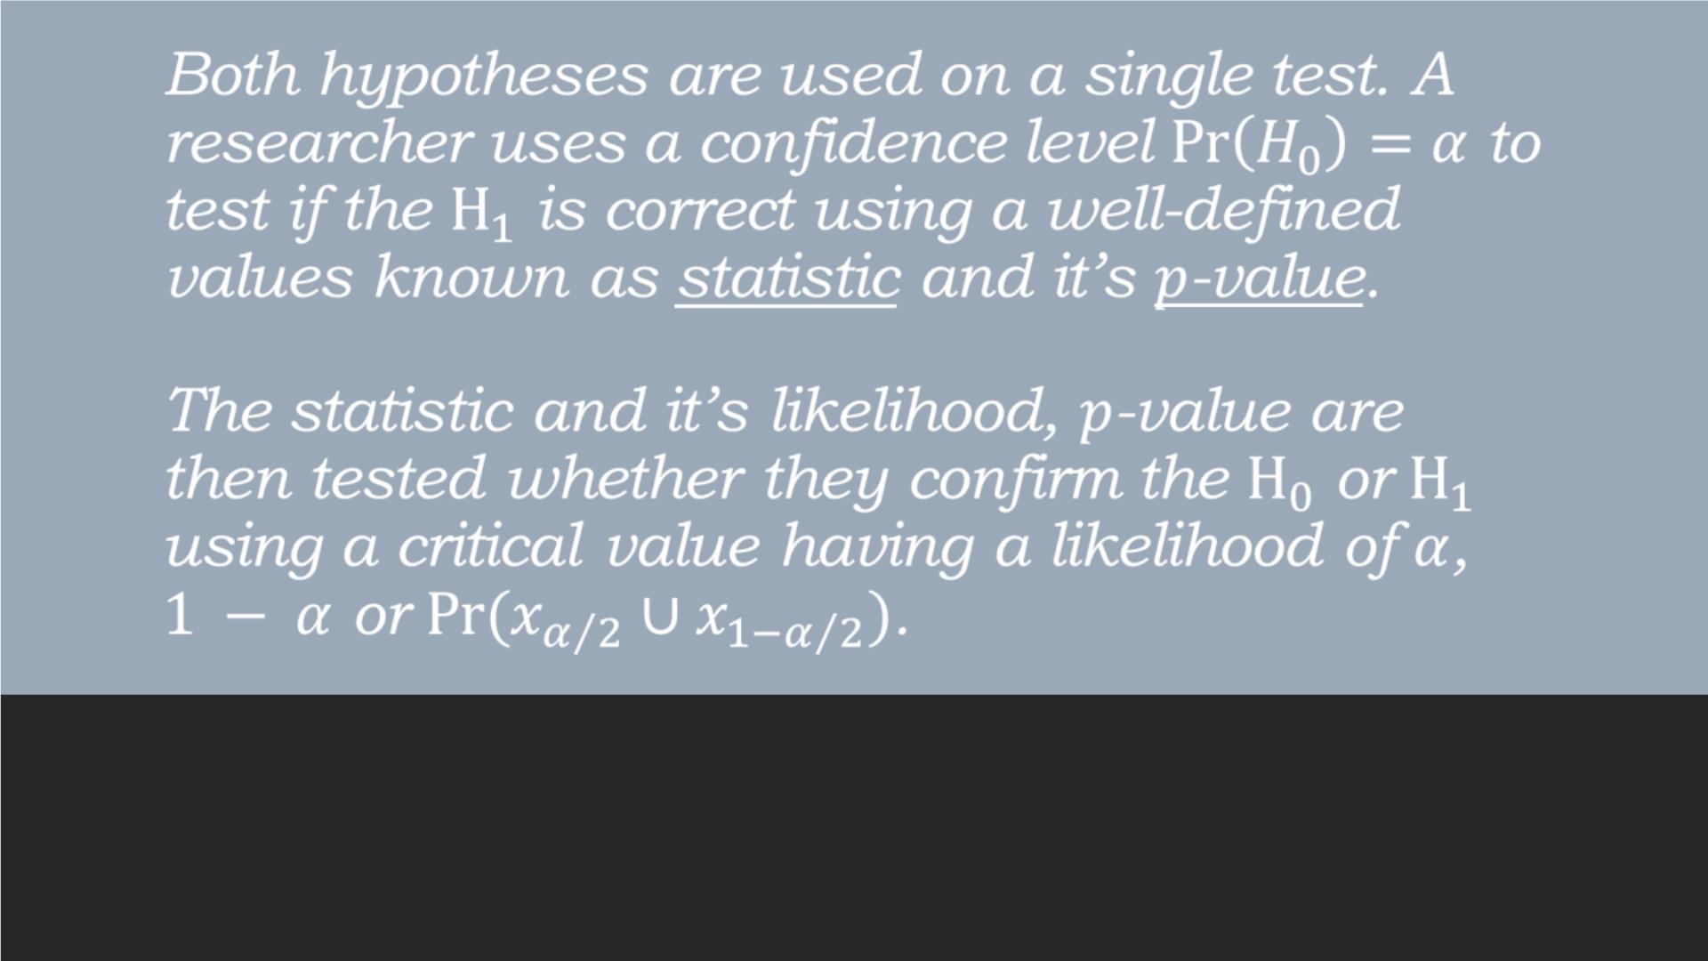

Slide 7
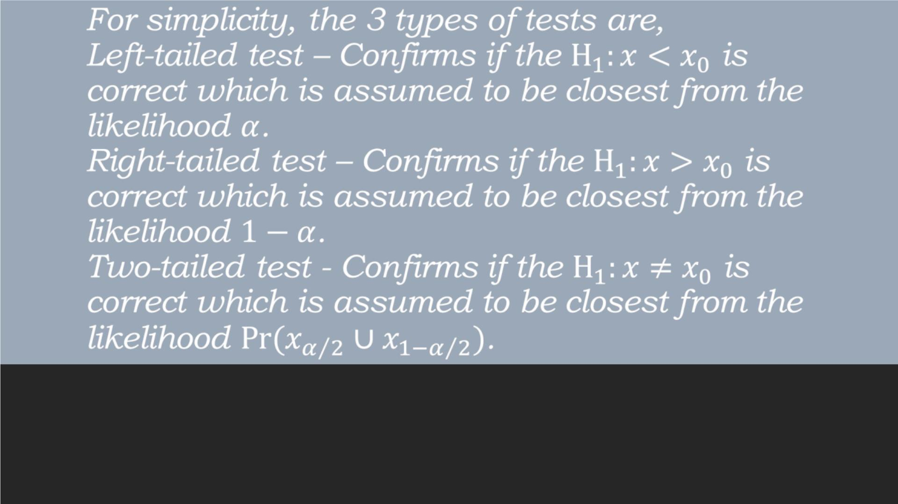

Slide 8
Statistical tests come in different sizes and
shapes but these concepts inevitably exist in all
of them. Generally, these are the things a
student must know before going to the actual
statistics. That ends our discussion about the
overview of general statistics. If you have any
questions feel free to ask, thank you!

