Slide 1
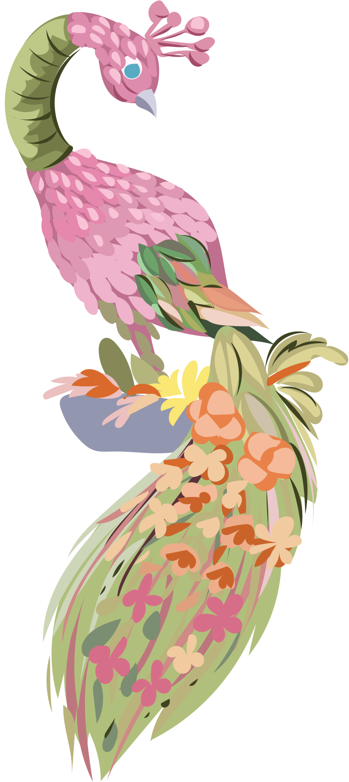

1/9
1
HOW ARE YOU?
khun-sa-bai-dee-mai?
Pearlthaitalk
Copying is prohibited. Unauthorized use may have legal consequences.
#YouTube:pknishappy
#IG:pknistutor

Slide 2
2/9
2
I AM FINE.
chan-sa-bai-dee
Pearlthaitalk
Copying is prohibited. Unauthorized use may have legal consequences.
#YouTube:pknishappy
#IG:pknistutor

Slide 3
3/9
3
I HAVE A FEVER.
chan-pen-kai
Pearlthaitalk
Copying is prohibited. Unauthorized use may have legal consequences.
#YouTube:pknishappy
#IG:pknistutor

Slide 4
4/9
4
WHAT IS
YOUR NAME?
khun-chue-a-rai?
Pearlthaitalk
Copying is prohibited. Unauthorized use may have legal consequences.
#YouTube:pknishappy
#IG:pknistutor

