Slide 1

Equations & Inequalities: Part 1
OCT
2024
LESSON 1

Slide 2
Prior Knowledge
To know how to work with Equations & Inequalities, you need a strong foundation in basic Algebra.

Slide 3
Prior Knowledge
Check the Algebra slides for a recap
Algebra Checklist:
Variables, constants, terms, and coefficients
Simplification
Factorisation
Order of operations
Exponents

Slide 4
Equations
Solving an equation means finding the value of the variable/variables that make(s) the equation true.
For example: x + 1 = 3
For the equation to be true x has to be equal to 2.
Basically, equations are about making the left-hand side equal to the right-hand side.

Slide 5
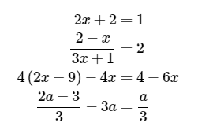
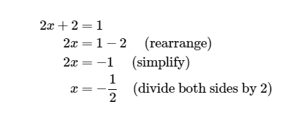
1.Linear Equations
Check the answer by substituting it into the variable(s).
The simplest equation to solve is a linear equation. A linear equation is an equation where the highest exponent of the variable is 1.
With linear equations, there is at most one solution for the equation.
Examples of equations:

Slide 6
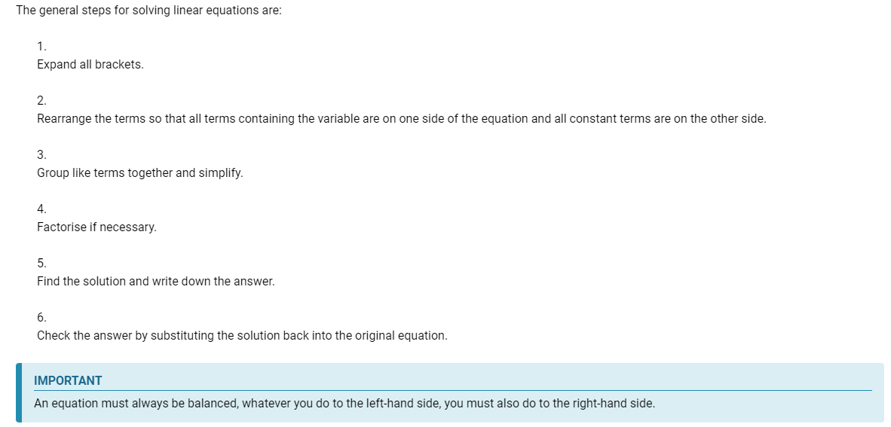
Method for solving Linear Equations

Slide 7
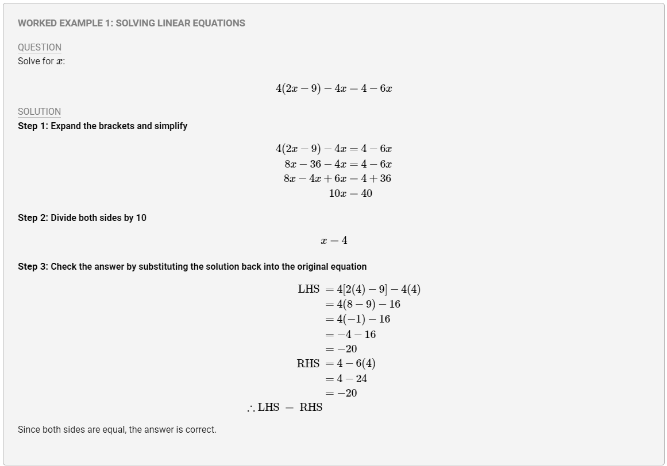
Examples

Slide 8
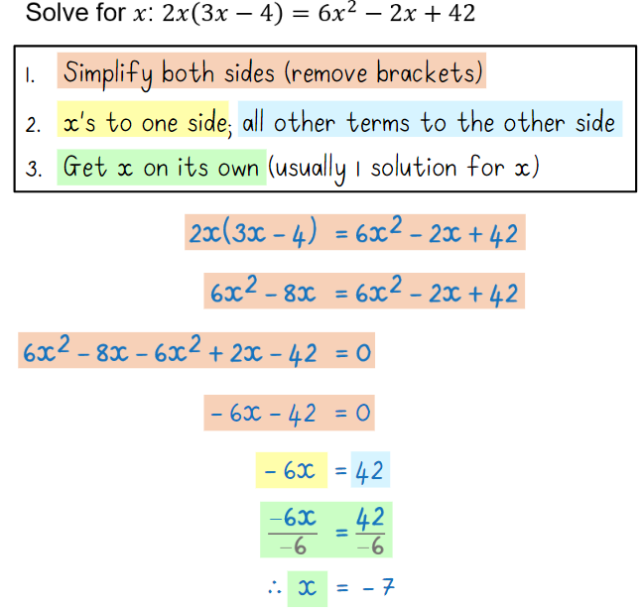
Examples

Slide 9
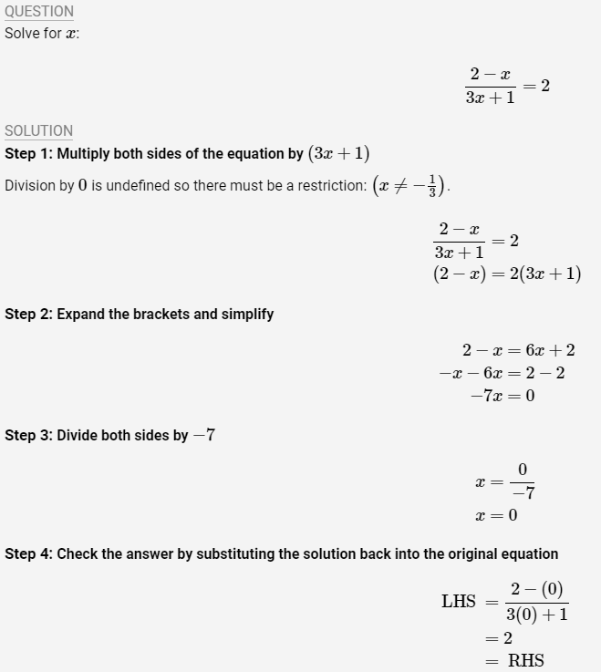
2.Equations with Fractions

Slide 10
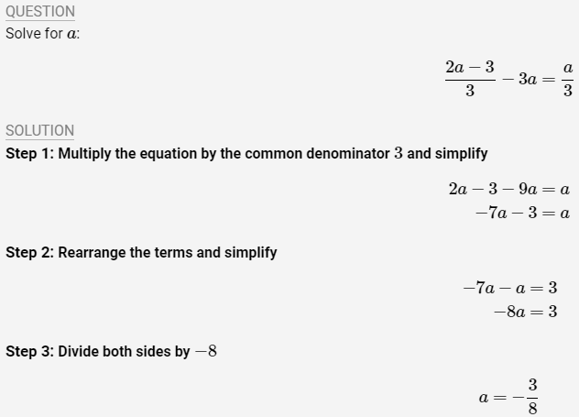
Examples

Slide 11

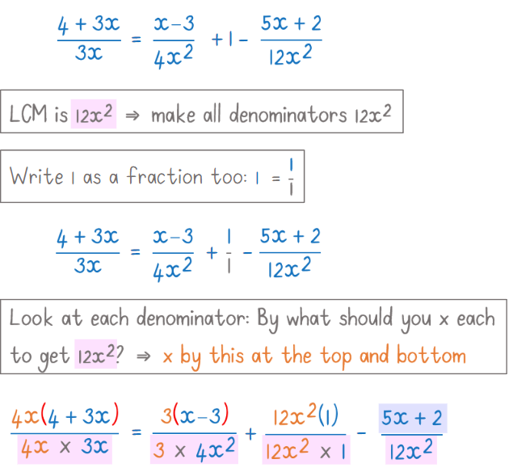
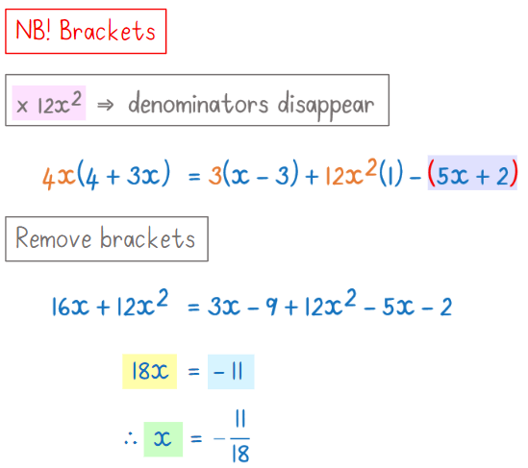
Examples: Method 1-make denominators the same

Slide 12
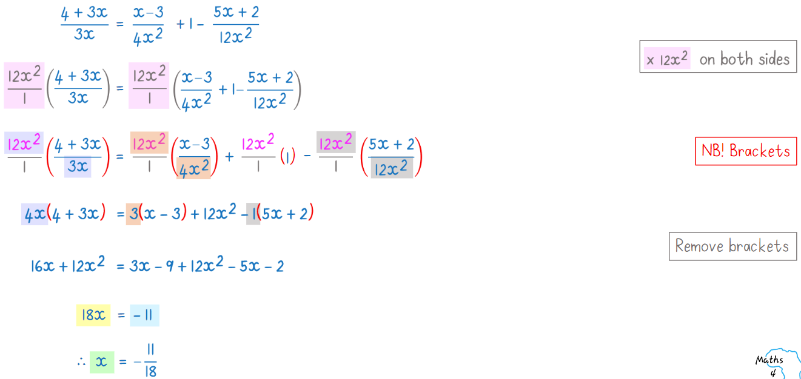
Examples : Method 2- x by LCM right away

Slide 13
Worksheet 1

Slide 14
3.Quadratic Equations
A quadratic equation is an equation where the highest exponent of the variable is 2.
With linear equations, there is at most two solutions for the equation.
There are some special situations where a quadratic equation has either 1 solution or no solutions.

Slide 15
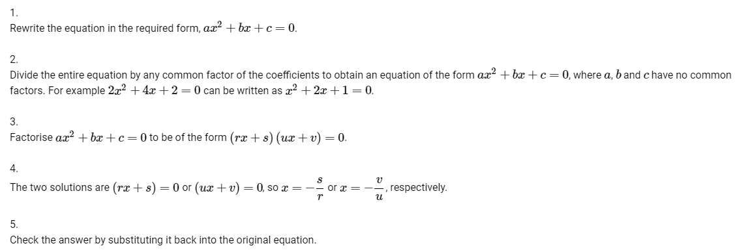
Method for solving Quadratic Equations

Slide 16
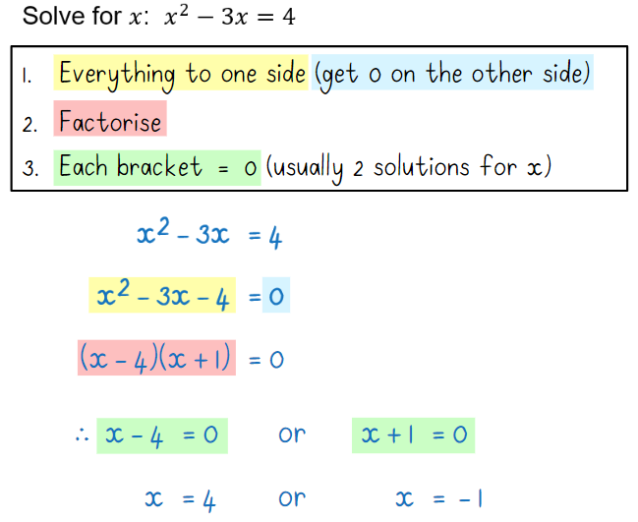
Examples

Slide 17
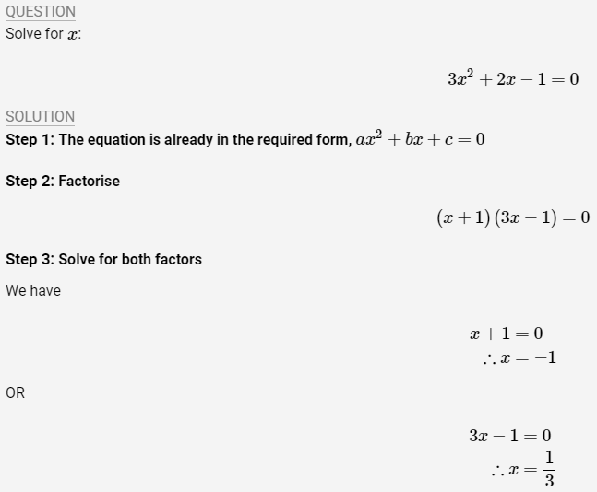
Examples

Slide 18
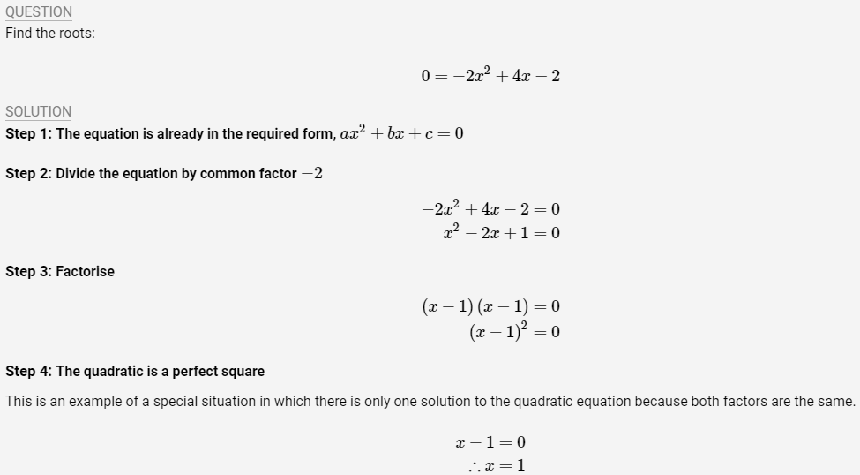
Examples

Slide 19
Worksheet 2

Slide 20
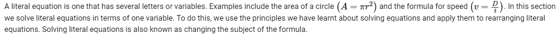
4.Literal Equations

Slide 21
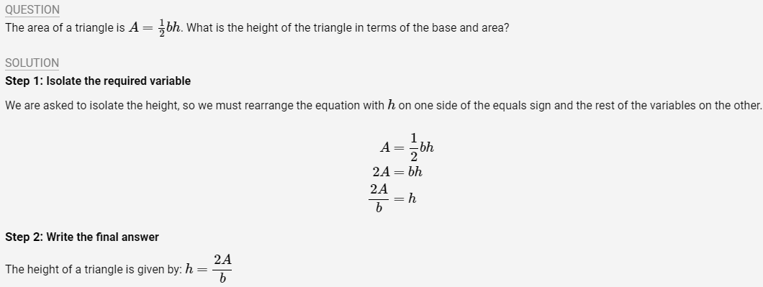
Examples

Slide 22
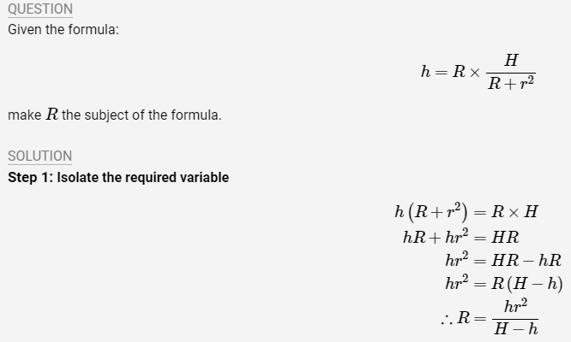
Examples

Slide 23
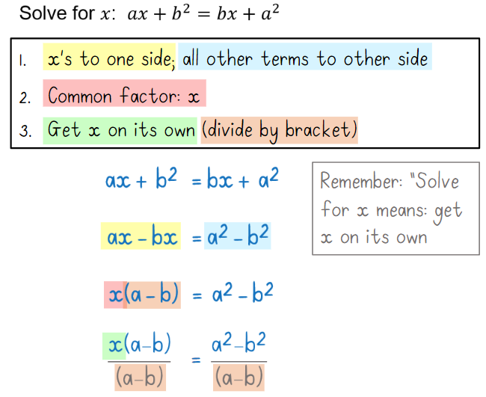
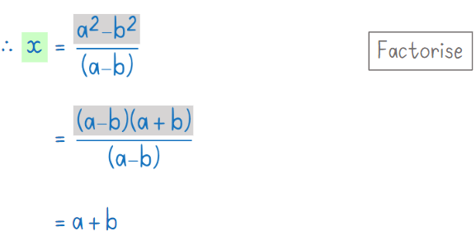
Examples

Slide 24
Worksheet 3

Slide 25
Credits
siyavula.com
maths4africa.co.za

