Slide 1
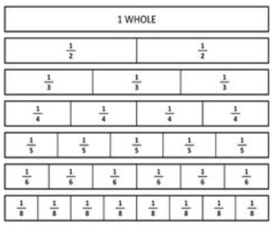
What is a Fraction

Slide 2
What is a Fraction?
A fraction represents part of a whole.
When something is broken up into a number of parts, the fraction shows how many of those parts you have.

Slide 3
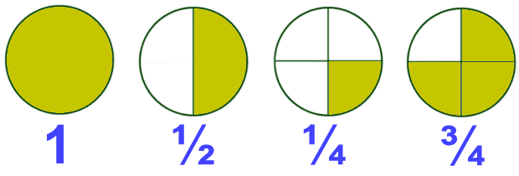
Pictures of Fractions
What do fractions look like. The easiest way to understand fractions is to visualise them. We can see a whole circle broken up into different fractions.

Slide 4
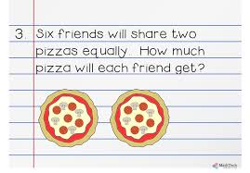
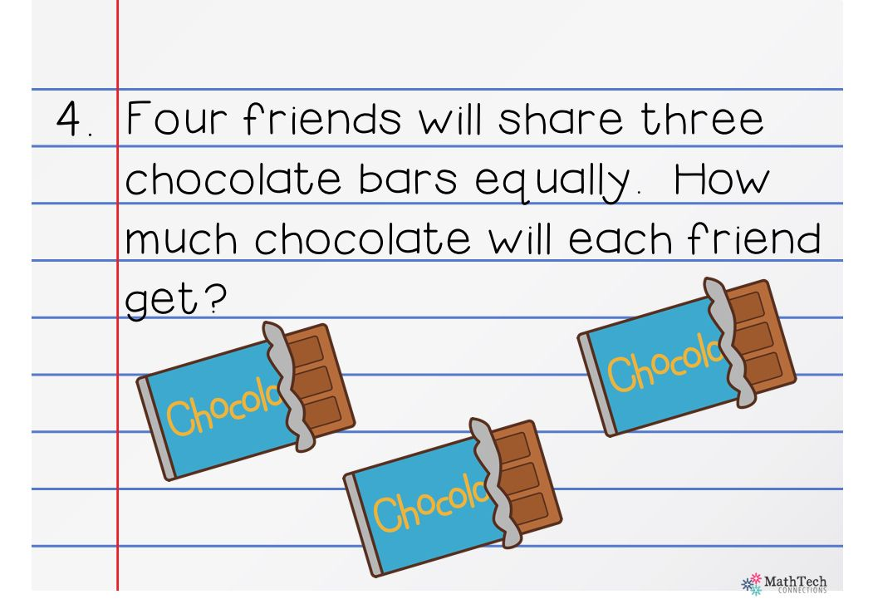
Still unsure.
Maybe you think what's the point of fractions or maybe still a bit confused.
When would I use fractions?
Have you ever shared food with someone?

Slide 5
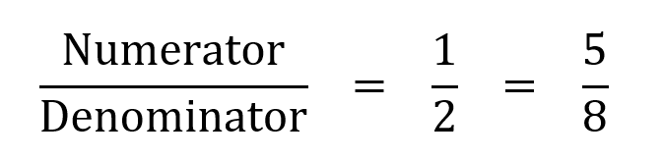
Let’s try get into it.
When writing a fraction there are two main parts: the numerator and the denominator.
Numerator is how many parts you have.
Denominator is how many parts the whole was divided into.
Fraction are written with the numerator on top and the denominator on the bottom and a line between them

Slide 6
Types of Fractions
Still following.
There are three different types of fractions.
Proper Fractions – Numerator is less than the denominator.
Improper Fraction – The numerator is greater than the denominator
Mixed Fractions – A whole number part and a fractional part.

Slide 7

Finally! Equivalent Fractions
Sometimes fractions may look different and have different numbers but thy are equivalent or have the same value.
On of the simplest examples of equivalent fractions is the number 1.
$$1=\frac{2}{2}= \frac{8}{8}= \frac{34}{34}= \frac{100}{100}$$
Here are some equivalent fractions of 1/4.
$$\frac{1}{4}= \frac{2}{8}= \frac{10}{40}= \frac{25}{100}$$

Slide 8
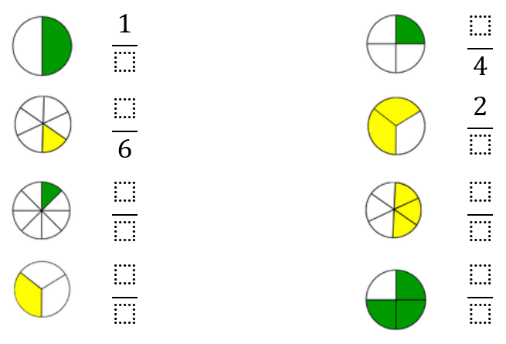
Try these
Give these questions a. go.

Slide 9

Future learning
Decimals and Percent have a special relationship with fractions
Decimal Points
  When Decimal points are used in numbers, the number on the right of the decimal point is a type of fraction. It depends on the place value.
0.3 = $\frac{3}{10}$ 0.42 = $\frac{42}{100}$
Percent
  Another type of fractions is the percent. The ‘percent’ is a fraction with the denominator of 100
50% = $\frac{50}{100}$ = ½

