Slide 1
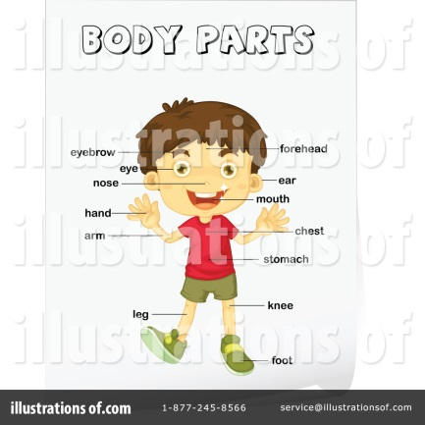

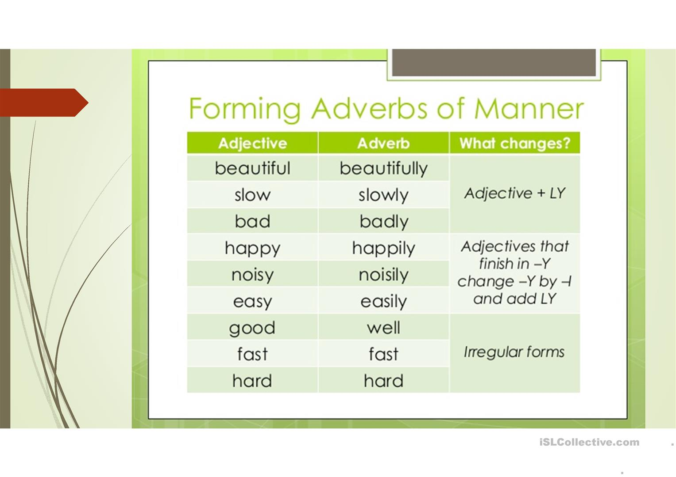
Adverbs of Manner
bad-badly
quick-quickly
calm-calmly
patient-patiently
careful-carefully
safe-safely
easy-easily
happy-happily
Irregular forms
good-well
fast-fast
hard-hard

Slide 2
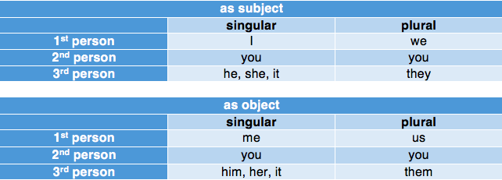
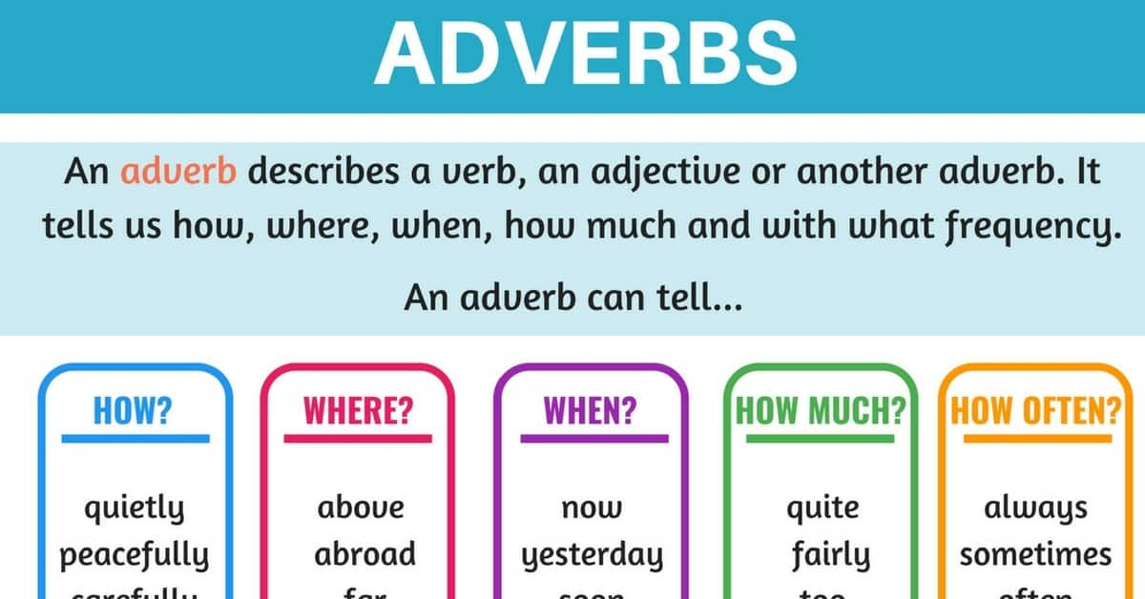
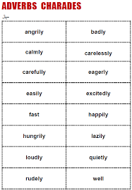
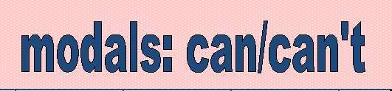
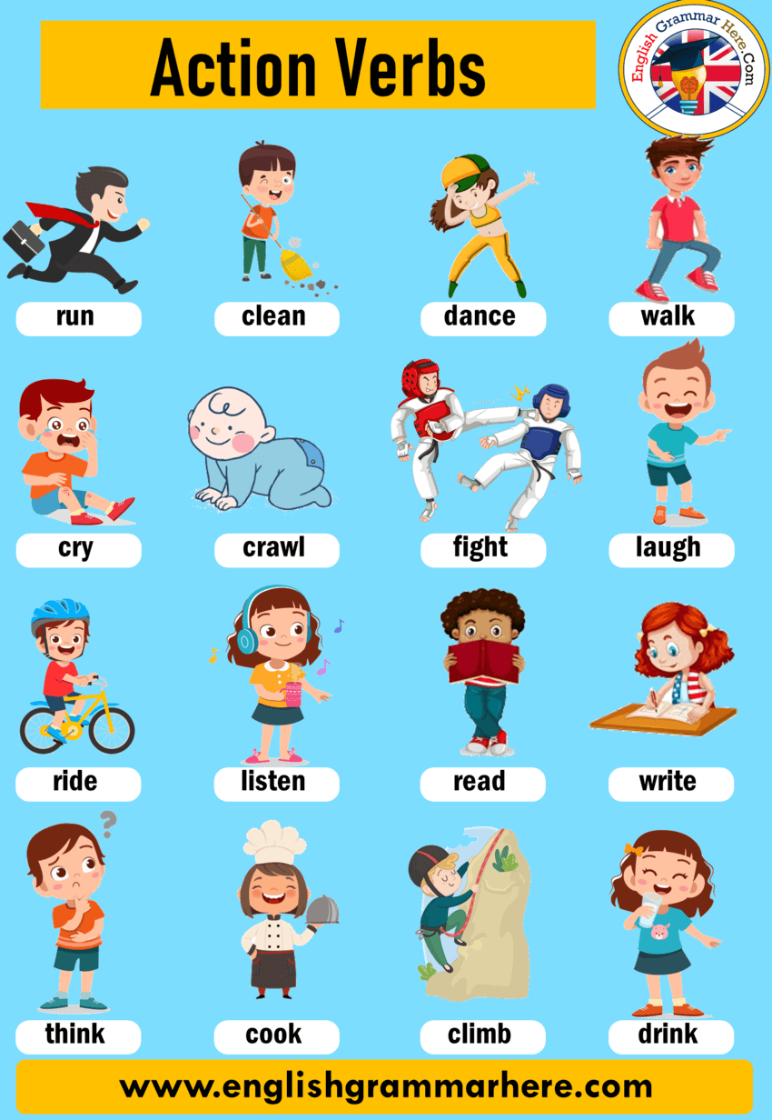
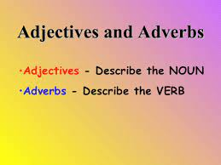
She can sing well.
She can’t sing well.
Subject + Modal Verb (can/can’t) + Action Verb/v1 + adverb

Slide 3


A: How do you stay fit and healthy?
B: I do my daily exercise.
A: What kind of exercise is that?
B: I do running, so I can run easily.
A: Can I join with you?
B: Yes, you can. (positive answer)
jumping-jump quickly, biking-bike carefully, climbing-climb badly, diving-dive calmly, & swimming-swim well

Slide 4
A: Hello my friend, which sport do you think is the easiest to play?
B: Well for me, I think football. Can you kick perfectly?
A: Yes, I can.
(positive answer)
-basketball-run quickly, volleyball-jump safely, baseball-hit strongly
& swimming-swim calmly
A: Hello my friend, which activity do you think is the best to do?
B: For me, I think cooking. Can you cook well?
A: No, I can’t.
(negative answer)
-playing guitar-play perfectly, Zumba dancing-dance slowly, learning Chinese-learn-easily, drawing-draw beautifully & singing English songs-sing amazingly

Slide 5
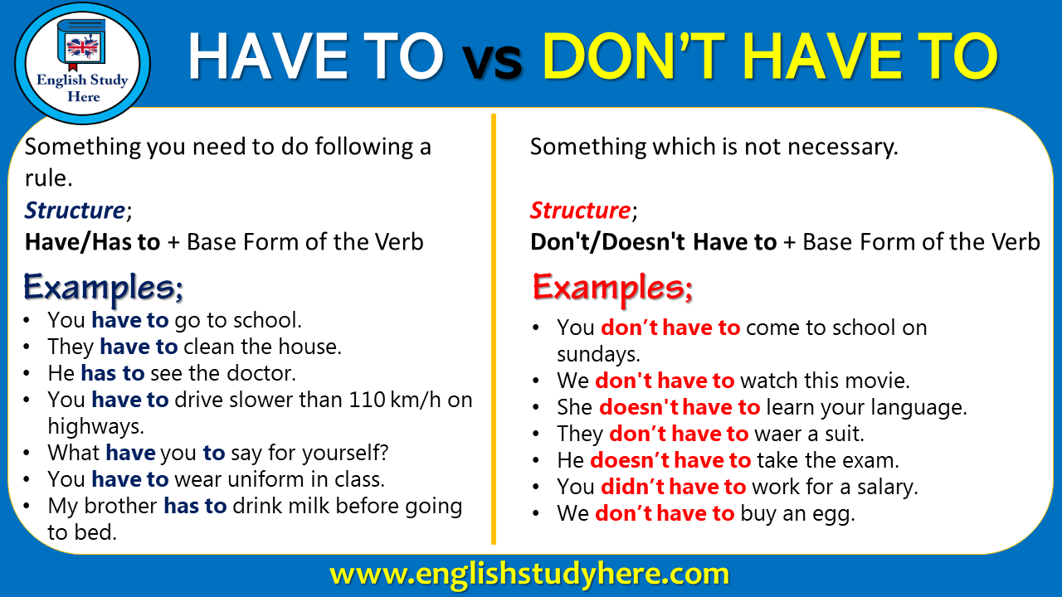
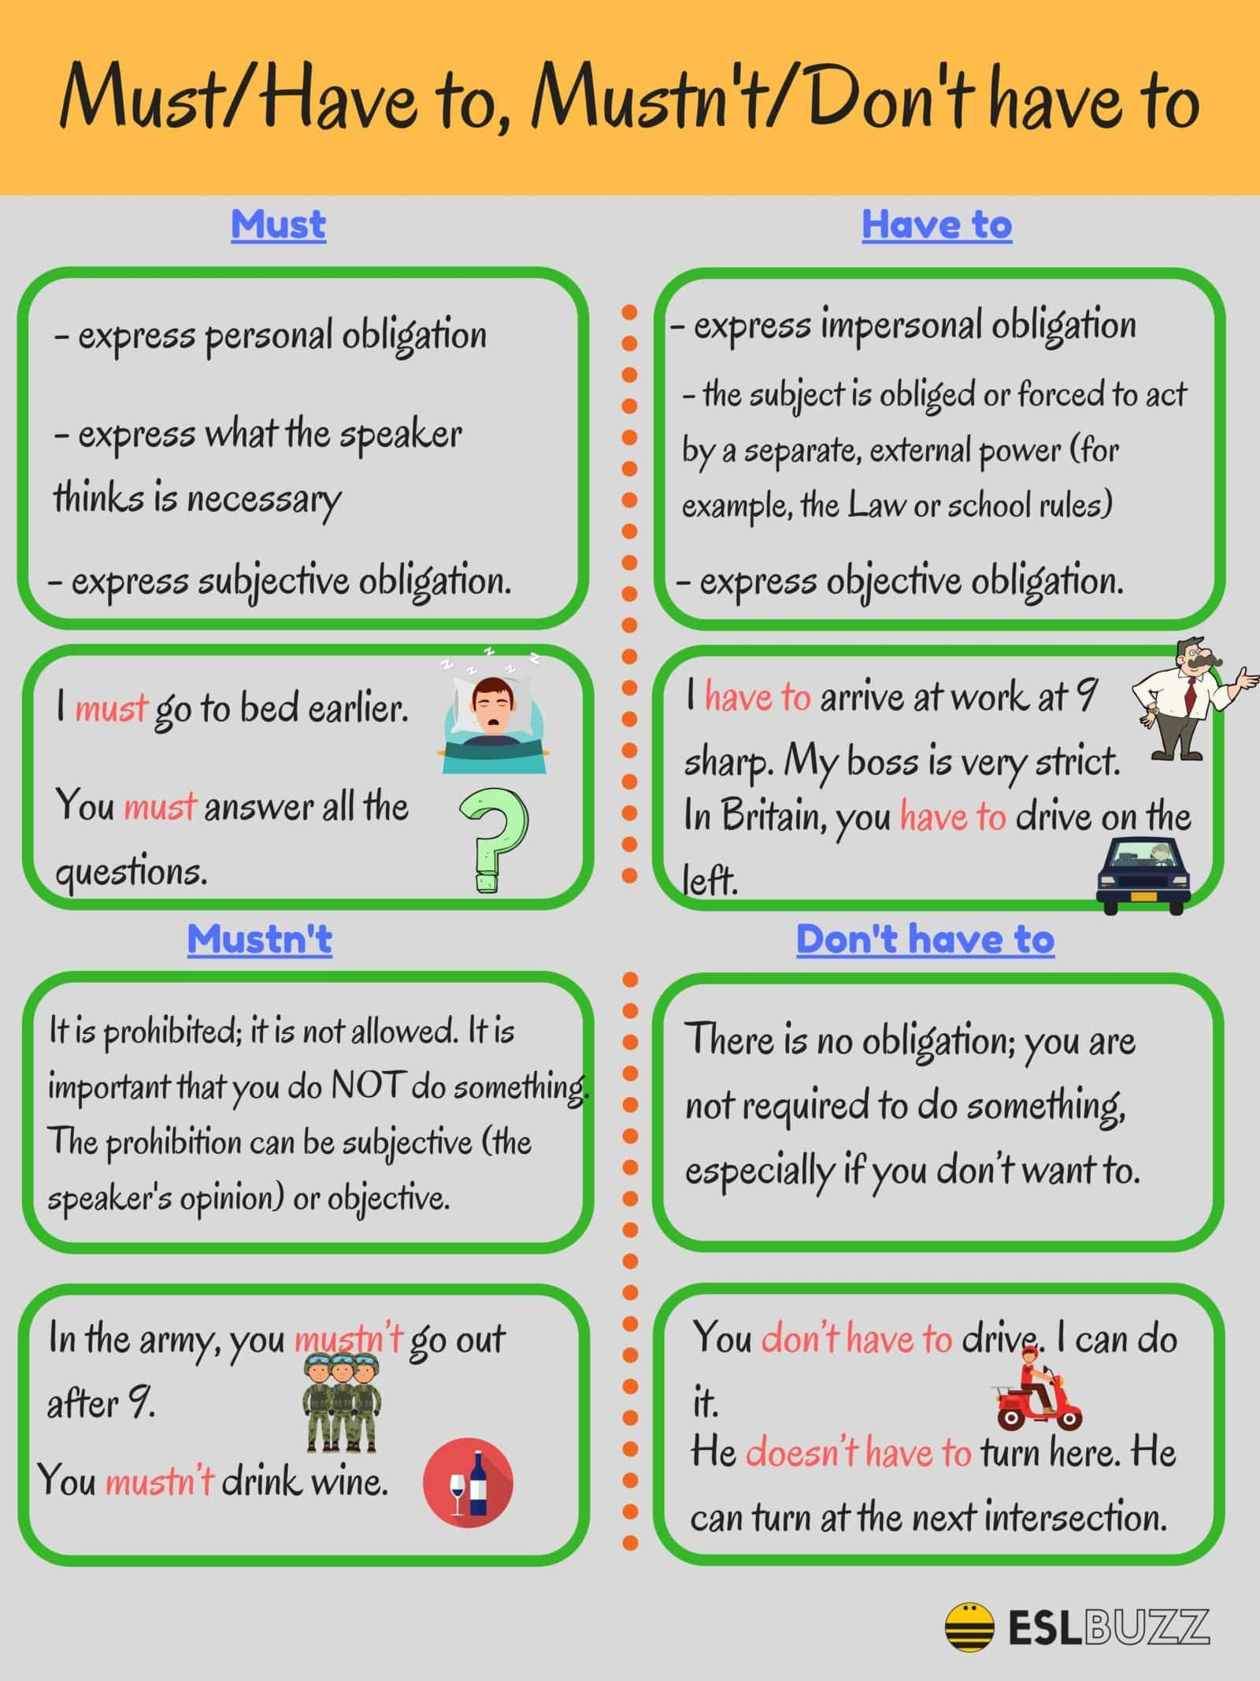
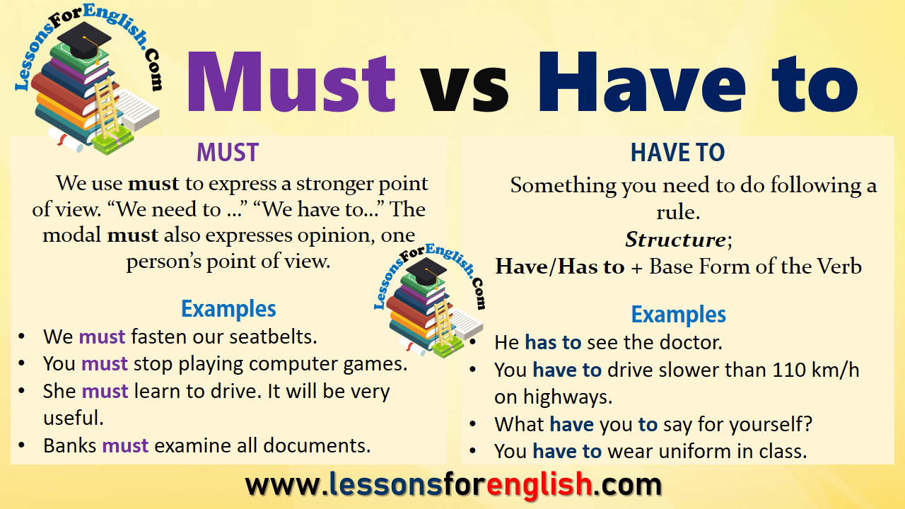

Slide 6
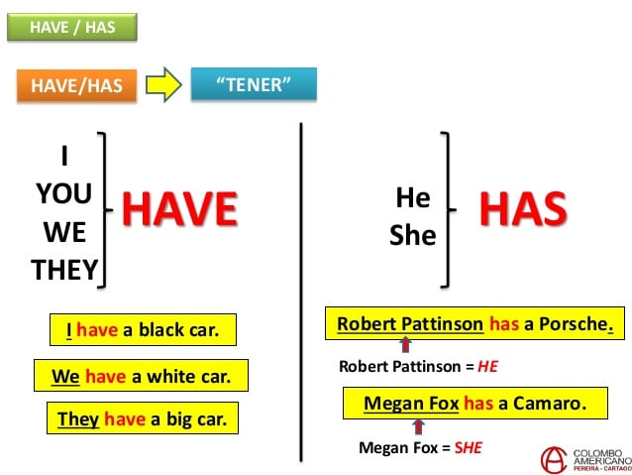
Affirmative Sentence
Short Answer
have
has
Do you have to wear a uniform?
Yes, I/you/we/they do.
to
It
to
Negative Sentence
No, I/you/we/they don’t.
don’t
doesn’t
have
Does she have to wear a uniform?
have
Yes, she/he/it does.
to
It
to
Question Sentence
No, she/he/it doesn’t.
Do
I
you
we
they
she
he
it
Does
have
have
to
to
I have to clean my room, so I don’t have to wash dishes.

Slide 7
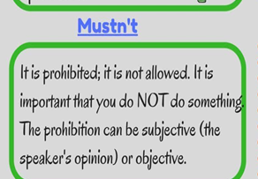
Affirmative Sentence
main verb
action verb
V1
-walk
-talk
-eat
-dance
-play
-sing
-listen
-learn
-write
-plan
-sleep
must
come.
It
Negative Sentence
mustn't
come.
It
I must learn, so I mustn't play my phone.
Pages 44-46

