Slide 1
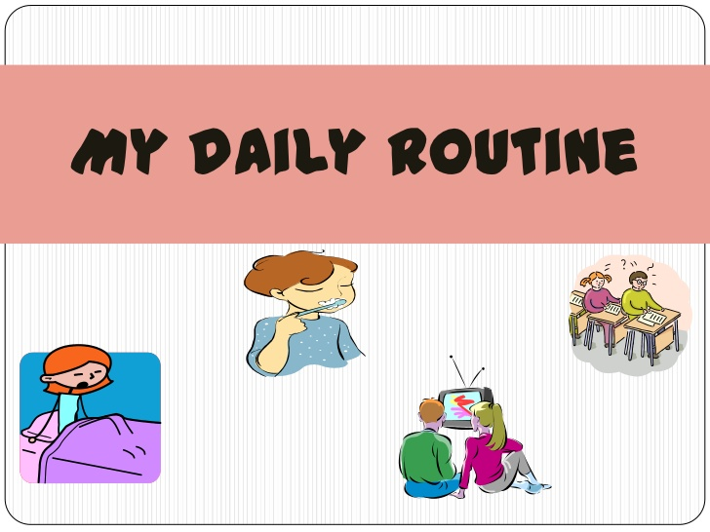
Present Simple Tense
and
its Grammar in Context

Slide 2
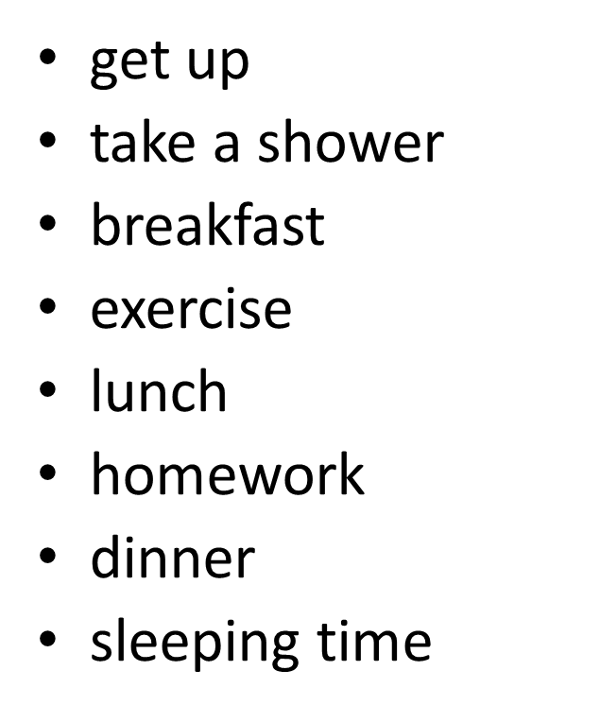
-Introducing some of those DAILY ROUTINE-

Slide 3
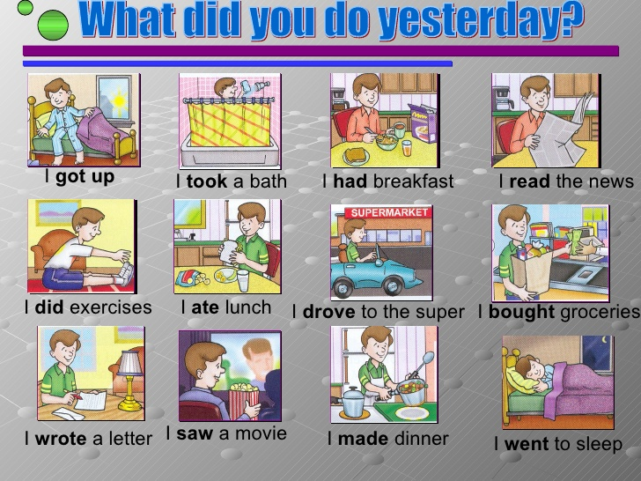
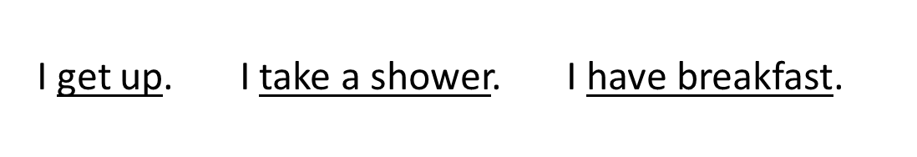
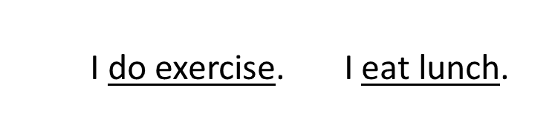
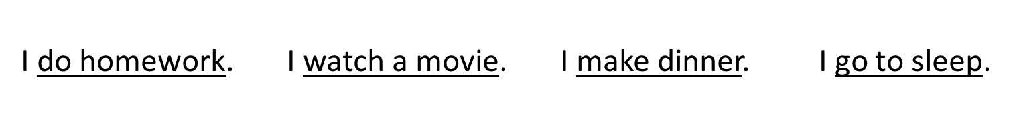
- apply simple present tense and using simple sentence correctly-

Slide 4
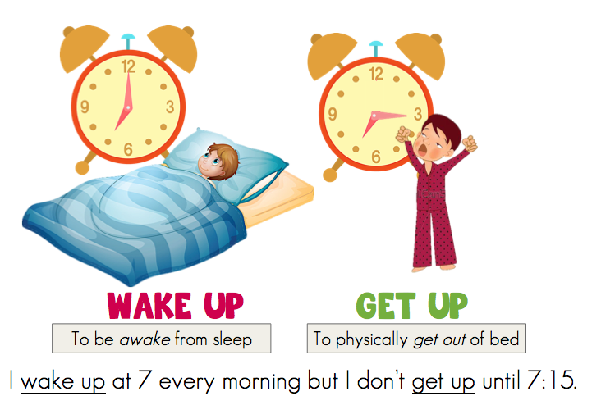
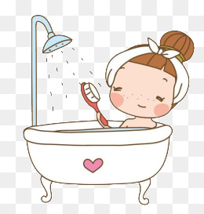
I get up at 6.00, and take a shower.
-to use them all again by with compound/complex sentence correctly-

Slide 5
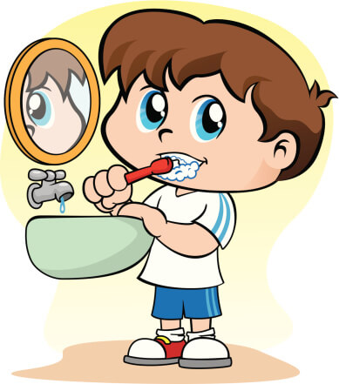
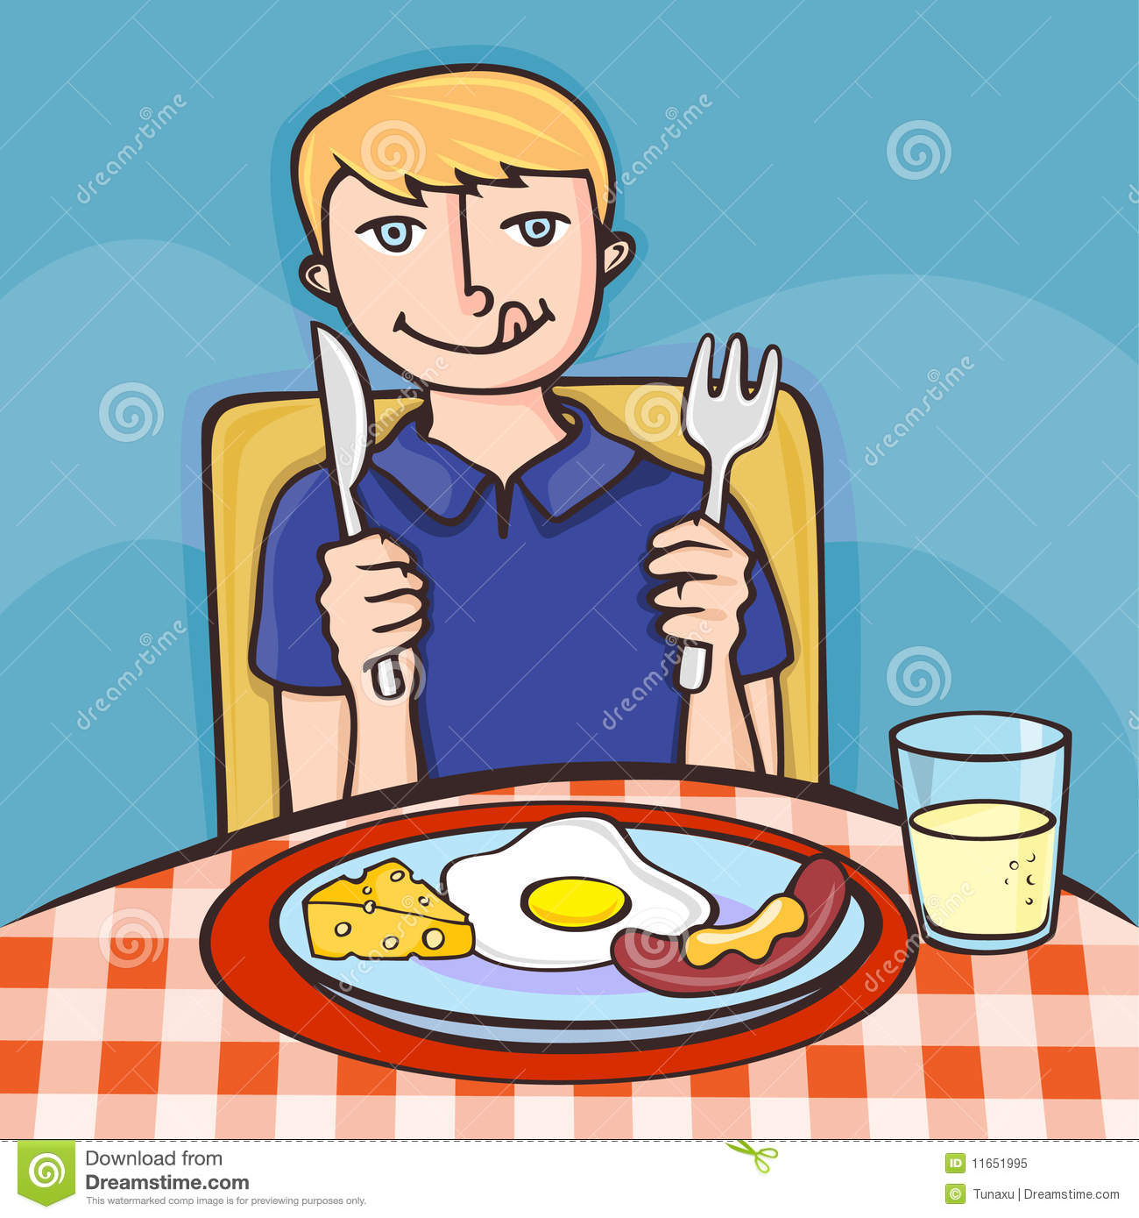
I have breakfast and then brush my teeth.

Slide 6
At school I do exercise and then have lunch.

Slide 7
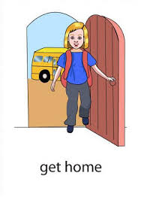
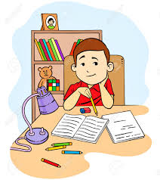
I get home, and do homework.

Slide 8
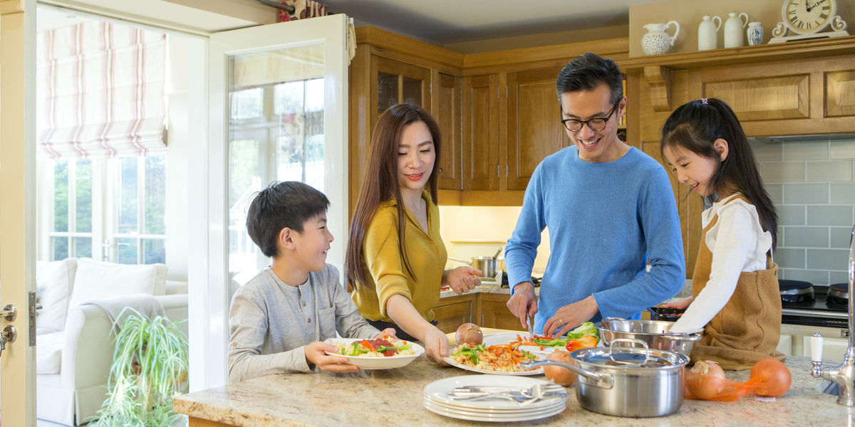
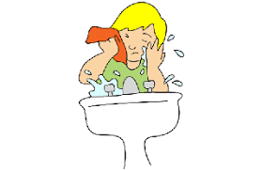
Our family eats dinner and then I wash myself.

Slide 9
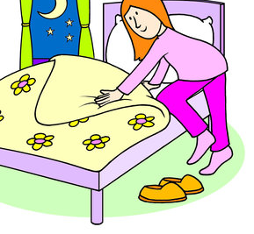
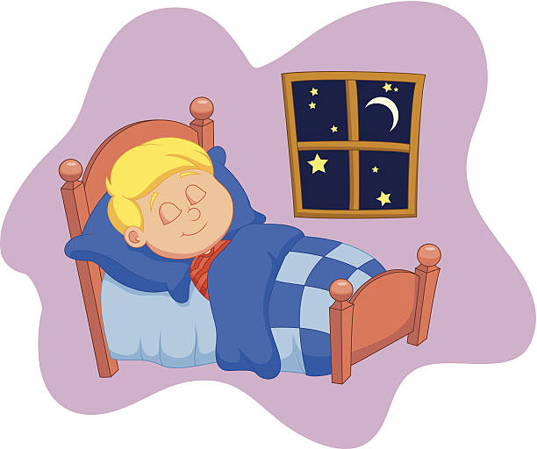
Lastly, I go to bed and sleep at 9 to make sure I am healthy.

Slide 10
Let’s repeat them all again confidently.
get up
take a shower
breakfast
exercise
lunch
homework
dinner
sleeping time

Slide 11
Ok let’s practice the Conversation Drill:
I am A and you’re B then swap later. Let’s start.
A: What time do you get up?
B: I get up at 6 every day. What about you?
A: I get up at 5.30 on weekdays.
B: Wow, thanks and see you later.
A: What time do you sleep at night?
B: I sleep at 9. What about you?
A: Me too, I sleep at 9.
B: All right, bye and see you tomorrow.

Slide 12
-To make sure you feel your routine, let’s make it in a paragraph. Then read it correctly and in English tone.-
MY ROUTINE on Weekdays
---I get up at 6 and take a shower. Then have breakfast and brush my teeth. At school I do exercise and then have lunch. Next, I arrive home and do homework. After that, our family eats dinner together then wash myself. Lastly, I go to bed and I sleep at 9 to make sure I am healthy.

Slide 13
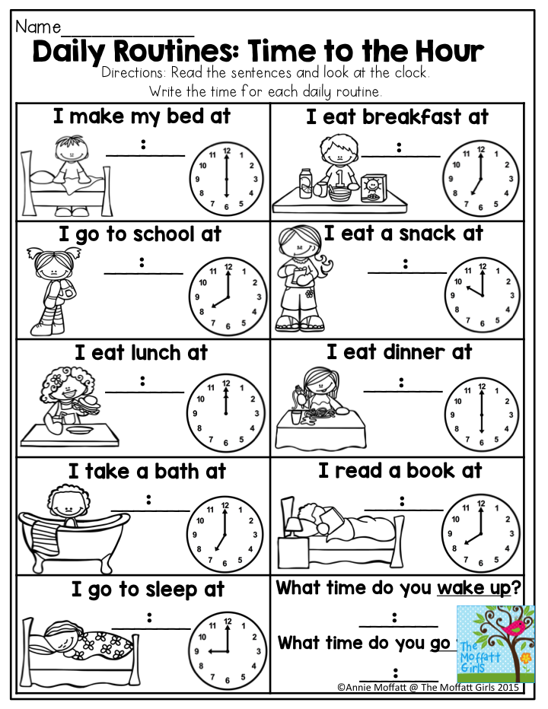
Thanks for learning with me, and you may answer your
homework properly and correctly.
Bye for now see you next time.

