Slide 1
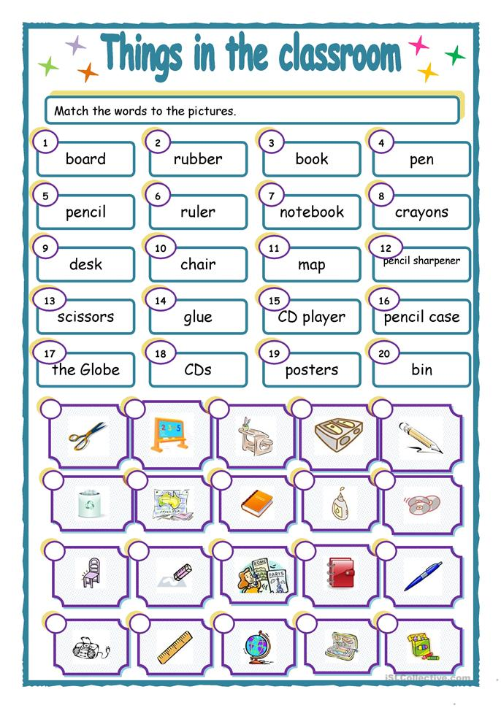

Slide 2
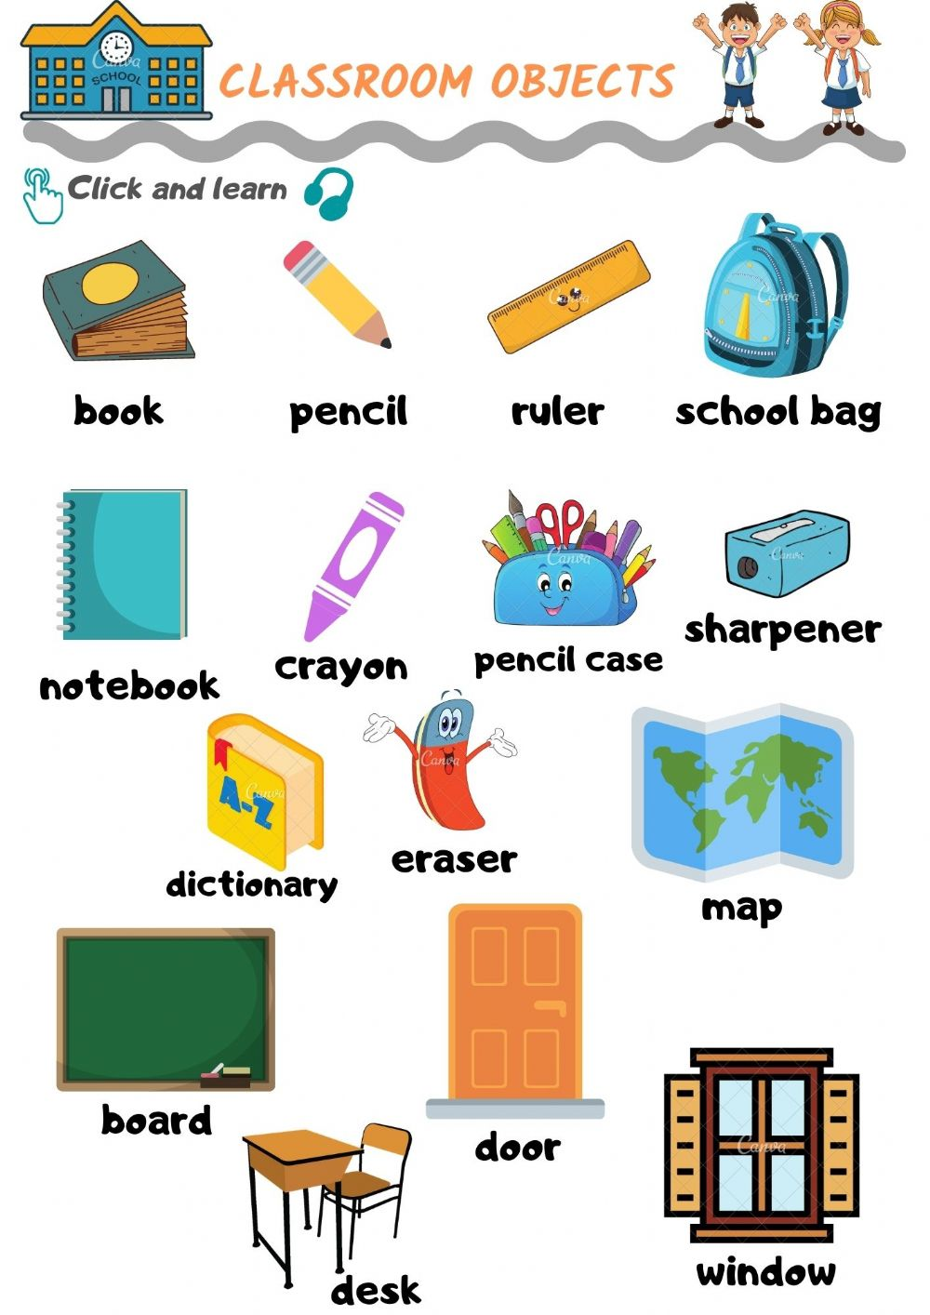
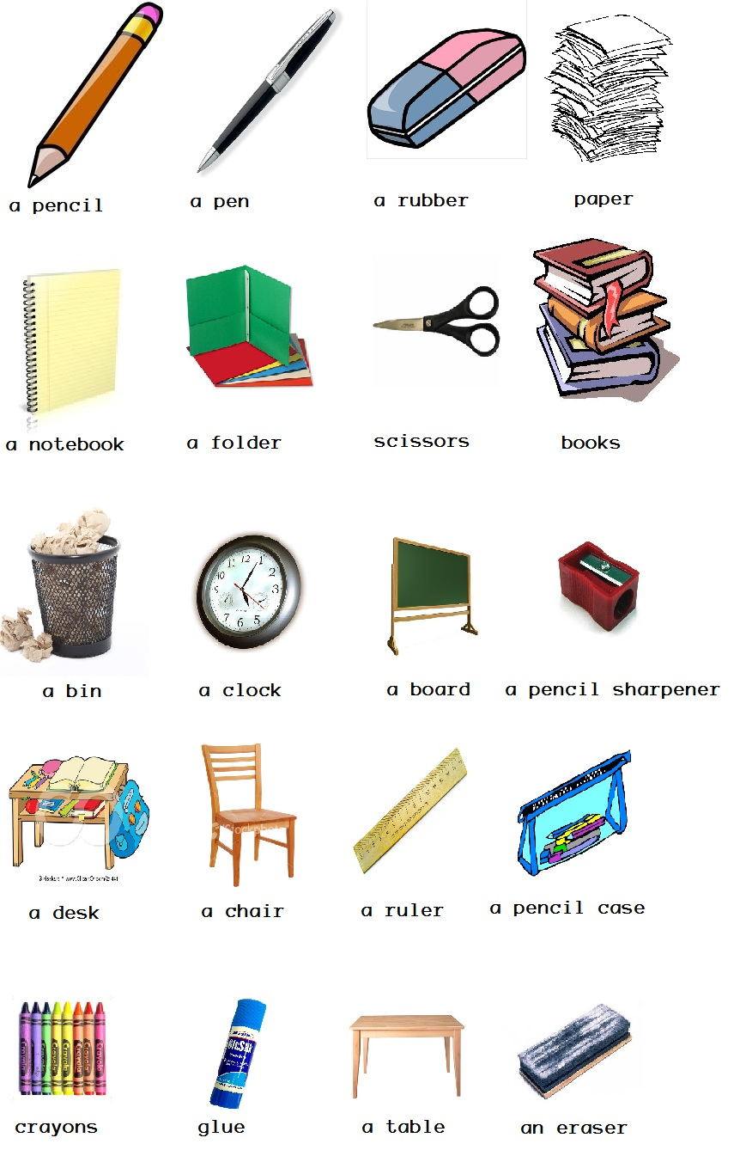

Slide 3
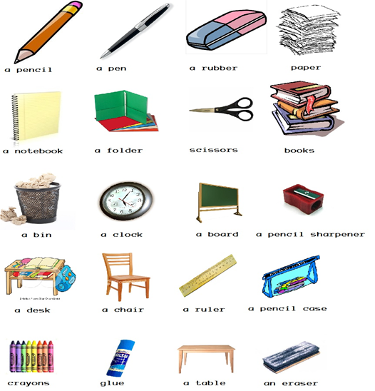
Can I borrow a pen?
Yes, you can. No, you can’t.
Do you have a pen?
Yes, I do. No, I don’t have.
Do you have
a pen/cil?
Can I borrow a pen/cil?
Yes, you can. No, you can’t.
Yes, I do. No, I don’t have.
Can I borrow a paper?
Do you have
a pa/per?
Yes, you can. No, you can’t.
Yes, I do. No, I don’t have.
Can I borrow an eraser?
Do you have
an e/ra/ser?
Yes, you can. No, you can’t.
Yes, I do. No, I don’t have.

Slide 4
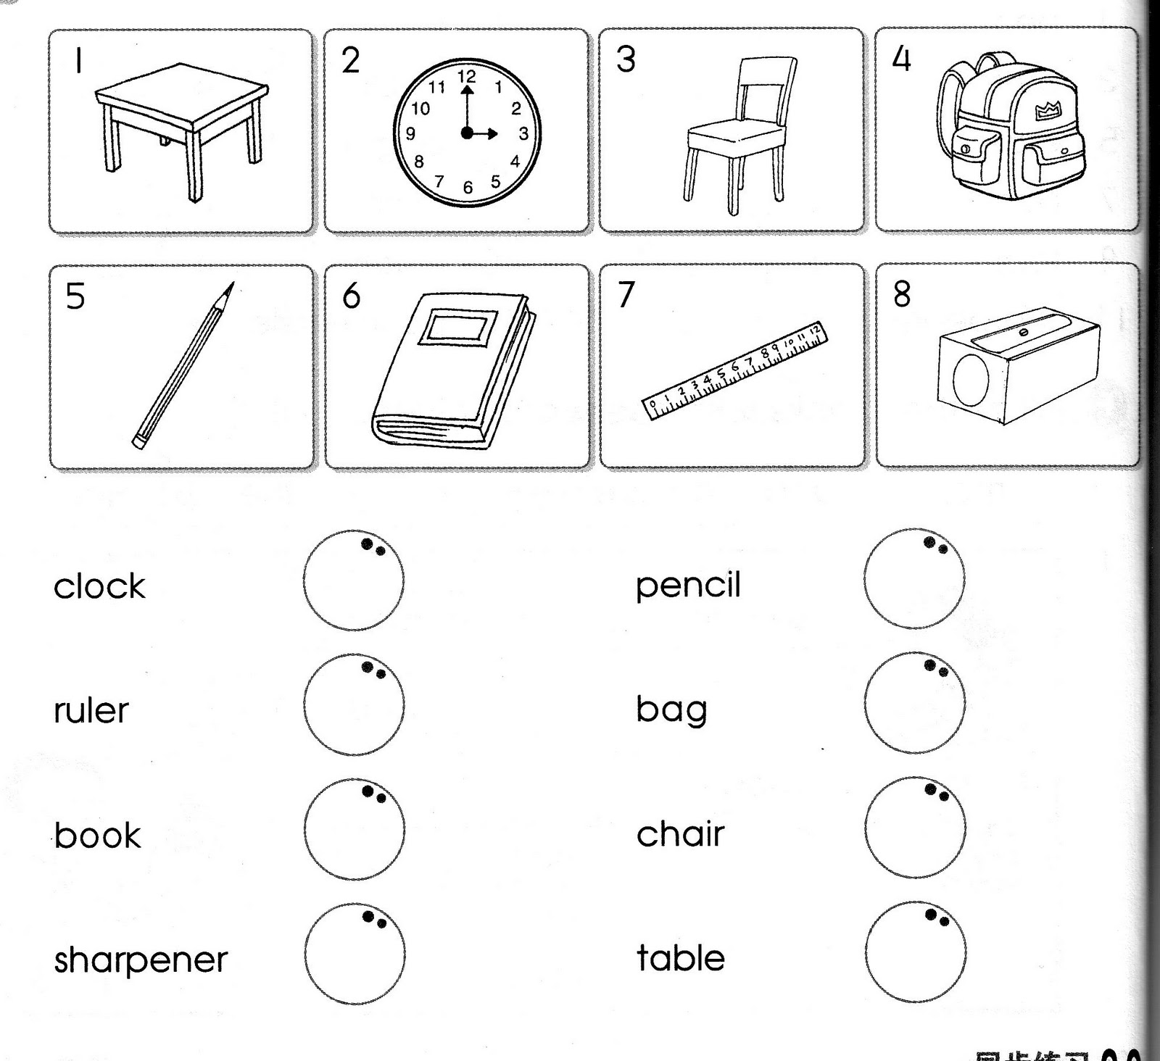
a table
a clock
a chair
a bag
a pencil
a book
a ruler
a sharpener

Slide 5
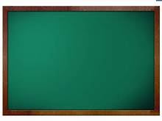

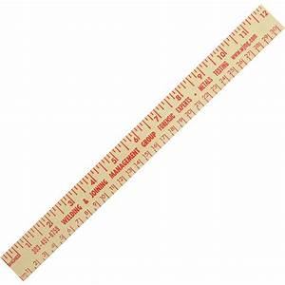
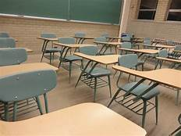
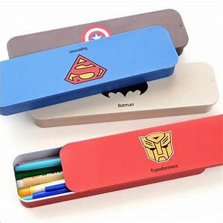
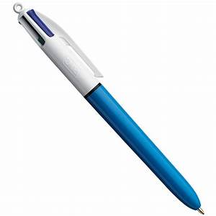
What is this?
What are these?
This is a board.
These are books.
These are chairs.
This is a ruler.
These are pencil cases.
This is a pen.

