Slide 1

Chapter 4: Ecosystems and Human Impact
Case Studies
Cambridge AS Environmental Management – Chapter 4

Slide 2
Learning Objectives
Understand different ecosystem types
Investigate human impacts on ecosystems
Apply real-world case studies to exam questions
Evaluate conservation and management strategies
Develop exam skills for extended responses
Cambridge AS Environmental Management – Chapter 4

Slide 3
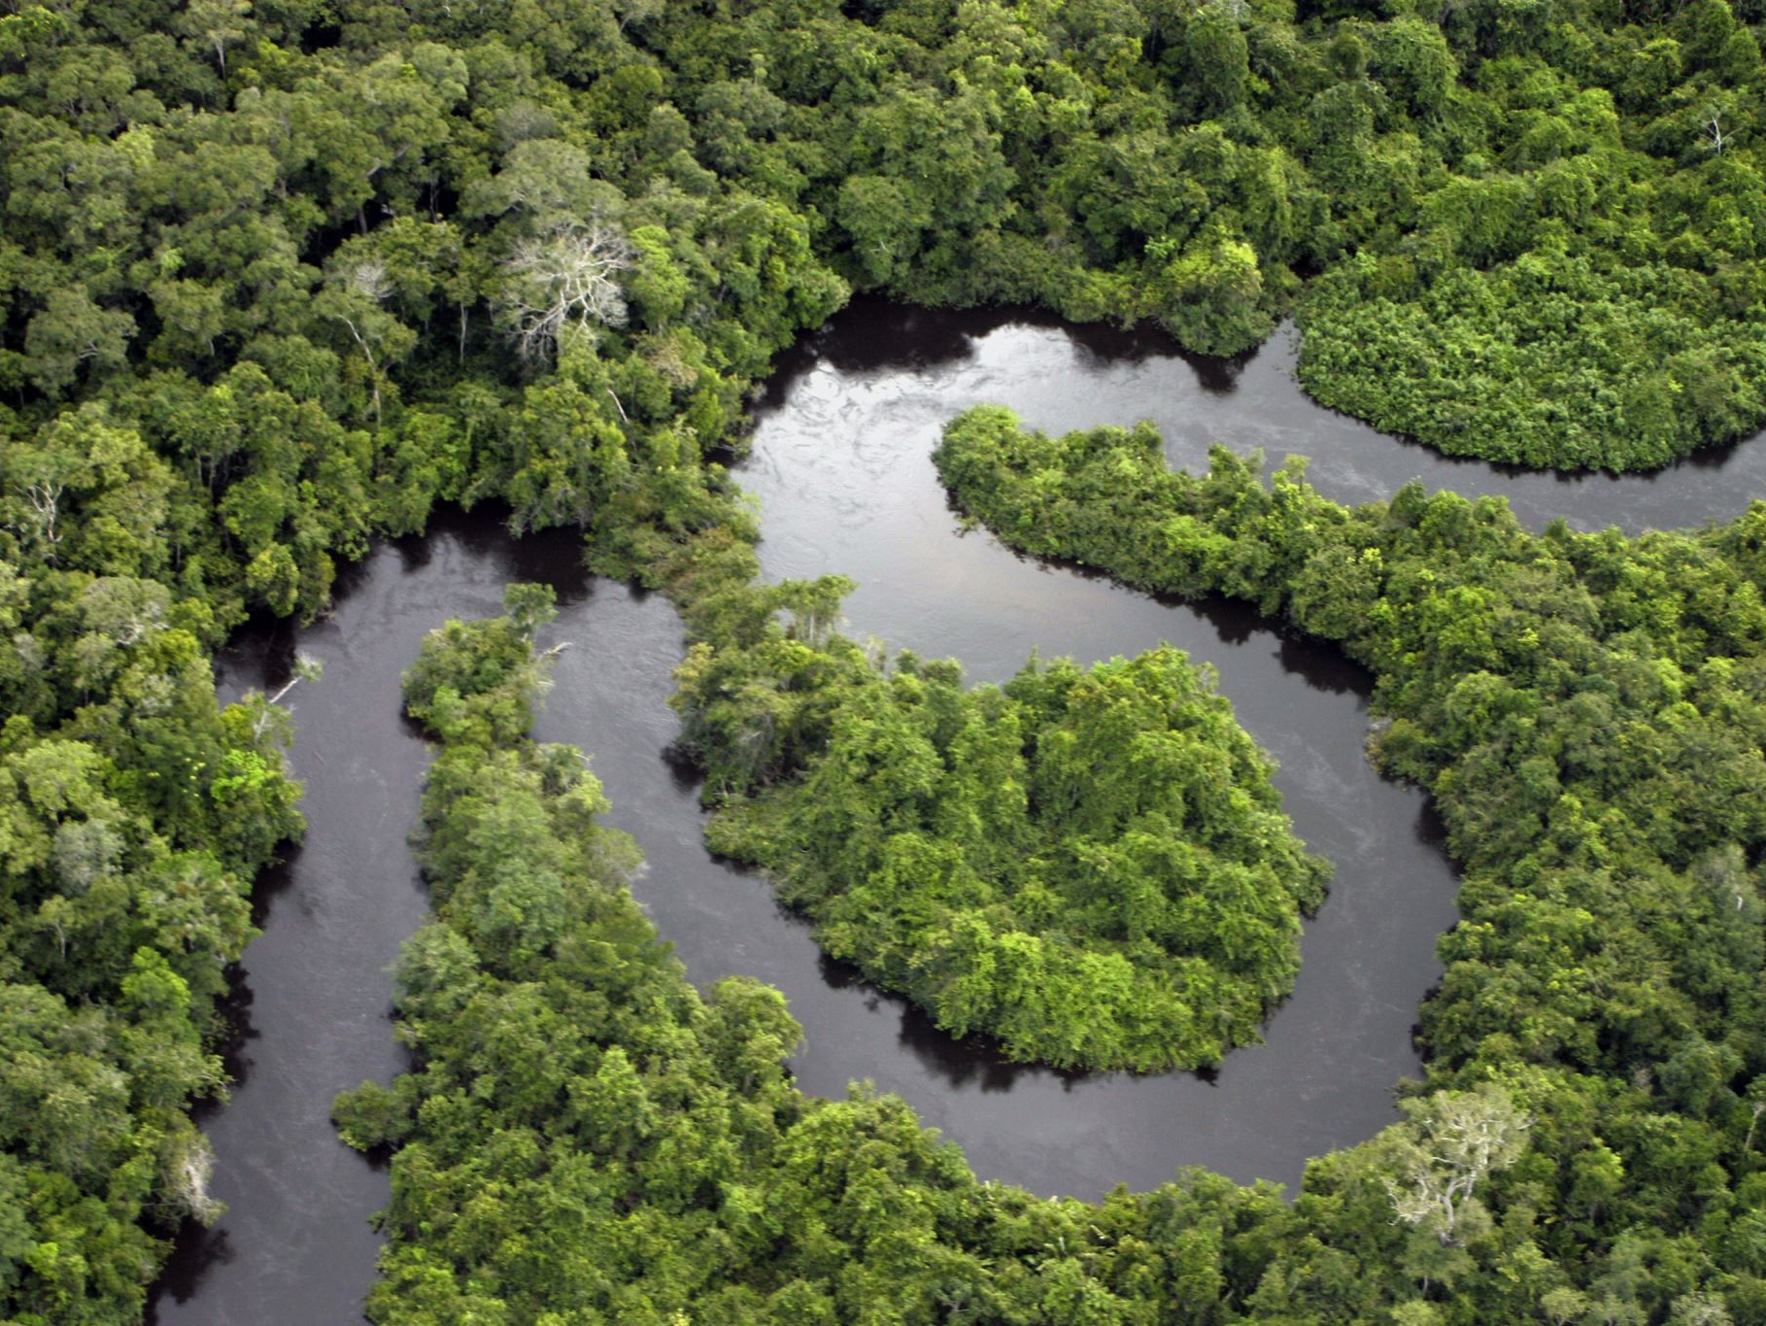
Amazon Rainforest
“Explain how human activities can disrupt nutrient cycling in a rainforest ecosystem.”

Slide 4
South America
  Tropical rainforest ecosystem with very high biodiversity
  Human impacts include logging, mining, farming and road building
  Deforestation causes habitat loss, soil erosion and increased CO₂ emissions
  Important for nutrient cycling and the global carbon cycle
  Management strategies include reforestation and sustainable forestry

Slide 5
Topic Focus:
Tropical rainforest ecosystem
Deforestation
Biodiversity loss
Carbon cycle disruption
Key Concepts:
High biodiversity and productivity
Complex food webs
Nutrient cycling in tropical soils
Human impacts from logging, farming, mining, and roads
Human Impacts:
Habitat destruction
Loss of species
Increased CO₂ emissions
Soil erosion
Management Strategies:
Protected areas
Reforestation
Sustainable forestry
Ecotourism

Slide 6
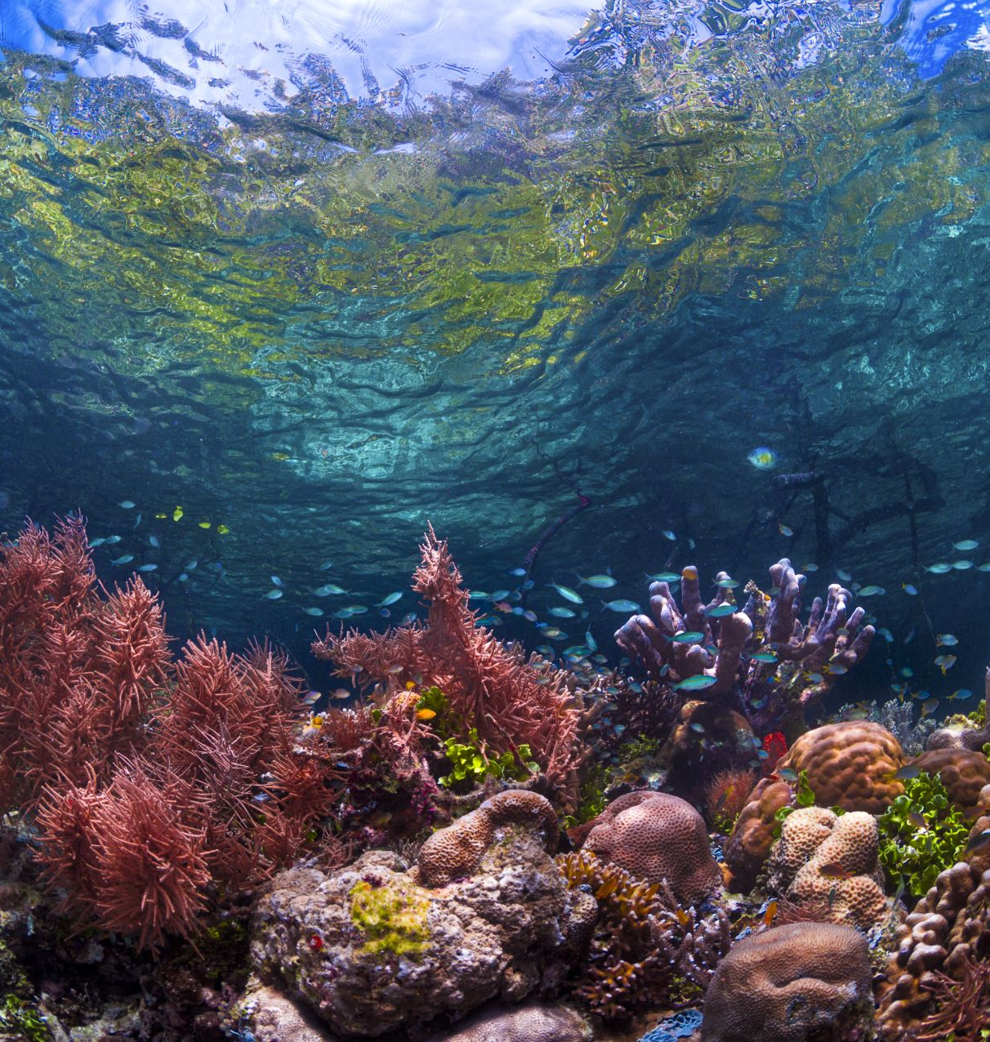
Great Barrier Reef
“Assess the effects of climate change on coral reef ecosystems.”

Slide 7
Queensland, Australia
  One of the world's largest coral reef ecosystems
  Coral bleaching caused by rising sea temperatures
  Pollution and tourism damage marine ecosystems
  Important example of biodiversity and symbiosis
  Protected marine zones help conservation efforts

Slide 8
Topic Focus:
Marine ecosystem
Coral reefs
Climate change
Biodiversity
Key Concepts:
Symbiotic relationships
Food chains and food webs
Abiotic factors (temperature, salinity, light)
Human Impacts:
Coral bleaching from rising sea temperatures
Ocean acidification
Pollution from agriculture
Tourism damage
Management Strategies:
Marine protected zones
Fishing regulations
Water quality control
Climate action

Slide 9
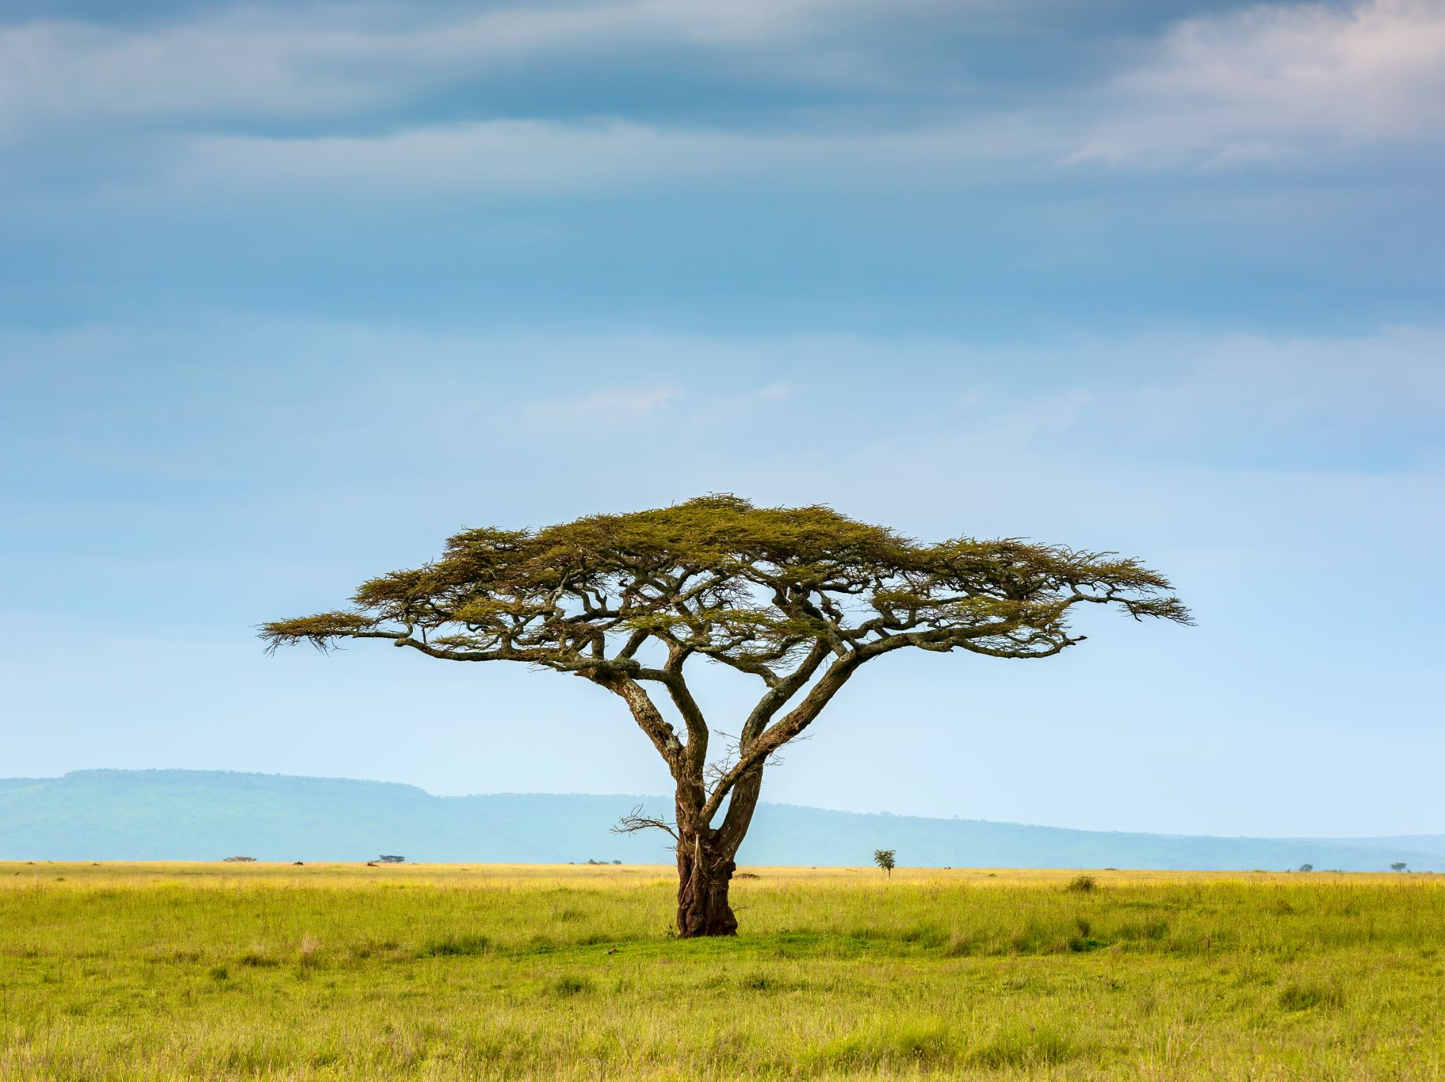
Serengeti National Park
“Explain why biodiversity is important in maintaining ecosystem stability.”

Slide 10
Serengeti National Park
Tanzania
  Grassland ecosystem with complex food webs
  Known for predator-prey relationships and migration patterns
  Human threats include poaching and land conversion
  Conservation protects biodiversity and ecosystem stability
  Wildlife corridors support animal migration
Cambridge AS Environmental Management – Chapter 4

Slide 11
Topic Focus:
Grassland ecosystem
Food webs
Conservation
Key Concepts:
Predator-prey relationships
Carrying capacity
Migration
Human Impacts:
Poaching
Land conversion
Tourism pressure
Management Strategies:
Anti-poaching patrols
National park protection
Wildlife corridors

Slide 12
Comparing the Case Studies
Amazon and Sahel show effects of deforestation
Great Barrier Reef highlights climate change impacts
Aral Sea demonstrates unsustainable water management
Chernobyl shows ecological recovery after disturbance
Serengeti demonstrates biodiversity conservation
Cambridge AS Environmental Management – Chapter 4

Slide 13
Summary
Human activities can severely damage ecosystems
Biodiversity is essential for ecosystem stability
Conservation strategies aim to reduce environmental damage
Case studies help apply theory to exam questions
Sustainability is key to long-term ecosystem management
Cambridge AS Environmental Management – Chapter 4

