Slide 1
CLASS ZERO
Presented by P’Namprung

Slide 2

Fundamental Skills
Speaking
Reading
Listening
Writing
Consistency

Slide 3
Core of Learning
Don't memorize individual words;
memorize them from sentences or stories.
Receive information (listening/reading) and immediately try to express it (speaking/writing).
Don't be afraid of mistakes, because every mistake is a learning experience.

Slide 4
Connecting Everything
“ Story-Based Learning ”
Vocabulary
Grammar
Extract vocabulary from the story and learn its meaning.
Identify which tense is used in the story and why that tense is used.

Slide 5
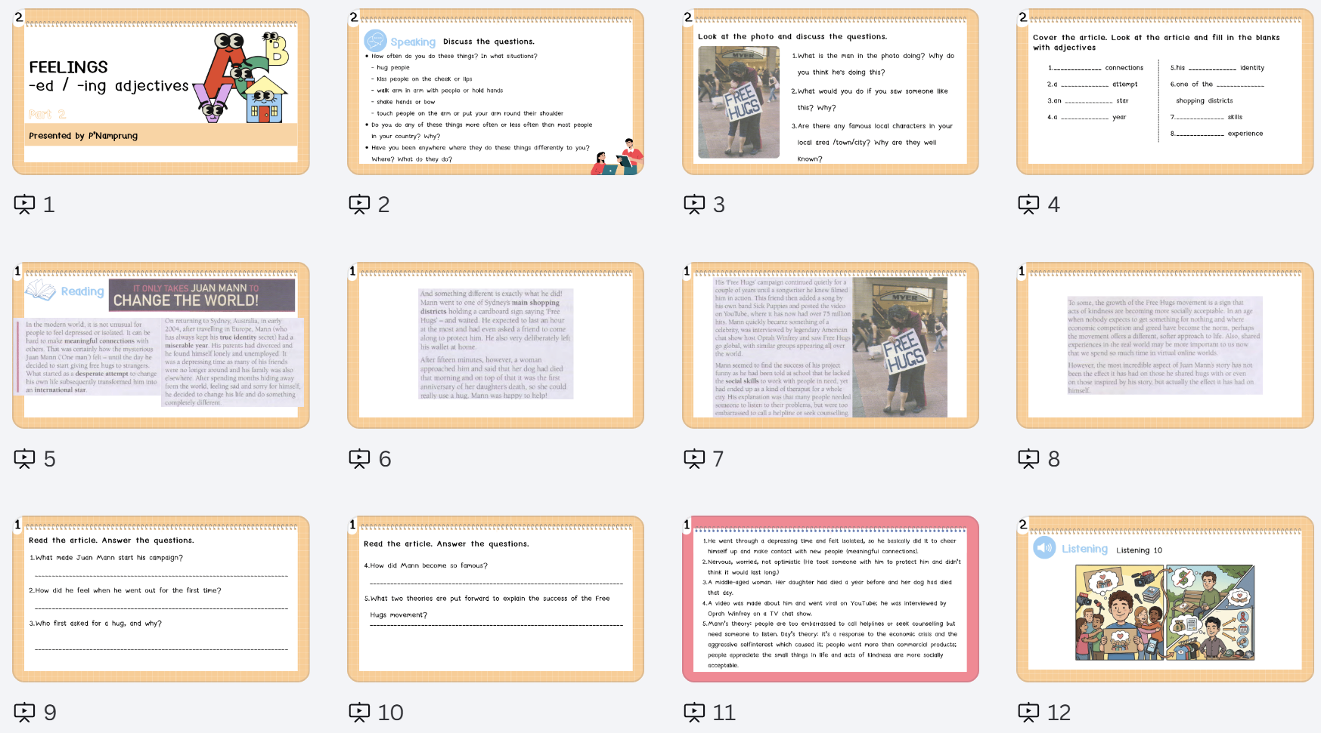

Slide 6
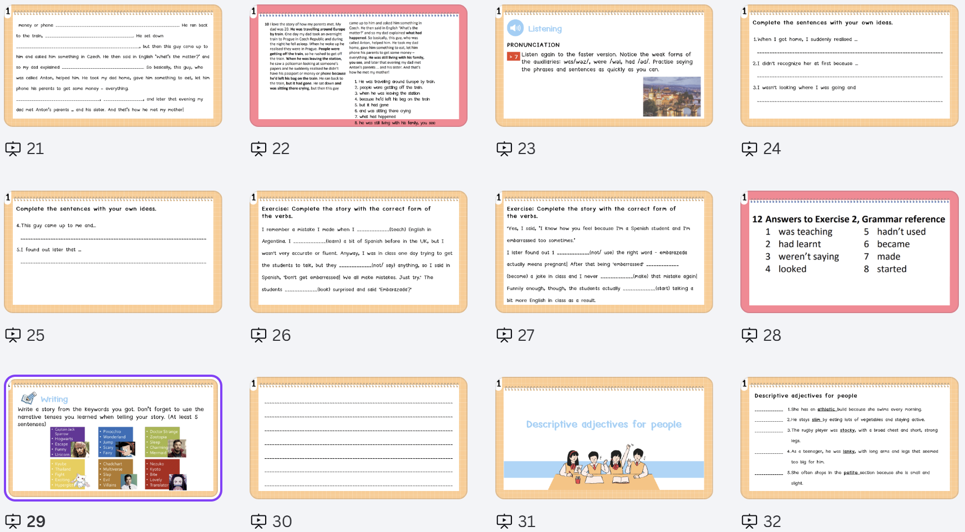
0

