Slide 1
IELTS: Reading
With Teacher Amanda
Excerpt

Slide 2
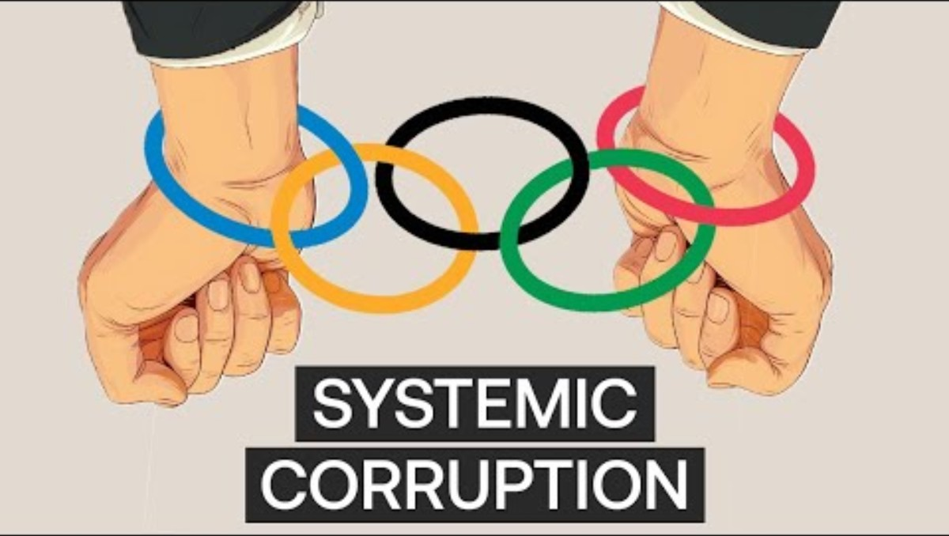
Bidding Corruption

Slide 3
Complete the Sentence
14. Bids to become a host city…
A. often help smaller cities to develop basic infrastructure.
B. tend to occur in areas where they are least needed.
C. require profitable companies to be put out of business.
D. are often never used again once the Games are over.
E. can take up to ten years to complete.
F. also satisfy needs of local citizens for first-rate sports facilities.
G. is usually only successful when it is from a capital city.
H. are closely related to how people feel emotionally about the Olympics.
I. are known for being very inaccurate.
J. often underlie the decisions of International Olympic Committee members.
K. are holding back efforts to reform the Olympics.
Olympic extravagances begin with the application process. Bidding alone will set most cities back about $20 million, and while officially bidding only takes two years (for cities that make the shortlist), most cities can expect to exhaust a decade [十年] working on their bid from the moment it is initiated to the announcement of voting results from International Olympic Committee members. Aside from the financial costs of the bid alone, the process ties up real estate [占用房地产] in prized urban locations [城市黄金地段] until the outcome is known. This can cost local economies millions of dollars of lost revenue [损失的收入] from private developers who could have made use of the land, and can also mean that particular urban quarters lose their vitality [失去活力] due to the vacant lots [空置地块]. All of this can be for nothing if a bidding city does not appease the whims [任性要求] of IOC members – private connections [私人关系] and opinions on government conduct [对政府行为的看法] often hold sway [起支配作用] (Chicago’s 2012 bid is thought to have been undercut by tensions [紧张关系] over U.S. foreign policy).

Slide 4
Connecting Ideas
Sentence stem | The Reading | Sentence ending | Key words / linking ideas
14. Bids to become a host city | "Bidding alone will set most cities back about $20 million, and while officially bidding only takes two years (for cities that make the shortlist), most cities can expect to exhaust a decade working on their bid from the moment it is initiated to the announcement of voting results from International Olympic Committee members." | E. can take up to ten years to complete. | bidding take up a decade exhaust a decade bidding process length
Synonyms | Chinese | Explanation
take up a decade exhaust a decade can take up to ten years bidding process length | 占用十年 zhànyòng shí nián | Means that something (the bidding process) lasts or requires about ten years.

Slide 5
Complete the Sentence
15. Personal relationships and political tensions…
A. often help smaller cities to develop basic infrastructure.
B. tend to occur in areas where they are least needed.
C. require profitable companies to be put out of business.
D. are often never used again once the Games are over.
E. can take up to ten years to complete.
F. also satisfy needs of local citizens for first-rate sports facilities.
G. is usually only successful when it is from a capital city.
H. are closely related to how people feel emotionally about the Olympics.
I. are known for being very inaccurate.
J. often underlie the decisions of International Olympic Committee members.
K. are holding back efforts to reform the Olympics.
Olympic extravagances begin with the application process. Bidding alone will set most cities back about $20 million, and while officially bidding only takes two years (for cities that make the shortlist), most cities can expect to exhaust a decade [十年] working on their bid from the moment it is initiated to the announcement of voting results from International Olympic Committee members. Aside from the financial costs of the bid alone, the process ties up real estate [占用房地产] in prized urban locations [城市黄金地段] until the outcome is known. This can cost local economies millions of dollars of lost revenue [损失的收入] from private developers who could have made use of the land, and can also mean that particular urban quarters lose their vitality [失去活力] due to the vacant lots [空置地块]. All of this can be for nothing if a bidding city does not appease the whims [任性要求] of IOC members – private connections [私人关系] and opinions on government conduct [对政府行为的看法] often hold sway [起支配作用] (Chicago’s 2012 bid is thought to have been undercut by tensions [紧张关系] over U.S. foreign policy).

Slide 6
Connecting Ideas
Sentence stem | The Reading | Sentence ending | Key words / linking ideas
15. Personal relationships and political tensions | "All of this can be for nothing if a bidding city does not appease the whims of IOC members – private connections and opinions on government conduct often hold sway (Chicago’s 2012 bid is thought to have been undercut by tensions over U.S. foreign policy)." | J. often underlie the decisions of International Olympic Committee members. | private connections opinions on government conduct sway undercut by tensions IOC members’ decisions
Synonyms | Chinese | Explanation
private connections personal relationships private connections and opinions | 私人关系 sīrén guānxi | Refers to relationships between people (often influential) that can affect decisions.
opinions on government conduct political tensions tensions over U.S. foreign policy | 对政府行为的看 duì zhèngfǔ xíngwéi de kànfǎ 政治紧张 zhèngzhì jǐnzhāng | Views about how a government acts; disagreements or strained relations between governments or political groups.
hold sway underlie the decisions Sway often hold sway | 起支配作用 qǐ zhīpèi zuòyòng | To have control or strong influence over decisions or outcomes.

Slide 7

Hosting the Olympics

Slide 8
Complete the Sentence
16. Cost estimates for the Olympic Games…
Bidding costs do not compare, however, to the exorbitant bills that come with hosting the Olympic Games themselves. As is typical with large-scale, one-off projects, budgeting for the Olympics is a notoriously formidable task. Los Angelinos have only recently finished paying off their budget-breaking 1984 Olympics; Montreal is still in debt for its 1976 Games (to add insult to injury, Canada is the only host country to have failed to win a single gold medal during its own Olympics). The tradition of runaway expenses [不断上升的开支] has persisted in recent years. London Olympics managers have admitted that their 2012 costs may increase ten times over their initial projections [最初的预算预测], leaving tax payers 20 billion pounds in the red [赤字].
A. often help smaller cities to develop basic infrastructure.
B. tend to occur in areas where they are least needed.
C. require profitable companies to be put out of business.
D. are often never used again once the Games are over.
E. can take up to ten years to complete.
F. also satisfy needs of local citizens for first-rate sports facilities.
G. is usually only successful when it is from a capital city.
H. are closely related to how people feel emotionally about the Olympics.
I. are known for being very inaccurate.
J. often underlie the decisions of International Olympic Committee members.
K. are holding back efforts to reform the Olympics.

Slide 9
Connecting Ideas
Sentence stem | The Reading | Sentence ending | Key words / linking ideas
16. Cost estimates for the Olympic Games | "As is typical with large-scale, one-off projects, budgeting for the Olympics is a notoriously formidable task... London Olympics managers have admitted that their 2012 costs may increase ten times over their initial projections" and "The tradition of runaway expenses has persisted in recent years." | I. are known for being very inaccurate. | cost projections initial projections may increase ten times notoriously formidable task runaway expenses
Synonyms | Chinese | Explanation
initial projections cost projections projections notoriously formidable task notoriously formidable | 最初的预算预测 zuìchū de yùsuàn yùcè | Early estimates or forecasts (especially of cost); here used to show projected budgets that may be inaccurate.
may increase ten times increase ten times over their initial projections runaway expenses budgeting is notoriously formidable cost estimates are very inaccurate | 大幅超出（预算） dàfú chāochū (yùsuàn) 开支失控 kāizhī shīkòng | Describes costs that grow far beyond original estimates; spending that becomes uncontrollable.

