Slide 1
Lesson 1
English Reading and Pronunciation
(Phonics)
@LauraLoraineLayfield

Slide 2
English Pronunciation Course
01
02
03
Phonics
General English
20 lessons
Identify sounds
Pronunciation
Spelling
Sound dictation
Reading
Reading and Writing
8 lessons
Independent reading and writing
Presentation
Real life conversation
10 lessons
Reading intonation
Reading fluency
Presentation
Understanding content
@LauraLoraineLayfield

Slide 3
Contents - 1) Phonics
1. Short Vowels: a, e, i, o, u | 11. Ending Sounds (Part 3): ble, dle, ple, tle, zle, ing
2. Consonants (b-z) | 12. Long Vowels (Part 1): ee, oo
3. Sound Patterns (at, an, et, en, ig, in, og, op, ub, ug) | 13. Long Vowels (Part 2): ai, ea, ie, oa, ue
4. Consonant Blending with ‘l’: bl, cl, fl, gl, pl, sl | 14. Long Vowels (Magic e): a_e, e_e, i_e, o_e, u_e
5. Consonant Blending with ‘r’: br, cr, dr, fr, gr, pr, tr, wr | 15. Long Vowels (Part 3): ay, igh, oi, oy, ou
6. Consonant Blending with ‘s’: sc, sk, sl, sm, sn, sp, st, sw | 16. (Different pronunciations) Long Vowels: ow, ou
7. Consonant Digraphs: ch, sh, ck, th, ph, wh | 17. (Different pronunciations) Long Vowels: ew, ue
8. Three Consonant Blends: scr, spr, str, shr, thr, spl | 18. (Different Pronunciations) ‘y’
9. Ending Sounds (Part 1): | 19. Ending Sounds (Part 4): ed
10. Ending Sounds (Part 2): | 20. Plural: s, es
@LauraLoraineLayfield

Slide 4
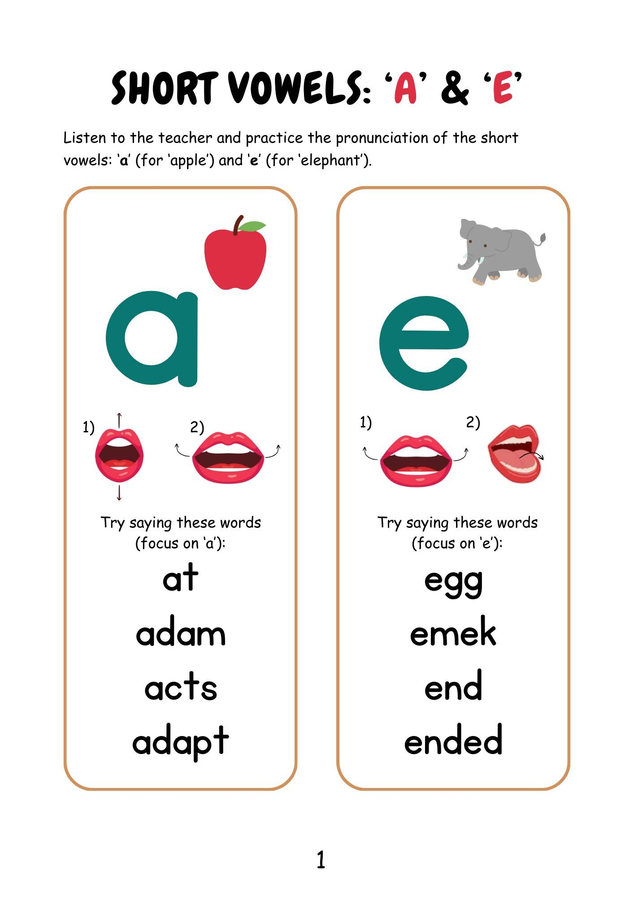
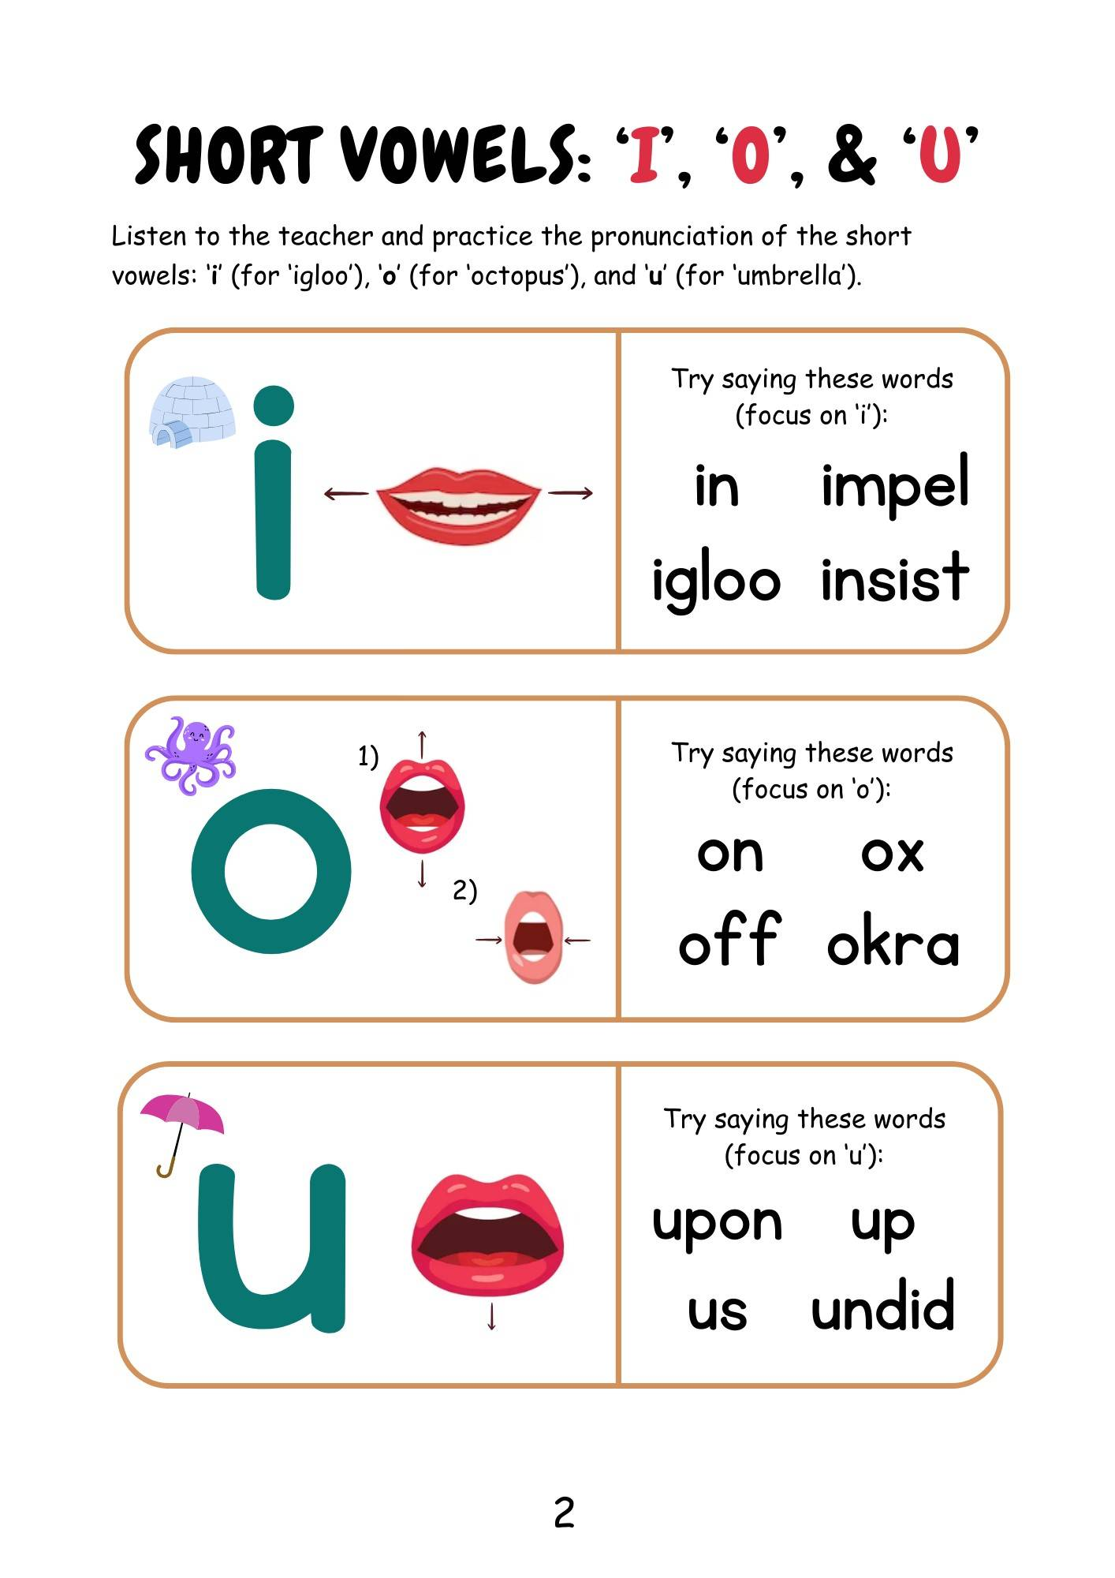
Short Vowels
a, e, i, o, u
Page 4
Page 5
@LauraLoraineLayfield

Slide 5
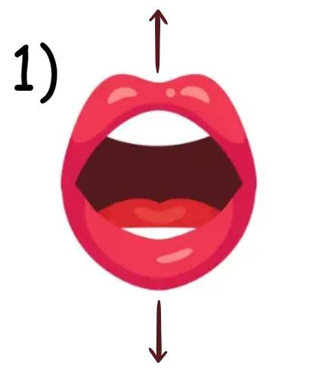
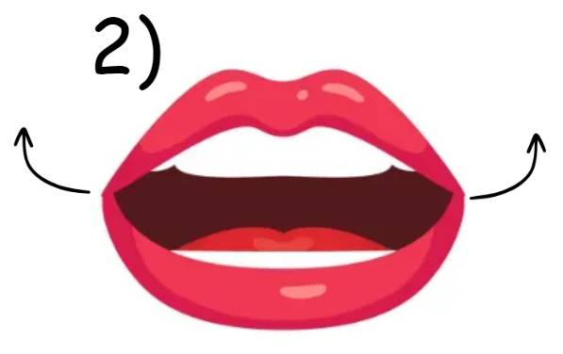

‘a’ for ‘apple’
a
@LauraLoraineLayfield

Slide 6
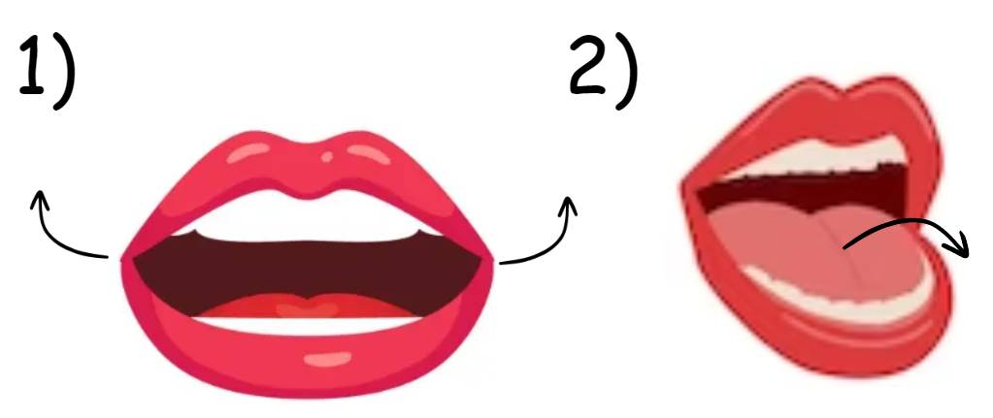

‘e’ for ‘elephant’
e
@LauraLoraineLayfield

Slide 7
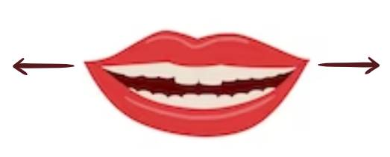

‘i’ for ‘igloo’
i
@LauraLoraineLayfield

Slide 8
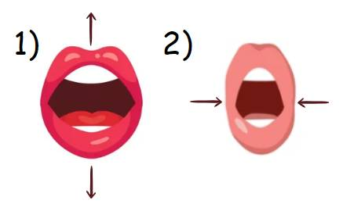

‘o’ for ‘octopus’
o
@LauraLoraineLayfield

Slide 9
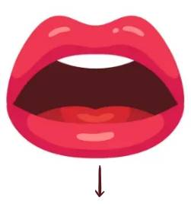

‘u’ for ‘umbrella’
u
@LauraLoraineLayfield

Slide 10
Short Story Reading
Phonics: (Short Vowels) a, e, i, o, u
Focus: Pronunciation of Short Vowels
@LauraLoraineLayfield

Slide 11
Adam’s Play (focus: a, e, i, o, u)
Adam wanted to act and Ann wanted to sit. Adam had a script with a toy ox and egg. The play was held in an igloo, but Ann wants more! So Adam acted on the bed, and under the bed. Adam and Ann went up, into a room and hugged before bed. Happy and content after a day of acting.
@LauraLoraineLayfield

Slide 12
Lesson 1 Homework
Print out the exercise pages,
Practice the pronunciation of the sounds: a, e, i, o, u (pages 2 and 3) - use the flashcards,
Then practice saying the words with the targeted sounds (pages 2 and 3).
Extra: Practice reading the story: Adam’s Play
@LauraLoraineLayfield

Slide 13
Thank you!
Do you have any questions?
Please feel free to contact me.
(I’ll reply as soon as possible)
@LauraLoraineLayfield

