Slide 1

Negative Numbers
Success Criteria:
Add and subtract negative numbers
Multiply and divide negative numbers
Raise a negative number to a power

Slide 2




Visualising negatives with a number line
-8 -7 -6 -5 -4 -3 -2 -1 0 1 2 3 4 5 6
For any addition/subtraction of numbers, you should ALWAYS visualise a number line. How would we visualise the following?
Click
>
Click
>
Click
>
Click
>
Bro Tip: Notice that the answer is always either the sum of the two numbers (ignoring sign) or the difference.

Slide 3
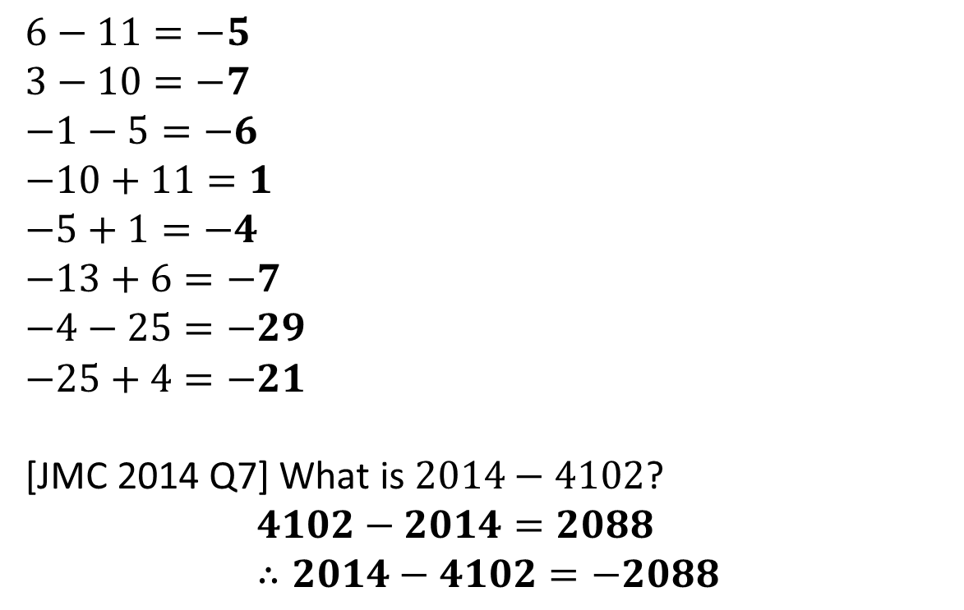
Test Your Understanding
Copy and complete the following.
a
?
b
?
c
?
d
?
e
?
f
?
g
?
h
?
☠
?

Slide 4

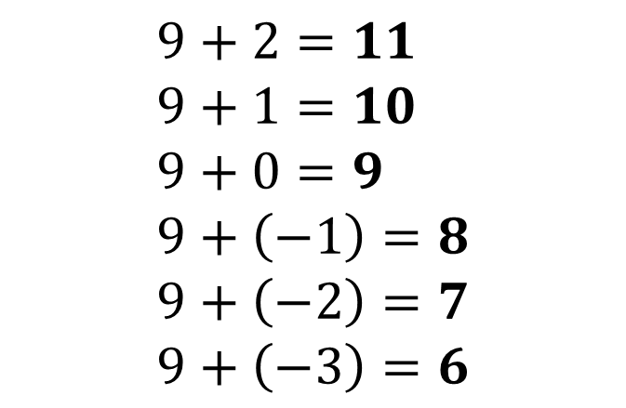
Adding/subtracting negative numbers
What is the answer. How could we show it?
?
?
?

Slide 5

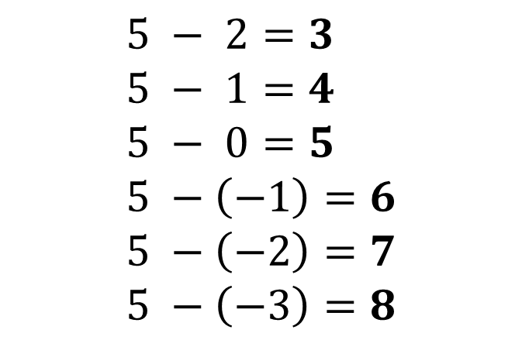

Adding/subtracting negative numbers
What is the answer. How could we show it?
?
?
?

Slide 6

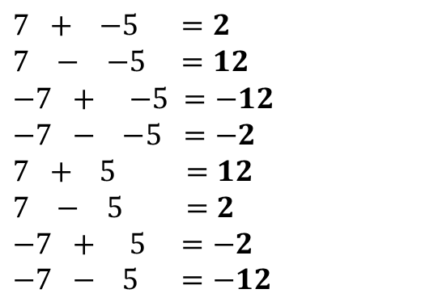
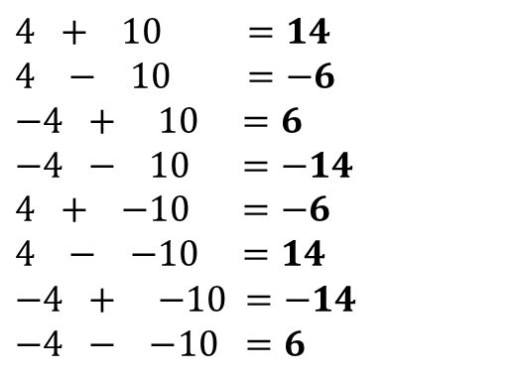
Common Misunderstanding:
“Two minuses make a plus!”
What did they do wrong?
Two minuses only become a plus when they’re next to each other.
If we think about a number line can see the above doesn’t make sense.
?
Quickfire Questions:
Check Your Understanding:
?
?
?
?
?
?
?
?
?
?
?
?
?
?
?
?

Slide 7
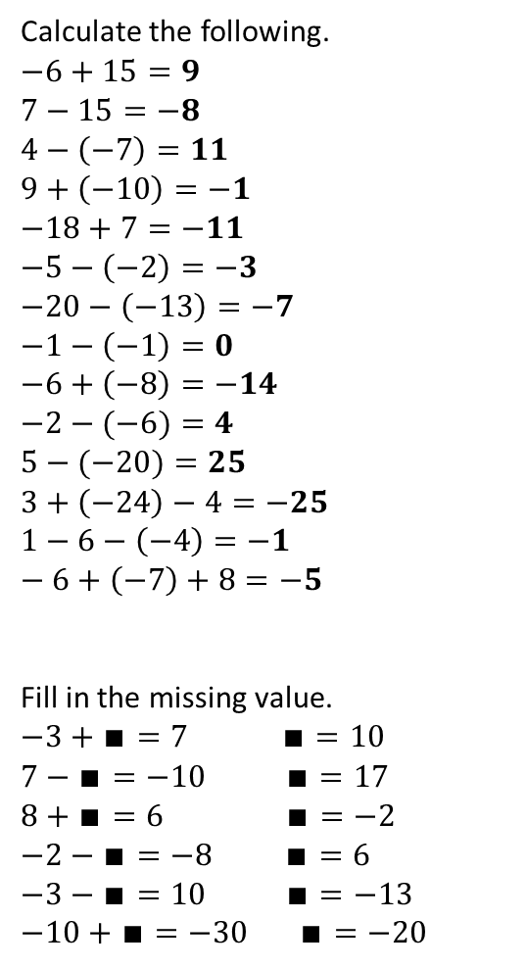
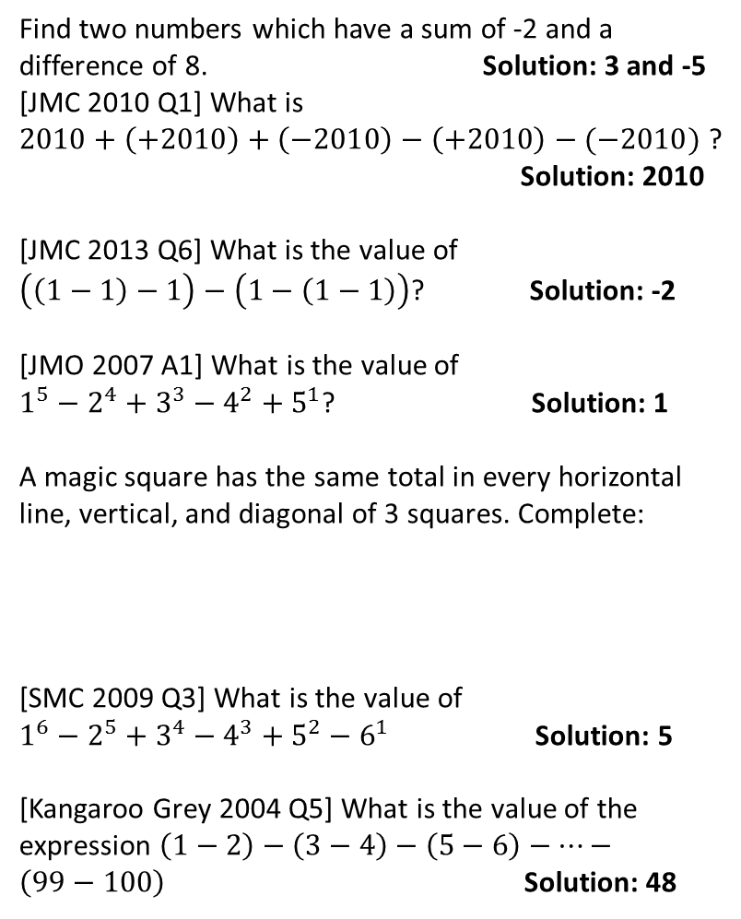
Exercise 1
1
3
a
?
?
b
?
4
c
?
d
?
?
e
?
f
?
5
?
g
?
h
?
i
?
6
?
j
?
k
?
l
?
7
m
?
n
?
?
?
?
?
?
?
?
2
?
?
?
a
?
8
b
?
?
c
?
d
?
☠
e
?
f
?
?

Slide 8

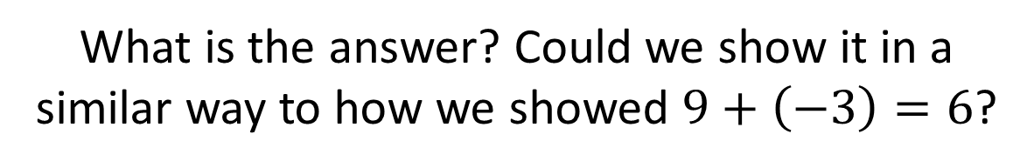
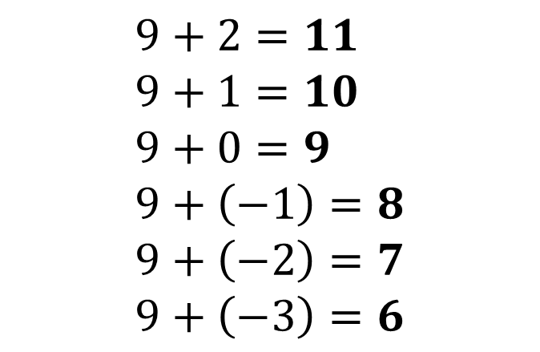
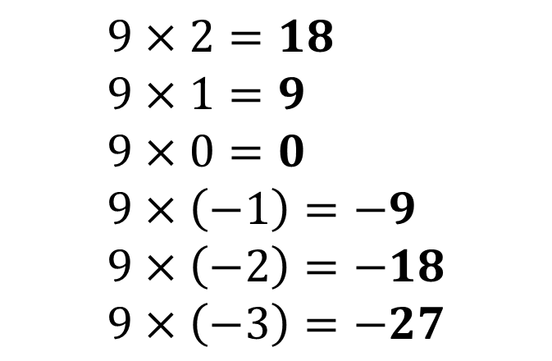
Multiplying Negative Numbers
?
?
?

Slide 9


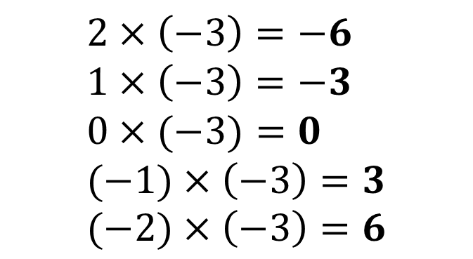

Multiplying Negative Numbers
?
?

Slide 10
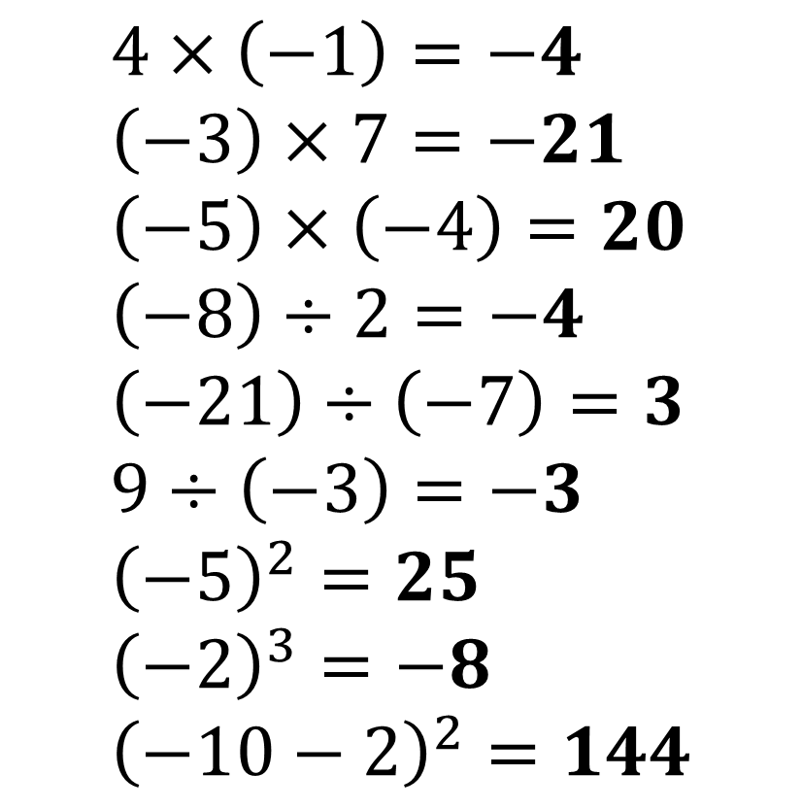
Quickfire Examples
?
?
?
?
?
?
?
?
?

Slide 11


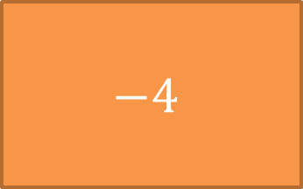

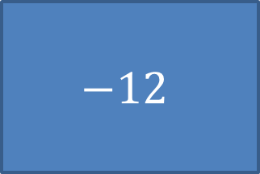

Slide 12

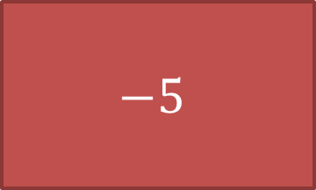
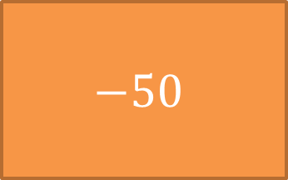

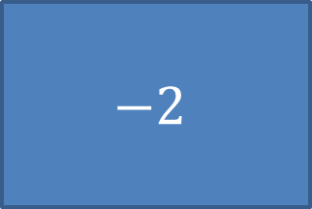

Slide 13

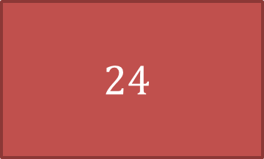
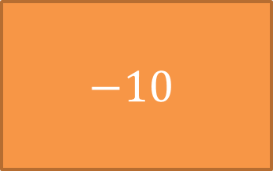
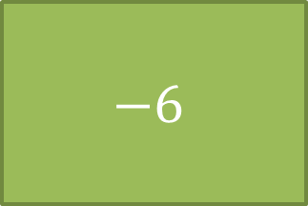


Slide 14


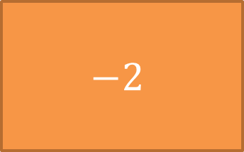

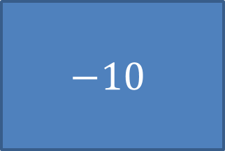

Slide 15

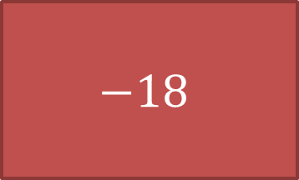
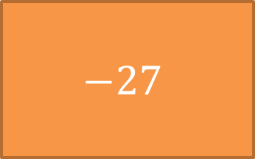



Slide 16

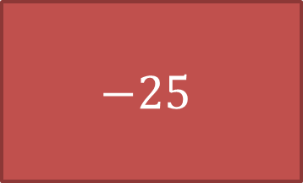

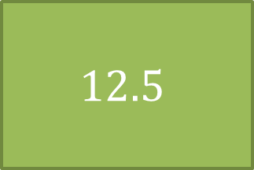


Slide 17
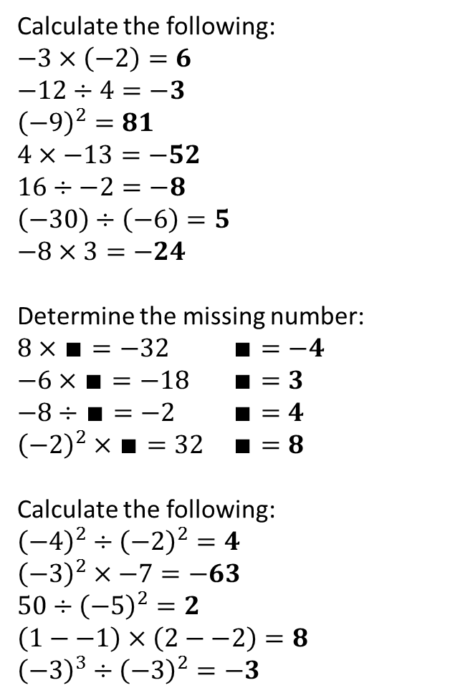
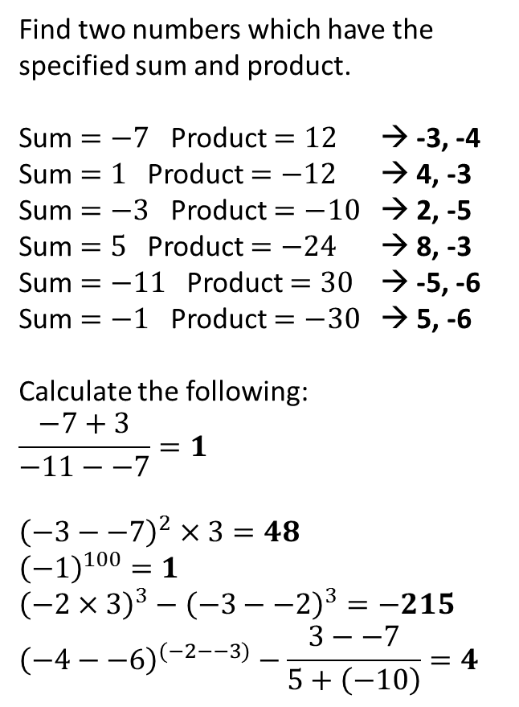
Exercise 2
1
4
a
?
b
?
c
?
a
?
d
?
b
?
e
?
c
?
f
?
d
?
g
?
e
?
f
?
2
a
?
5
b
?
?
c
?
a
d
?
b
?
3
c
?
?
d
?
a
b
?
e
?
c
?
d
?
e
?

