Slide 1


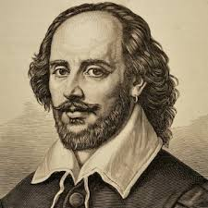
Secondary School Level
S1-S2
Building Basis Expository Writing Skills: through studying acclaimed biography
Will and the World : How Shakespeare Became Shakespeare
Instructor: Andrew Ness

Slide 2
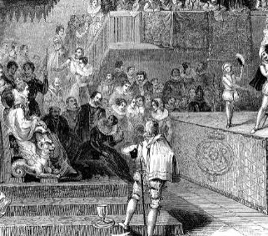
For the first time in his life, Will was watching a play
Will, a boy who was intelligent, quick and sensitive, would have stood between his father’s legs to see the players. For the first time in his life, William Shakespeare was watching a play. But what was the name of the play which the Queen’s Men brought to Stratford in 1569, which may have been the first year when Will was in the audience? There are records of this, and perhaps it does not matter.

Slide 3

Questions for discussion
Shakespeare was born in 1564. The author speculates that Shakespeare may have been how old when he saw his first, live drama?

Slide 4
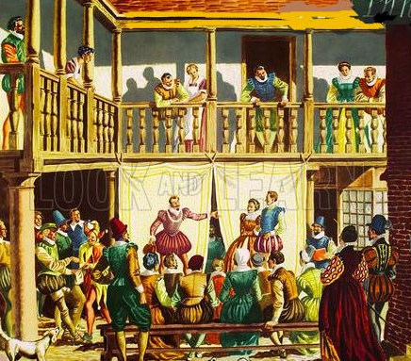
The sheer magic of playing may have been enough to capture the young boy forever
The sheer magic of playing – the fashioning of an imaginary space, the artful impersonations, the elaborate costumes, the flood of heightened language-may have been enough to capture the young boy’s imagination forever. There was, in any case, more than one occasion for the spell to be cast

Slide 5
Questions for discussion
What was it about these performances by traveling players, which capture the imagination of Shakespeare, as a child?

Slide 6
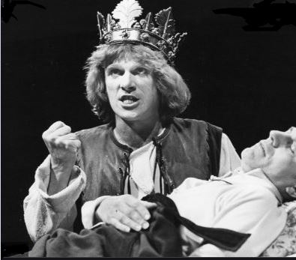
Each time the players came, they had a thrilling effect on the child
Troupes came repeatedly to Stratford – the Earl of Leicester’s Men in 1573, for example, when Will was nine years old, the Earl of Warwick’s Men and the Earl of Worcester’s Men in 1575, when he was eleven, and each time the thrilling effect, initially enhanced by the child’s sense of his father’s importance and power, may have been renewed and strengthened, the clever devices stored away as treasured memories

Slide 7

Questions for discussion
Besides the quality of the players’ performances, what else made watching the plays so thrilling for Shakespeare, as a child?

Slide 8
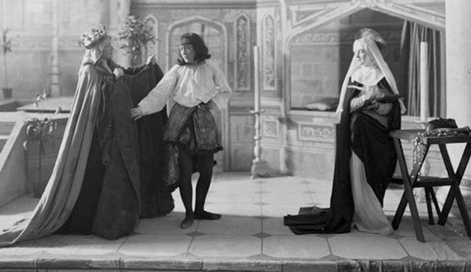
The plays in the 1560s and 1570s were for the most part “morality plays”
The plays in the 1560s and 1570s repertory of these theatre troupes were for the most part “morality plays” or moral interludes, secular sermons designed to show the terrible consequences of disobedience, idleness or dissipation. Typically, a character – an embedded abstraction with a name like Mankind or Youth – turns away from a proper guide such as Honest Recreation or Virtuous Life and begins to spend his time with Ignorance, All-fo-Money or Riot.

Slide 9
Questions for discussion
Why were morality plays called “morality” plays? These 16th century dramas were intended to show the terrible consequences of what?

Slide 10
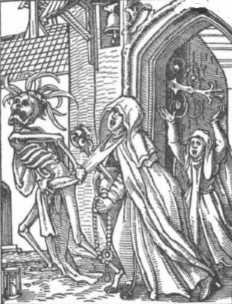
In a Morality Play typically, a character –with a name like Mankind or Youth – turns away from a guide such Virtuous Life and begins to spend his time with Ignorance
In a Morality Play typically, a character – an embedded abstraction with a name like Mankind or Youth – turns away from a proper guide such as Honest Recreation or Virtuous Life and begins to spend his time with Ignorance, All-for-Money or Riot It is rapidly downhill from there – Riot introduces Youth to his friend Pride. Pride introduces him to his glamorous sister Lechery – and it looks like it will all end badly. And sometimes it does end badly.

Slide 11

Questions for discussion
In morality plays are the characters supposed to be realistic and represent real people? If not, what are they supposed to represent?

Slide 12
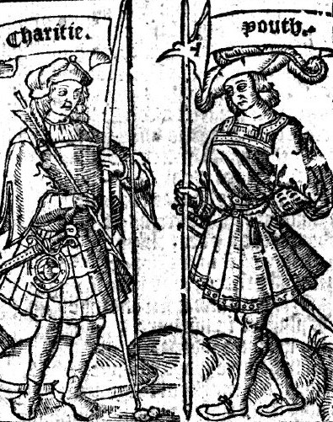
In a morality play typically, something happens to awaken the hero’s slumbering conscience, just in time
In a morality play, sometimes a wicked, slumbering king is carried away and transformed into a swine. However, more typically, something happens to awaken the hero’s slumbering conscience, just in time. In The Interlude of Youth, Charity, reminding the sinner of Jesus’s great gift to him, frees him from the influence of Riot and restores him to the company of Humility.

Slide 13
Questions for discussion
In a morality play, after a character gets led astray, what generally happens next? What is the general overall trajectory of their plot development?

