Slide 1



Transformations in Geometry
Geometry is a fundamental branch of mathematics that explores the properties and relationships of shapes, figures, and spaces. At the heart of geometric concepts lie transformations - the process of manipulating and altering these geometric entities in various ways. From the simplest translations to the more complex dilations, understanding the different types of transformations and their applications is crucial for both students and professionals in fields ranging from architecture to computer graphics.
by Onwurah Onyedikachi

Slide 2

What are Geometric Transformations?
1
Definition
2
Purpose
Geometric transformations are mathematical operations that change the position, size, or orientation of a geometric object, while preserving its essential properties and relationships.
Transformations allow for the manipulation and analysis of shapes, enabling the exploration of symmetry, patterns, and spatial relationships in both two- and three-dimensional spaces.
3
Applications
Transformations have a wide range of applications in fields such as engineering, design, computer graphics, and mathematics, allowing for the efficient creation, manipulation, and study of geometric objects.

Slide 3

Types of Transformations
1
Translations
Shifting a shape or figure without changing its size, shape, or orientation.
2
Rotations
Rotating a shape or figure around a fixed point or axis.
3
Reflections
Flipping a shape or figure over a line or plane, creating a mirror image.

Slide 4
Translations
Definition
Properties
Applications
Translations are transformations that shift a geometric object from one position to another, without changing its size, shape, or orientation.
Preserves the size, shape, and orientation of the object
Translations are widely used in areas such as computer graphics, engineering, and architecture, where the positioning and movement of objects are crucial.
Maintains the relative positions of all points within the object
Can be described by a vector that indicates the direction and distance of the shift

Slide 5

Rotations
Definition
Properties
Rotations are transformations that involve the circular movement of a geometric object around a fixed point or axis, changing its orientation without altering its size or shape.
Rotations preserve the size and shape of the object, but change its orientation. The angle and direction of rotation are crucial in determining the resulting position of the object.
Applications
Rotations are extensively used in computer graphics, engineering designs, and spatial reasoning, allowing for the manipulation and positioning of objects in various orientations.

Slide 6




Reflections
Line Reflections
Flipping a shape over a line, creating a mirror image.
Plane Reflections
Flipping a three-dimensional object over a plane, creating a mirror image.
Point Reflections
Flipping a shape over a single point, creating a mirror image.

Slide 7

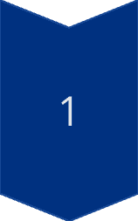

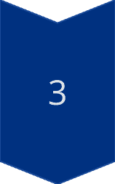
Dilations
Enlargement
Increasing the size of a shape or figure while maintaining its proportions.
Reduction
Decreasing the size of a shape or figure while maintaining its proportions.
Scaling
Resizing a shape or figure by a specific factor, either enlarging or reducing it.

Slide 8
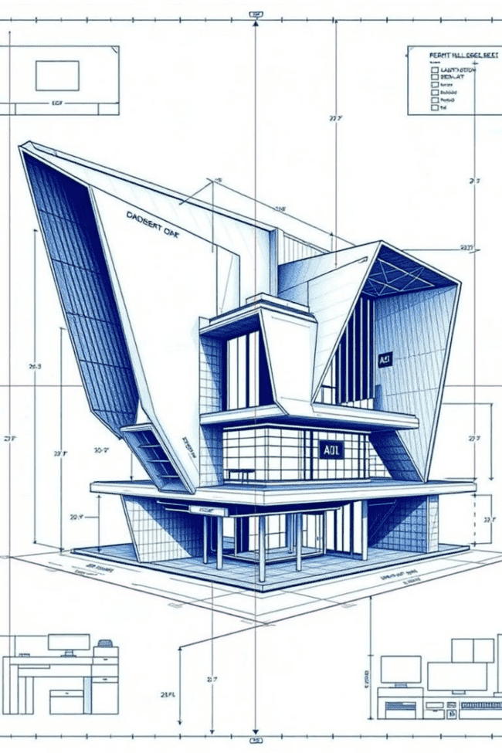
Practical Applications of Transformations
Computer Graphics
Transformations are essential for creating, manipulating, and animating 2D and 3D objects in digital media.
Engineering Design
Geometric transformations are used to model, analyze, and optimize the design of various products and structures.
Architecture
Transformations are employed in the design and visualization of buildings, spaces, and landscapes.
Mathematics Education
Understanding transformations is crucial for teaching and learning concepts in geometry, algebra, and beyond.

